Slide 1


OTP Verification System
A secure and efficient Python-based OTP verification system for user authentication
by K.SAISRIKAR – S9558

Slide 2


Problem Statement
The Challenge
Our Solution
Traditional password-based authentication is vulnerable to breaches and difficult to manage.
Implement a robust OTP system that strengthens security and simplifies user experience.

Slide 3


Key Requirements
1
Secure OTP Generation
2
Reliable OTP Transmission
Randomly generated 6-digit codes for high security.
Email delivery for a secure and user-friendly approach.
3
Accurate OTP Validation
4
User-Friendly Interface
Verify user-entered OTPs for accurate authentication.
Simple and intuitive interactions for a smooth user experience.

Slide 4





Architecture Overview
User Interface
1
User interaction for OTP entry and validation.
OTP Generator
2
Generates a random 6-digit code.
Email Sender
3
Sends the OTP to the user's email.
OTP Validator
4
Verifies the entered OTP against the generated code.

Slide 5

OTP Generation
Randomization
Security Measures
Leverage Python's `random` module to generate truly random 6-digit codes.
Utilize strong cryptography techniques to ensure the OTP's integrity.

Slide 6
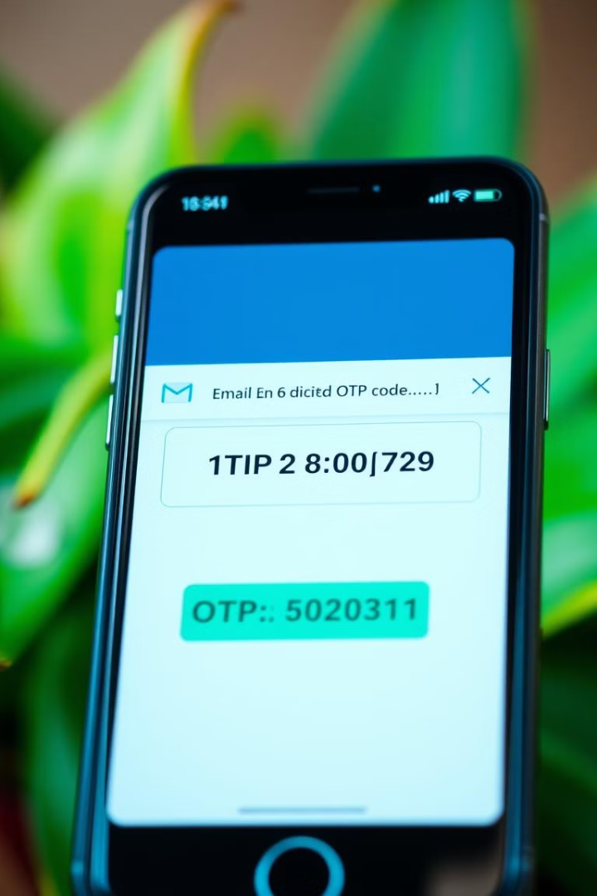



OTP Transmission
Email Integration
Utilize Python's `smtplib` module to send emails securely.
Email Template
Design a user-friendly email template with clear instructions.
Error Handling
Implement error handling for failed email delivery.

Slide 7
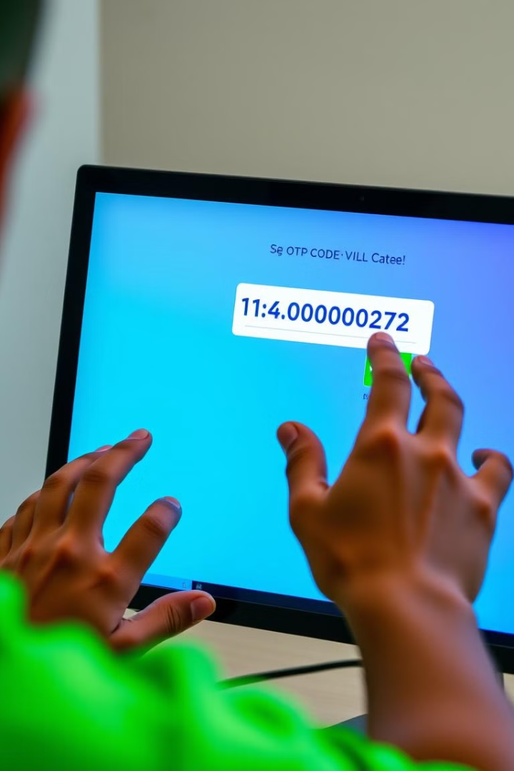





OTP Validation
Matching
Mismatch
Compare the entered OTP with the generated code.
Prompt the user to re-enter the OTP if it doesn't match.
Timeout
Set a time limit for OTP validity to enhance security.

Slide 8

Conclusion and Next Steps
The Python-based OTP verification system provides a secure and user-friendly authentication solution. Future enhancements include adding support for two-factor authentication and integrating the system with various applications.

