Slide 1


Activity Essentials Finder
By
Lakkoju Sai Srinivas
Ragannagari Bala Krishna Reddy
Darapureddy Bhagavath Sai
Nadakuditi Sai Avinash

Slide 2

Problem Statement
In everyday life, individuals often engage in planned activities such as hiking, camping, sports, or travel, where remembering and preparing the necessary tools and equipment is crucial. However, due to human oversight, it’s common to forget essential items, especially when they are not immediately visible or mentally accessible. This leads to inefficiencies, safety concerns, and a disrupted experience.

Slide 3
Proposed Solution
To address the challenge of forgetting essential items during planned activities, we designed a smart AI assistant that follows a three-step approach:
Understand the Activity & Context
Generate Essential Item List
Visual Item Detection

Slide 4
Way Of Approach
Activity Understanding: Extracts type and context of activity.
Knowledge Graph: Stores relationships between activities and items.
Intelligent Recommendations: Suggests important items.
Object Detection: To Detect Object in Image

Slide 5
Tech Stack Used
Flask: Web Framework (Python)
OpenRouter (OpenAI API): Language model to extract activity and context (mistral-small-3.1-24b)
YOLOv8: Object Detection Model
Neo4j: Graph Database to store activity-context-item relationships
Supervision: Visualization (bounding boxes, labels)
OpenCV (cv2): Image processing
Python: Main programming language
Environment: Hosted locally for demonstration

Slide 6
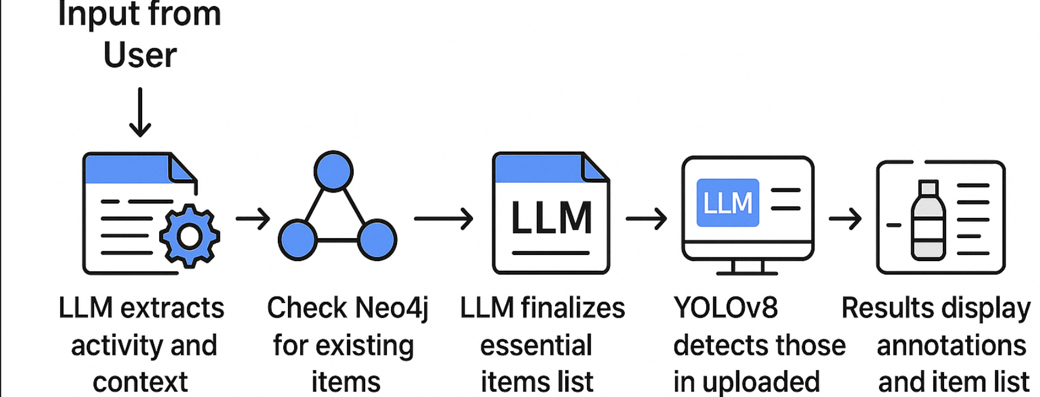
Application Workflow

Slide 7
Work Flow:
User submits description and image.
LLM extracts activity and environment.
Check Neo4j for essential items.
LLM finalizes item list if needed.
Updates the Knowledge Base
YOLO World detects essential items in image.
Results displayed with annotated image and detected item list.

Slide 8
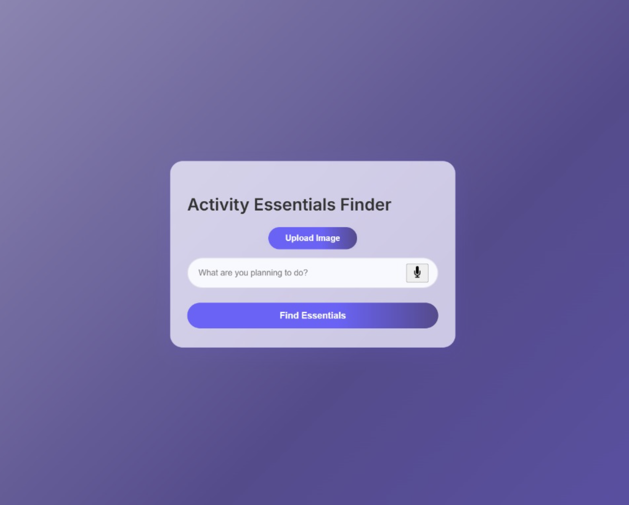
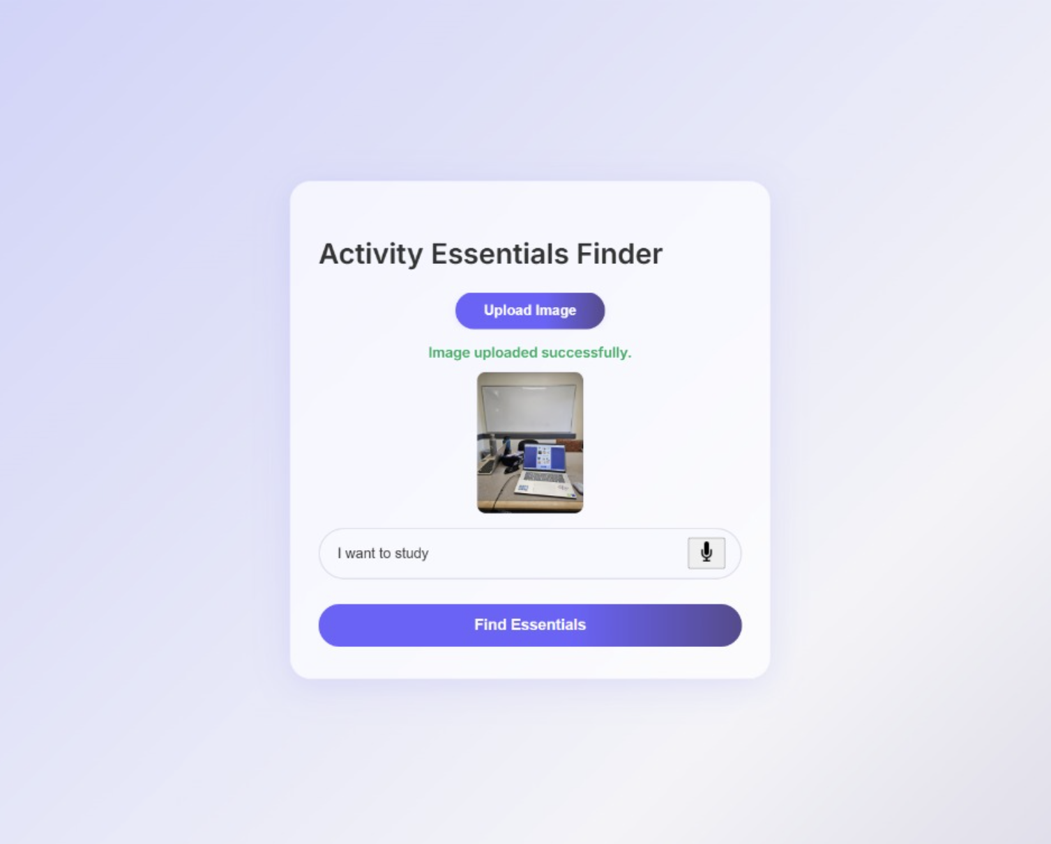
Results Input :

Slide 9
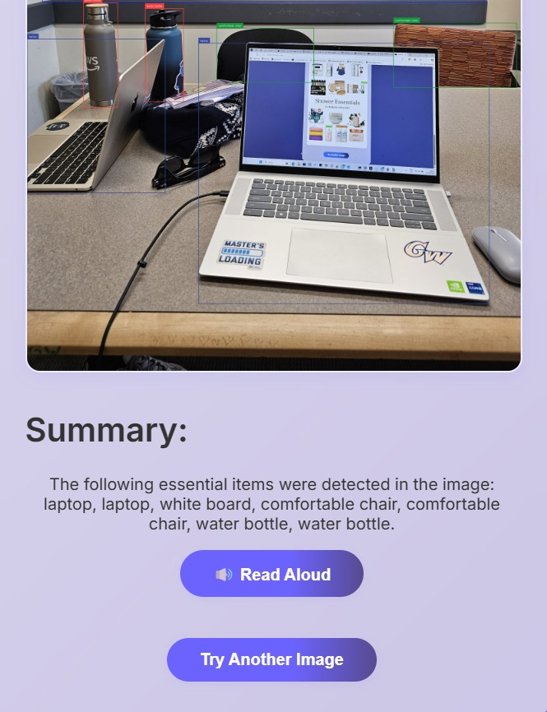
Results : output (live demo)

Slide 10
Future Enhancements
Fine-tune YOLOv8 with more activity-specific datasets.
Expand Neo4j database with more contexts and activities.
Add support for multi-language voice inputs.
Deploy application to cloud platforms like AWS/GCP.
Github Link:
https://github.com/Saisrinivas783/Capstone_Group_5

Slide 11


Thank you.

