Slide 1
Quora Question Pair Similarity Detection using NLP and ML
Sai Srinivas Lakkoju
Vinay Vasetti

Slide 2
Problem Statement: Duplicate Questions on Quora
Challenge :
Quora faces issues with duplicate questions.
Users spend more time searching for answers.
Writers answer similar questions repeatedly.
Goal :
Develop advanced NLP techniques to classify question pairs as duplicates or not.
Benefits :
Enhanced user experience.
Easier access to high-quality answers.
More efficient knowledge sharing.

Slide 3
“
Data Details
Number of Observations in data are 404290
Field | Description
id | Unique identifier for each question pair
qid1, qid2 | Unique IDs for individual questions (train.csv only)
question1, question2 | Full text of each question in the pair
is_duplicate | Target variable (1 = same meaning, 0 = different)
“

Slide 4
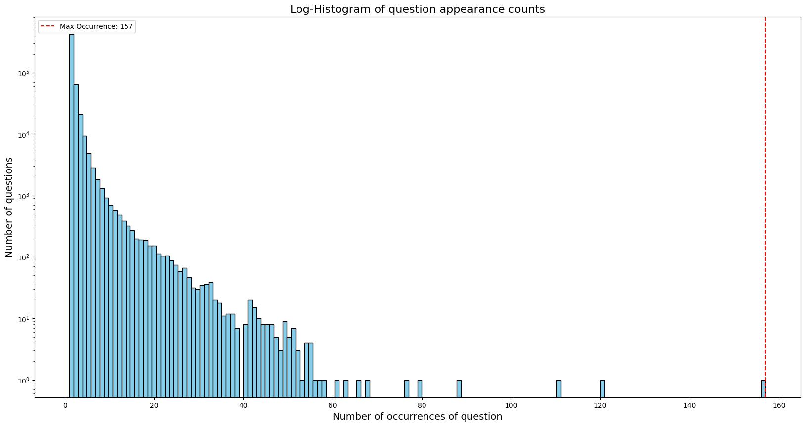
“
Basic EDA
“

Slide 5
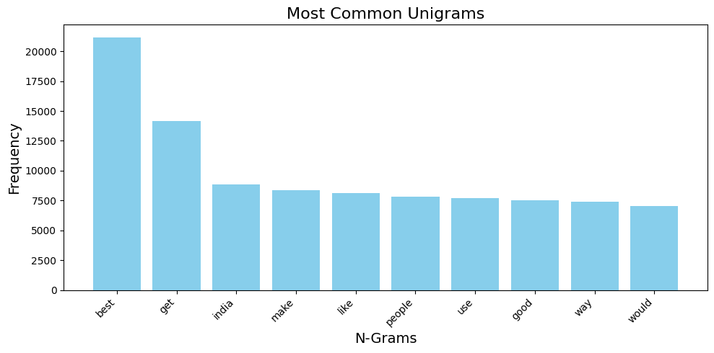
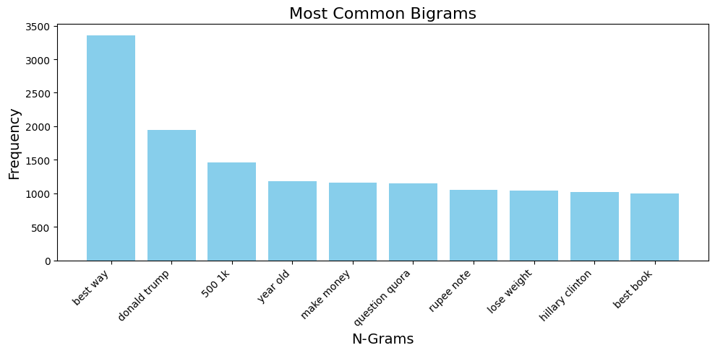
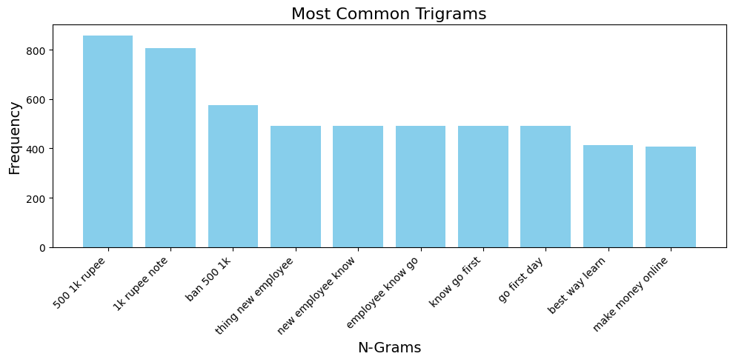

Slide 6
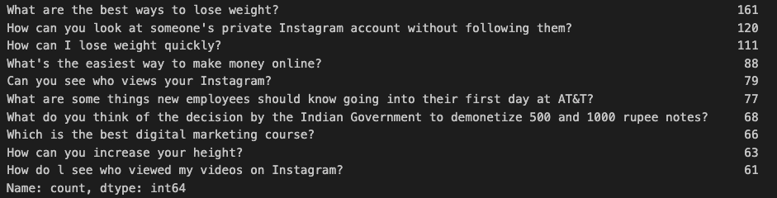
Top 10 Most asked questions on Quora

Slide 7
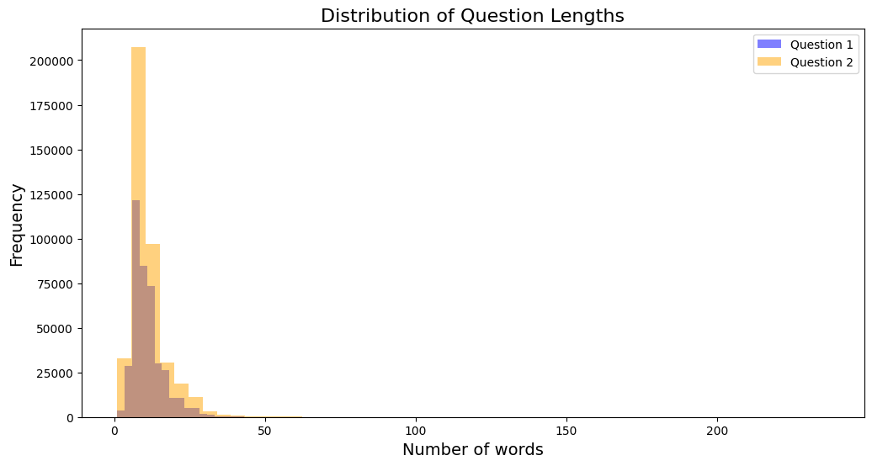

Slide 8
Processing and Extracting Features
Overview of Preprocessing Steps
We have converted all text to lowercase for uniformity.
We have expanded common contractions to their full forms (e.g., "won't" → "will not").
We have replaced special symbols like %, ₹, $, € with their textual equivalents (e.g., % → "percent").
We have simplified large numbers into shorthand notations (e.g., 1,000,000 → 1m).
We have removed non-alphanumeric characters using regular expressions.
Lemmatization
We have utilized the WordNet Lemmatizer to reduce words to their base or dictionary form.
We have determined the correct part of speech (POS) for each word using a custom function (get_wordnet_pos) for accurate lemmatization.
Tokenization and Cleaning
We have split text into individual words (tokens).
We have removed unwanted characters and patterns using regex.
Final Output
We have produced a clean, lemmatized, and standardized format of text.
This ensures consistency and prepares data for downstream tasks like machine learning or natural language processing.

Slide 9
Feature Extraction for Question Similarity
Text-based Features:
Word count: Quantifies the number of words in each question
Character count: Measures the total length of each question
Common words: Identifies shared vocabulary between questions
Word share: Calculates the proportion of shared words to total unique words
Length differences: Compares the size discrepancy between questions
Token Features:
Common word ratios: Assesses the overlap of non-stop words
Stop word ratios: Evaluates the similarity of grammatical structure
Token count ratios: Measures overall token similarity, including all words
Word position comparison: Checks if questions start or end with the same words
Fuzzy Matching Features:
Token set similarity: Compares questions based on unique words, ignoring order
Token sort similarity: Analyzes questions after alphabetically sorting words
Overall string similarity: Calculates the general likeness of entire questions
Partial string alignment: Identifies similar segments within questions
Longest common substring: Finds the longest shared sequence of characters

Slide 10
Advanced Features
Linguistic Features:
Common prefix/suffix: Length of shared beginning/ending of questions
Jaccard similarity: Overlap of unique words between questions
Longest common subsequence: Length of longest shared sequence of characters
Semantic Features:
TF-IDF vectorization: Importance of words based on frequency in corpus
Word embeddings: Dense vector representations of words using spaCy
Question embeddings: Aggregated word vectors weighted by TF-IDF scores
Model Integration:
Feature combination: Merging text-based, fuzzy, and semantic features
Machine learning: Input for models to predict question similarity

Slide 11
Data Modelling
Train-Test Split
Utilized stratified sampling to maintain class balance
70% training set, 30% test set
Random state set to 42 for reproducibility
Baseline Model: Logistic Regression
Simple and interpretable
Achieved reasonable accuracy as a starting point
Advanced Model: XGBoost
Gradient boosting algorithm
Chosen for its high performance on various machine learning tasks
Hyperparameter tuning performed using RandomizedSearchCV
Deep Learning Model: Siamese BERT
Utilized a Siamese BERT (Bidirectional Encoder Representations from Transformers) architecture
Custom fully connected layers for feature extraction

Slide 12
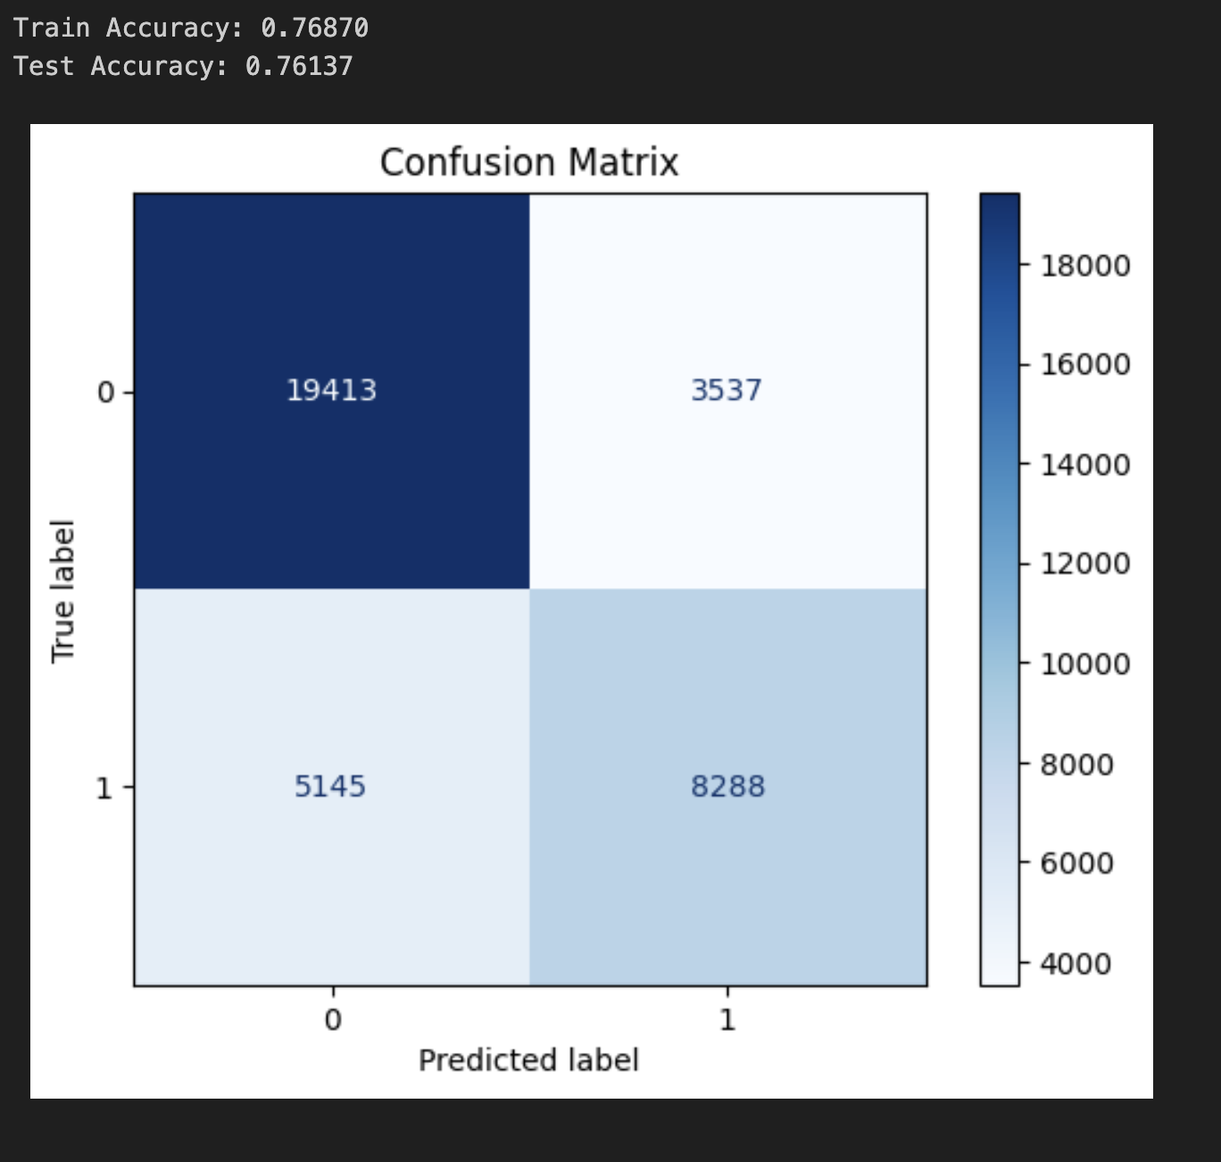
Logistic Regression Model
Implementation Details
Used sklearn's LogisticRegression with default hyperparameters.
Advantages
Fast training and prediction times
Provides probability scores for classifications
Serves as a good baseline for comparison with more complex models.
Limitations
Did not not capture complex non-linear relationships in the data
Performance suggests room for improvement with advanced models

Slide 13
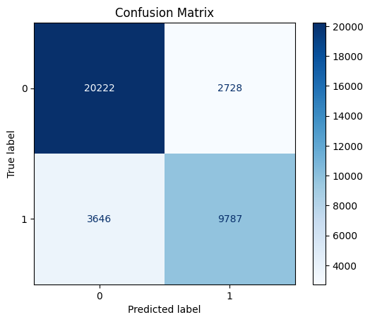
eXtreme Gradient Boosting
Implementation Details
Utilized XGBClassifier from the xgboost library
Leveraged GPU acceleration with 'gpu_hist' tree method for faster training
Performed hyperparameter tuning using RandomizedSearchCV
Key Hyperparameters Tuned
n_estimators: Number of boosting rounds
learning_rate: Step size shrinkage to prevent overfitting
max_depth: Maximum depth of trees
subsample: Fraction of samples used for training trees
colsample_bytree: Fraction of features used for training trees
gamma: Minimum loss reduction for split
Model Training
Used 5-fold cross-validation during hyperparameter search
Performed 10 iterations of random search to find optimal parameters
Trained on the best parameters found by the random search
Advantages
Efficient handling of large datasets with GPU acceleration
Automatic feature selection and handling of missing values
Robust to overfitting through regularization techniques
Train Accuracy: 0.99886 Test Accuracy: 0.82481

Slide 14
BERT-Model
Siamese BERT Model Architecture and Setup
Utilized pre-trained BERT model (bert-base-uncased) as the foundation
Implemented a Siamese network architecture for question pair similarity detection
Custom fully connected layers added on top of BERT for feature extraction:
Linear layer: 768 -> 256 units with ReLU activation
Linear layer: 256 -> 128 units
Cosine similarity used to measure similarity between question embeddings
Model created and moved to GPU for accelerated training
Tokenization and encoding function implemented for text preprocessing
Data augmentation using SynonymAug to enhance dataset diversity
Dataset preparation includes:
Encoding original questions
Augmenting and encoding additional questions
Combining original and augmented data

Slide 15
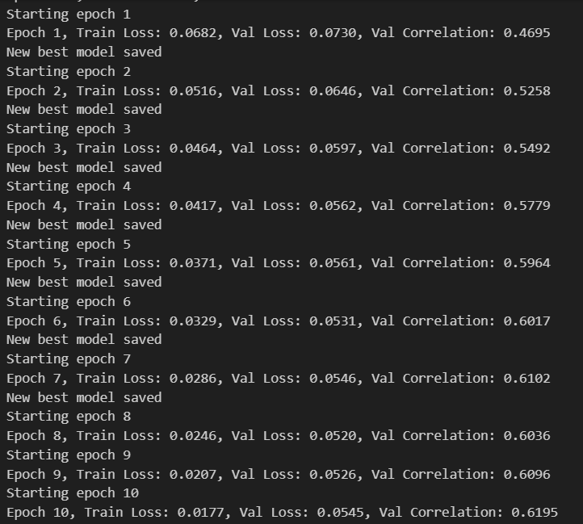
BERT-Model
Training Process and Evaluation
Training setup:
Adam optimizer with learning rate 2e-5
ReduceLROnPlateau scheduler for adaptive learning rate
Custom ContrastiveLoss function implemented
Gradient clipping applied (max norm: 1.0)
Training loop:
10 epochs with early stopping based on validation performance
Model trained on augmented dataset
Evaluation using Spearman's rank correlation
Data handling:
Train, validation, and test datasets prepared
DataLoader used with batch size of 32
Model evaluation:
Best model saved based on highest validation correlation
Final evaluation on test set after training
Reported metrics: Test Loss and Test Correlation
Additional features:
Environment variable set for CUDA memory allocation
Test Loss: 0.0548, Test Correlation: 0.6199

Slide 16
Github :Saisrinivas783/NLP_Final_Project
Thank You

