Slide 1

Design and Implementation of a 16-Bit ALU with OLED Display on the Zybo Z7 FPGA
23ECE383 VLSI Design Laboratory | ECE B | TEAM 7 | 2026-27 Odd Semester
Bollavaram Sankirth (CB.EN.U4ECE24107)
Darbarwar Abhiram (CB.EN.U4ECE24112)
Kotakota Sai Srivanth (CB.EN.U4ECE24131)

Slide 2
Overview and Objectives
  An ALU is the core computational block of a CPU: a combinational circuit that performs arithmetic and logic on A and B, selected by an opcode
  Our 16-bit ALU supports 16 operations: unsigned and signed arithmetic, logic, shifts and rotates
  Status flags: Zero, Carry, Overflow, Negative
  Verilog design, simulated and synthesized in Vivado, verified on hardware
  Inputs from Pmod keypad and switches; results on a Pmod OLED

Slide 3
System Architecture
Pmod KYPD
(hex entry)
Input Registers
A and B
16-bit ALU
(opcode select)
OLED Controller
(SSD1306, SPI)
Control: 4 onboard switches = opcode; Pmod switch 1 = reset input; Pmod switch 2 = select A (0) or B (1)
  Keypad scanner: debounced 4x4 scan, one key_valid pulse per press
  OLED shows A, B, Y (decimal and hex), operation name and flags Z C V N
  Whole design runs on the 125 MHz system clock

Slide 4
Opcode Table (ALU_Sel)
Opcode | Operation | Function
0000 | Unsigned ADD | A + B
0001 | Unsigned SUB | A - B
0010 | Unsigned MUL | A x B
0011 | Unsigned DIV | A / B
0100 | AND | A & B
0101 | OR | A | B
0110 | XOR | A ^ B
0111 | NOT | ~A
Opcode | Operation | Function
1000 | Signed ADD | A + B
1001 | Signed SUB | A - B
1010 | Signed MUL | A x B
1011 | Signed DIV | A / B
1100 | Shift Left (LSL) | A << B[3:0]
1101 | Shift Right (LSR) | A >> B[3:0]
1110 | Rotate Left (ROL) | rotl A by B[3:0]
1111 | Rotate Right (ROR) | rotr A by B[3:0]
Shift and rotate amount = lower 4 bits of B (0 to 15)

Slide 5
Status Flags and Edge Cases
Zero (Z)
Set when the 16-bit result is 0
Carry (C)
Unsigned ADD carry-out, SUB borrow, shift carry-out
Overflow (V)
Signed overflow; MUL upper bits non-zero; divide-by-zero
Negative (N)
Result bit 15 for signed operations
  Division by zero returns 0xFFFF with Overflow set
  Signed -32768 / -1 returns 0x8000 with Overflow set (+32768 does not fit)
  Multiplication keeps the lower 16 bits; Overflow flags a truncated result

Slide 6
Hardware Results and Conclusion
Test | Result | Flags
ADD 1 + 2 | 3 | none
SUB 3 - 5 | 65534 (FFFE) | C
MUL 256 x 256 | 0 | Z V
DIV 8 / 0 | 65535 (FFFF) | V
SADD -32768 + -32768 | 0 | Z V
SADD 32767 + 1 | -32768 | V N
SDIV 10 / -2 | -5 | N
ROR 3 by 1 | 32769 (8001) | none
  All tested cases matched expected values and flags
  Full chain verified: keypad, switches, ALU, OLED
  Next: testbench coverage, timing and utilization reports

Slide 7
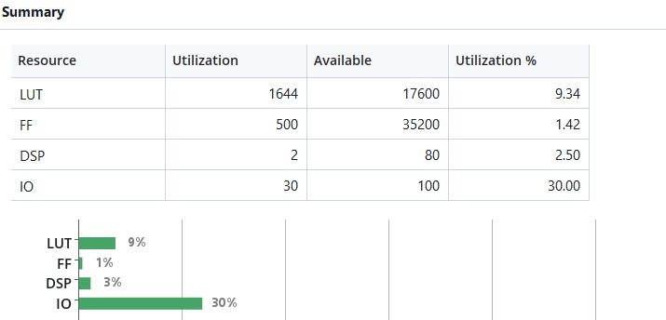
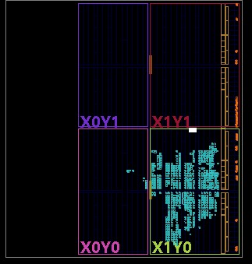
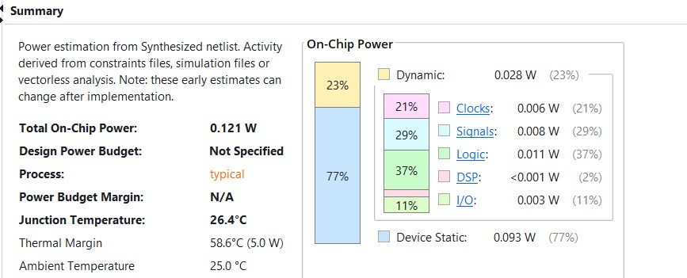
Hardware Results and Conclusion
UTILIZATION REPORT
POWER REPORT

Slide 8
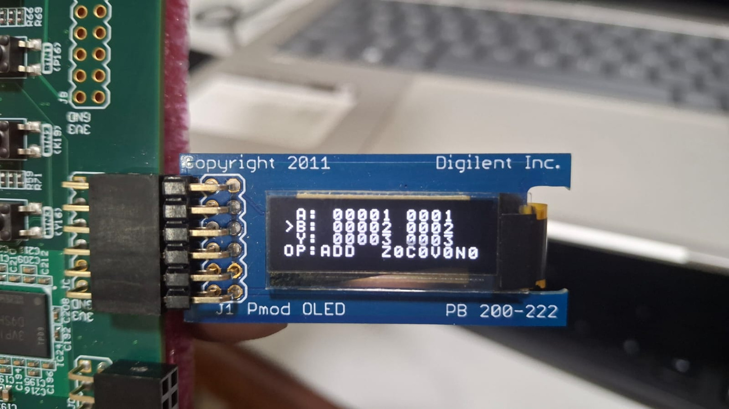
Hardware Results and Conclusion
  A=0001
  B=0002
  Y=0003
  Operation=ADD (opcode 0000 )
How the flags came out
Z = 0
C = 0
V = 0
N = 0
Z = (Y == 0) = 0.
C = bit 16 of the 17-bit sum: 0x0001+0x0002 = 0x00003, so C=0.
V and N are always 0 for unsigned ops.

Slide 9
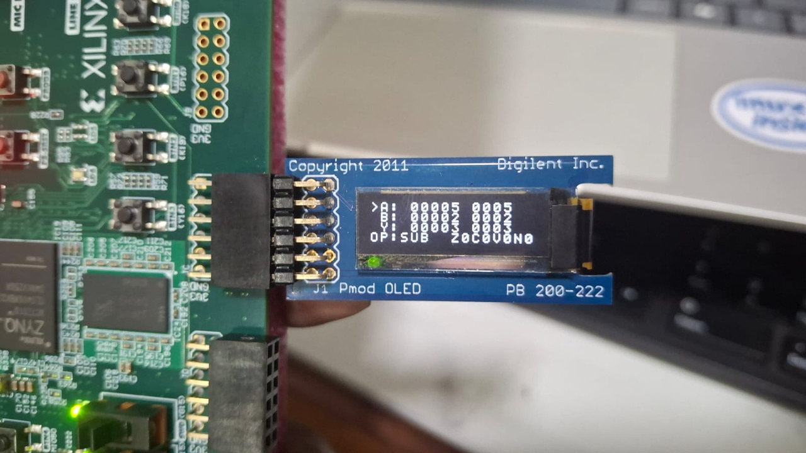
Hardware Results and Conclusion
  A=0005
  B=0002
  Y=0003
  Operation=SUB (opcode 0001 )
How the flags came out
Z = 0
C = 0
V = 0
N = 0
Z = (Y == 0) = 0.
C = borrow = (A<B): 5 >= 2, so C=0.
V and N are always 0 for unsigned ops.

Slide 10
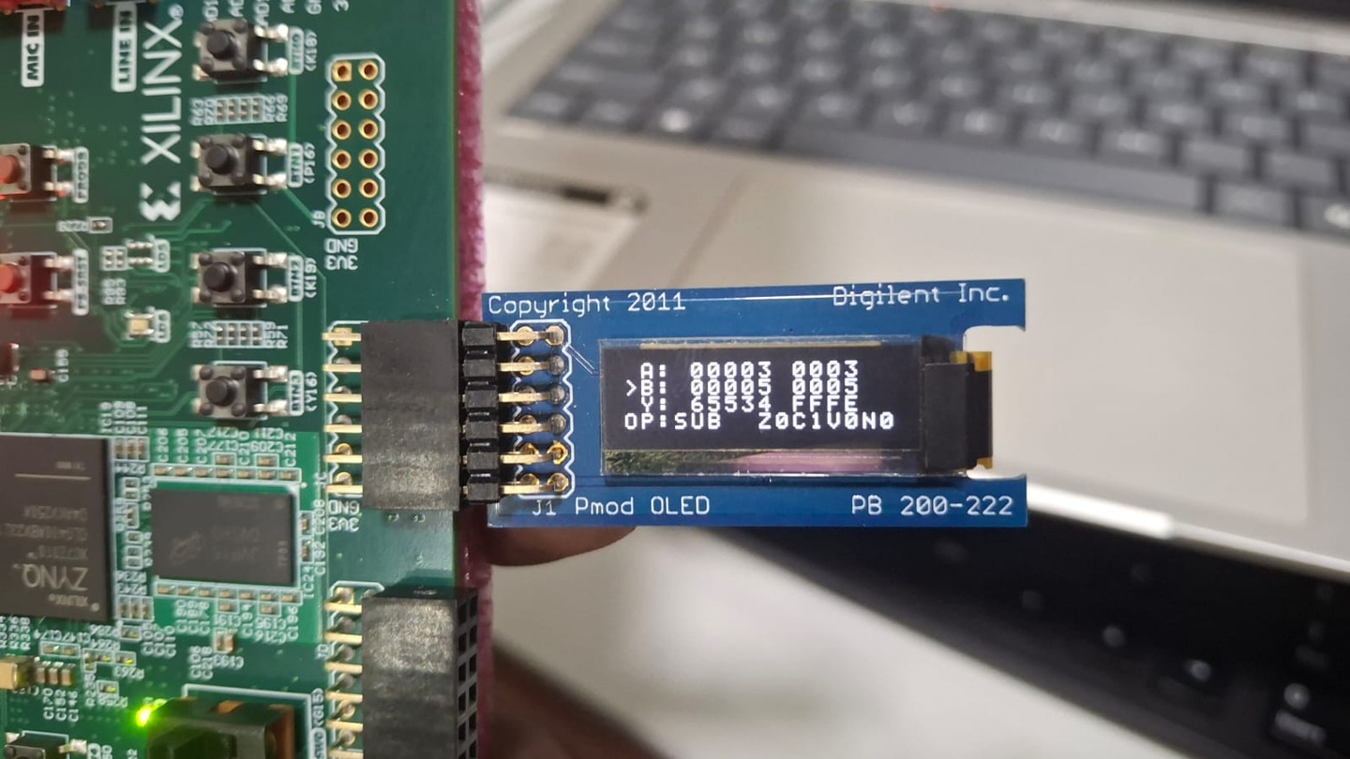
Hardware Results and Conclusion
  A=0003
  B=0005
  Y=FFFE
  Operation=SUB (opcode 0001 )
How the flags came out
Z = 0
C = 1
V = 0
N = 0
Z = (Y == 0) = 0.
C = borrow = (A<B): 3 < 5, so C=1. Result wrapped to 16 bits.
V and N are always 0 for unsigned ops.

Slide 11
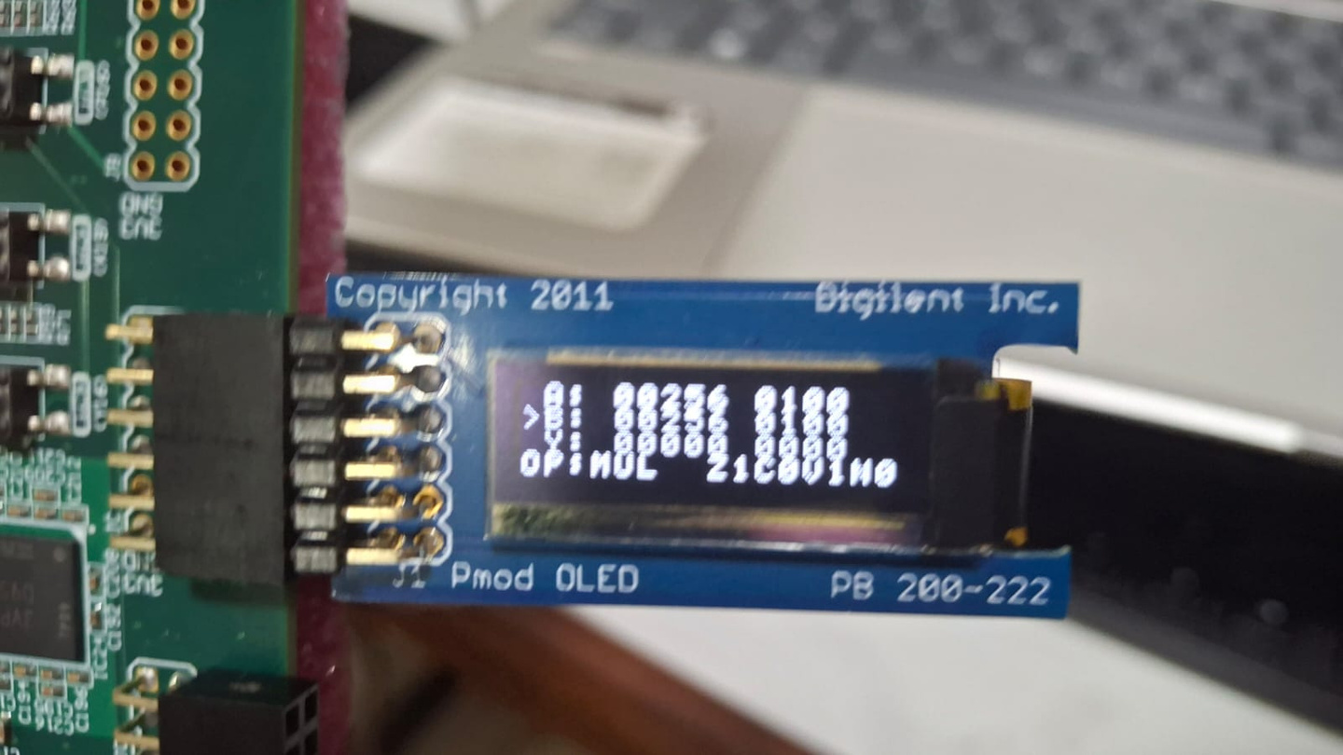
Hardware Results and Conclusion
  A=0100
  B=0100
  Y=0000
  Operation=MUL (opcode 0010 )
How the flags came out
Z = 1
C = 0
V = 1
N = 0
Z = (Y == 0) = 1.
V = any bit set in product[31:16]: 256x256 = 0x10000, upper half 0x1 is non-zero, so V=1 (result truncated).
C and N are always 0.

Slide 12
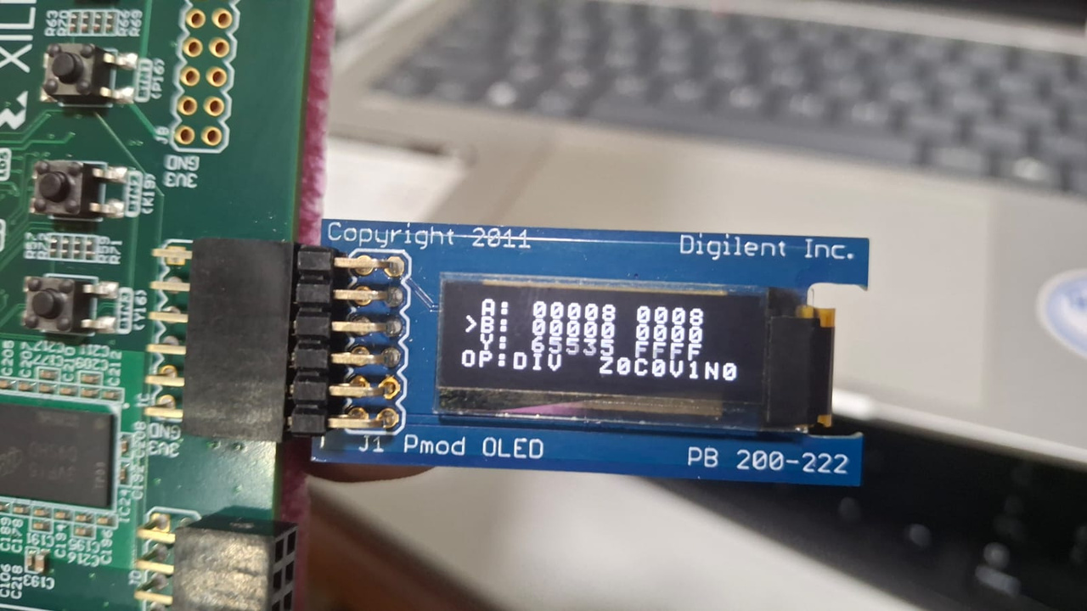
Hardware Results and Conclusion
  A=0000
  B=0000
  Y=FFFF
  Operation=DIV (opcode 0011 )
How the flags came out
Z = 0
C = 0
V = 1
N = 0
Z = (Y == 0) = 0.
B = 0 so the divider is bypassed: Y = FFFF and
V = 1 (divide-by-zero).
C and N are 0.

Slide 13
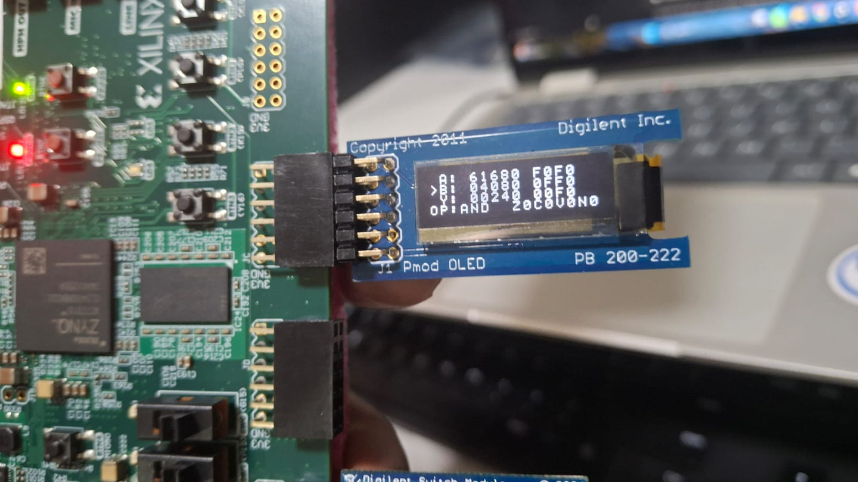
Hardware Results and Conclusion
  A=F0F0
  B=0FF0
  Y=00F0
  Operation=AND (opcode 0100 )
How the flags came out
Z = 0
C = 0
V = 0
N = 0
Z = (Y == 0) = 0.
Logic ops force C = V = N = 0.
Only Z can be set.

Slide 14
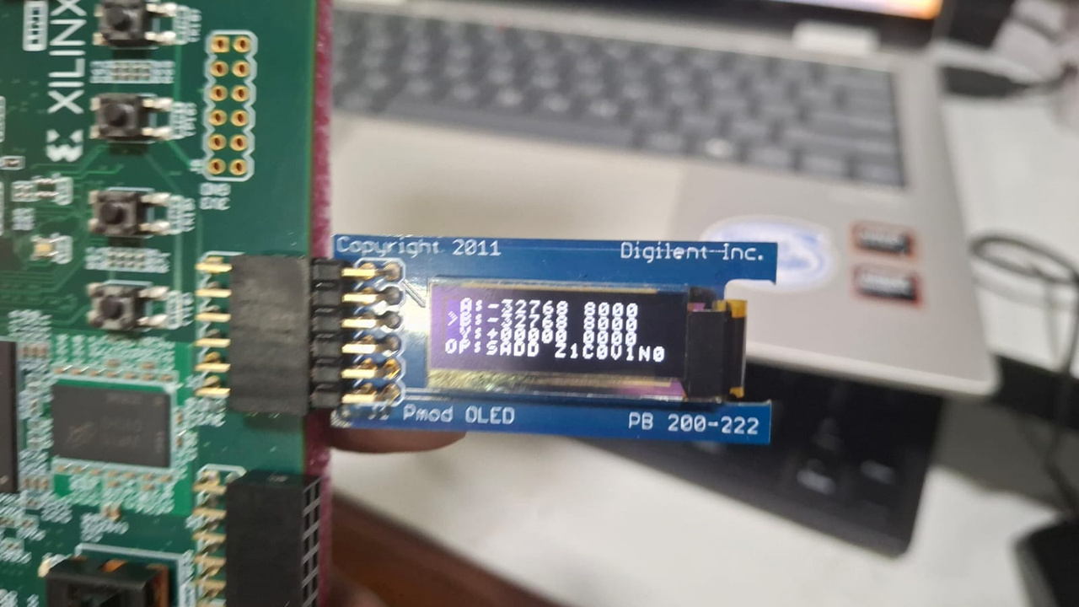
Hardware Results and Conclusion
  A=8000
  B=8000
  Y=0000
  Operation=SADD (opcode 1000 )
How the flags came out
Z = 1
C = 0
V = 1
N = 0
Z = (Y == 0) = 1.
V = 1 only if both inputs have the same sign and the result sign differs. Here A sign=1, B sign=1, result sign=0, so V=1.
N = Y[15] = 0. C is 0 for signed ops.

Slide 15
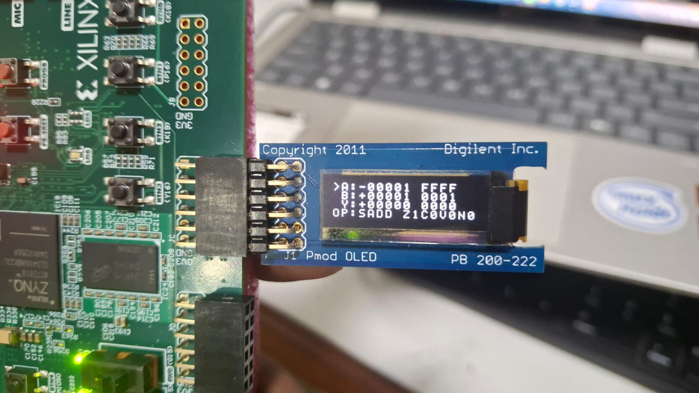
Hardware Results and Conclusion
  A=FFFF
  B=0001
  Y=0000
  Operation=SADD (opcode 1000 )
How the flags came out
Z = 1
C = 0
V = 0
N = 0
Z = (Y == 0) = 1.
V = 1 only if both inputs have the same sign and the result sign differs. Here A sign=1,
B sign=0, result sign=0, so V=0.
N = Y[15] = 0. C is 0 for signed ops.

Slide 16
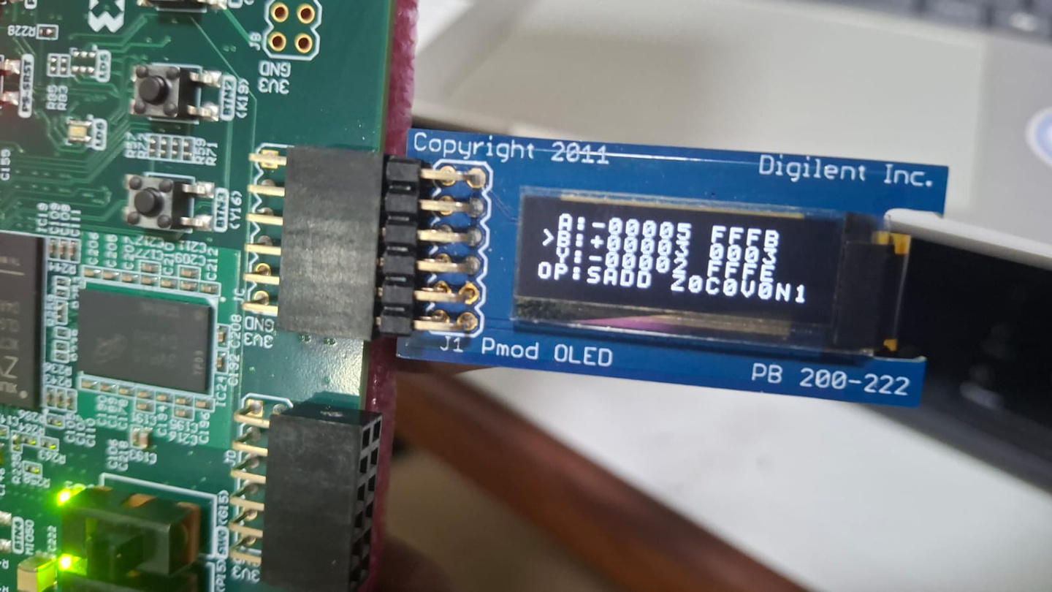
Hardware Results and Conclusion
  A=FFFB
  B=0003
  Y=FFFE
  Operation=SADD (opcode 1000 )
How the flags came out
Z = 0
C = 0
V = 0
N = 1
Z = (Y == 0) = 0.
V = 1 only if both inputs have the same sign and the result sign differs. Here A sign=1,
B sign=0, result sign=1, so V=0.
N = Y[15] = 1. C is 0 for signed ops.

Slide 17
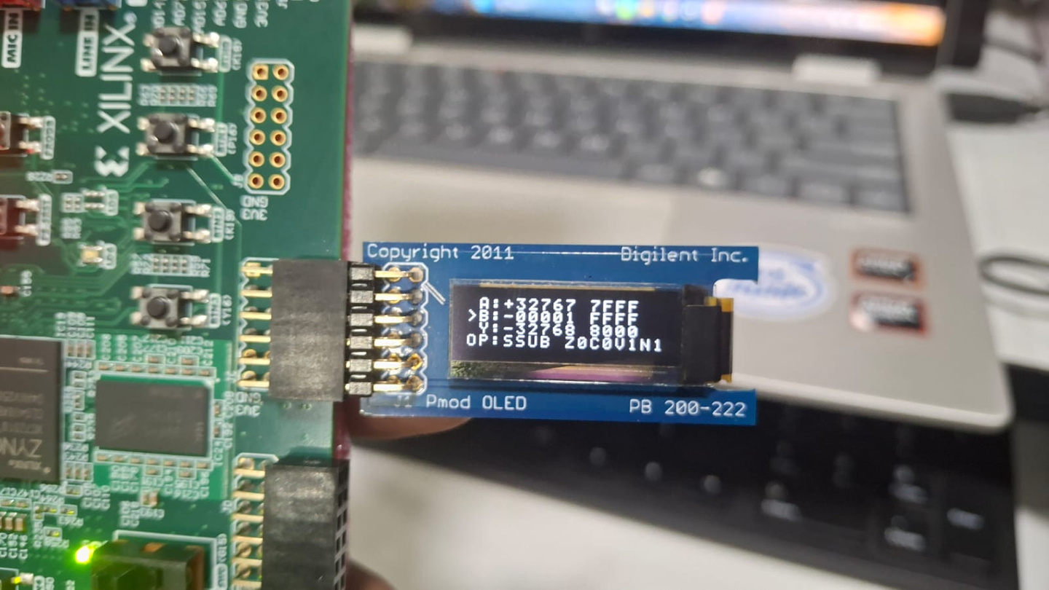
Hardware Results and Conclusion
  A=7FFF
  B=FFFF
  Y=8000
  Operation=SSUB (opcode 1001 )
How the flags came out
Z = 0
C = 0
V = 1
N = 1
Z = (Y == 0) = 0.
V = 1 only if the inputs have different signs and the result sign differs from A. Here A sign=0,
B sign=1, result sign=1, so V=1.
N = Y[15] = 1. C is 0 for signed ops.

Slide 18
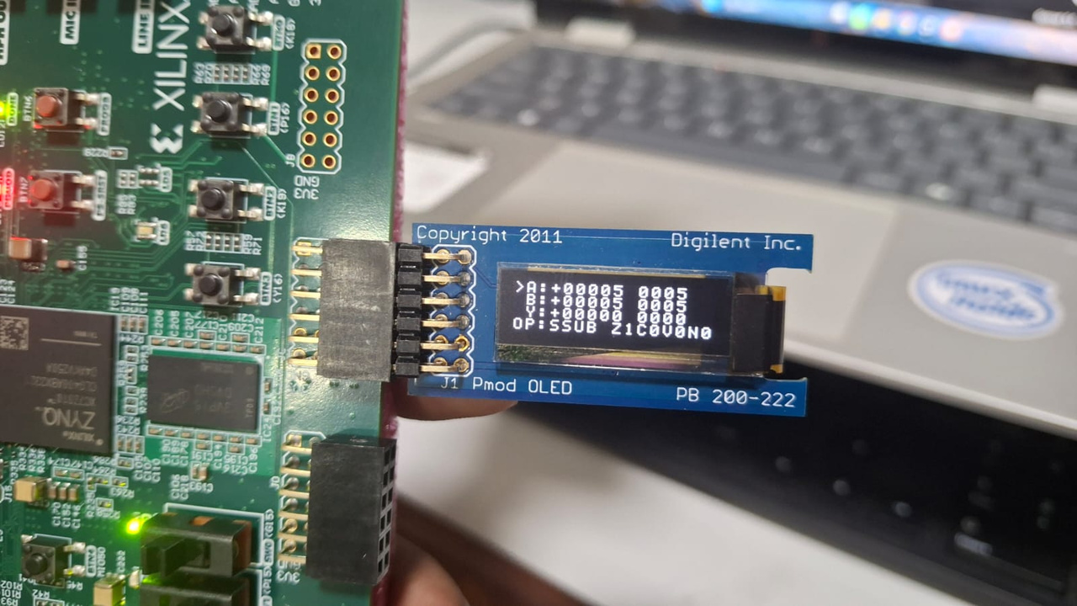
Hardware Results and Conclusion
  A=0005
  B=0005
  Y=0000
  Operation=SSUB (opcode 1001 )
How the flags came out
Z = 1
C = 0
V = 0
N = 0
Z = (Y == 0) = 1.
V = 1 only if the inputs have different signs and the result sign differs from A. Here A sign=0,
B sign=0, result sign=0, so V=0.
N = Y[15] = 0. C is 0 for signed ops.

Slide 19
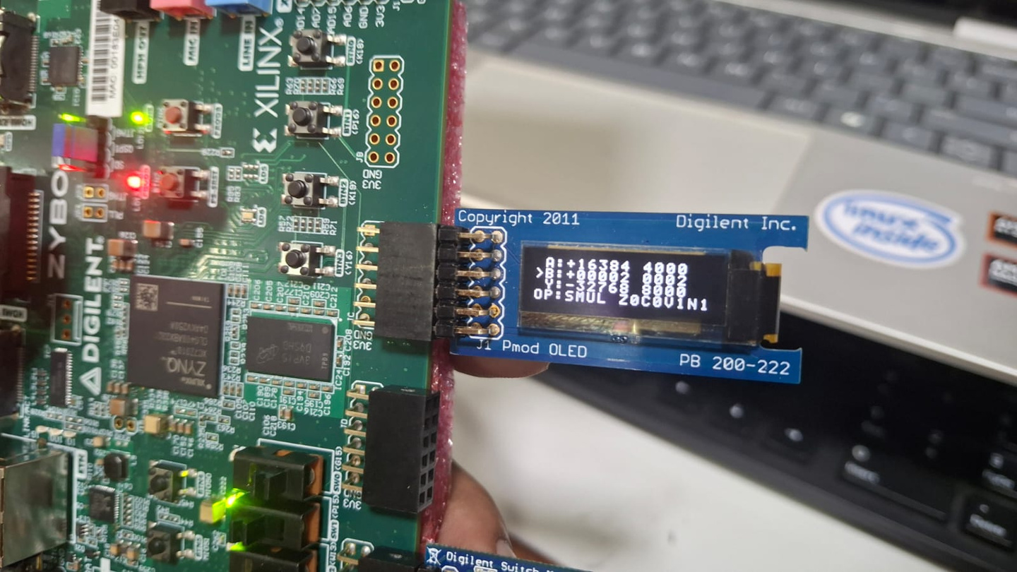
Hardware Results and Conclusion
  A=4000
  B=0002
  Y=8000
  Operation=SMUL (opcode 1010 )
How the flags came out
Z = 0
C = 0
V = 1
N = 1
Z = (Y == 0) = 0.
True product = 16384 x 2 = 32768. V = 1 if it is outside -32768..32767, so V=1.
N = Y[15] = 1.

Slide 20
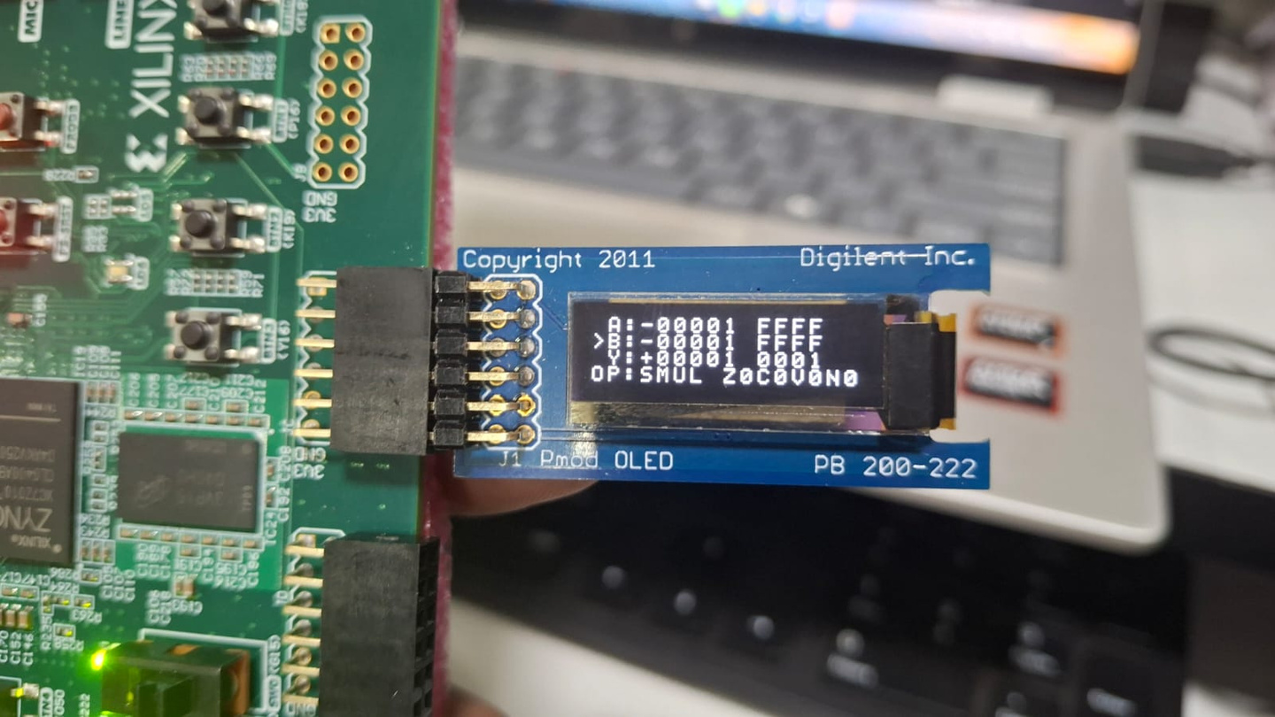
Hardware Results and Conclusion
  A=FFFF
  B=FFFF
  Y=0001
  Operation=SMUL (opcode 1010 )
How the flags came out
Z = 0
C = 0
V = 0
N = 0
Z = (Y == 0) = 0.
True product = -1 x -1 = 1. V = 1 if it is outside -32768..32767, so V=0.
N = Y[15] = 0.

Slide 21
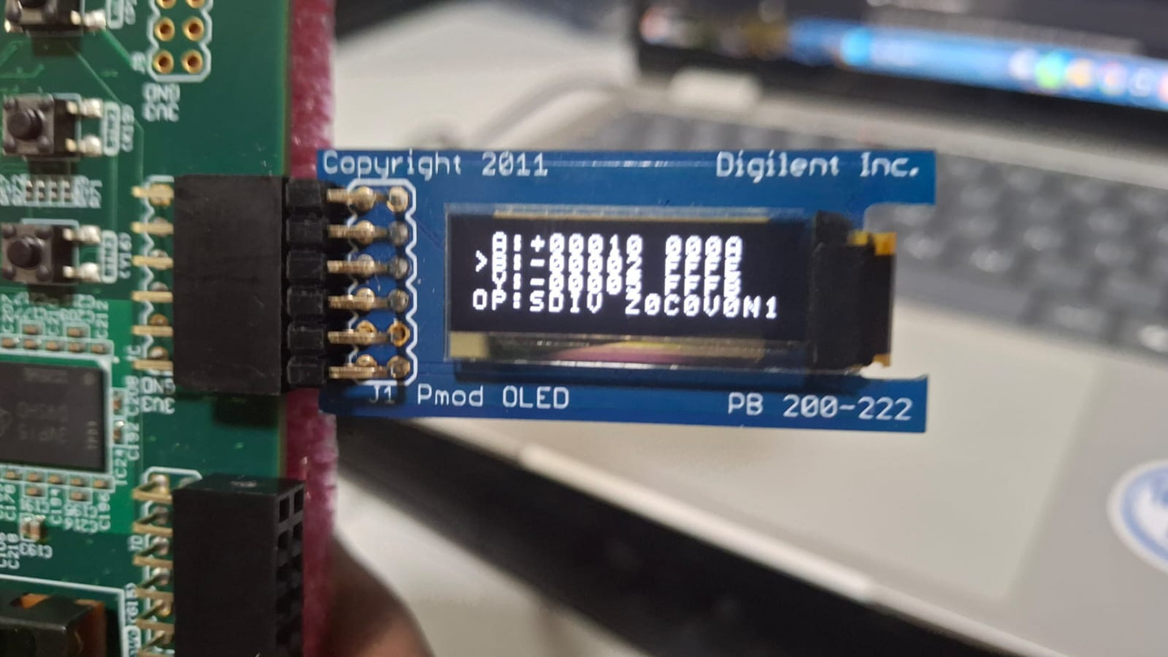
Hardware Results and Conclusion
  A=000A
  B=FFFE
  Y=FFFB
  Operation=SDIV (opcode 1011)
How the flags came out
Z = 0
C = 0
V = 0
N = 1
Z = (Y == 0) = 0.
Signed divide: 10 / -2 = -5 (truncates toward zero). V = 0.
N = Y[15] = 1, set because the quotient is negative.

Slide 22
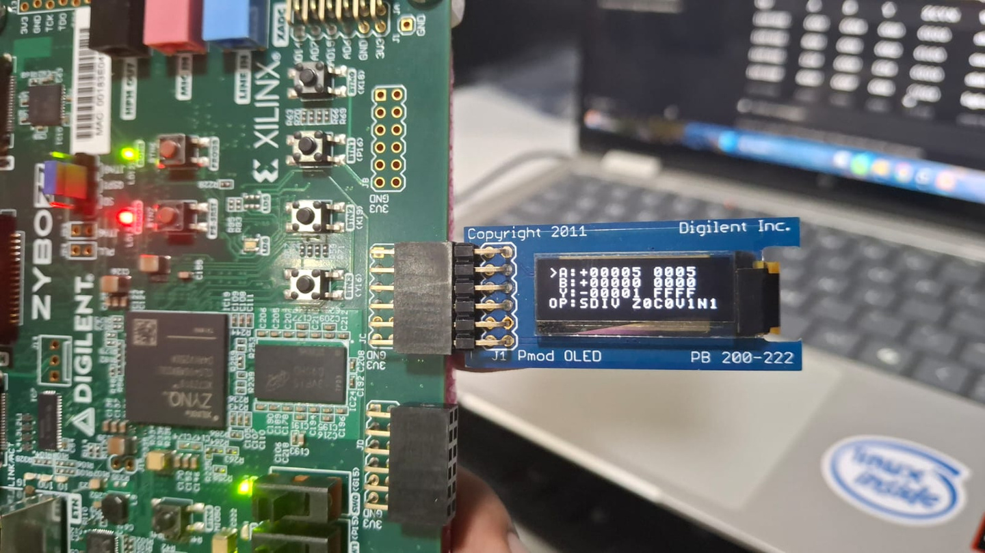
Hardware Results and Conclusion
  A=0005
  B=0000
  Y=FFFF
  Operation=SDIV (opcode 1011 )
How the flags came out
Z = 0
C = 0
V = 1
N = 0
Z = (Y == 0) = 0.
B = 0: Y = FFFF and V = 1 (divide-by-zero).
N = Y[15] = 1 (FFFF has bit 15 set).

Slide 23
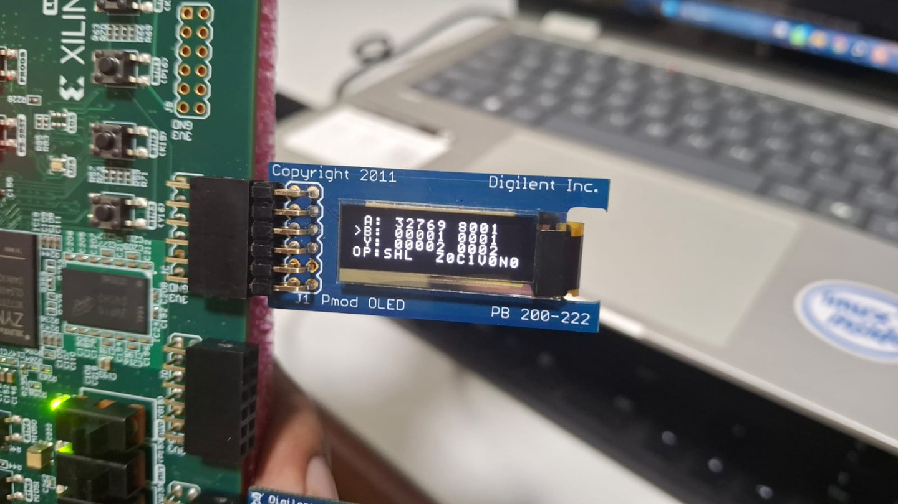
Hardware Results and Conclusion
  A=8001
  B=0001
  Y=0002
  Operation=LSL (opcode 1100 )
How the flags came out
Z = 0
C = 1
N = 0
V = 1
Z = (Y == 0) = 0,because Y = 0002 is not zero.
Shift amount = B[3:0] = 1. C = last bit shifted out = A[16-1] = A[15] = 1.
A = 8001 has bit 15 set, and that bit is pushed out.
V and N are always 0 for shifts.

Slide 24
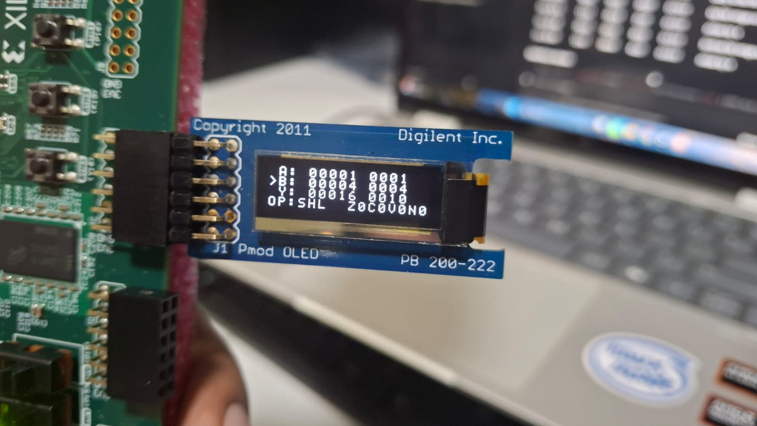
Hardware Results and Conclusion
  A=0001
  B=0004
  Y=0010
  Operation=LSL (opcode 1100 )
How the flags came out
Z = 0
C = 0
V = 0
N = 0
Z = (Y == 0) = 0.
Shift amount = B[3:0] = 4. C = last bit shifted out = A[16-4] = 0.
V and N are always 0.

Slide 25
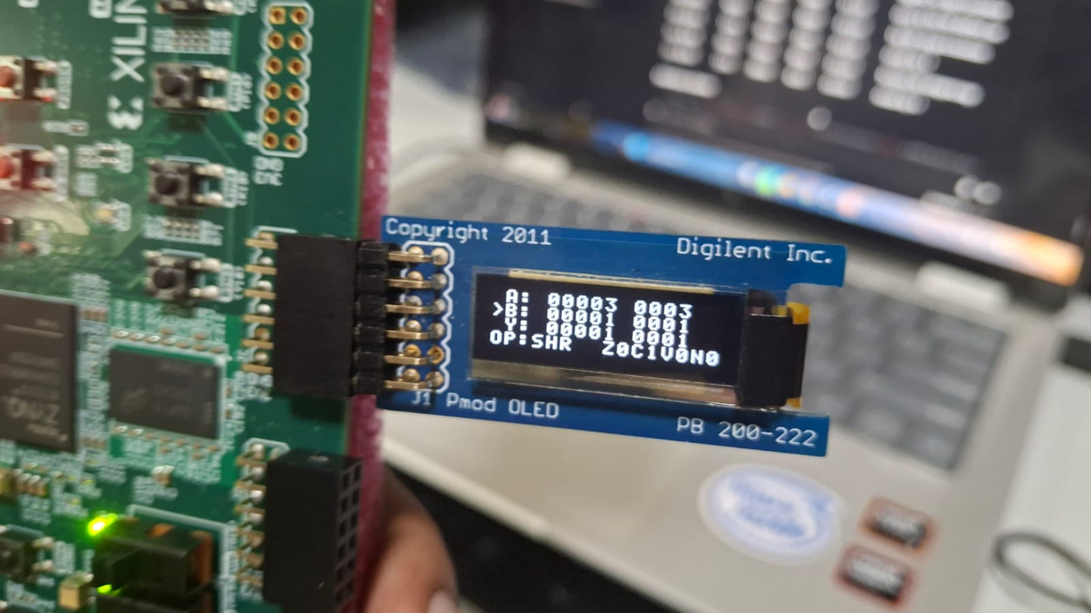
Hardware Results and Conclusion
  A=0003
  B=0001
  Y=0001
  Operation=LSR (opcode 1101)
How the flags came out
Z = 0
C = 1
V = 0
N = 0
Z = (Y == 0) = 0.
Shift amount = B[3:0] = 1. C = last bit shifted out = A[1-1] = 1.
V and N are always 0.

Slide 26
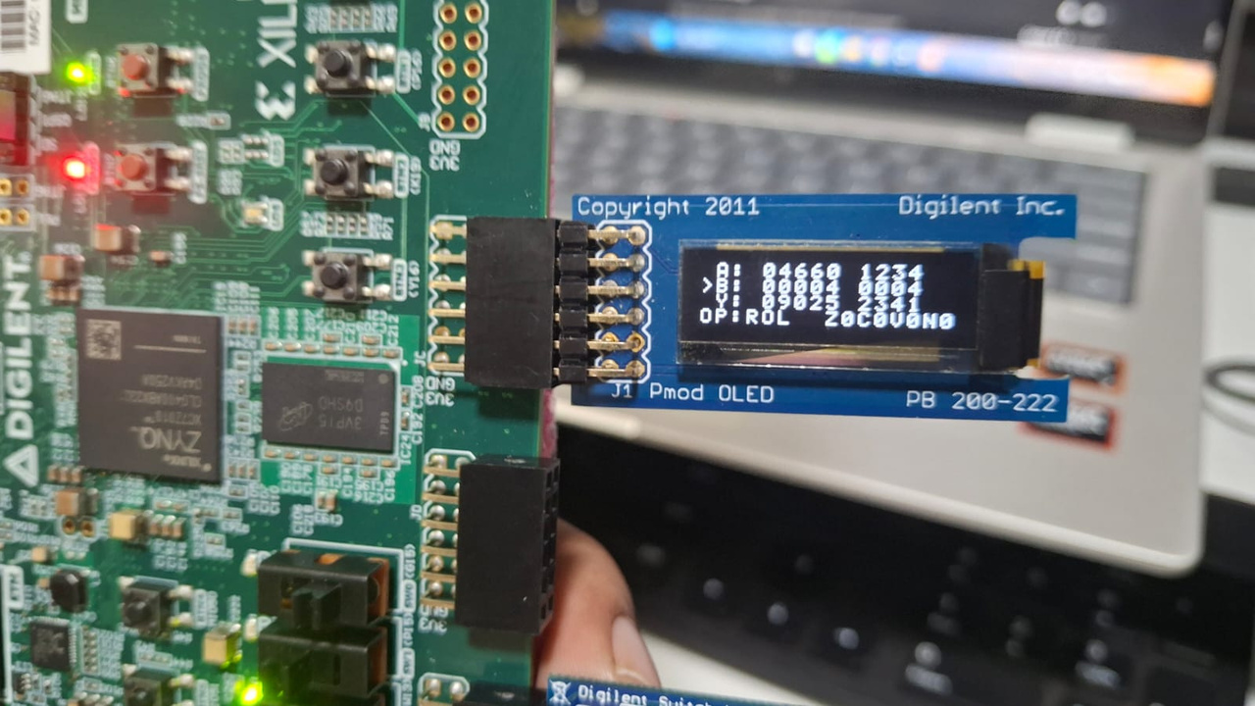
Hardware Results and Conclusion
  A=1234
  B=0004
  Y=2341
  Operation=ROL (opcode 1110 )
How the flags came out
Z = 0
C = 0
V = 0
N = 0
Z = (Y == 0) = 0.
Rotate left by B[3:0] = 4: bits wrap around, none are lost.
Rotates force C = V = N = 0.

Slide 27
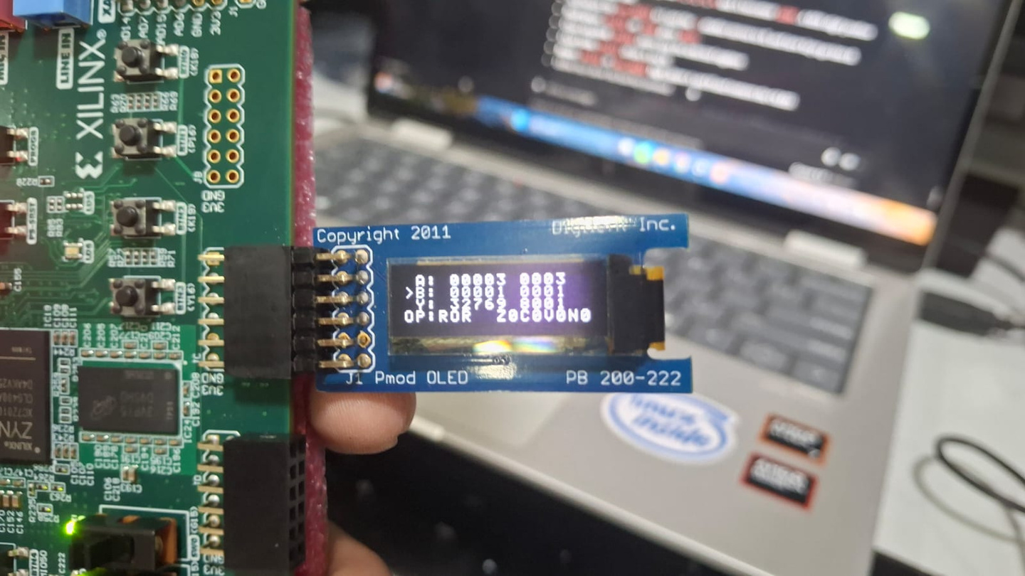
Hardware Results and Conclusion
  A=0003
  B=0001
  Y=8001
  Operation=ROR (opcode 1111)
How the flags came out
Z = 0
C = 0
V = 0
N = 0
Z = (Y == 0) = 0.
Rotate right by B[3:0] = 1: bits wrap around, none are lost.
Rotates force C = V = N = 0.

