Slide 1
Task 4 – Dashboard Design Data Analyst Internship
Saisruthi 25.4.25

Slide 2
Dataset Overview
Dataset Used: Financials Dataset (from sample powerbi)
Key Columns: Sales, Profit, Units Sold, Product, Segment, Country
Purpose: To visualize and analyze key business metrics

Slide 3
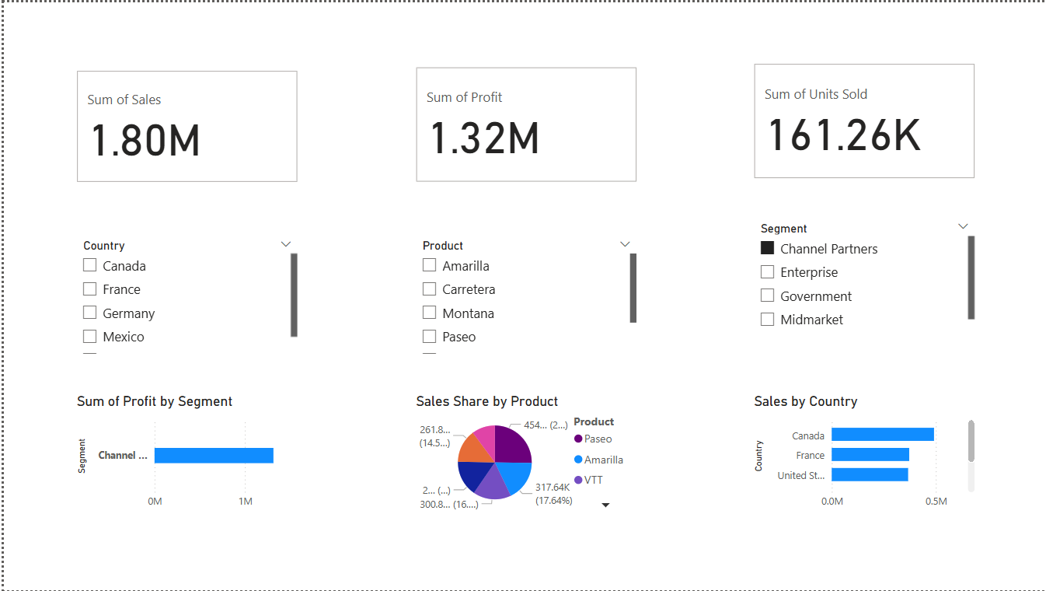
Dashboard Summary
KPIs:
- Total Sales
- Total Profit
- Units Sold
Visuals:
- Sales by Country (Bar Chart)
- Profit by Segment (Bar Chart)
- Sales by Product (Pie Chart)
Filters Used:
- Country, Segment, Product

Slide 4
Key Insights
- The segment with the highest profit is channel partners.
- Country Canada generates the most sales.
- Product paseo has the highest contribution to total sales

Slide 5
Tools Used & Conclusion
Tools Used:
- Power BI
- GitHub
Conclusion:
This dashboard helps stakeholders analyze performance by product, segment, and region without needing to check raw tables.

