Slide 1

FINAL REPORT
PROJECT :BOOK MANAGEMENT SYSTEM
SECTION:BG
UNDER THE GUIDANCE OF
SHIVANI BHARDWAJ
Submitted By:
SAI SUDHAKAR UTKARSH SINGH
ESWAR SAI
----------------------- K21BGB45
-------------------------- K21BGB70
-------------------------K21BGA20

Slide 2
INTRODUCTION
PROJECT AIMS AND OBJECTIVES:
The project aims and objectives that will be achieved after completion of this project are discussed in this subchapter. The aims and objectives are as follows:
Online book reading.
A search column to search availability of books.
Facility to download required book.
Video tutorial for students.
An Admin login page where admin can add books, videos or page sources.open link for Learning Websites
E-Library Management System is an application which refers to library systems which are generally small or medium in size. It is used by librarian to manage the library using a computerized system where he/she can add new books, videos and Page sources.
Books and student maintenance modules are also included in this system which would keep track of the students using the library and also a detailed description about the books a library contains. With this computerized system there will be no loss of book record or member record which generally happens when a non computerized system is used.
All these modules are able to help librarian to manage the library with more convenience and in a more efficient way as compared to library systems which are not computerized.
OBJECTIVE:

Slide 3
DESIGN
PYTHON 3.10-
Python is an interpreted, object-oriented, high-level programming language with dynamic semantics. Its high-level built-in data structures, combined with dynamic typing and dynamic binding, make it very attractive for Rapid Application Development, as well as for use as a scripting or glue language to connect existing components together. Python's simple, easy-to- learn syntax emphasizes readability and therefore reduces the cost of program maintenance. Python supports modules and packages, which encourages program modularity and code reuse.
TKINTER :
Tkinter is the standard GUI library for Python. Python when combined with Tkinter provides a fast and easy way to create GUI applications. Tkinter provides a powerful object-oriented interface to the TK GUI toolkit.
Creating a GUI application using Tkinter is an easy task. All you need to do is perform the following steps. Import the Tkinter module. Create the GUI application main window Add one or more of the above-mentioned widgets to the GUI

Slide 4
Common attributes used
a. Fg is a common attribute to color the text as in the project the foreground of the text is white.
b. Bg is a common attribute called background, already clear from the name it is used for giving color to the background of the text. In the project the bg or background of the text in the button is black. and the color of the window is grey.
c. Command is used at various times. It is used in the buttons. The functions are called using this command attribute.
d. Font it is used to beautify as well as magnify the text. In the project, the font used is

Slide 5
PROCESSOR | INTEL CORE PROCESSOR OR BETTER PERFORMANCE
OPERATING SYSTEM | WINDOWS VISTA ,WINDOWS7, UBUNTU
MEMORY | 1GB RAM OR MORE
HARD DISK SPACE | MINIMUM 3 GB FOR DATABASE USAGE FOR FUTURE
DATABASE | MY SQL
SYSTEM ANALYSIS:
In this chapter, we will discuss and analyze about the developing process of Library Management System including software requirement specification (SRS) and comparison between existing and proposed system . The functional and non functional requirements are included
in SRS part to provide complete description and overview of system requirement before the developing process is carried out. Besides that, existing vs proposed provides a view of how the proposed system will be more efficient than the existing one.

Slide 6
SOFTWARE REQUIREMENT SPECIFICATION
GENERAL DESCRIPTION
PRODUCT DESCRIPTION:
Library Management System is a computerized system which helps user(librarian) to manage the library daily activity in electronic format. It reduces the risk of paper work such as file lost, file damaged and time consuming. It can help user to manage the transaction or record more effectively and time- saving
PROBLEM STATEMENT:
The problem occurred before having computerized system includes:
File lost
When computerized system is not implemented file is always lost because of human environment.Some times due to some human error there may be a loss of records.
File damaged When a computerized system is not there file is always lost due to some accdent like spilling of water by some member on file accidentally. Besides some natural disaster like floods or fires may also damage the files.
Difficult to search record

Slide 7
FUNCTIONAL REQUIREMENTS:
1. NORMAL USER
USER LOGIN
Description of feature
This feature used by the user to login into system. They are required to enter user id and password before they are allowed to enter the system .The user id and password will be verified and if invalid id is there user is allowed to not enter the system.
Functional requirements
-user id is provided when they register
-The system must only allow user with valid id and password to enter the system -The system performs authorization process which decides what user level can acess to.
-The user must be able to logout after they finished using system.
1.1 REGISTER NEW USER
Description of feature
This feature can be performed by all users to register new user to create account.
Functional requirements
-System must be able to verify information
-System must be able to delete information if information is wrong

Slide 8
REGISTER NEW BOOK:
Description of feature
This feature allows to add new books to the library Functional requirements
-System must be able to verify information
-System must be able to enter number of copies into table.
- System must be able to not allow two books having same book id.
REQUIREMENTS:
Functional Requirements:
Book Entry: In this module we can store the details of the books.
Register Student: In this module we can keep the details of the new student.
Book Issue: This module is used to keep the track of book issue details.
Book Return: This module enables to keep a track of returned books
LABEL:- We used label for text like frame and headings, etc
and also we use for entry
BUTTON:- We used button for signup, signin , register ,login and more etc
ENTRY:-We used entry for widgets for reading the books ,author, newpages and more etc………..
.

Slide 9
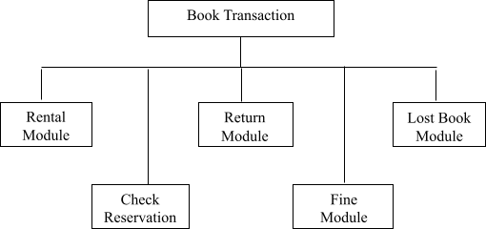
Book Transaction Module
Book Transaction module is a main module in Library Management System. When member wants to borrow books, return books or they want to register lost book, it is all under book Transaction module.
This module can be accessed by normal user or admin user. When member wants to borrow a book, librarian needs to scan in their member id.
After that, librarian will scan their book’s barcode id. If the book is under reservation, the book is not available to rent.
For return module, librarian just needs to scan the book’s barcode id, and confirm the rental detail with user.

Slide 10
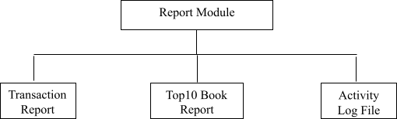
Report Module
Report module is the main module for admin user. It is because normal user is not allowed to view the report. The report divided into 3 types. First one is transaction report which can let admin views the book transaction happen on particular date such as rental report and return report.
Top10 Report is the top rental rate’s book. Admin can filter the information based on book’s category and also filter by date in type of daily, monthly and yearly.
Activity Log File is a log which records every process in the Library Management System such as login / logout activity, register new book, new member or edit information or a member. All the activity done by every user will be record so that when system crash, admin or system admin are able to check the activity that may crash the system.

Slide 11
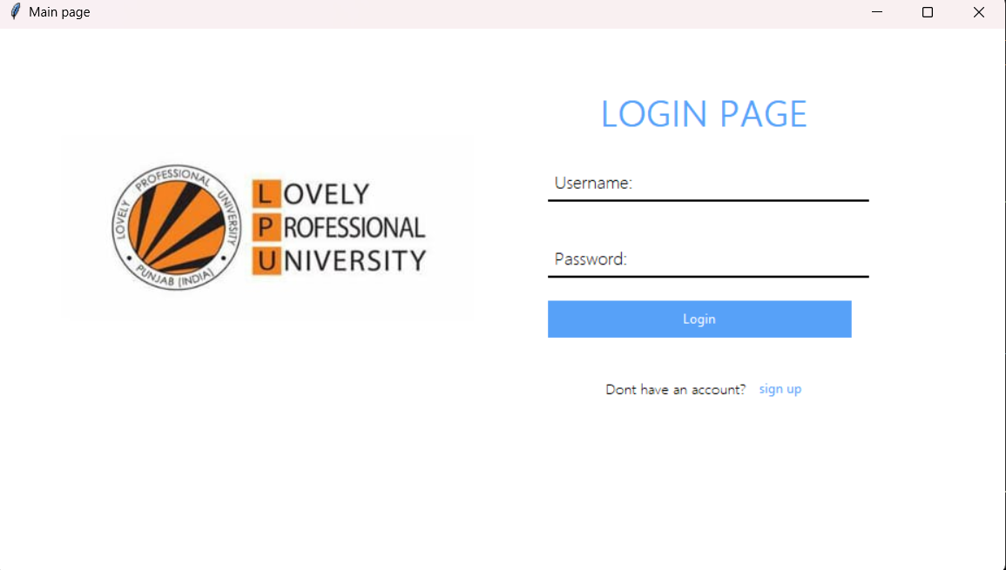
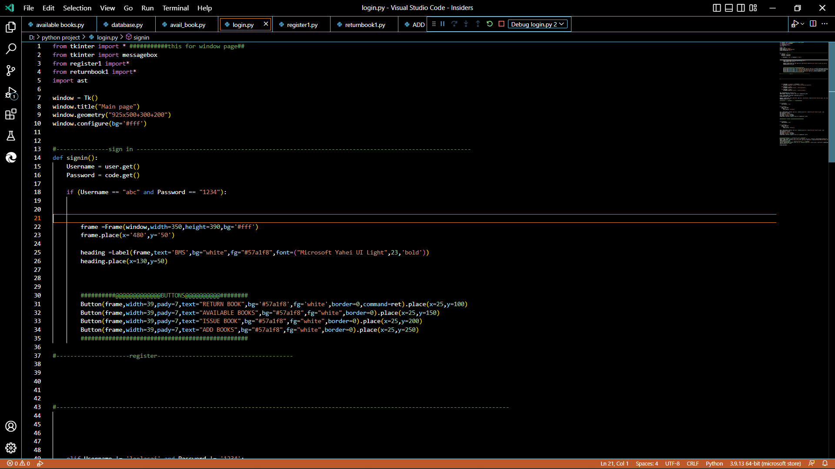
Screen shots of gui
Snapshots of the coding :

Slide 12
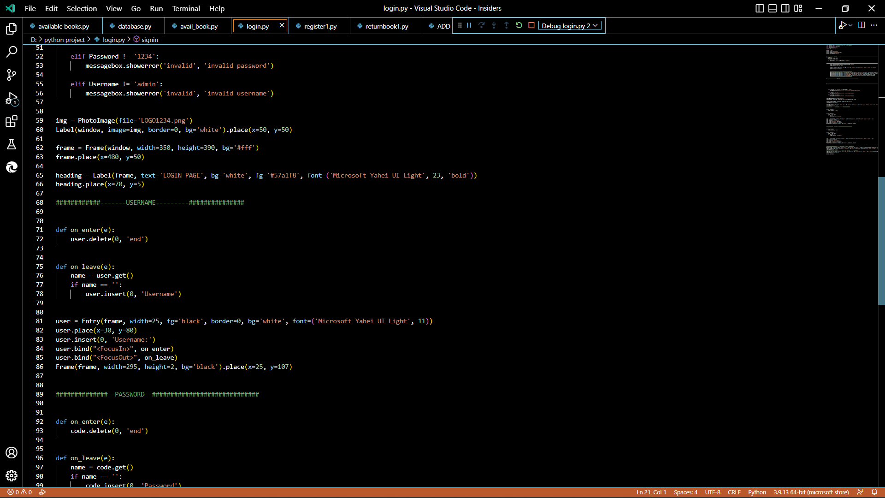
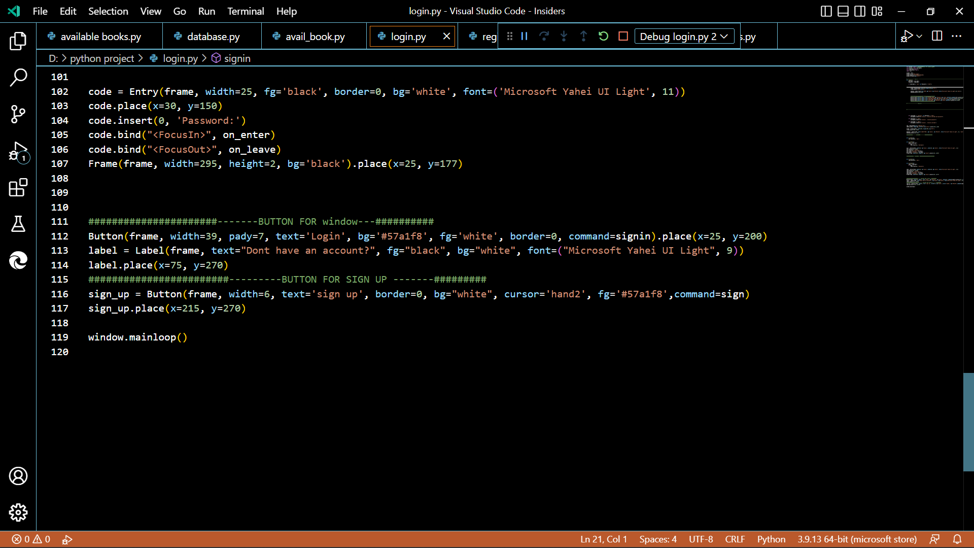

Slide 13
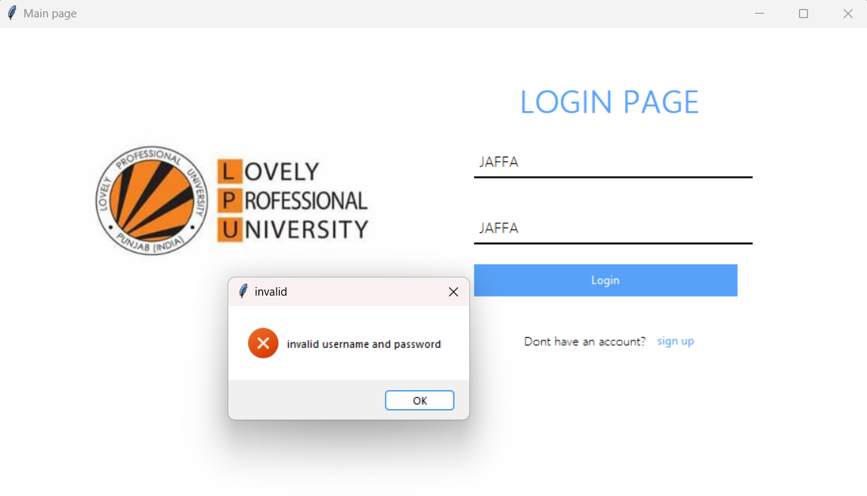
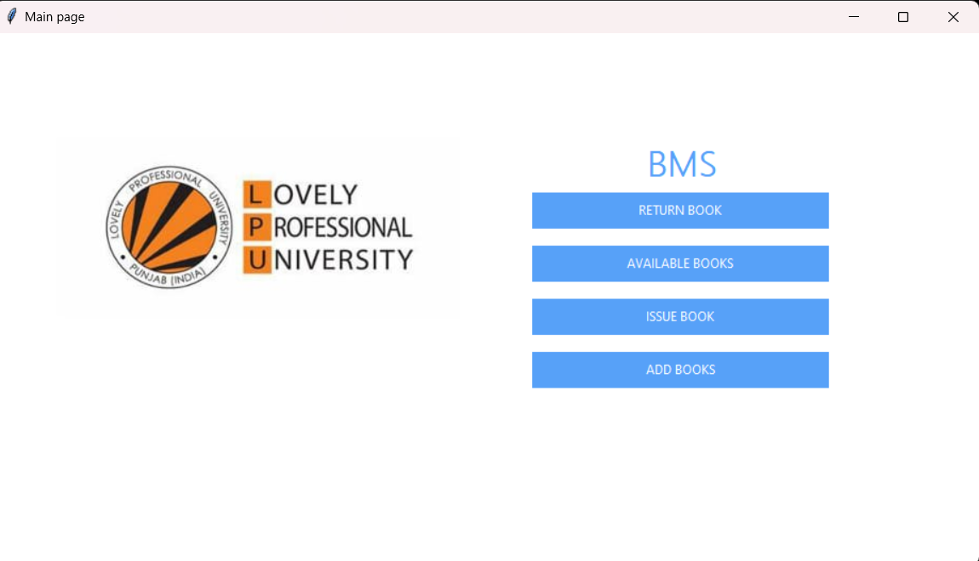

Slide 14
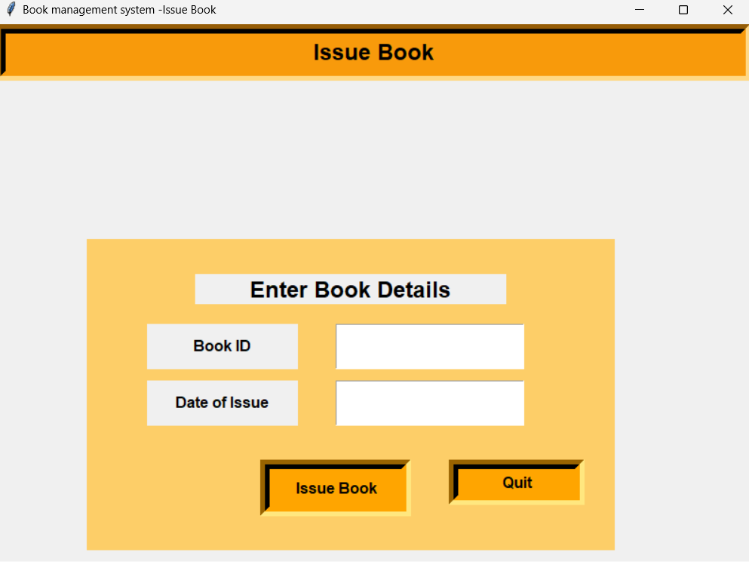
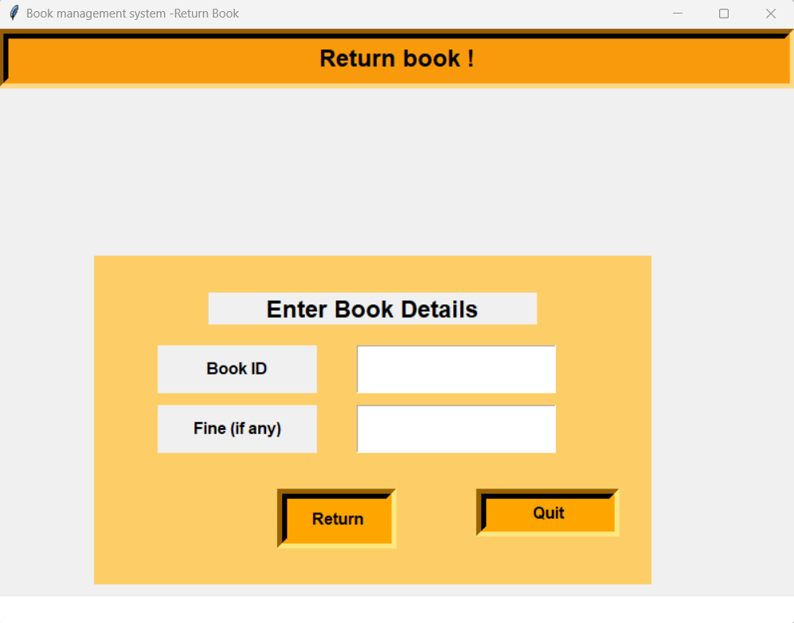

Slide 15
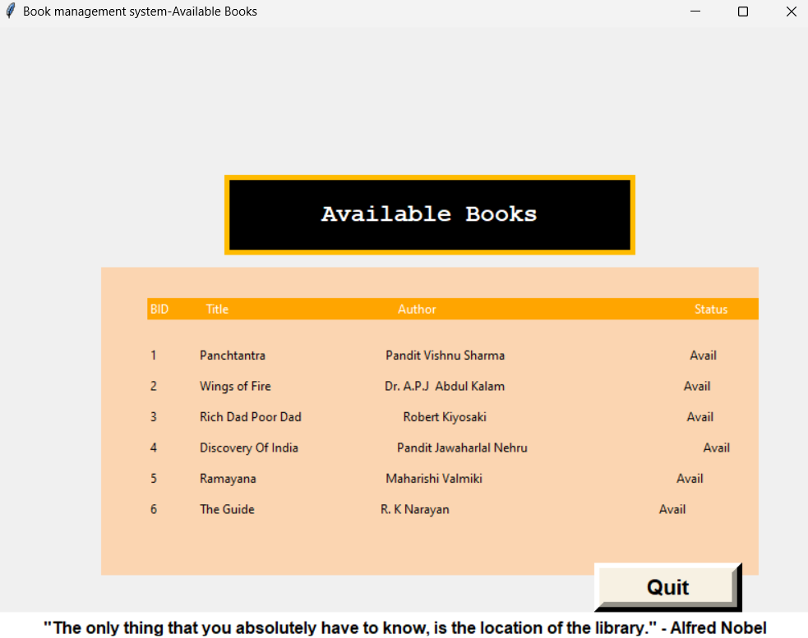
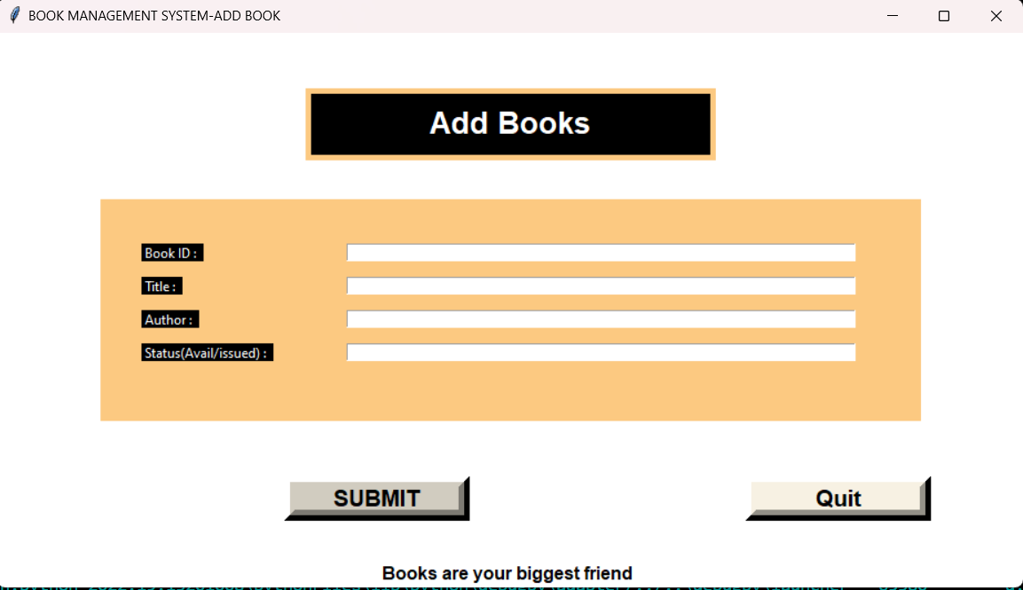

Slide 16
CONCLUSION:
It will take care of the current book detail at any point of time.
The book issue, book return will update the current book details automatically show that user will get the update current book details.
The main purpose of this project is to reduce the manual work.
This software is capable of managing book issues, returns, and calculating/managing fines.
Generating various reports for record keeping according to end user requirements.
Work Done BY Sai Sudhakar (Roll No: B45)
Written code for the main page (login page ,register ,bms page)
Linking pages with gui interface
Written the codes how to input
Created the buttons to linking
Work Done BY Utkarsh (Roll No:B70 )
Helping in the code of the labelling of the gui
Given some descriptions in the coding part
Report file created

Slide 17
Work Done BY Eswar (Roll No: A20)
Helped to created the available book , return book, issue book
Designed the page with data saving
Imported images and linked the page
Conclusion
This software is successfully done to maintain a book shop’s transaction.
The project is completed that follow incremental model
Reference
YOUTUBE
GOOGLE
https://www.google.com/search?q=book+management+system+project
https://itsourcecode.com/free-projects/python-projects/book-store-man agement
GitHub Link for project:-
Thank You!!!!

