Slide 1

Department of CSE
(ARTIFICIAL INTELLIGENCE AND MACHINE LEARNING)
SPEECH RECOGNITION SYSTEM
Prof.Pradeep Kumar K
Assistant Professor, CSE(AIML), DSU
Prof.Sahil Pocker
Assistant Professor, CSE(AIML), DSU
Presented By:
K V Sai Sudheendra kumar(ENG22AM0105)
K M N S Silesh (ENG22AM0100)
G Deveswar Reddy (ENG22AM0090)

Slide 2
OVERVIEW
Abstract
Problem Statement
Introduction
Literature Survey
Flow chart
Implementation
References

Slide 3
ABSTRACT
Speech recognition technology is one of the fast growing technology.
There are many people who really want to make a note of many thing from the speeches give by the speakers in the seminars, technical talk, and conferences.
The project is designed and developed by keeping these kind of cases in mind to achieve this aim.

Slide 4
PROBLEM STATEMENT
Going and attending many speech ,lectures ,seminars to gain knowledge on a particular subject of interest. Unable to make note down all the important point should not be the reason of not gaining complete knowledge.
So , this project can solve the issue of the these kind of people just by pressing a button when required to note the points can help the person to gain complete knowledge given by the speakers.

Slide 5
INTRODUCTION
Speech recognition technology has made significant strides, enabling virtual assistants like Siri and Google Assistant. It continues to improve in understanding various accents and languages, driving its adoption across industries for tasks like dictation, customer service automation, and more.
To convert speech to text using Speech Recognition
To develop an interface to convert speech to text . Which can be used easily by user to take the notes.
It can be useful in the real world to make notes of the required things.

Slide 6
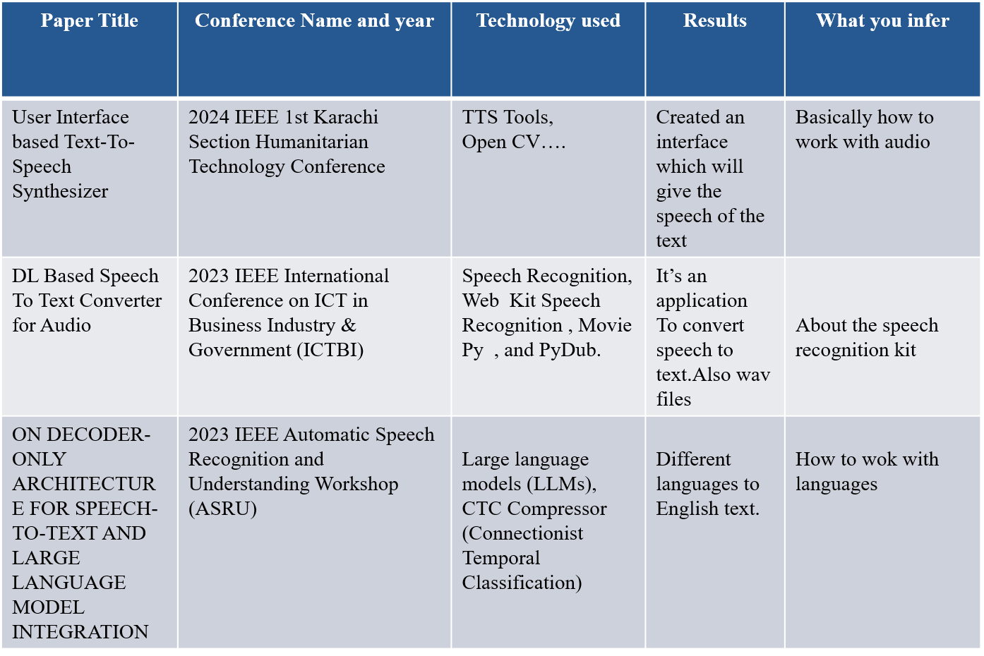
LITERATURE SURVEY
Dept of CSE., SOE-Dayananda Sagar University
5/26/2025

Slide 7
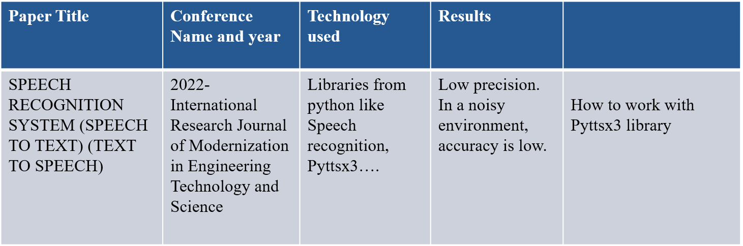
LITERATURE SURVEY

Slide 8
FLOW CHART
Start main thread
Entry point of main program
Initialize Recognizer
Create an instance of the speech recognizer
Use Default Microphone
Set the default microphone as the audio source.
Adjust for Ambient Noise Analyze the background noise and adjust the recognizer's sensitivity
Capture Audio Input
Continuously listen for speech input from the microphone
Keyboard Interrupt
Perform Speech Recognition Use the recognizer to convert the audio input into text.
Stop Continuous Recognition
Exit the speech recognition loop
Recognition Successful?
Check if the speech recognition was successful.
error
Handle Request Error
Catch and handle any errors related to the speech recognition service.
successful
error
Print Recognized Text
Display the recognized speech text
Handle Unknown Error
Catch and handle any unknown errors that may occur during speech recognition.

Slide 9
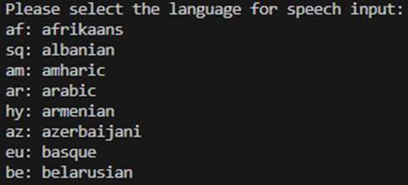
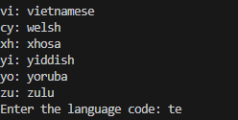
IMPLEMENTATION
Fig 1:prompt to select the language for the speech input.
Fig 2:gave the input language code.

Slide 10
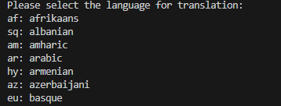
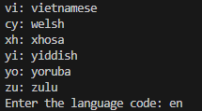

Fig 3:prompt to select the language for the text output.
Fig 4:gave the output language code.
Fig 5: the final output.

Slide 11
CONCLUSION
embracing speech-to-text recognition technology is not just about keeping up with technological trends; it's about leveraging a powerful tool that enhances inclusivity, efficiency, and communication in our society. As we move forward, this technology will continue to evolve, offering even greater benefits and transforming the way we interact with the world around us.

Slide 12
REFERENCES
User Interface based Text-To-Speech Synthesizer . Yatesh Khandelwal , Reema Goyal ,Poonam Negi Department of Computer Science and Engineering Chandigarh University, Mohali, Punjab ,2024 IEEE 1st Karachi Section Humanitarian Technology Conference (Khi-HTC) ,DOI: 10.1109/KHI-HTC60760.2024.10481952.
DL Based Speech To Text Converter for Audio Visual Applications. Prof. Rekha Kulkarni, Prof. Mukta Takalikar, Nikhil Awatade, Ameya Bhalgat Department of Computer Engineering Pune Institute of Computer Technology Pune, India . 2023 IEEE International Conference on ICT in Business Industry & Government (ICTBIG)DOI: 10.1109/ICTBIG59752.2023.10456000.Mental Health Research in India By Manipal Study
ON DECODER-ONLY ARCHITECTURE FOR SPEECH-TO-TEXT AND LARGE LANGUAGE MODEL INTEGRATION . Jian Wu, Yashesh Gaur, Zhuo Chen, Long Zhou, Yimeng Zhu, Tianrui Wang, Jinyu Li, Shujie Liu, Bo Ren, Linquan Liu, Yu Wu Microsoft, One Microsoft Way, Redmond, USA. 2023 IEEE Automatic Speech Recognition and Understanding Workshop (ASRU) ,DOI: 10.1109/ASRU57964.2023.10389705.
SPEECH RECOGNITION SYSTEM (SPEECH TO TEXT) (TEXT TO SPEECH). International Research Journal of Modernization in Engineering Technology and Science. Rajat Saini,Student, Faculty Of Engineering And Technology, SGT University, Gurugram, India. January-2022
Speech to Text Translation enabling Multilingualism. Shahana Bano , Pavuluri Jithendra , Gorsa Lakshmi Niharika Yalavarthi Sikhi Department Of CSE Koneru Lakshmaiah Education Foundation Vaddeswaram, India.2020 IEEE International Conference for Innovation in Technology (INOCON) Bengaluru, India. Nov 6-8, 2020.

Slide 13
REFERENCES
SPEECH TO TEXT CONVERSION AND SENTIMENT ANALYSIS ON SPEAKER SPECIFIC DATA. Nikhil Jain*1, Manya Goyal*2, Agravi Gupta*3, Vivek Kumar*4 *1,2,3,4Department Of Computer Science And Engineering, Meerut Institute Of Engineering And Technology, Meerut, India. International Research Journal of Modernization in Engineering Technology and Science. June-2021.
Stuttered Speech Recognition using Convolutional Neural Networks. Phani Bhushan S, Vani H Y, D K Shivkumar, Sreeraksha M R Dept. Information Science and Engg JSS Science and Technological University Mysuru, India. International Journal of Engineering Research & Technology (IJERT). Special Issue – 2021.
Python-Powered Speech-to-Text: A Comprehensive Survey and Performance Analysis. Aschin Dhakad, Shruti Singh Electronics and Telecommunication Engineering R.V. College of Engineering Banglore, Karnataka. International Journal of Engineering Research & Technology (IJERT). 09, September-2023.

Slide 14
THANK YOU

