Slide 1
Dependency Injection
&
Inversion of Control

Slide 2
Dependency Injection
An injection means passing of a dependency(a service) to a dependent object(a client)
Passing the service to the client, rather than allowing a client to build or find the service is the fundamental requirement of the pattern

Slide 3
Dependency Injection(contd..)
Dependency Injection connects objects with other objects or “injects” objects into other objects via constructors, setters
It removes the dependency of the programs. In such case we provide the information from the external file

Slide 4
Advantages
It helps to keep our classes as independent as possible
Increase reuse by applying low coupling
Easy testing

Slide 5
Without using DI
We need to instantiate an implementation of Item Interface within Store class itself
Public class Store {
private Item item;
public store() {
item = new ItemImpl();
}
}

Slide 6
Using DI
We can rewrite the above example without specifying the implementation of Item
Public class Store {
private Item item;
public Store(Item item) {
this.item = item;
}
}

Slide 7
DI by Constructor
We can inject the dependency by constructor. The <constructor-arg> which is a subelement of <bean> is used for constructor injection

Slide 8
Using <constructor-arg>
To inject primitive type, use the type attribute which defines the primitive types along with the value attribute through which we pass the value
<constructor-arg value="1" type="int">
</constructor-arg>
To inject String, we only use the value attribute and type attribute is not required
<constructor-arg value="Bubblu">
</constructor-arg>

Slide 9
Using <constructor-arg>(contd..)
To inject Object Type, <ref> is used with an attribute of bean
Example:
<constructor-arg>
<ref bean="owner"></ref>
</constructor-arg>

Slide 10
DI by Setter Method
We can inject the dependency by setter method also. The <property> sub element of <bean> is used for setter injection

Slide 11
Using <Property>
To inject Primitive Type and Strings, define name and value attributes. name attribute should be same as the instance variable of a class
<property name="id" value="1"></property>
<property name="name“ value=“bob"></property>
To inject Object Type, define name and ref attributes. ref attribute should be same as the bean id which was already defined
<property name="address" ref="address"></property>

Slide 12
Bean Definition
Objects that form the backbone of application and managed by IoC container are called beans
It is instantiated, assembled, and managed by IoC
Created with configuration metadata that supply to container
Configuration metadata for container tells about:
How to create a bean
Bean’s lifecycle details
Bean’s dependencies

Slide 13
Bean Properties
Class | This attribute is mandatory and specifies the bean class to be used to create the bean.
Name | Specifies identifier uniquely. Id or name is used to specify bean identifier(s).
Scope | Specifies scope of object
Constructor-arg | Used to inject dependencies
Properties | Used to inject dependencies

Slide 14
Bean Properties (cont..)
Autowiring mode | Used to inject dependencies
Lazy-initialization mode | Tells IoC container to create bean instance when it is first requested, rather than startup
Initialization method | A callback to bean have set by the container
Destruction method | A callback to container to destroy bean

Slide 15
Configuration Metadata
Three methods to provide configuration metadata to Spring Container
XML based configuration file
Annotation-based configuration
Java-based configuration
We are going to discuss only XML based configuration

Slide 16
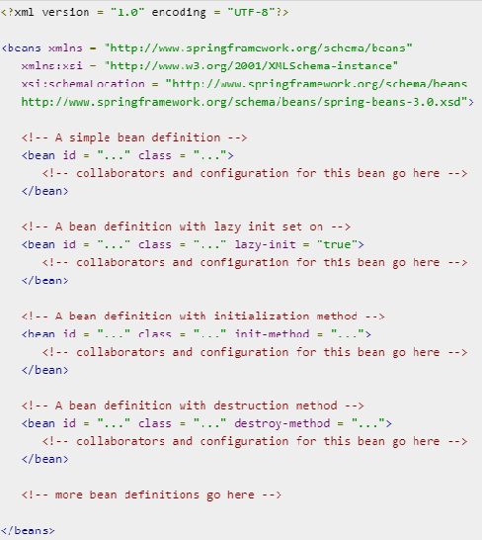
XML based configuration

Slide 17
Inversion of Control
It means giving the control of creating and instantiating the spring beans to the Spring IOC container
IOC container gets information from the XML file and works accordingly

Slide 18
Main tasks of IoC container
To instantiate the application class
To configure the object
To assemble the dependencies between the objects

Slide 19
Two types of IoC Container
Bean Factory
ApplicationContext

Slide 20
BeanFactory
org.springframework.beans.factory.BeanFactory acts as the IoC container
XmlBeanFactory is the implementation class for BeanFactory interface
To use BeanFactory, instance of XmlBeanFactory class needed to be created

Slide 21
Creating BeanFactory
The constructor of XmlBeanFactory class receives the Resource object, so we need to pass the resource object to create the object of BeanFactory.
Resource resource=new ClassPathResource("applicationContext.xml");
BeanFactory factory=new XmlBeanFactory(resource);

Slide 22
ApplicationContext
org.springframework.context.ApplicationContext interface acts as the IoC container
The ApplicationContext interface is built on top of the BeanFactory interface.
It adds some extra functionality such as
simple integration with Spring's AOP,
message resource handling (for I18N),
event propagation,
application layer specific context

Slide 23
ApplicationContext (Cont..)
So it is better to use ApplicationContext than BeanFactory
The ClassPathXmlApplicationContext class is the implementation class of ApplicationContext interface
We need to instantiate the ClassPathXmlApplicationContext class to use the ApplicationContext

Slide 24
Creating ApplicationContext
The constructor of ClassPathXmlApplicationContext class receives string, so we can pass the name of the xml file to create the instance of ApplicationContext
ApplicationContext context =
new ClassPathXmlApplicationContext("applicationContext.xml");

Slide 25
Dependencies required
<dependency> <groupId>org.springframework</groupId> <artifactId>spring-core</artifactId> <version>5.2.4.RELEASE</version>
</dependency>
<dependency>
<groupId>org.springframework</groupId> <artifactId>spring-context</artifactId> <version>5.2.4.RELEASE</version>
</dependency>

Slide 26
References
https://www.javatpoint.com/ioc-container
https://www.tutorialspoint.com/spring
https://www.javatpoint.com/spring-tutorial-dependency-injection-by-setter-method
https://www.javatpoint.com/spring-tutorial-dependency-injection-by-constructor

Slide 27
The End

