Slide 1
Patient Case Similarity
PIP2001 Capstone Project
Review-03
Batch Number: 02
Name | Roll Number
L. Akanksha | 20211CIT0047
Sanjana R | 20211CIT0043
Koyi Mithun | 20211CIT0055
B. Vishnuvardhan Reddy | 20211CIT0013
P. Sai Surya | 20211CIT0079
Under the Supervision of,
Dr. Sharmasth Vali Y
Associate Professor
School of Computer Science and Engineering
Presidency University
Name of the HoD: Dr. Anandaraj S P
Name of the Program Project Coordinator: Dr. Sharmasth Vali Y
Name of the School Project Coordinators: Dr. Sampath A K / Dr. Abdul Khadar A
/ Mr. Md Ziaur Rahman

Slide 2
Problem Statement Number:
Organization: ezDI
Category (Software): Healthcare & Biomedical Devices
Problem Description:
The objective of patient case similarity is to identify similar patients based on their medical reports. Identification of similar patient cases be useful for improving patient outcome, for treatment or drug recommendation to a new patient, prediction of clinical outcome, clinical decision support, research on those cases. Task: Applying machine learning algorithms to find similar patient cases from given dataset.
Difficulty Level: Complex

Slide 3
Methodology
Methodology for a Patient Case Similarity Project Using Decision Trees
Data Collection and Preprocessing
Dataset Splitting
Decision Tree Construction
Model Evaluation
Model Deployment and Use

Slide 4
Proposed Method
Decision Trees
How it works: Decision trees create a tree-like model where each internal node represents a test on an attribute, and each leaf node represents a class label.
Strengths:
Interpretable and easy to visualize.
Can handle both numerical and categorical data.
Robust to outliers.
Can be used for feature selection.
Weaknesses:
Prone to overfitting, especially with deep trees.
Sensitive to noise in the data.
May not capture complex relationships between features.

Slide 5
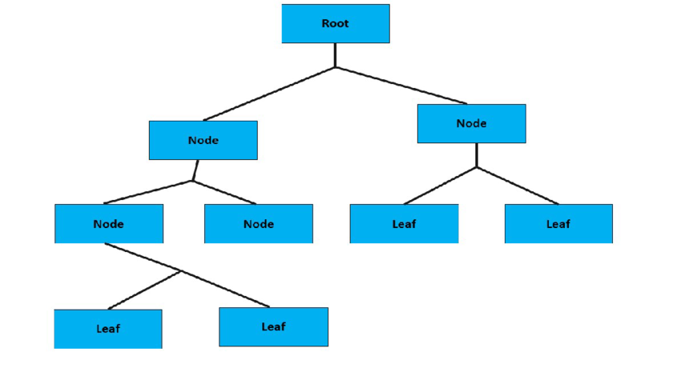
Model Architecture

Slide 6
Objectives
Compare the performance of decision trees with other machine learning algorithms for patient case similarity.
Explore the impact of different decision tree algorithms and hyperparameters on model performance.
Investigate the ethical implications of using patient data for similarity analysis and ensure compliance with relevant regulations.
Assess the generalizability of the decision tree model to new, unseen data.

Slide 7
Flow of Project
Stage 1: Data Collection and Preprocessing
Stage 2: Dataset Splitting
Stage 3: Decision Tree Model Building
Stage 4: Model Evaluation
Stage 5: User Interface Development
Stage 6: Model Deployment
Stage 7: Ongoing Monitoring and Evaluation

Slide 8
Outcomes

Slide 9
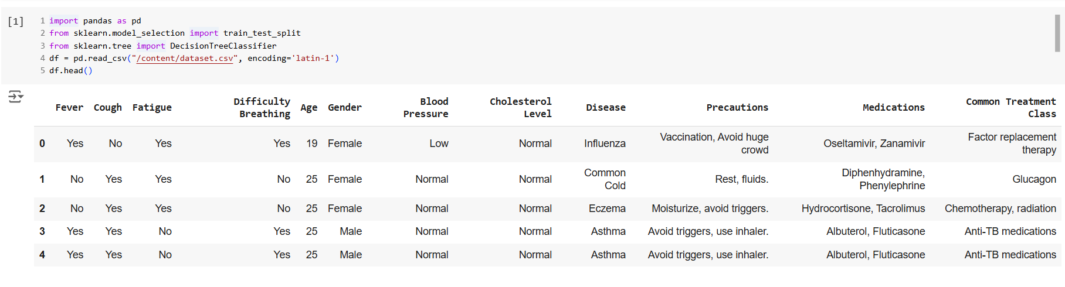

Slide 10
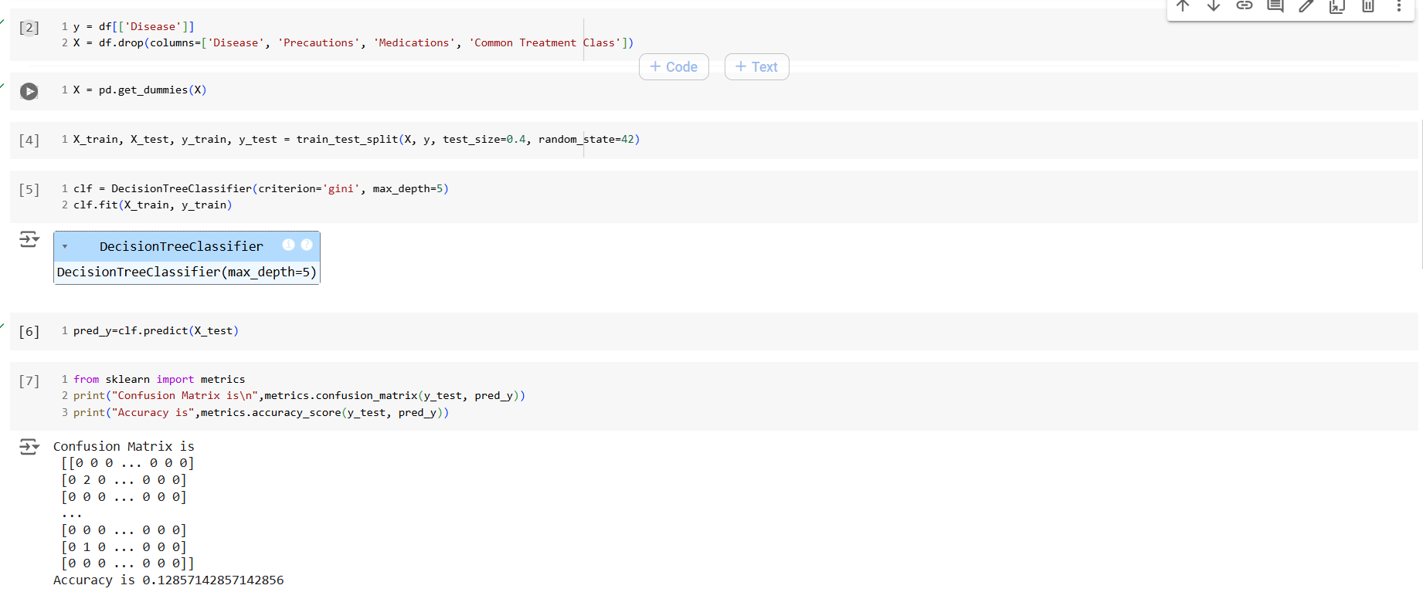

Slide 11
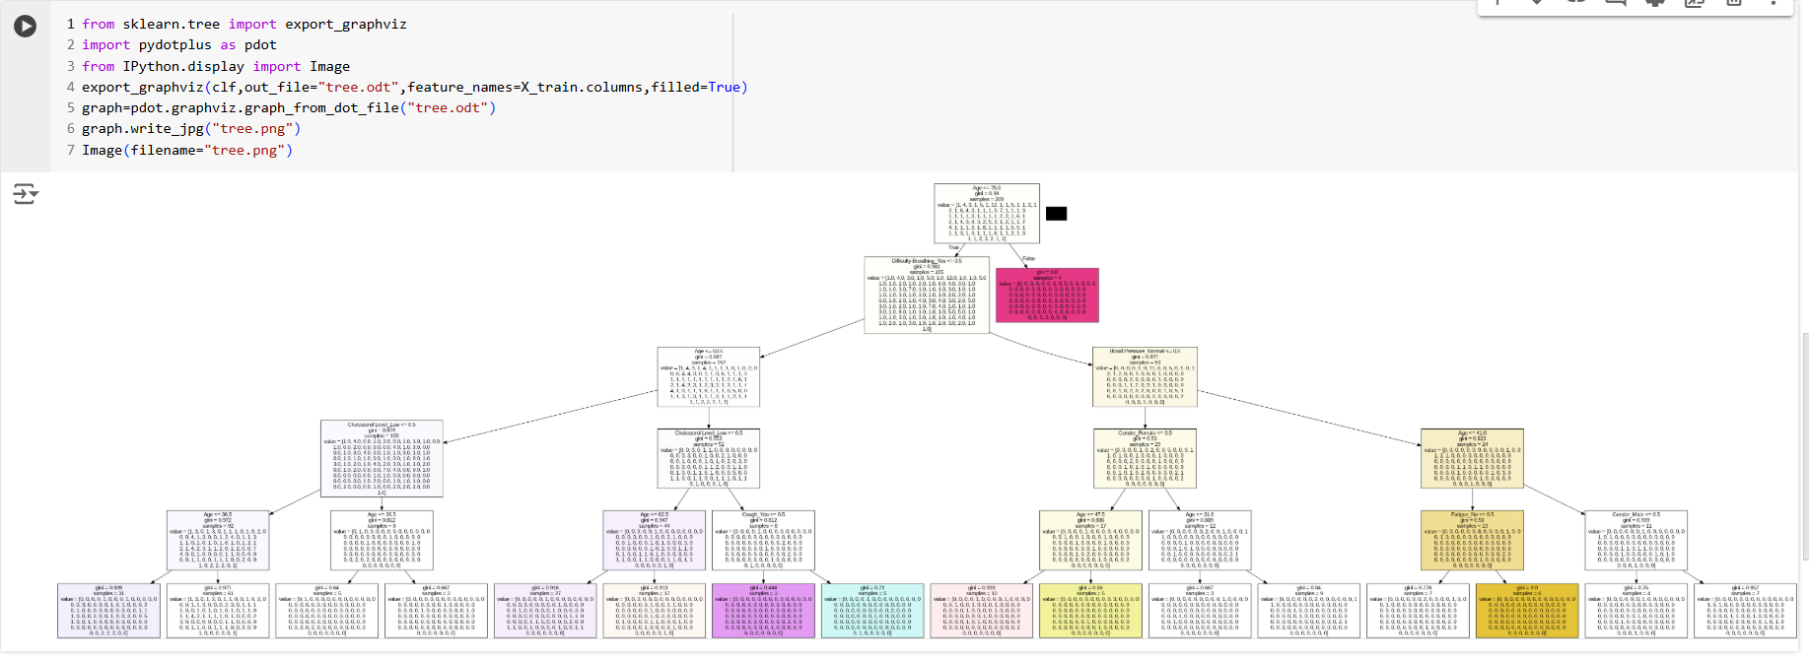

Slide 12
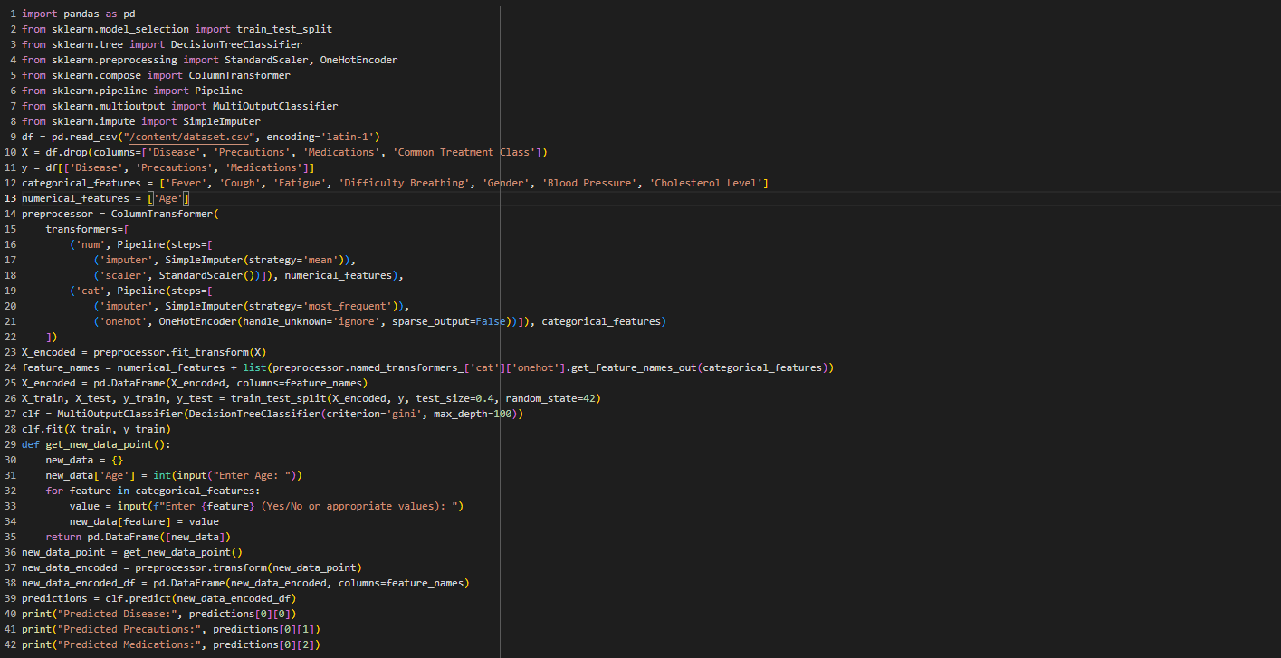

Slide 13
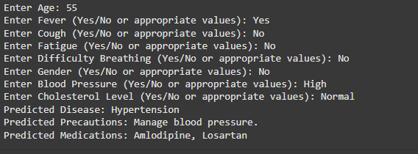

Slide 14
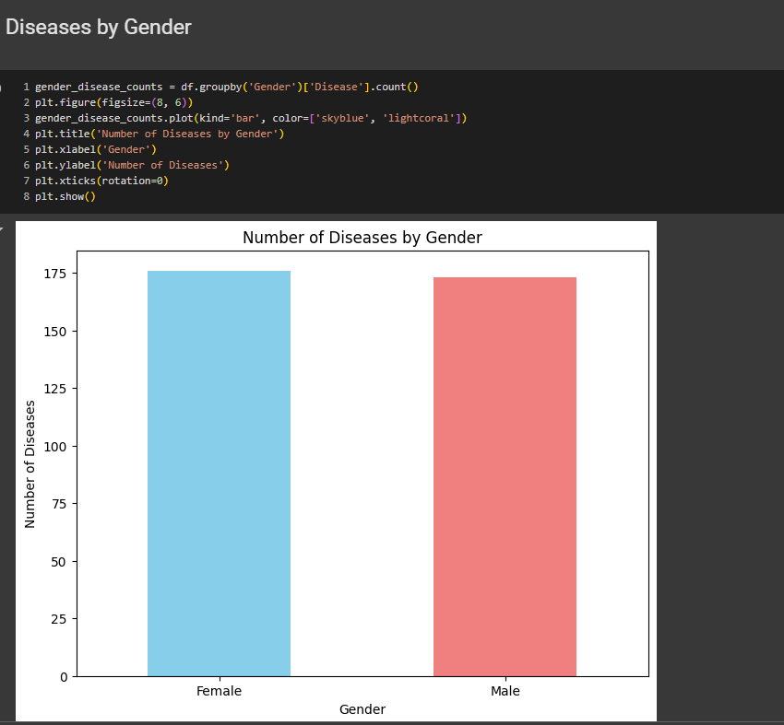

Slide 15
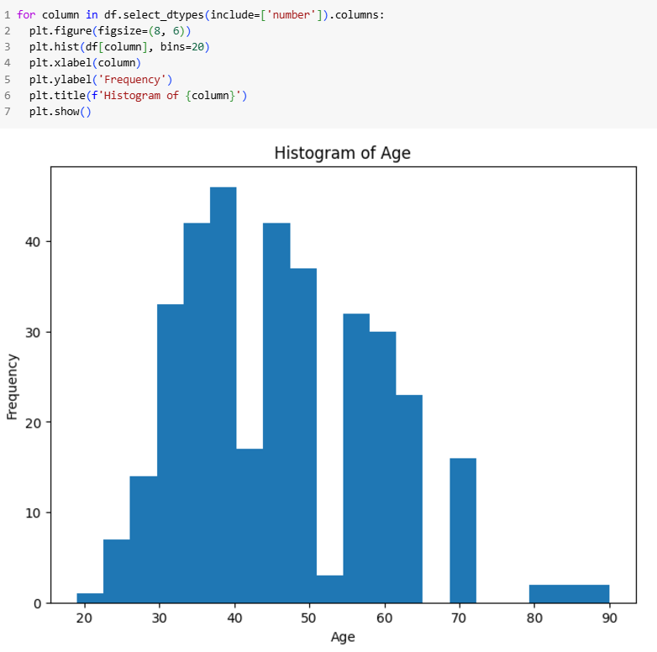

Slide 16
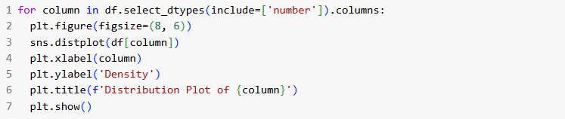
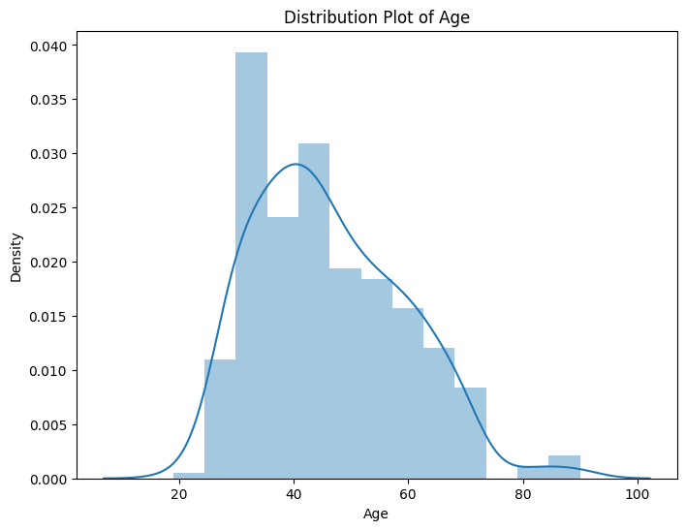

Slide 17
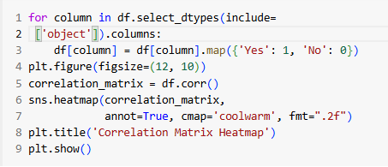
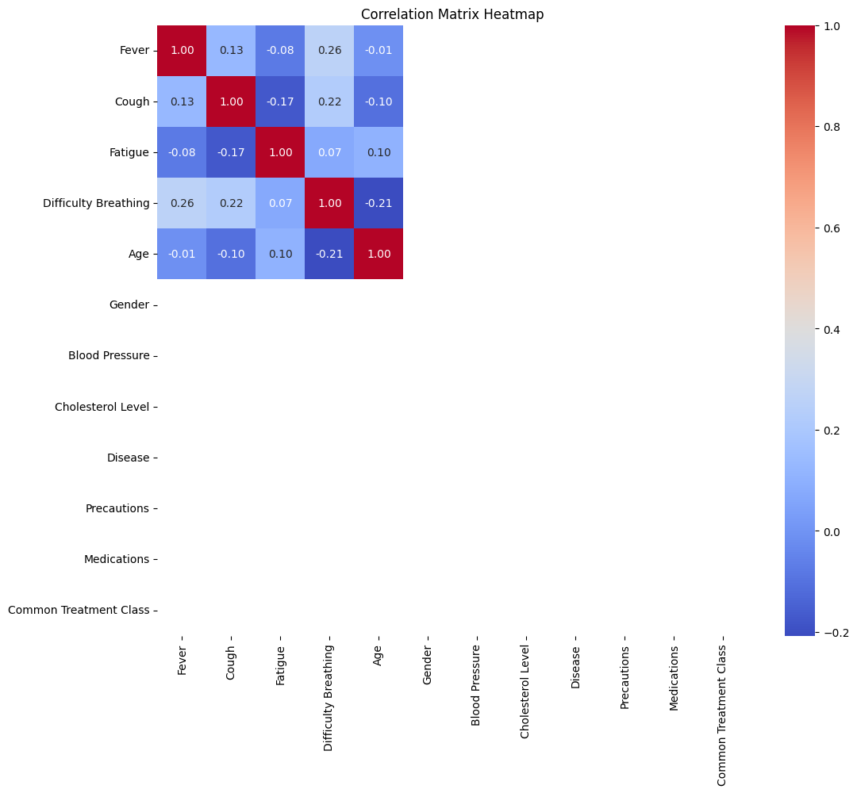

Slide 18
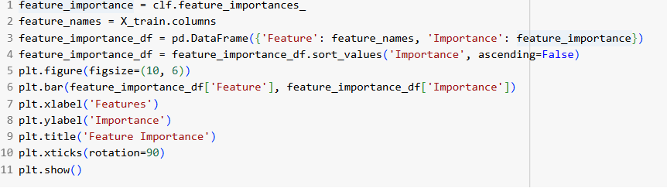
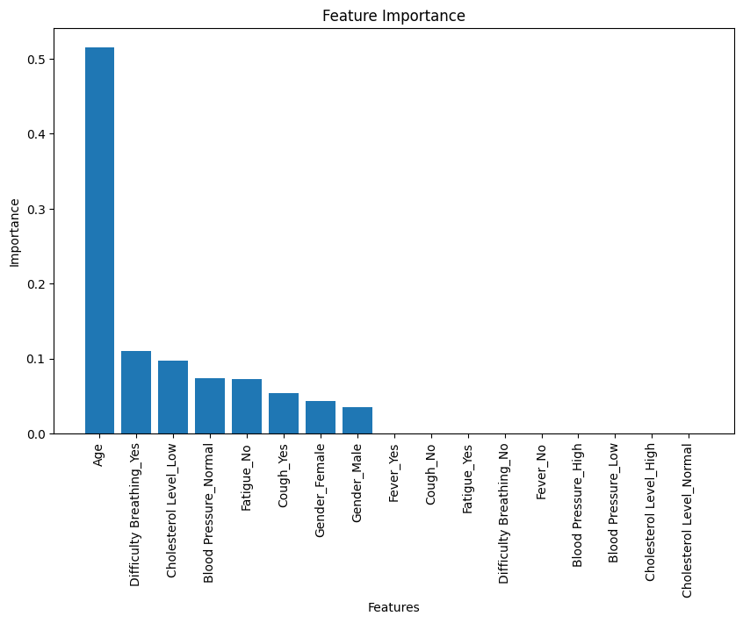

Slide 19
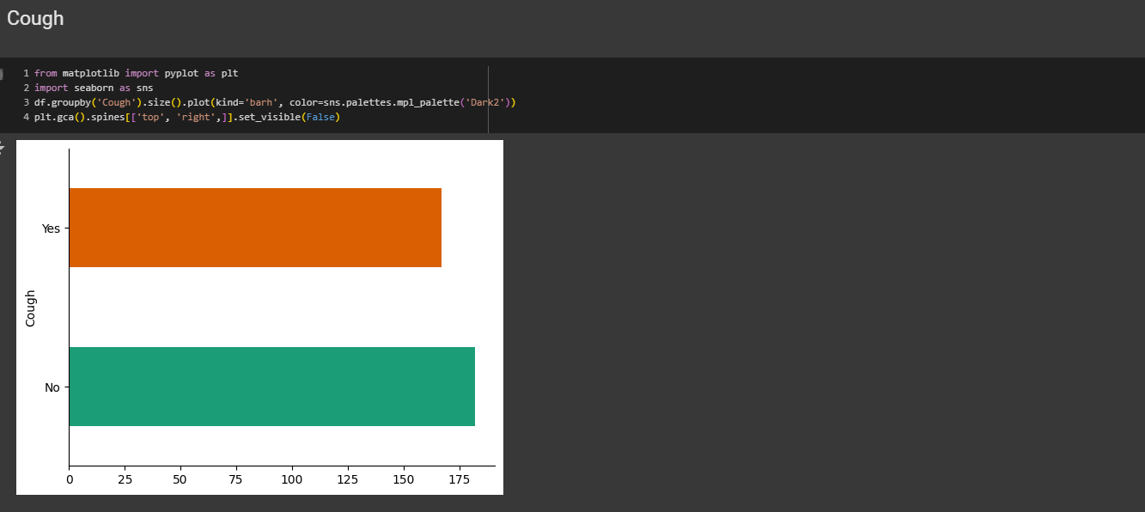

Slide 20
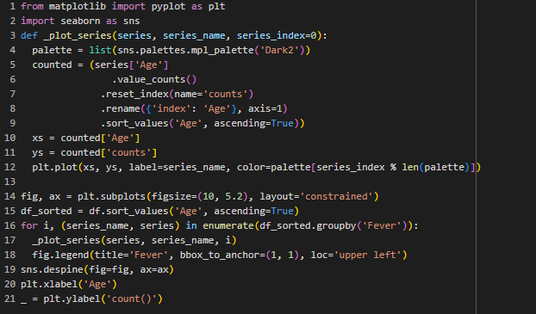
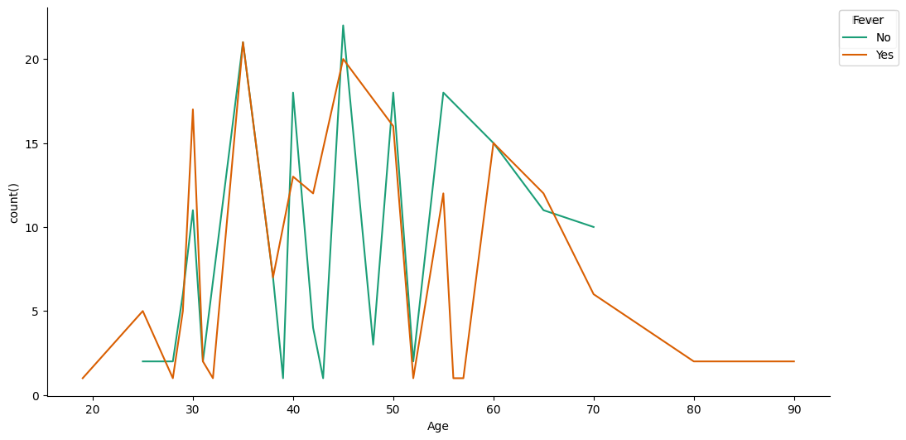

Slide 21
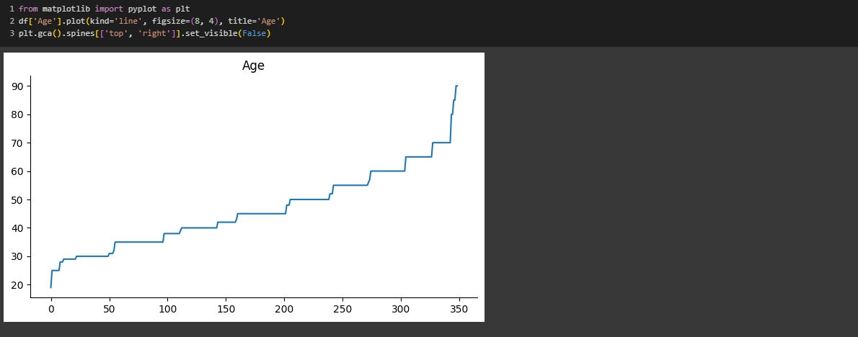

Slide 22
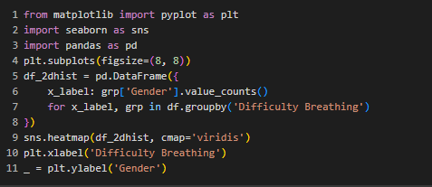
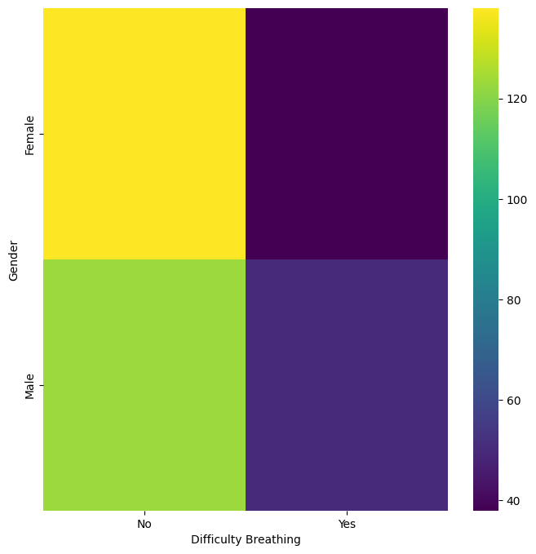

Slide 23
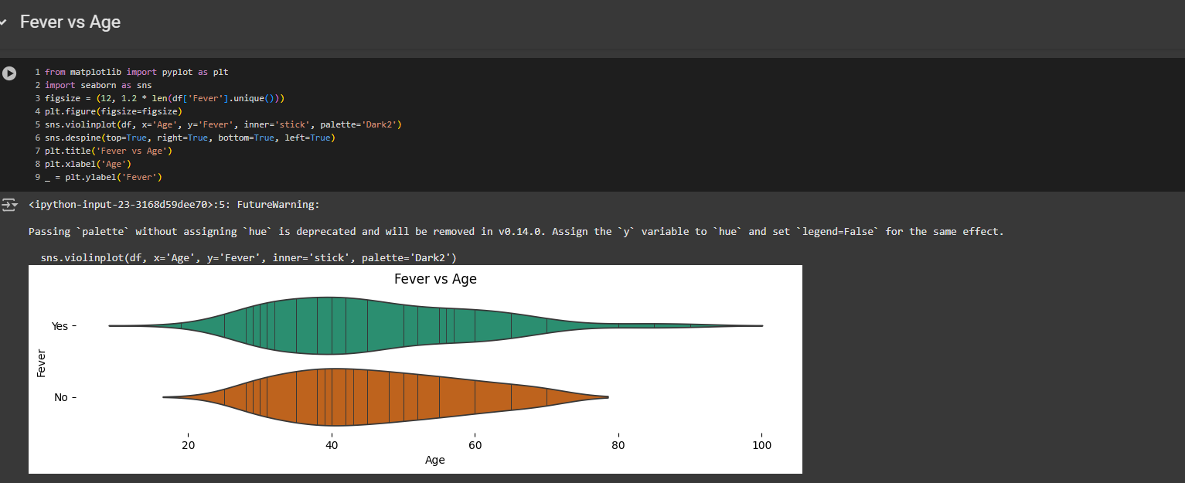

Slide 24
Conclusion
Therefore, this project has shown that decision trees indeed work well in patient similarity analysis. Through making ample use of the interpretability and flexibility of decision trees, we have come up with a model which can actually correctly identify similar patients based on their medical records. The model's output has tremendous potential for supporting clinical decision-making and enhancing the improvement of patient outcomes; it could also be utilized to speed up drug discovery.
Decide on limitations - how are decisions any more favorable to improvements in ensemble methods and deep learning approaches by further developing the models to improve the patient similarity. The aspect of ethical considerations, respect for privacy in data, etc., while working on this and envisioning all of this-how these technologies can responsibly be put to use.
Therefore, further refinement and improvement in patient similarity analysis will unlock the full potential of precision medicine in offering personalized care to patients.

Slide 25


