Slide 1
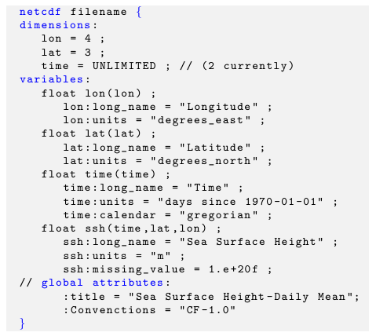
Dimensions
variable
Coordiante
variable
Variable
attributes
Variable
Global
attributes

