Slide 1



Fact Finder
Justice League

Slide 2
FactFinder
Justice League
Introduction
Problem Statement
Persona
Technologies
Team
Agreement
Retrospective
Project
Schedule
Project Description

Slide 3


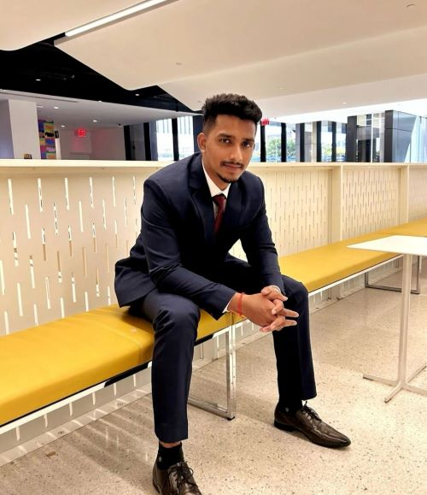
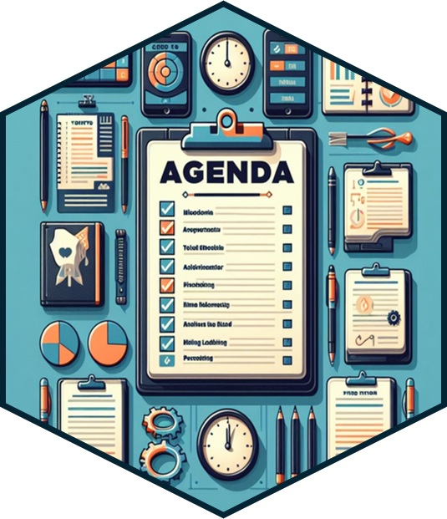

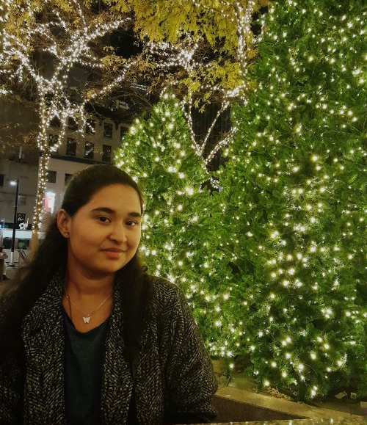
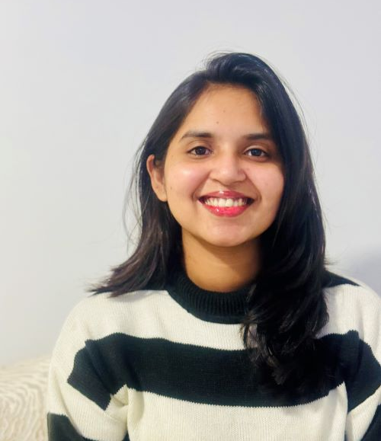
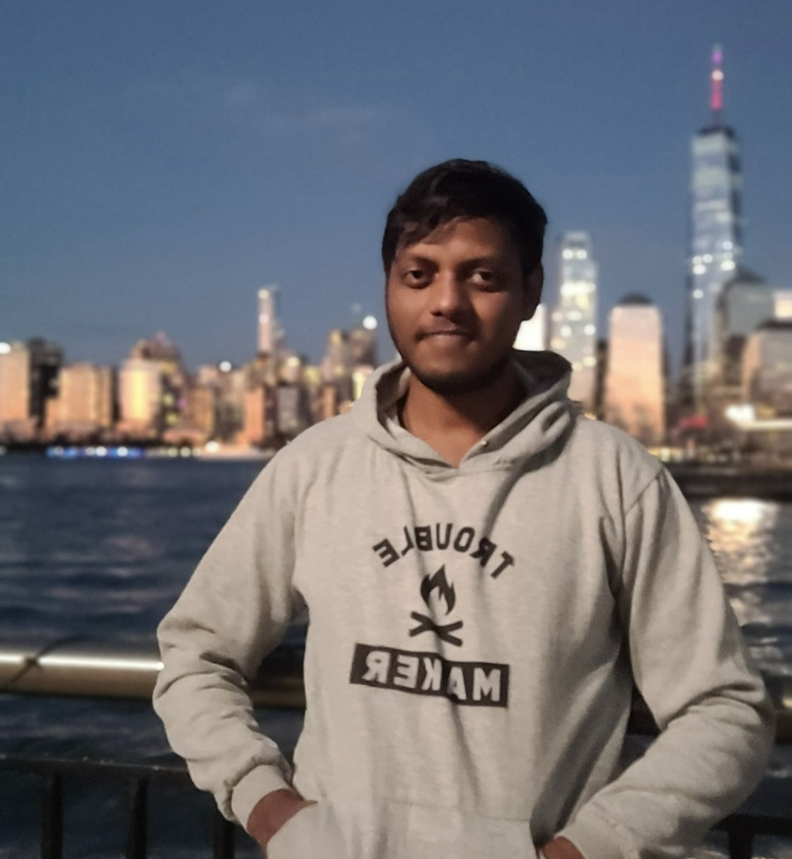
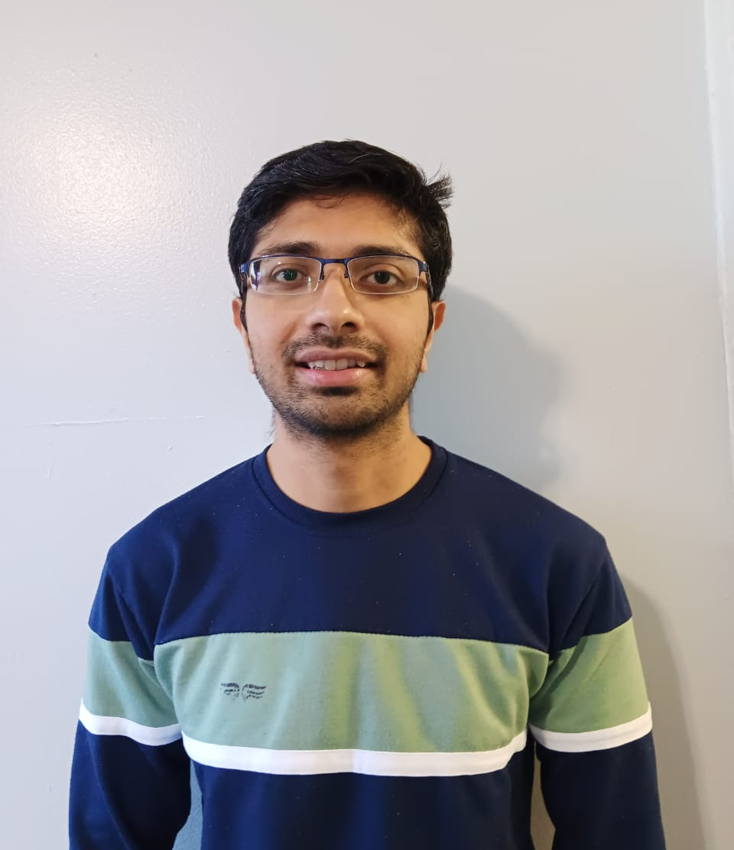
Agenda
Suraj Salunke
Manthan Kale
Introduction
Problem Statement
Quality Analyst & Tester
Scrum Master
Kavita Kamtekar
Saurabh Chaudhary
Persona
Technologies
Full Stack Developer
Product Manager & Developer
Team
Agreement
Gayatri Kulkarni
Maheswari Vidyadharani
Developer
Developer
Retrospective
Project
Schedule
Project Description
Sai Kumar Tata
Rushabh Shingala
Developer
Developer

Slide 4
Meet our team
Suraj Salunke
Manthan Kale
Quality Analyst & Tester
Scrum Master
Kavita Kamtekar
Saurabh Chaudhary
Full Stack Developer
Product Manager & Developer
Gayatri Kulkarni
Maheswari Vidyadharani
Developer
Developer
Sai Kumar Tata
Rushabh Shingala
Developer
Developer
4

Slide 5

Introduction
Fake news is a pervasive problem not only in the United States but also globally.
It has significant implications on public opinion, politics, and societal trust.
The spread of misinformation has been facilitated by the rise of social media platforms.
False information can lead to harmful consequences, such as public panic or misinformation-driven decisions.
Our Fact Finder web app aims to combat the spread of fake news by providing users with reliable information and analysis.
Through continuous updates and improvements, we strive to stay ahead of emerging trends in misinformation.
By empowering users with tools to discern truth from falsehood, we contribute to fostering a more informed society.
Education and media literacy are essential components in the fight against fake news, and our platform seeks to promote these values.
Collaborations with experts in journalism, data science, and technology are integral to our mission of combating fake news effectively.
5

Slide 6
Misinformation makes it hard for people to make good decisions and also makes reliable sources less trustworthy. We urgently need solutions to stop the spread of fake news and encourage responsible information use in the digital age. Our project is all about giving people the skills and tools to think critically and tell credible sources apart from unreliable ones. By doing this, we hope to help create a better online conversation and a healthier information system.
Problem Statement

Slide 7
Project Description
In today's digital age, the proliferation of misinformation poses a significant challenge to media consumers worldwide. Our Fake news analyzer and summary generator web application provides the users with reliable tools to combat misinformation by identifying fake news articles and summarizes the news content. it not only analyzes but also gives users insights into their media habits. Users can track their browsing history, delve into search trends, and gain valuable analytics on the types of news articles they engage with.
Our platform utilizes advanced algorithms and machine learning techniques to analyze news articles and determine their authenticity, offering users a reliability score or classification. To ensure privacy and personalized experiences, each user is granted a unique username and password for user authentication, facilitating features such as saved search history and access to previous analyses. This fosters self-awareness and empowers informed decision-making regarding media consumption.

Slide 8
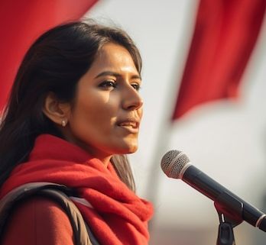
Personas
Background: Maria is a community activist working on social justice issues. She recognizes the role of misinformation in shaping public opinion and wants to combat false narratives that may undermine her advocacy efforts. Maria is motivated to use the web application as a tool to verify information before sharing it within her community.
Age: 35
Occupation: Community Activist
Goals and Motivation: Maria's goal is to empower her community with reliable information. By leveraging the web application, she aims to strengthen the credibility of her advocacy work, foster informed discussions, and counteract misinformation that may be used to undermine social justice causes

Slide 9

Personas
Background: David owns a small business that heavily relies on its online presence for customer engagement. He's concerned about potential misinformation impacting the reputation of his business. The web application is crucial for David to verify news and updates related to his industry.
Age: 38
Occupation: Small Business Owner
Goals and Motivation: David's primary goal is to safeguard his business's reputation. By using the web application, he aims to prevent the spread of false information that could harm customer trust and loyalty. His motivation is to maintain transparency and integrity in his business communications.

Slide 10
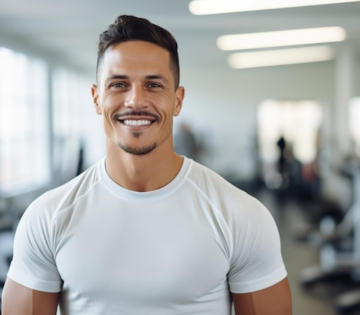
Personas
Background: Michelle is a fitness and health enthusiast who frequently relies on online health-related information. With the abundance of health-related news articles and social media posts, Michelle often encounters conflicting information. The web application is valuable for him to discern between credible and misleading health information.
Age: 31
Occupation: Fitness Trainer
Goals and Motivation: Michelle's primary goal is to maintain a healthy lifestyle and share accurate health advice with her followers. By using the web application, he aims to avoid the spread of misinformation in the fitness and health community, contributing to a more informed and health-conscious online environment.

Slide 11





Technologies
1.FrontEnd: JavaScript, HTML, HTML5, CSS.
2.Framework: React, Flask.
3.Backend : Python
4.Database : PostgreSQL

Slide 12
Algorithms
Machine Learning Algorithms (scikit-Learn)
Logistic Regression : Supervised learning algorithm for classification.
K Nearest Neighbour (KNN): Instance based, non-parametric algorithm for classification
Decision Tree: Supervised learning algorithm for classification.
Deep Learning(Tensorflow)
Recurrent Neural Network(RNN): Ideal for Natural Language Processing(NLP) task.

Slide 13
Team Working Agreement
Participation: At our meetings, we'll uphold confidentiality, encourage truthfulness and openness, appreciate a range of viewpoints, give everyone an equal opportunity to contribute, be receptive to fresh ideas, and concentrate on streamlining procedures rather than placing blame for problems on individuals.
Interaction: We will make an effort to understand before we are heard, speak clearly and concisely, actively listen, keep our attention on the subject at hand, and use visual aids to facilitate the discourse.
Decision making: We will try to do so by gathering as much information as we can, discussing factors like cost, time, and impact, taking into account different interpretations of the data.
Procedures for Meetings: All meetings will begin and terminate at the appointed time. Attendees need to arrive at the meeting prepared. Each meeting will end with a discussion of the agenda items for the following one. Any subjects that come up outside of the discussion should be put in an idea bank.

Slide 14
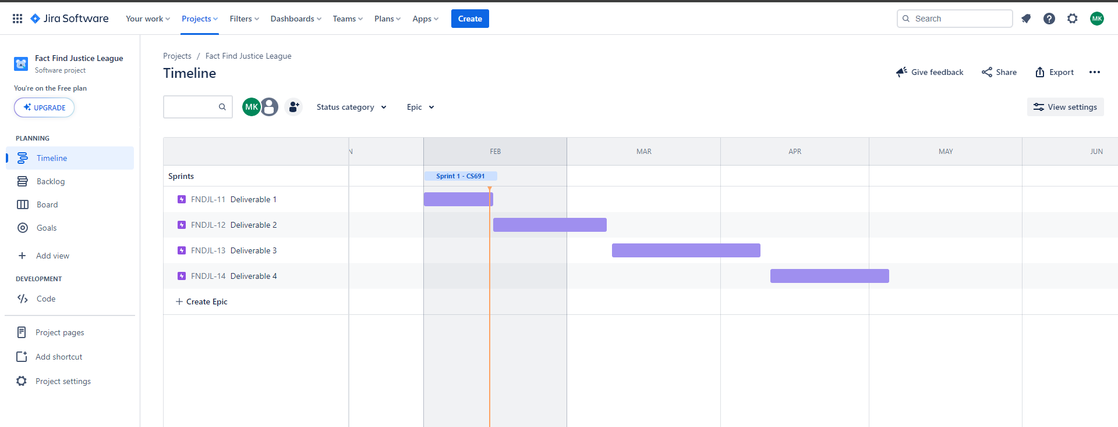
Project Schedule

Slide 15
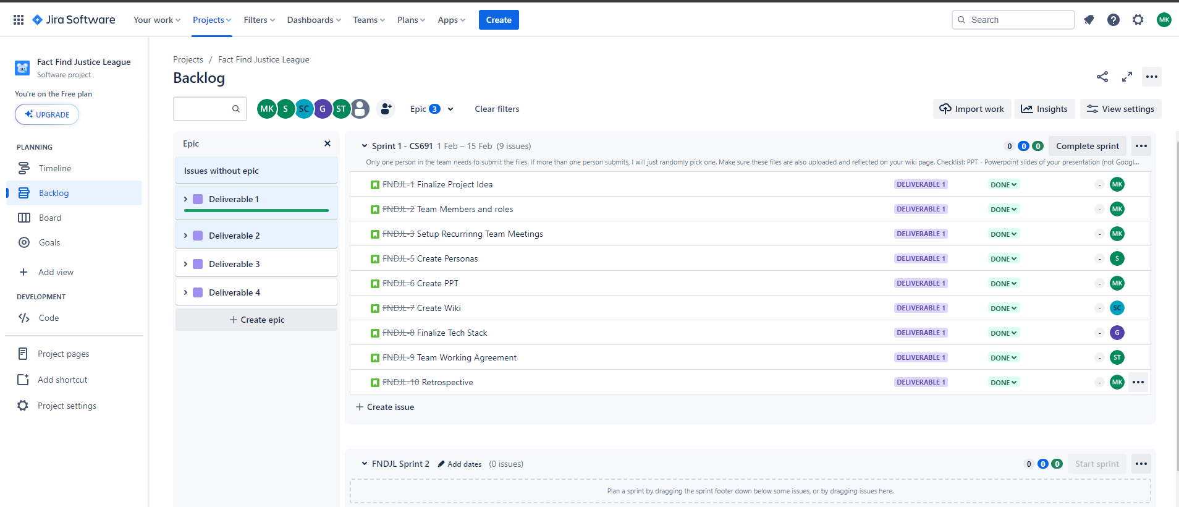
Sprint 1

Slide 16
Retrospective
What went well
What did not go well
What can we improve
What can we keep
Additional Feedback
Team agreed on the Project Idea
We were able to agree well on the tech stack
Everyone picked up roles and responsibilities
We were a bit delayed on the timeline Since the team was not fully clear on all the steps
Staying on top of our tasks
Communicating more often
Taking Responsibility
We have frequent meetings and daily updates which can help us track all the work.
Increased efficiency
Need more time to discuss the architecture
Need to add more items in the backlog for all deliverables

Slide 17


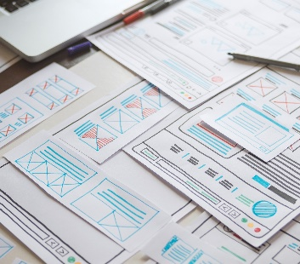
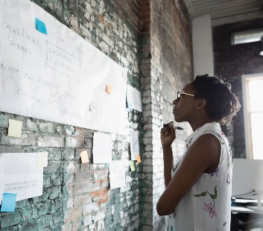
Thank you
Team Justice League

