Slide 1
Junior AI Investigator
An AI first pass on every fraud referral, with the human making the final call
The problem
Every case is already flagged by a fraud engine, and most are false alarms. The investigator's real problem is deciding which referrals deserve their time, and closing the obvious false alarms quickly.
50
referrals assessed before anyone looks
16 · 10 · 24
High · Medium · Low risk
~3 min
to assess all 50 with a free LLM
Saitej Reddy Gajula · github.com/Saitej0211/Junior_AI_investigator_fraud_triage
Notes:
Every case is already a referral; most are false alarms. The prototype assesses all 50 before a human looks, explains each in plain English, and the investigator makes the final call.

Slide 2
How it works: from the CSV to a decision
1
2
3
4
5
Ingest
Reason
Assess
Check
Decide
Load the 50 referred claims from the CSV
Add facts no row shows: shared claim numbers, “× the usual” for the care type
The LLM returns a 0-100 score, risk level, summary, key indicators and next action
Every cited fact is checked against the data; hard evidence is never closed
The investigator reviews the queue in a web app and moves each case forward
Built as one notebook. Groq's free tier (gpt-oss-120b, falling back to gpt-oss-20b). Results are saved, so the app opens instantly and anyone can browse the cases without an API key.
Notes:
Steps 1 to 4 run before an investigator looks. The model only explains and suggests; a fact-checker verifies every value it cites, and hard evidence can never be closed.

Slide 3
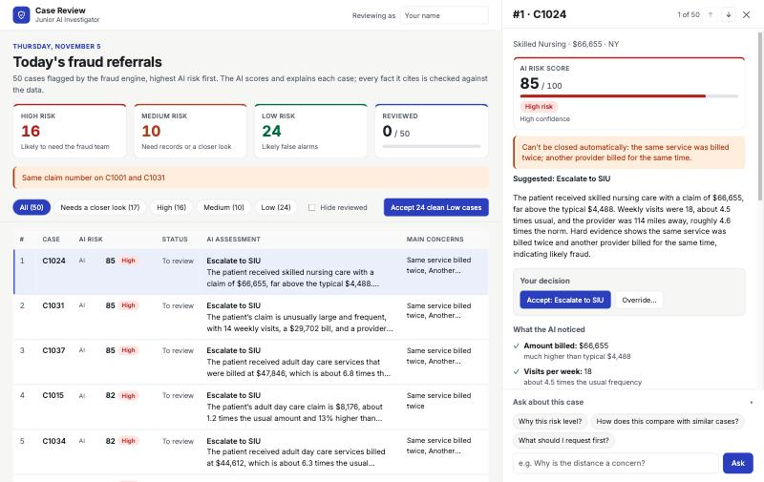
The investigator stays in control
1
Drill in
Score, summary and ✓-checked key indicators
2
Ask
Questions answered from the case's facts only
3
Accept / override
Override needs a level, an action and a reason
4
Add notes
Kept with every decision in an audit trail
5
Move forward
Escalated to SIU · documents requested · closed
The web app, served by the notebook: queue ordered by AI risk, open case on the right
Notes:
Open a case, read the AI's reasoning, ask questions, then accept or override. Each decision moves the case to its next stage, and clean Low cases can be closed in one click.

Slide 4
Design choices, limits and next steps
Design choices
Honest limits
Next steps
The AI suggests; the human decides
Synthetic data, no fraud labels: accuracy can't be measured yet
Use overrides as labels to measure the AI
Trust from checking: every cited fact verified
AI scores vary ~6 points between runs
A test set of agreed answers for every prompt change
Hard evidence is never closed
“Usual” values come from referrals only
With real outcomes: a learned model explained with SHAP
Plain English for non-experts
Notes:
The model is a first pass, not the decision maker. The biggest gap is labels: investigator overrides are the path to measuring and improving it.

