Slide 1
Course: Tinkering Lab Course Instructor : Mr. A. Suraj Kumar. Branch : CSD Semester : V Batch members: Y. Sai Teja (23NU1A4461) P. Hema (23NU1A4442) K. Kusumanjali (23NU1A4425) M. Dhamodara rao (23NU1A4435)

Slide 2
Project Overview:
Problem statement:
Focus Point, a smart, AI-Driven personalized learning and productivity platform.
Description:
Students struggle with:
Managing time and balancing multiple subjects
Remembering important dates, exams, and deadlines
Finding personalized and trustworthy study material
Maintaining consistent study habits
Handling pressure from family, expectations, and self-image
Staying focused due to distractions
Tracking progress and evaluating their own performance Focus Point solves these problems through a guided, structured, and automated learning experience.

Slide 3
Project Abstract:
Focus Point is an AI-powered study and productivity assistant designed to help students manage time, reduce mental pressure, track learning progress, and maintain consistency. It unifies personalized notes, smart notifications, goal tracking, exam calendars, and resource recommendations into one integrated platform.
The system helps learners overcome academic stress, distractions, and unstructured study patterns by providing a guided, organized, and supportive digital workspace. Focus Point aims to create a learning experience that is efficient, personalized, and emotionally reassuring.

Slide 4
Core Ideas:
Learning should be simple, not stressful.
A student needs clarity more than complexity.
Consistency is more powerful than talent.
Smart tools reduce burden and increase performance.
Organization helps reduce anxiety and confusion.
A student performs better when systems support them.

Slide 5
Key features:
Personalized Smart Notes Automatically generated short, simple, easy-to-remember notes tailored to the student’s syllabus and needs..
Comprehensive Resource Collection Curated subject-wise PDFs, books, links, videos, and materials.
Smart Exam Calendar tracks exams, deadlines, and important dates with reminders.
AI-Powered Study Assistant Helps explain concepts, answer doubts, plan study schedules, and guide progress.
Notifications & Alerts Gentle reminders for study tasks, pending topics, and new resources.
Recent History Tracking Automatically records actions so students can quickly revisit past work.
Notes App & Bookmarks Save important topics, questions, and links.

Slide 6
System Overview:
Focus Point architecture includes:
Frontend (React.js) – User interface, interactive components.
Backend (Node.js + Express) – APIs, data handling, history, notes, exams.
JSON, Local Database(for temporary pupose) – Stores events, notes, users, history, bookmarks.
AI Assistant (Client-side logic) – for study planning and expressing notes.
Modular Components – history, notes, calendar, notifications, etc.

Slide 7
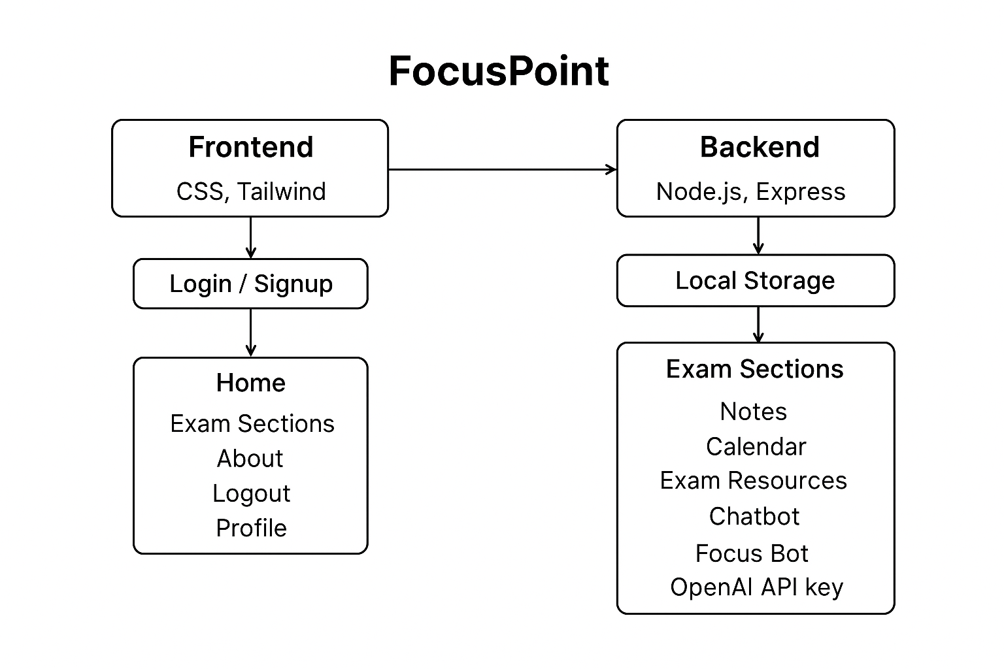
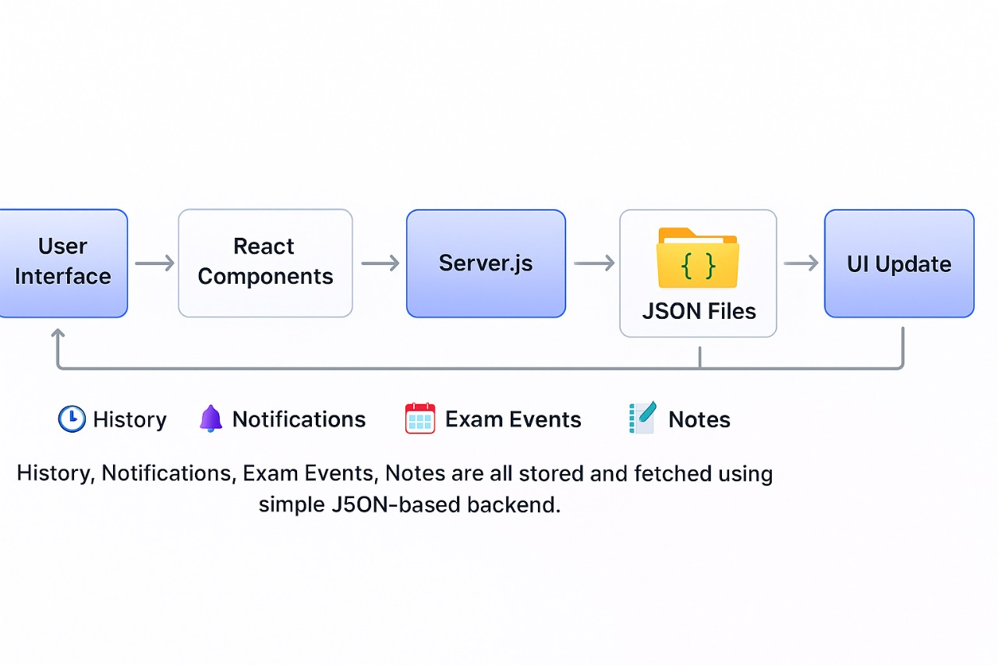
Architecture of Focus-point:

Slide 8
Conclusion:
Focus Point is more than a productivity tool—it is a mentor, guide, and emotional support system for students. It reduces pressure, builds discipline, and brings clarity into a student’s journey. Through its simple design and AI-powered features, it empowers learners to focus, grow, and succeed with confidence.

Slide 9
THANK YOU

