Slide 1
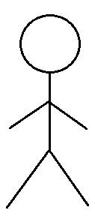
Use Case Diagram
MaidEase
Use Case Diagram
Module: 01. Account Management
1.1 Create a user account
1.2 Authenticate Account
Account Manager
1.3 Update Account
User
1.4 Maintain Account Summary
1.5 Close Account
Service Provider
Manager
1.6 Track loyalty
Customer Support Executive

Slide 2
Use Case Diagram
MaidEase
Use Case Diagram
Module: 02. Service Management
2.1 Manage Services
2.2 Add favorite
User
2.3 Book a Service
2.4 Give Ratings/Review
Service Providers
2.5 Modify Appointment
2.6 Send Reminder
Manager

