Slide 1
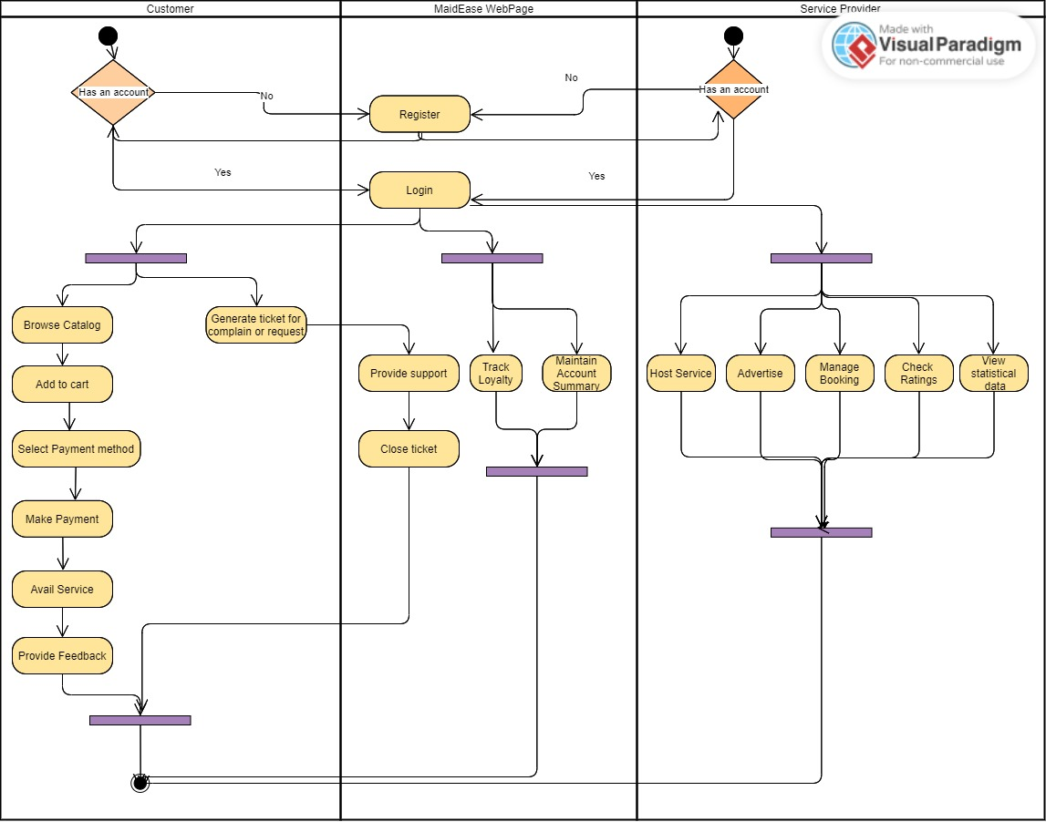
Activity Diagram- MaidEase

