Slide 1
Operating Systems for Wireless Mobile Devices (cont)
Dr. Tal Lavian
http://cs.berkeley.edu/~tlavian
tlavian@cs.berkeley.edu
UC Berkeley Engineering, CET
Why does the OS matter?

Slide 2

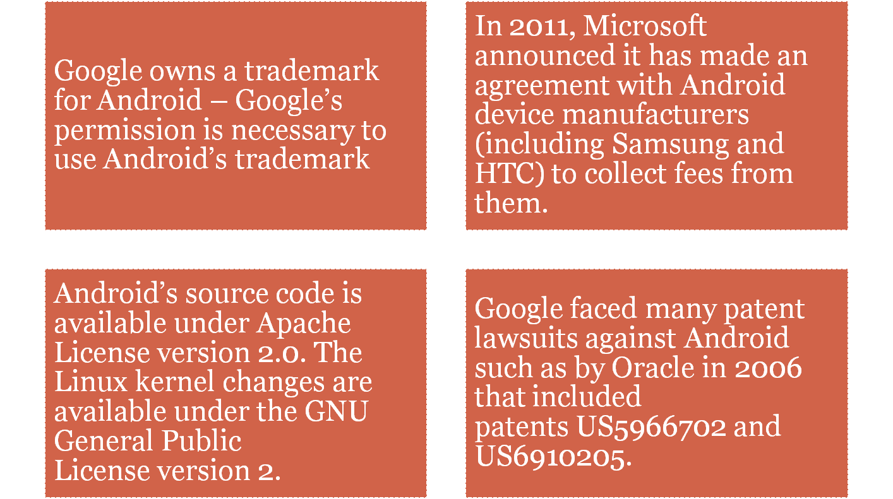
Android

Slide 3
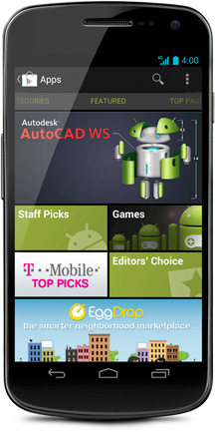
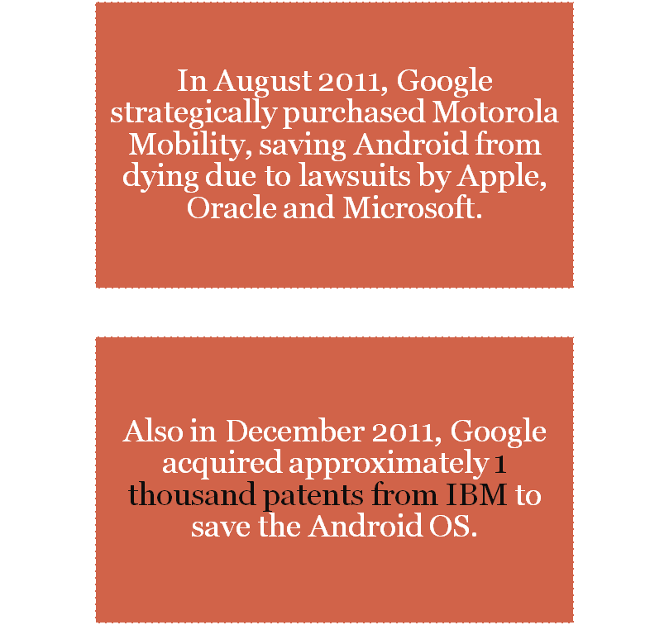
Android (contd.)

Slide 4

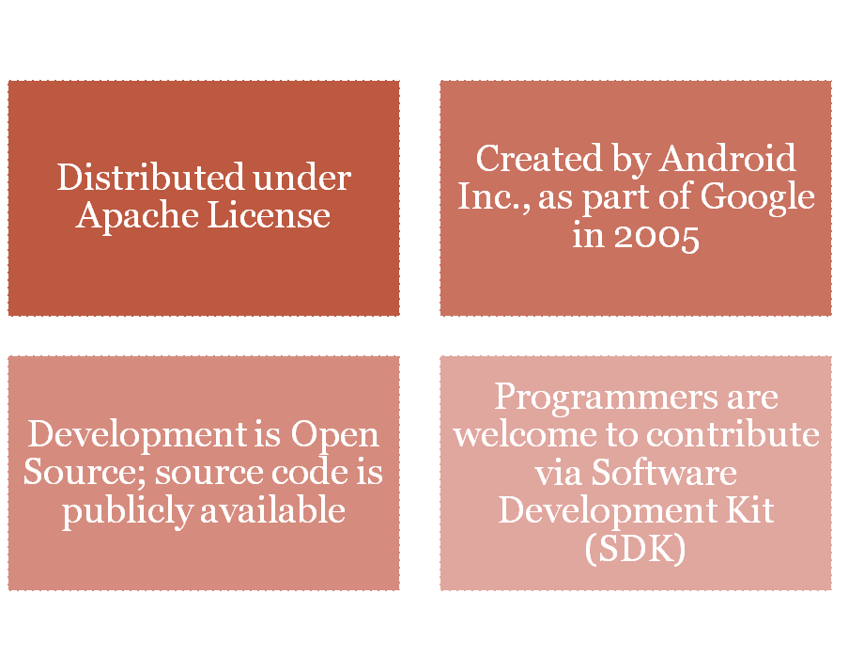

Android Mobile OS
http://cmer.cis.uoguelph.ca

Slide 5
Android
Background
Android is Linux based mobile OS for mobile devices such as Tablets and Smartphones.
In 2005 Google acquired the initial developer of the OS, Android Inc.
Then in 2007 Google formed an Open Handset Alliance with 86 hardware, software and telecom companies.
This alliance developed and announced Android as an open source mobile OS under the Apache License.
Now, this OS is being used by multiple device manufacturers (Samsung, Motorola, HTC, LG, Sony etc) in their handsets
Android developer community has large number of developers preparing APPs in Java environment and the APP store ‘Google Play’ now has close to 450,000 APPs, among which few are free and others are paid.
It is estimated that, as of December 2011, almost 10B APPs were downloaded.
It is estimated that as of February 2012 there are over 300M Android devices and approximately 850,000 Android devices are activated every day.
The earliest recognizable Android version is 2.3 Gingerbread, which supports SIP and NFC.
In 2011 Android Honeycomb version (3.1 and 3.2) are released with focus on Tablets. This is mainly focused on large screen devices.

Slide 6
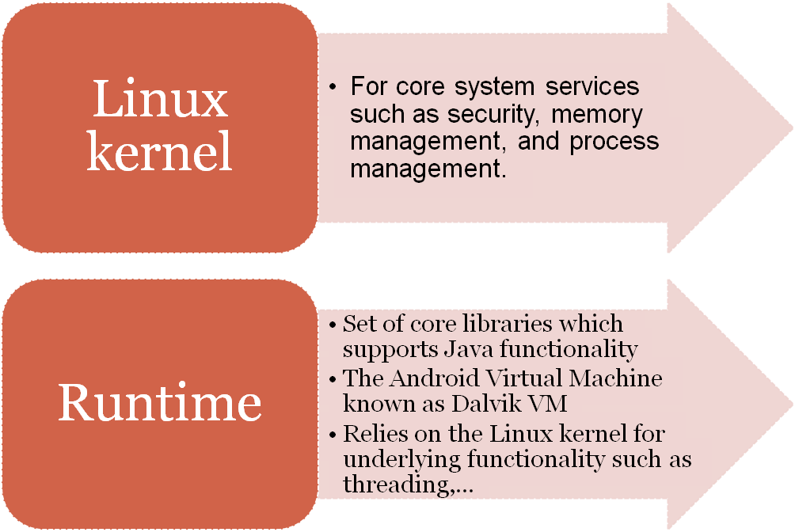
Android Mobile OS – Architecture (Contd.)

Slide 7
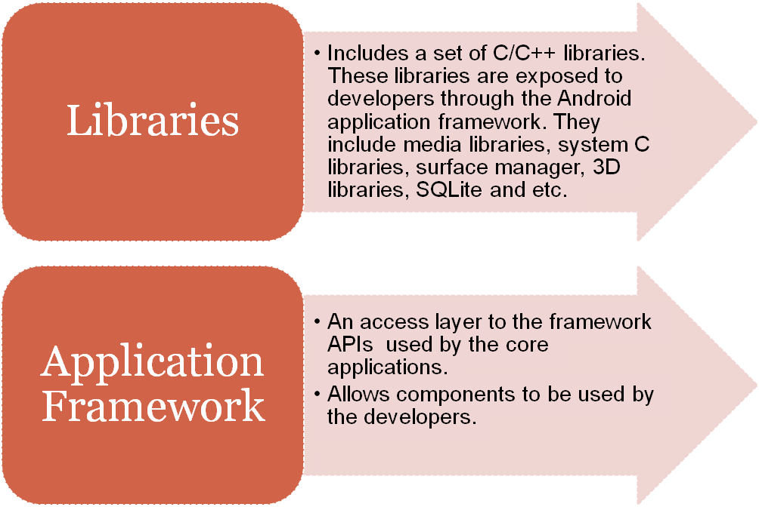
Android Mobile OS – Architecture (Contd.)
  Source: http://code.google.com/android/what-is-android.html

Slide 8
Android (contd.)
Main features
Handset layouts – compatible with different handset designs such as larger, VGA, 2D graphics library, 3D graphics library based
Storage – a lightweight relational database, is used for data storage
Connectivity - GSM/EDGE, IDEN, CDMA, EV-DO, UMTS, Bluetooth, Wi-Fi, LTE, NFC and WiMAX
Messaging – SMS, MMS, threaded text messaging and Android Cloud To Device Messaging (C2DM)
Multiple language support
Web browser
Java support
Media support
Streaming media support
Additional hardware support
Multi-touch
Bluetooth
Video calling
Multitasking
Voice based features
Tethering
Screen capture
External storage
Android 4.0 Ice Cream Sandwich
Released in October 2011, with new features such as facial recognition, network data usage monitoring and control, unified social networking contacts.

Slide 9
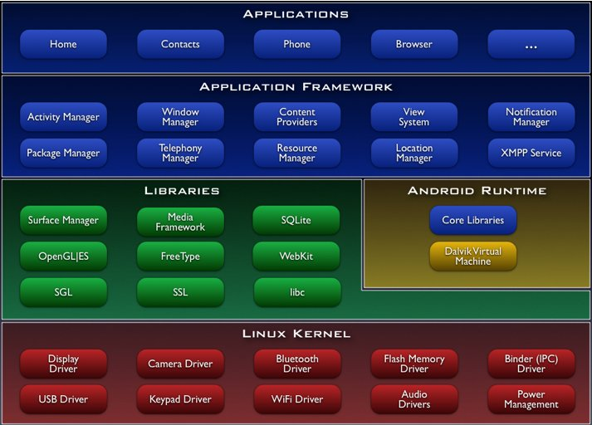
Android Mobile OS - Architecture
http://code.google.com/android/what-is-android.html

Slide 10
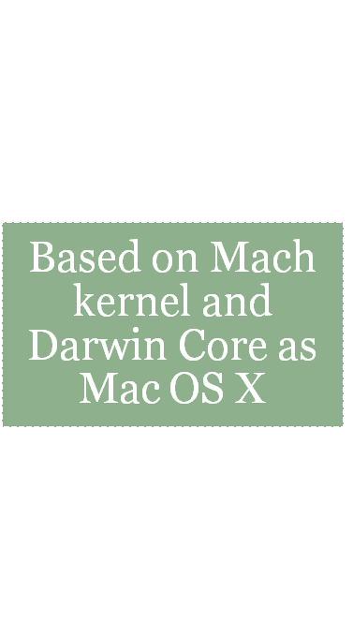
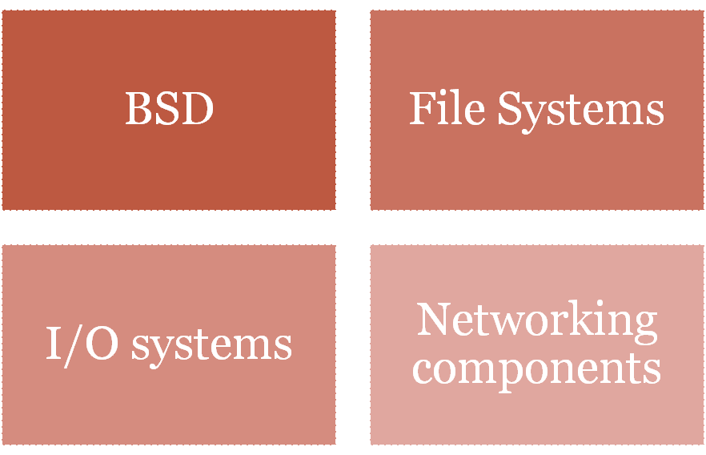

iPhone OS
http://developer.apple.com/documentation/Darwin/Conceptual/KernelProgramming/Architecture/Architecture.html

Slide 11
iOS
About Apple’s Proprietary Mobile OS – iOS
iOS is Apple’s proprietary mobile operating system initially developed for iPhone and now extended to iPAD, iPod Touch and Apple TV.
Initially known as “iPhone OS”, in June 2010 renamed “iOS”.
iOS is not enabled for cross licensing, it can only be used on Apple’s devices.
The user interface of iOS is based on the concept of usage of multi touch gestures.
iOS is a Unix based OS.
iOS uses four abstraction layers, namely: the Core OS layer, the Core Services layer, the Media layer, and the Cocoa Touch layer.
Apple’s App store contains close to 550,000 applications as of March 2012.
It is estimated that the APPs are downloaded 25B times till now.
First version of iOS is released in 2007 with the mane ‘OS X’ and then in 2008 the first beta version of ‘iPhone OS’ is released.
In 2007 September Apple released first iPod Touch that also used this OS.
In 2010 iPad is released that has a bigger screen than the iPod and iPhone.
Cisco owns the trademark for ‘IOS’; Apple licenses the usage of ‘iOS’ from Cisco.

Slide 12
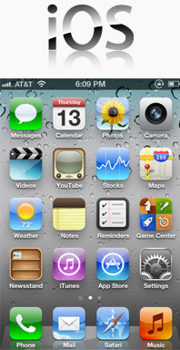
iOS (contd.)
Main features
Home screen Folders Notification Center Default APPs Multitasking Switching applications Game Centre

Slide 13
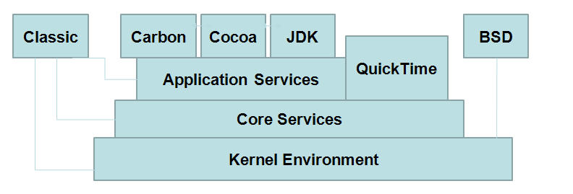



Mac OS X Architecture
Each application has 4GB space
http://developer.apple.com/documentation/Darwin/Conceptual/KernelProgramming/Architecture/Architecture.html

Slide 14
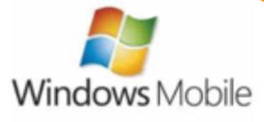
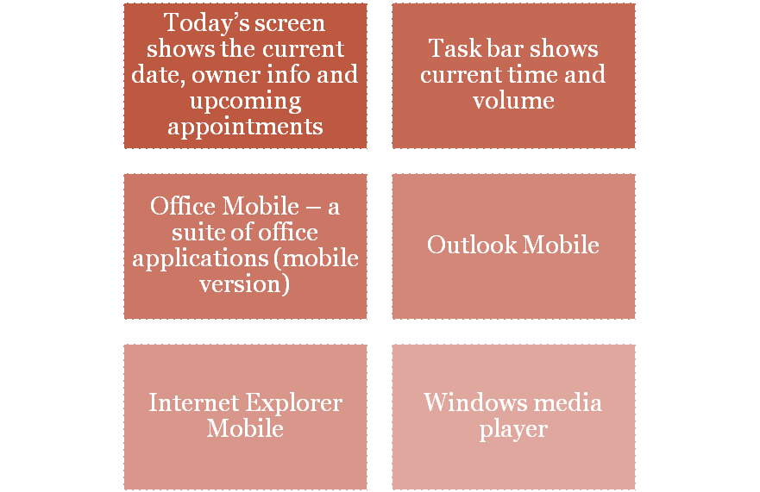
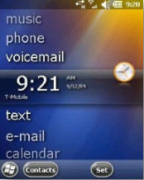
Windows Mobile OS

Slide 15
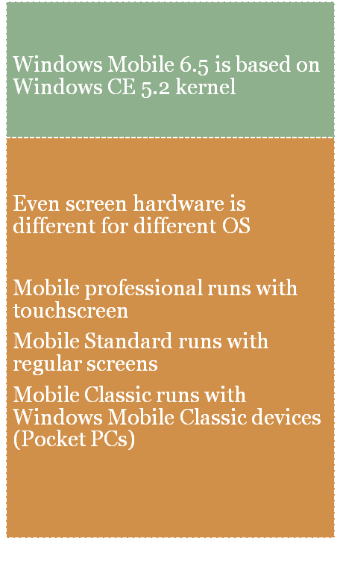
Types of Windows Mobile OS
Windows Mobile Classic Devices (Pocket PC)
Windows Mobile Smartphones
Windows Mobile 2003
Windows Mobile 2003 SE
Windows Mobile 5
Windows Mobile 6
Windows Mobile 6.5.1
Windows Mobile 6.5.3
Windows Mobile 6.5.5
Windows Phone 7
http://www.authorstream.com/Presentation/aSGuest89856-889448-mobile-operating-system/

Slide 16
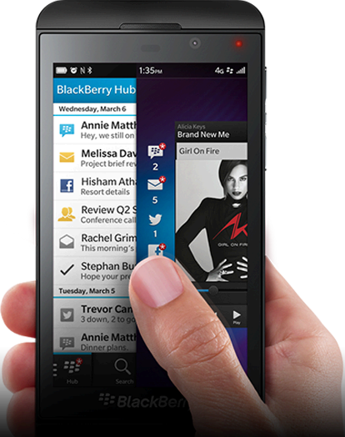
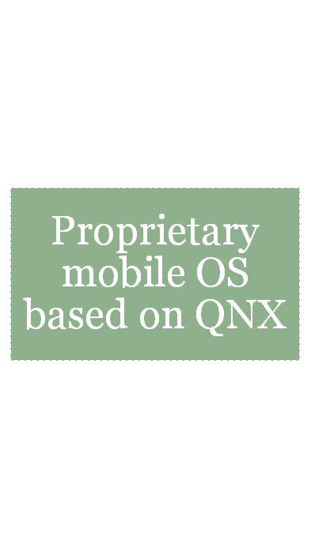
BlackBerry Z10

Slide 17
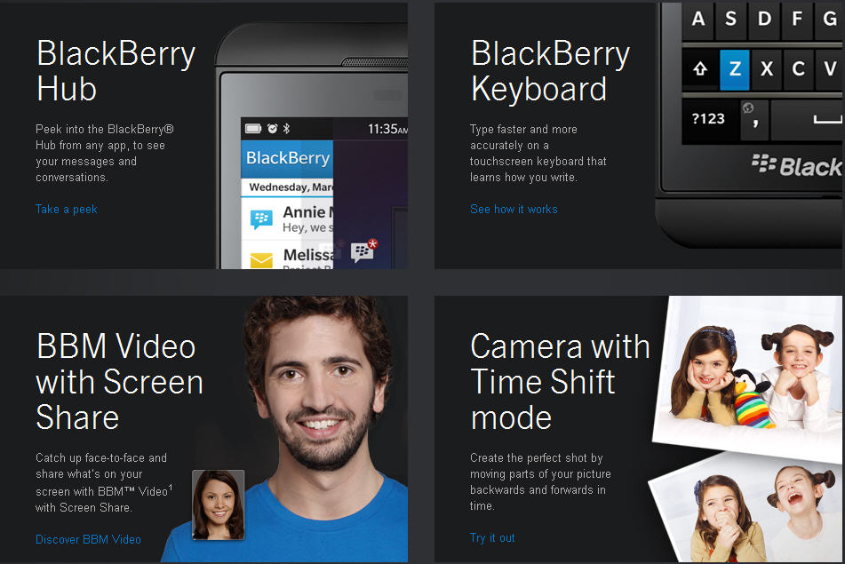
BlackBerry Z10 and Q10
http://ca.blackberry.com/smartphones/blackberry-z10.html?LID=ca:bb:devices:blackberryz10:getdetails&LPOS=ca:bb:devices

Slide 18
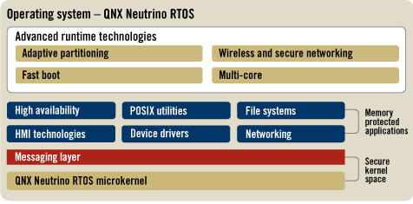
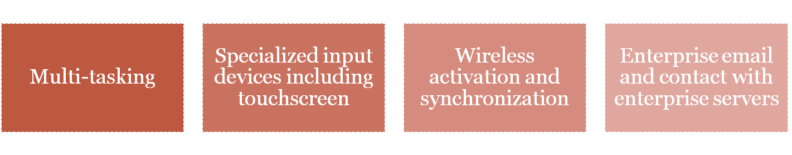
BlackBerry OS
http://www.qnx.com/products/neutrino-rtos/neutrino-rtos.html

Slide 19
Microsoft’s Approach to Smartphone Patent
Microsoft has approached smartphone patents from a different angle than many others
Things to keep in mind:
  Microsoft has many software patents that courts could potentially deem read upon by the Android OS
  Suing for patent infringement is
    A) costly
    B) no way to make friends

Slide 20
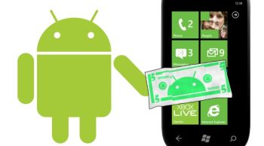
Microsoft’s Approach (Contd.)
Microsoft has chosen to pursue de facto licensing arrangements in lieu of litigation
Instead of suing manufacturers
of Android devices for software
infringement, has agreed to not
sue OEM so long as they pay
royalties to Microsoft
Such deals exemplify yet another means companies have for making money from their IP

Slide 21
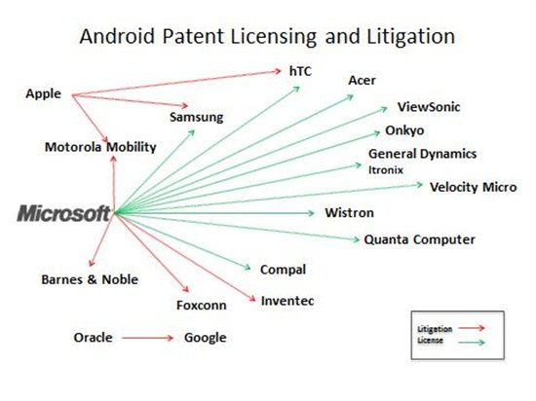
Microsoft’s Approach (Contd.)

Slide 22

Microsoft’s Approach (Contd.)
Microsoft has litigated:
  Motorola
    Software patents for email
  Barnes & Noble
    Android OS on Nook ebook reader
  Foxconn
    Android OS
  Inventec
    Android OS
Microsoft hasn’t litigated nearly as much as some other companies.
Why might that be?

Slide 23
Summary
Android OS
iOS
Microsoft has a cost-saving approach to patent litigation: licensing.
Next week: patenting wireless technology—the important parts of a patent.

