Slide 1
Open Source Software in Libraries
Sukhdev Singh.
Bibliographic Informatics Division,
National Informatics Centre,
A - Block, CGO Complex, Lodhi Road,
New Delhi-110003. (India).
sukhi@nic.in

Slide 2

What is Open Source Software?
First of all let us see what is:
  Software?
  Source?
  Open?

Slide 3

Software
Computer programme or software is set of instructions to computer to work in a desired manner.

Slide 4
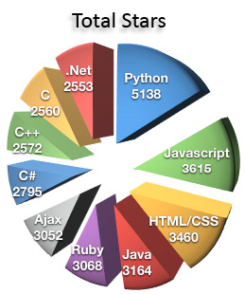
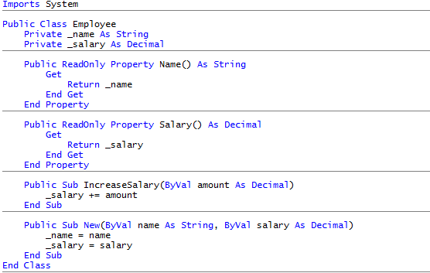
Source

Slide 5
Source
Instructions to computers are normally written by programmers in Programming Languages like – C, C++, Java etc.
These instructions are readable by humans and referred as Source Code.
To make machines i.e. computers to understand this source code – it either permanently translated (compiled) or on-the-fly translated (interpreted) into machine level codes.

Slide 6
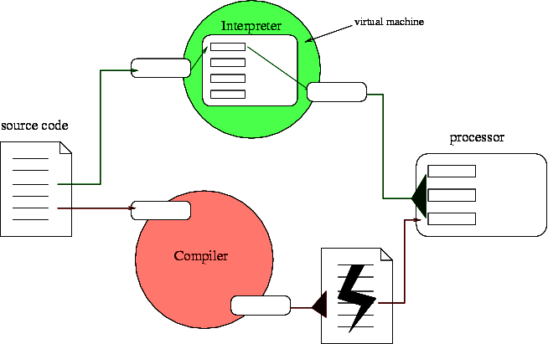

Slide 7
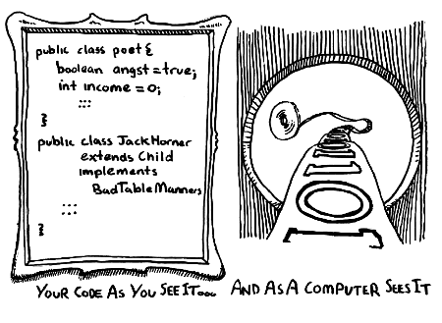

Slide 8
As normal software industry practice, only the final working machine readable version (Compiled Program) of the software is handed over to users.
The software works fine because machines don’t need source code. They only understand the compiled version.
However, the recipients or the users do not know how it works.
If any modification is required, the same can be done only by the producers who retain the source code.

Slide 9


Slide 10

Open
Here original source code of the software is also given.
If required, the users can modify the source code and then compile the software to use it.
Thus, the source code is Opened up.

Slide 11
Open Source Software
Thus, Open Source Software is software for which the underlying programming code is also available to the users.
They may read it, make changes, and build new versions of the software incorporating their changes.

Slide 12

Open Source Initiative (OSI)
The Open Source Initiative (OSI) is a non-profit corporation formed to educate about and advocate for the benefits of open source and to build bridges among different constituencies in the open-source community.
http://www.opensource.org/

Slide 13
Open Source Software
Open source is a development method for software that harnesses the power of distributed peer review and transparency of process.
The promise of open source is better quality, higher reliability, more flexibility, lower cost, and an end to predatory vendor lock-in.

Slide 14
Open Source Licenses
Open source license doesn't just mean access to the source code – it has to meet other criteria as well.
The important issue is that the source code should available; there should be permission to modify the source code and further distribute it.

Slide 15
Open Source Definition
1. Free Redistribution
2. Source Code
3. Derived Works
4. Integrity of The Author's Source Code
5. No Discrimination Against Persons or Groups

Slide 16
6. No Discrimination Against Fields of Endeavor
7. Distribution of License
8. License Must Not Be Specific to a Product
9. License Must Not Restrict Other Software
10. License Must Be Technology-Neutral

Slide 17
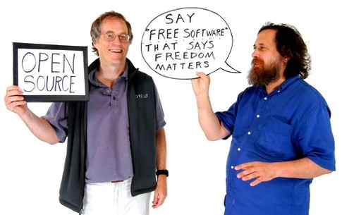
Open Source Software vs.
Free Software

Slide 18
Free software movement was launched in 1983.
In 1998, a splinter group of this movement advocated that the term “free” software should be replaced by “open source” software.
Problem with “Free” was that it implied “Zero Cost” and not the intended meaning “Freedom”.

Slide 19

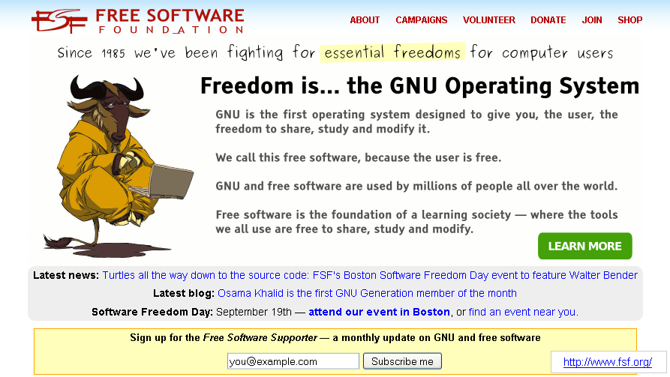
Free Software Foundation

Slide 20
Free Software
The freedom to run the program, for any purpose (freedom 0).
The freedom to study how the program works, and change it to make it do what you wish (freedom 1). Access to the source code is a precondition for this.

Slide 21
The freedom to redistribute copies so you can help your neighbor (freedom 2).
The freedom to improve the program, and release your improvements (and modified versions in general) to the public, so that the whole community benefits (freedom 3). Access to the source code is a precondition for this.

Slide 22
Open Source Software vs.
Free Software
Are they different?
  NO
  Open Source Software and Free Software for all practical purposes are same .
But “Free” here actually means Freedom not free of cost
“Free User “ rather “Free Software”

Slide 23
Freeware vs.
Free Software
Are they same?
  NO
ZERO COST is not the criteria for Free Software

Slide 24
IS CDS/ISIS or WINISIS A FREE SOFTWARE?
Notes:
The receiving institution/person may not:
(a) Use or permit others to use CDS/ISIS except under the terms listed above;
(b) Make copies or translations of CDS/ISIS and the related manuals obtained by UNESCO except as provided above;
(c) Erase, replace or modify any copyright notice displayed by the programs during their execution;
(d) Sell, lease or grant any right on CDS/ISIS to other parties, or distribute CDS/ISIS for profit.

Slide 25
Is there freedom to run the program, for any purpose? (freedom 0).
  NO
Is there freedom to study how the program works, and change it to make it do what you wish? (freedom 1).
  NO
  The source code is not available

Slide 26
Is there freedom to redistribute copies? (freedom 2).
  Perhaps YES
Is there freedom to improve the program, and release your improvements (and modified versions in general) to the public, so that the whole community benefits (freedom 3).
  NO
  The source code is not available

Slide 27
But
Why Libraries Should Use
Open Source Software?

Slide 28
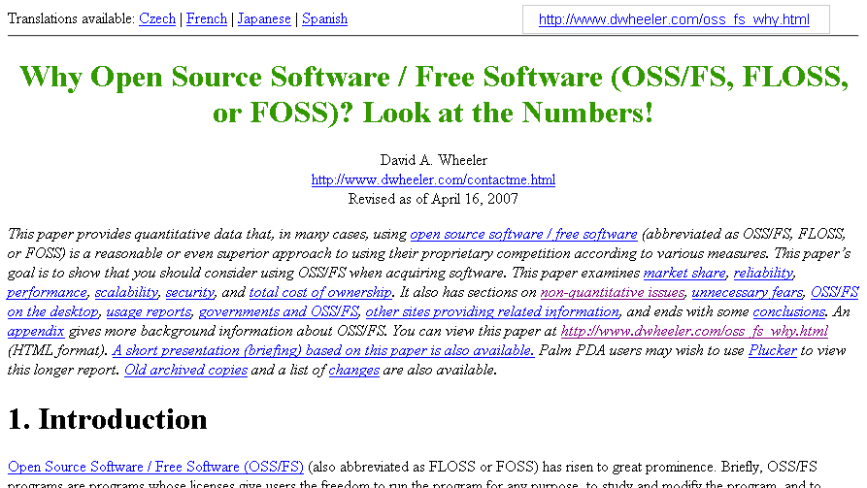

Slide 29
Mature Open Source Software
is more reliable,
perform better,
capable of being scaled up
and is more secure than comparable proprietary software.

Slide 30
Developers
Developers don’t have to create it from the scratch as massive open source library of software is readily available.
They can concentrate only on what has not been done so far.
Notes:
This is very similar to how research is done and built upon existing knowledge.
Like researcher, they create a reputation for themselves and gain experience though working on open source projects.

Slide 31
Developers get feedback on the quality of their code through the community of other developers and users.
Advancement and development of software for community benefit takes priority over issues of ownership and intellectual property rights.

Slide 32
Users
Zero Cost
  It is mostly available free of cost.
  User support groups which are helpful and responsive to users.
Freedom
  It can be used without any restriction.
  Users can modify the source code and customise them to suit their requirements
  Even redistribute it.

Slide 33
That is fine Sukhdev !!
But why Libraries …??

Slide 34
Are they really speaking something that is alien to Librarians?

Slide 35
Both library and open source communities share the same basic philosophy – Community First.
Sharing for mutual benefits and community advancement takes priority over the commercial considerations.

Slide 36
Blake Carver’s modification of Ranganathan's Laws for software:
Software is for use.
Every computer its users.
Every reader his source code
Save the time of the user.
A system is a growing organism.
Notes:
Blake Carver, editor of LIS News, modified Ranganathan's Rules
In - Open source software in libraries
http://infomotions.com/musings/ossnlibraries by Eric Lease Morgan

Slide 37
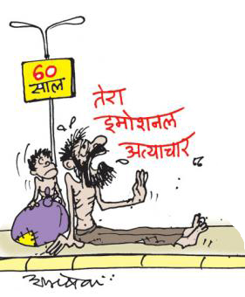
emotional atyachar ?

Slide 38
Ok, the best reason …

Slide 39
Libraries outlive any software producer or vendor.

Slide 40
Lessons from computing history
The average life for hardware is about 3 to 5 years.
The life span for software is even shorter.
  New versions are launched for latest technology and to add more features.
  Having a new version every year or two is rather a rule than exception.
  The producers tend to withdraw support to obsolete versions after a period of time.

Slide 41
Software business is a risky affair
Companies go out of business.
Software products become orphaned.
No alternative but to migrate to other software solutions.

Slide 42
Libraries have established work processes
Basic organisational structure and processes remain the same for long time.
Have large volume of data.
Even a small change require huge efforts in conversion and disruption of services.
Getting struck with software whose producer has withdrawn support or has gone out of business could proof to be disastrous.

Slide 43
Ideal situation -
Build and own software?
+ Library can use its software for ever with necessary improvement from time to time.
- Not practical for most libraries.

Slide 44
The best way forward →
Use open source software
It is as good as owning it
No dependence on vendors or producers.
Source code available even in event of its original developers deciding to discontinue development or support.

Slide 45
Open source software is community driven
Others in case original developers leave.
Library can itself take care of further development with availability of the source code.
Library can even sponsor software development.

Slide 46
Usual advantages of open source software applies to libraries too !

Slide 47
Collaboration – very foundation of open source software.
Reduced Cost.
For any purpose – be it for profit or not-for-profit at any number of sites.
Reliability: code is under constant peer-review of vast number of users and developers.

Slide 48
Platform Independent: Open source software usually has its versions for all popular operating systems – Linux, Windows or Mac.
Flexibility in Choosing Support: Open Source Software is backed by online forums and support groups.
Established open source software is even backed by paid support services and training programmes.
There is no loyalty or commercial binding as who can provide paid support.

Slide 49
Thus it is philosophy, flexibility, freedom, cost and continuity which make Open Source Software ideal candidates for libraries.

Slide 50
Some Well Known Open Source Software
    Linux – an operating system.
    Apache – widely used web-server software.
    MySQL – widely relational database software that power most web-based applications.
    PERL – a scripting language.
    PHP – a widely used scripting language in dynamic websites.
    OpenOffice – Office suit like Microsoft Office.
    Firefox – Internet browsing software like Microsoft’s Internet Explorer.

Slide 51
    Thunderbird – E-mail client.
    Audacity – is an open source tool to edit audio.
    Songbird – is a media player.
    GIMP – is an Image Editor.

Slide 52
Glimpse of Open Source Software that can be used in Libraries

Slide 53
Content Management System (CMS)
A content management system is used to manage work flow needed to collaboratively create, edit, review, index, search, publish and archive various kinds of text.
  Open Source CMS like Drupal, Joomla and Alfresco Labs (now Alfresco Community) may be used to build library website.
  Some modules for Drupal can also provide OPAC 2.0 front-end.

Slide 54
Web Development and Authoring Tools
Software tools for developing library websites.
  Kompozer, Bluefish 1.0 and Nvu 1.0
  OpenLaszlo 4.0 is generally used for generating macromedia flash files (swf) and AJAX/DHTML for use on web pages and sites.
  Instant Instruction Feedback Forms are web-based surveys that are designed to offer librarians a simple way to evaluate their information literacy/bibliographic instruction sessions.

Slide 55
  Librarians may use PDF Creator to convert their documents in PDF.
  OpenOffice can also be used to create and publish PDF files on library’s website.
  For images, an open source image editor- GIMP - can be used.
  Audacity can be used for audio recording and editing before making audio content available from library website.
  VLC can be used for steaming video files as well as a media player. It has support for a large number of formats.

Slide 56
  ht://Dig search engine software would be very useful in case library web site has rich volume of content to be made available to users.
  Library a la Carte is a content management system that integrates Web 2.0 features, chat and RSS feeds, etc. with traditional library content, such as catalogs and articles.
  Similarly, The Reference Portal is a departmental intranet that is designed to consolidate web resources, services, and assessment tools for reference librarians.

Slide 57
Open Source Software Tools for Publishing
Libraries are increasingly playing role of institutional publisher.
There are number of open source software tools that assist libraries in this this role:
  Can publish Open Access Journals using Open Journals System. It assists in every stage of the refereed journal publishing process, from submissions through to online publication and indexing.

Slide 58
  Libraries can maintain wikis on subjects in which their parent organisations excels. There are number of open source software tools for setting up wikis.
    TWiki (pronounced "twee-kee") is a web-based collaboration platform.
    PhpWiki is a Wiki written in PHP that uses a database. It is easy to set up and can use an optional database prefix, allowing hosting more than one Wiki using the same database.
    MediaWiki is the software used by Wikipedia and is available for others too as open source software

Slide 59
  Blogs are becoming very popular these days. Libraries can maintain their own blogs as well as establish blogging platform for people affiliated to parent organisation.
  Number of open source tools are available for libraries:
    WordPress is a state-of-the-art blog publishing platform with a focus on aesthetics, web standards and usability.
    Drupal can also be used as blogging platform.
    Other popular blogging platforms that are open source are Movable Type and Livejournal.

Slide 60
  Libraries can also actively participation in online education by hosting open source e-leaning software like Moodle.

Slide 61
Integrated Library Systems
Libraries handle number of routine processes like acquisitions, cataloguing, circulation, serial control, maintaining OPAC etc.
Integrated Library System (ILS) assists a library in carrying out these processes efficiently and effectively.
Number of such software packages are available in open source domain.

Slide 62
Koha
  It includes OPAC, Circulation Management, Budget-based Acquisitions, Serials Management, and Administrative modules.
    MARC21 and UNIMARC are supported.
    Written in Perl, MySQL at backend.
    Zebra indexing engine for searching.
  features include faceted navigation, limit searching to ‘available’ books, browsing by most popular, relevance ranking, RSS feeds, user tagging and reviews.

Slide 63
NewGenLib
From India by Kesavan Institute of Information and Knowledge Management (KIIKM) and Verus Solutions Pvt. Limited (VSPL).
Uses Java Web Start™ technology.
Compatible with international standards like MARC-21, MARC-XML, z39.50, SRU/W and OAI-PMH
Notes:
SRU is a standard XML-focused search protocol for Internet search queries, utilizing CQL (Contextual Query Language), a standard syntax for representing queries. http://www.loc.gov/standards/sru/

Slide 64
Evergreen
Georgia Public Library Service
Highly scalable and thus can be used by very large libraries.
PMB
Another web-based ILS using PHP, MySQL and ajax.

Slide 65
Special Applications for Libraries
  Scriblio (formerly WPopac) is an OPAC application with faceted searching and browsing features based on WordPress. It also offers RSS feeds for the search results.
  VuFind is another such OPAC application and has been developed by libraries.
  SOPAC is yet another OPAC application that is web 2.0 enabled. Its USP is user reviews, rating and tagging.
Notes:
VuFind - Its goal is to enable users to search and browse library's resources by replacing the traditional OPAC to include Catalog Records, Locally Cached Journals, Digital Library Items, Institutional Repository, Institutional Bibliography and other Library Collections and Resources.

Slide 66
  LibraryFind, is a meta-search application with features like:
    Built-in OpenURL resolver,
    2-click find workflow
    Ability to locally index collections.
    It has web-based administration facility and customizable user interface.
  dbWiz another such meta-searching application.
Notes:
LibraryFind, developed by Oregon State University Libraries

Slide 67
Digital Libraries and Repositories Applications
Libraries can set up Digital Libraries for their parent organisations or for some special collection under their control and ownership.
The best known digital library application is Greenstone Digital Library. It is a suite for building and distributing digital library collections.

Slide 68
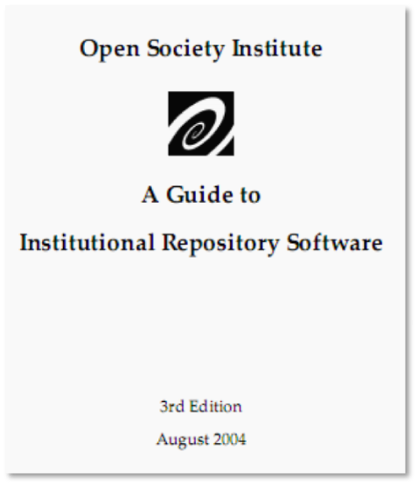
Libraries may also take lead in setting up institutional repositories.
  Numbers of open source repository applications are available .
  http://www.soros.org/openaccess/software/index.shtml

Slide 69
DSpace and EPrints has majority of the Installation base. Both are good candidates for setting up digital repositories.
EPrints uses PERL language and goes well with Standard LAMP configuration.
DSpace is built on JAVA technology and runs on Tomcat.
  However a gateway can be established between Apache and Tomcat.

Slide 70

Teething Problems in Using Open Source Software Applications in Libraries

Slide 71
Open source software solutions are best suited for libraries.
However librarians do face problems with them.
The majority of these problems are in-fact teething problems.
Will go away with on “growing up” .

Slide 72
Requires technical knowledge and experienced.
Emphasis is more functionality rather on usability.
Accompanying documentation is usually is poor.
Paid support is difficult to get for new software.
There is poor coordination between hardware vendors and open source community.

Slide 73
Librarians are used to proprietary software applications integrated or running over Microsoft Windows platform.
Might have already invested lot of money and efforts in establishing automated systems over a period of time.
Switchover is very difficult if the things are well established and working as integral part of the whole library system.

Slide 74
However, the benefits of using open source software over a period far outweigh as compared to propriety software.
It would be prudent to hire paid support services of established vendors
Invest in training of open source software for reaping their benefits.

Slide 75

Conclusion
Using open source software is as good as owning it.
Suitable candidate for long term library use.
Worth spending time and energy on learning and adopting.

Slide 76
THANK YOU
This presentation would be uploaded at
http://slideshare.net/sukhi
FOLLOWING SLIDES ARE FOR REFERENCE AND NOT FOR PRESENTATION

Slide 77
URLs of software applications mentioned:
http://portal.unesco.org/ci/en/ev.php-URL_ID=5330&URL_DO=DO_TOPIC&URL_SECTION=201.html
http://www.linux.org/
http://www.apache.org/
http://www.mysql.com/
http://www.perl.org/
http://www.php.net/
http://www.openoffice.org/
http://www.mozilla.com/en-US/firefox/personal.html
http://www.mozillamessaging.com/en-US/thunderbird/
http://audacity.sourceforge.net/
http://www.getsongbird.com/

Slide 78
http://www.gimp.org/
http://drupal.org/
http://www.joomla.org/
http://www.alfresco.com/index-a1.html
http://www.kompozer.net/
http://www.osalt.com/bluefish
http://www.osalt.com/nvu
http://www.osalt.com/openlaszlo
http://www.skmatic.com/projects/evaluation.php
http://linux.softpedia.com/get/System/Archiving/Indexed-PDF-Creator-1071.shtml
http://www.videolan.org/vlc/
http://www.htdig.org/
http://alacarte.library.oregonstate.edu/

Slide 79
http://www.skmatic.com/projects/portal.php
http://pkp.sfu.ca/?q=ojs
http://twiki.org/
http://phpwiki.sourceforge.net/
http://www.mediawiki.org/wiki/MediaWiki
http://www.wikipedia.org/
http://wordpress.org/
http://www.movabletype.org/opensource/
http://community.livejournal.com/lj_dev/
http://moodle.org/
http://koha.org/
http://www.verussolutions.biz/web/
http://open-ils.org/

Slide 80
http://www.sigb.net/index.php?page=secteurs&id_rubrique=1&lang=en
http://about.scriblio.net/
http://vufind.org/
http://www.thesocialopac.net/
http://libraryfind.org/
http://dbwiz.lib.sfu.ca/dbwiz/
http://www.greenstone.org/
http://www.dspace.org/
http://www.eprints.org/

Slide 81
References
  Cross Web (2009). Cross web Glossary of Internet Terms. http://www.crosswebtech.com/information/glossary.htm#O (Accessed 15/07/2009).
  Free Software Foundation (2009). Free Software Definition.
  http://www.gnu.org/philosophy/free-sw.html (Accessed 17/07/2009).
  Kyle, Odin. The pros and cons of open source software.
  http://www.helium.com/items/514407-the-pros-and-cons-of-open-source-software
  (Accessed 11/07/2009).

Slide 82
  Morgan, Eric Lease (2004). Open source software in libraries. http://infomotions.com/musings/ossnlibraries (Accessed 17/07/2009).
  Open Society Institute (2004). A Guide to Institutional Repository Software v 3.0, 3rd Edition. New York, Open Society Institute.
  http://www.soros.org/openaccess/software/ (Accessed 17/08/2009).
  Open Source Initiative (2009). Home.
  http://opensource.org/ (Accessed 17/08/2009).

Slide 83
  Open Source Initiative (2009a). Open Source Definition.
  http://opensource.org/docs/osd (Accessed 17/08/2009).
  Raymond, Eric S. (2007). Goodbye, "free software"; hello, "open source". http://www.catb.org/~esr/open-source.html (Accessed 17/08/2009).
  Wheeler,David A (2007). Why Open Source Software / Free Software (OSS/FS, FLOSS, or FOSS)? Look at the Numbers.
  http://www.dwheeler.com/oss_fs_why.html (Accessed 11/07/2009).
  http://www.beau.lib.la.us/~jmorris/linux/ala-talk/

Slide 84
Credits for Images
  http://www.redcanary.ca/view/top-programming
  http://cqtl.colstate.edu/teach/opensource/
  http://www.gnu.org/graphics/gnulaptop.png
  http://www.cs.adelaide.edu.au/students/java/images/viewpoints.gif
  http://www.pasteur.fr/formation/infobio/python/images/compiler_interpreter.png
  http://www.pediatricdentistsf.com/images/faq06.jpg

