Slide 1
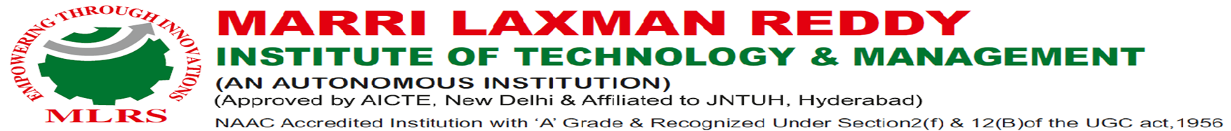
Railway Monitoring System Using Machine Learning
UNDER THE GUIDENCE OF
MR.CH.V.KRISHNA MOHAN
ASSOCIATE PROFESSOR ,
DEPT OF CSM.
PRESENTED BY –
CHEEPI SAI TEJA – 217Y1A6653
V CHANDRA SHEKHAR – 227Y5A6605

Slide 2
Introduction
The Railway Monitoring System utilizes Machine Learning (ML) and YOLO (You Only Look Once), an advanced object detection algorithm, to ensure the safety and efficiency of railway operations. By analyzing real-time video feeds from railway tracks and surrounding areas, this system detects and tracks objects such as trains, obstacles, and other hazards. YOLOv8, the latest version of the YOLO algorithm, is employed for its speed, accuracy, and capability to process multiple objects simultaneously. This system plays a crucial role in enhancing operational safety, minimizing delays, and automating the monitoring of extensive railway networks.

Slide 3
Railway Monitoring System Overview
The Railway Monitoring System leverages Machine Learning (ML) and the YOLOv8 object detection algorithm to monitor railway tracks in real-time. The system analyzes live video streams to detect and track objects such as trains, obstacles, and any potential hazards on the tracks. It automatically identifies issues, triggers alerts, and enhances the overall safety and operational efficiency of the railway network. Key features include:
Real-Time Video Analysis: Instant detection of objects and threats on tracks.
YOLOv8 Algorithm: Fast, accurate, and reliable object detection.
Automation & Alerts: Reduces human intervention by automatically identifying issues.
Improved Safety: Minimizes accidents and operational delays.

Slide 4
YOLOv8 Version Details
YOLOv8 is the latest iteration of the You Only Look Once (YOLO) series of object detection models, designed to provide significant improvements in both speed and accuracy for real-time applications. YOLOv8 is particularly suitable for complex environments like railway monitoring, where speed and precision are critical.
Key Features:
Enhanced Detection Accuracy: YOLOv8 improves on previous versions with better performance on smaller objects and dense scenes.
Optimized for Speed: Faster inference time, enabling real-time detection in live video streams.
Smarter Model Architecture: Utilizes advanced neural network techniques for higher accuracy and efficiency.
Support for Customization: Easily trainable on custom datasets (e.g., railway objects) for domain-specific applications.
Improved Generalization: Better at handling variations in lighting, weather, and occlusions.

Slide 5
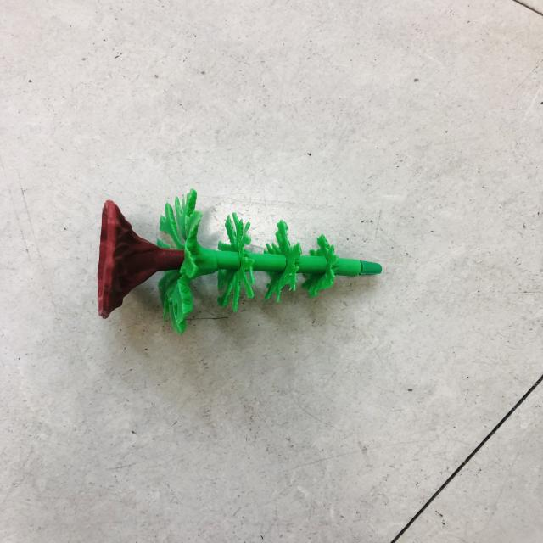
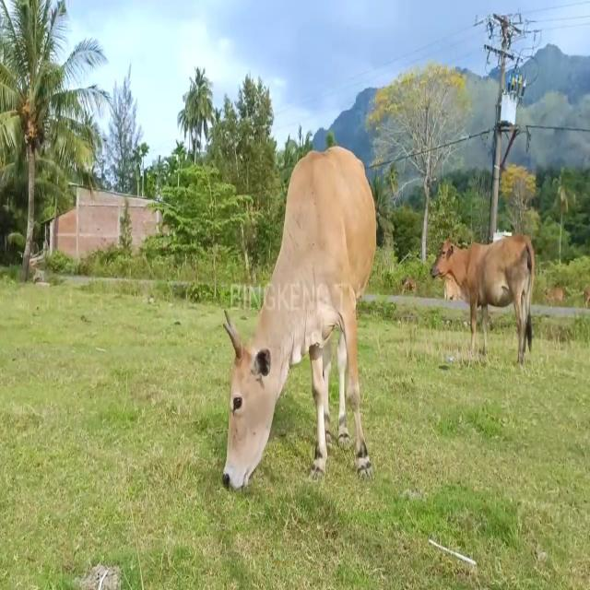
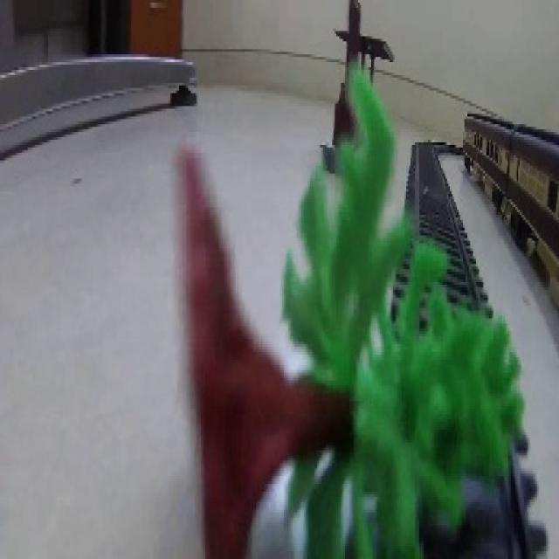
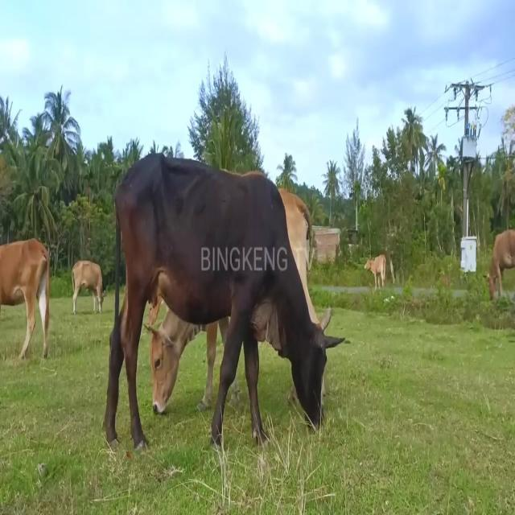
Step 1: Collect Data
The first step involves gathering images or video frames from railway environments to train the object detection model.

Slide 6
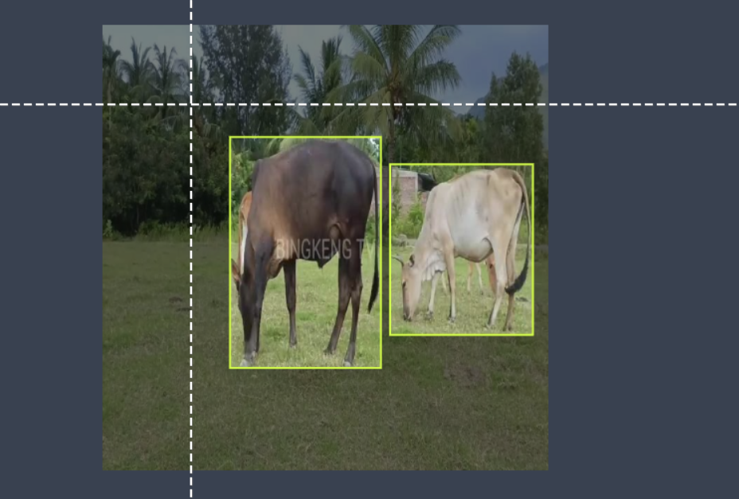
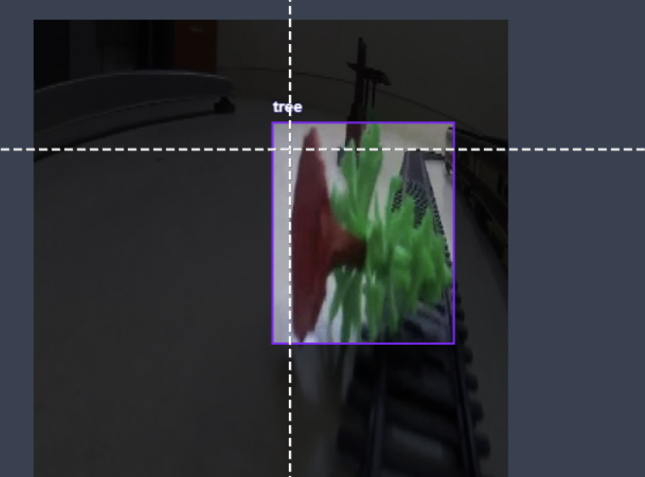
Step 2: Label Data
Using tools like Roboflow, label the images with bounding boxes around the objects of interest (e.g., trains, obstacles, etc.).

Slide 7

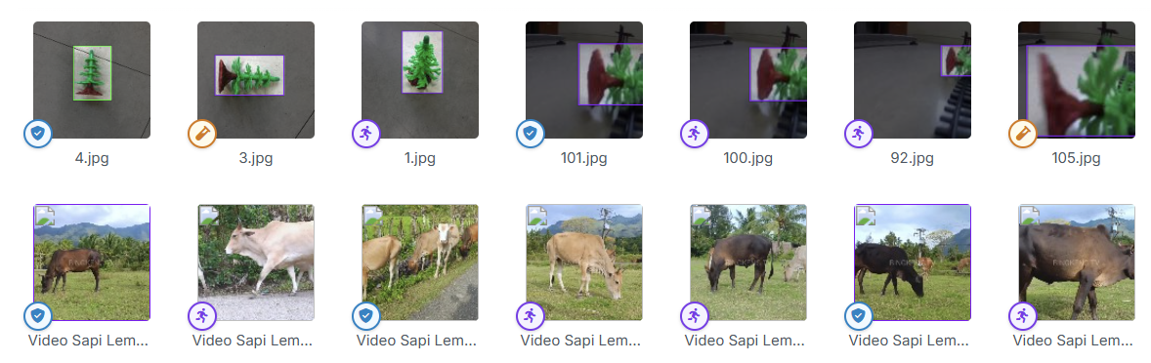
Step 3: Divide Data
Split the labeled dataset into
training, testing, and validation sets to ensure model accuracy and prevent overfitting.

Slide 8
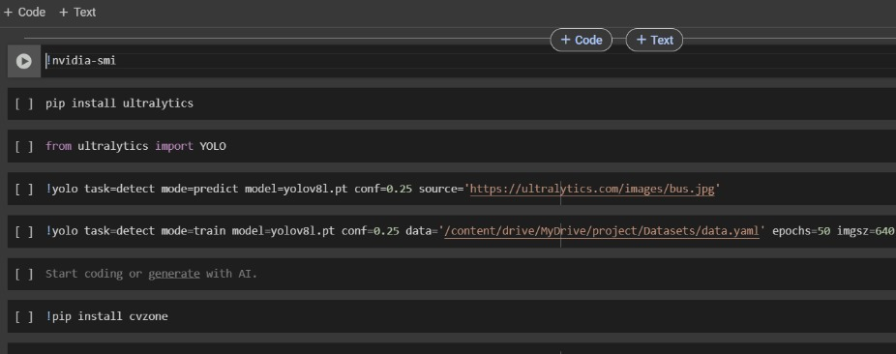
Step 4: Train Model using Custom Dataset
Train the model using YOLOv8 in Google Colab. This requires mounting Google Drive, importing the dataset, and training the model using the labeled data.

Slide 9
Step 5: Performing Operations to Get Best Weights
After training, evaluate the model’s performance using the test dataset. Fine-tune hyperparameters for optimal results.

Slide 10
Step 6: Using Best Weights Finding Obstacles
By Using the Best weights we find the objects over the Railway Track
The YOLO version analyses whether the object the video frame matches with the image by analyzing that if confidence was there then it will detect the object over the Railway Track

Slide 11
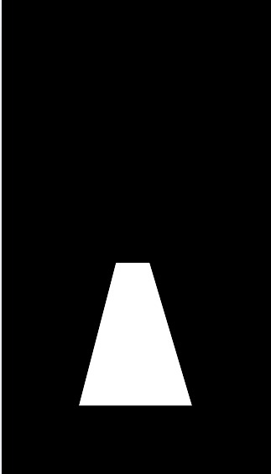
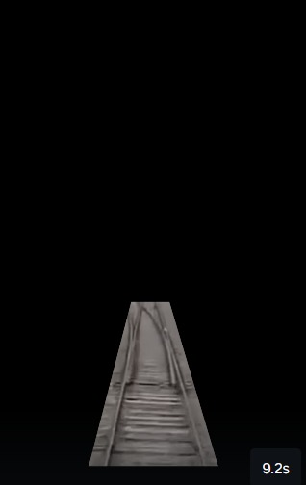
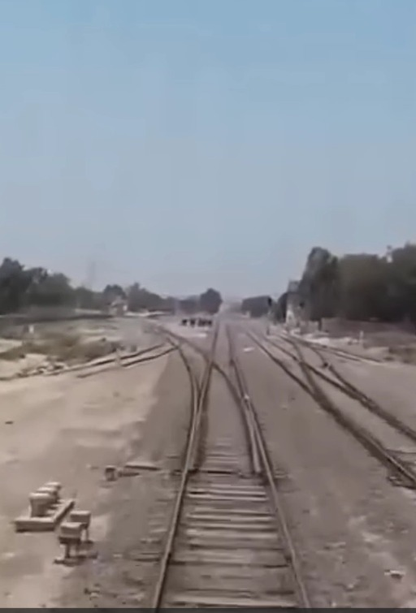
Step 6: Apply Masking
Use photo editing tools or custom code to apply masks on detected objects (e.g., trains, obstacles) for clear visualization.

Slide 12
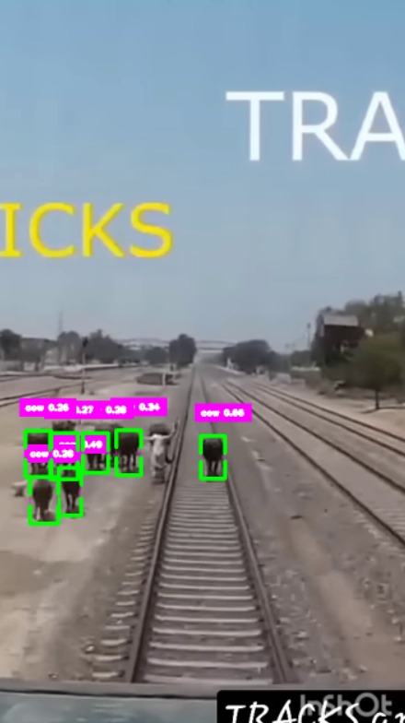
Step 7: Real-time Monitoring Using Best Weights Finding Obstacles
Once trained, apply the YOLOv8 model to real-time video streams from railway environments to detect objects and monitor tracks.

Slide 13
Applications
• Real-time railway track monitoring
• Train movement tracking
• Hazard detection on tracks (e.g., obstacles)
• Passenger and vehicle monitoring for safety.

Slide 14
Advantages of YOLOv8
High speed and real-time object detection
Accurate bounding box predictions
Scalable for large datasets
Efficient for monitoring dynamic environments like railways.

Slide 15
Drawbacks
• Dependent on high-quality data and training
• Potential false positives in dynamic environments
• Computationally expensive on edge devices
• Limited in certain weather conditions.

Slide 16
Conclusion
The Railway Monitoring System using YOLOv8 and ML offers an efficient solution for real-time monitoring, though challenges like data quality and environmental factors remain. The system can significantly enhance safety and operational efficiency in railway management.

Slide 17

Thank you
QnA

