Slide 1

DEPARTMENT OF INFORMATION TECHNOLOGY Sagi Rama Krishnam Raju Engineering College (a). chinnamiram, Bhimavaram- 534204
HUMAN AUTHENTICATION SYSTEM USING DEEP LEARNING TECHNIQUES
Batch:06
GANDHAM SAI TEJA (20B91A1255)
CHELLEM NARASIMHA MURTHY (20B91A1233) CHALLA MANEESH GOWTHAM (20B91A1225)
DURBHA V. KALI VARA PRASAD (20B91A1250)
GUIDED BY
Sri Dr.K Kishore Raju sir
(Associate Professor)

Slide 2
CONTENTS
ABSTRACT
INTRODUCTION
LITERATURE SURVEY
PROBLEM STATEMENT
PROPOSED SYSTEM
SYSTEM ARCHITECTURE
OVERVIEW OF SYSTEM EXECUTION
RESULT ANALYSIS
CONCLUSION
REFERENCES

Slide 3

ABSTRACT
The project aims to develop a facial recognition system that leverages deep learning techniques to enhance security . It is designed to recognize individuals in front of a camera, verifying their identity against a database of authorized users. If the person is recognized as an authorized user, the system displays their details, such as Name of that person. Conversely, if the individual is found as an unauthorized user, the system predicts and displays their age, gender, and emotion.
By employing convolutional neural networks (CNNs) and pre-trained models, the system achieves robust performance across various scenarios This dual functionality not only enhances security by restricting access to authorized individuals but also gathers demographic data on unauthorized attempts, The project addresses the growing need for secure and efficient authentication systems in modern applications.

Slide 4
INTRODUCTION
Introduction To Project Area
This project is about making a smart facial recognition system using advanced technology called deep learning. Deep learning helps computers recognize faces by looking at photos, much like how humans do but faster and more accurately. We are using this technology to check if someone is allowed to enter a place or access something. If the system knows the person (because their information is already saved), it will quickly confirm their identity and show their details like their name and registration number.
But here's what makes our system special: it doesn't just stop at identifying people it knows. If it sees someone it doesn't recognize, it won't just block them out. Instead, it will use its smart technology to guess their age, whether they're male or female, and what kind of mood they seem to be in. This is helpful because it gives more information about who tried to enter and how they were feeling, which could be important for security reasons.
So, in short, our project uses smart tech not only to make places more secure by checking who's allowed in but also to learn more about people who aren't recognized. This also, the system is not just a gatekeeper but also a smart observer that helps gather useful information.

Slide 5
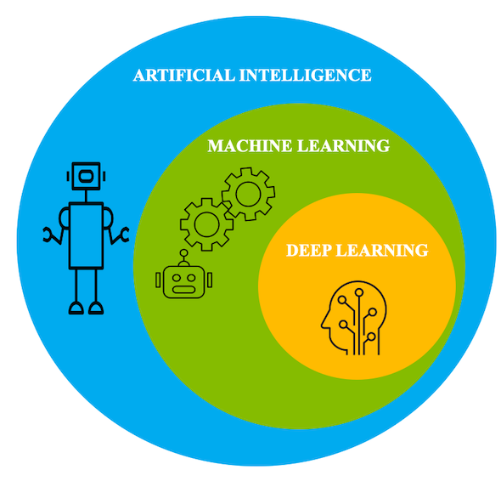
Introduction To Deep Learning
Deep learning is a branch of machine learning which is based on artificial neural networks. It is capable of learning complex patterns and relationships within data. In deep learning, we don’t need to explicitly program everything. It has become increasingly popular in recent years due to the advances in processing power and the availability of large datasets. Because it is based on artificial neural networks (ANNs) also known as deep neural networks (DNNs).
These neural networks are inspired by the structure and function of the human brain’s biological neurons, and they are designed to learn from large amounts of data. Deep Learning is a subfield of Machine Learning that involves the use of neural networks to model and solve complex problems. Neural networks are modelled after the structure and function of the human brain and consist of layers of interconnected nodes that process and transform data.
The key characteristic of Deep Learning is the use of deep neural networks, which have multiple layers of interconnected nodes. These networks can learn complex representations of data by discovering hierarchical patterns and features in the data. Deep Learning algorithms can automatically learn and improve from data without the need for manual feature engineering.
Deep Learning has achieved significant success in various fields, including image recognition, natural language processing, speech recognition, and recommendation systems. Some of the popular Deep Learning architectures include Convolutional Neural Networks (CNNs), Recurrent Neural Networks (RNNs), and Deep Belief Networks (DBNs).Training deep neural networks typically requires a large amount of data and computational resources.

Slide 6
Facial Recognition:
Facial recognition is a technology that uses algorithms to identify or verify individuals based on their unique facial features. It works by analyzing patterns in facial images, such as the distance between the eyes, nose shape, and jawline. Facial recognition systems can be used for various purposes, including security access control, surveillance, and identity verification in digital applications.
These systems capture facial images from photos or video streams and compare them against a database of known faces to make a match. Advances in deep learning and artificial intelligence have greatly improved the accuracy and reliability of facial recognition technology in recent years. However, concerns about privacy, bias, and security risks remain, prompting ongoing discussions and debates about its ethical and legal implications. Despite these challenges, facial recognition continues to be adopted in various industries and applications for its convenience and efficiency in identifying individuals.

Slide 7
LITERATURE SURVEY
S.NO | TITLE | AUTHOR NAME | YEAR | DESCRIPTION
1. | Face Detection and Recognition Using OpenCV | M. Khan, S. Chakraborty, R. Astya and S. Khepra | 2019 | They suggested PCA algorithm to reduce the size of the feature space required to efficiently represent the data from its existing high amount of storage
2. | Face Detection and Recognition System using Digital Image Processing | G. Singh and A. K. Goel | 2020 | The focus of this research is on developing a face recognition system utilizing digital image processing..
3. | Age and Gender Classification using Convolutional Neural Networks | Gil Levi and Tal Hassner | 2015 | The paper aims to improve age and gender estimation in face recognition by utilizing deep convolutional neural networks (CNN). This approach follows the progress made in recent face recognition systems, leveraging CNNs despite limited age and gender data in existing face datasets.

Slide 8
PROBLEM STATEMENT
Design a facial recognition-based human authentication system using deep learning techniques to verify individual identities without the need for additional biometric data. This system must overcome challenges of an existing system from facial images, model training and optimization specifically tailored for facial recognition tasks, security considerations to protect facial data, and privacy preservation. The objective is to develop an accurate and efficient facial recognition solution that can be seamlessly integrated into various applications while maintaining user privacy and security.

Slide 9
PROPOSED SYSTEM
The facial recognition-based authentication system will utilize deep learning techniques for accurate identity verification solely based on facial images. It will involve:
1. Facial data acquisition: Capturing facial images from cameras or databases and standardizing image quality.
2. Feature extraction with deep learning: Using CNNs to extract discriminative features invariant to lighting, pose, and expressions.
3. Real-time processing: Developing algorithms optimized for low-latency inference, potentially deploying on edge devices.
ADVANTAGES
High Accuracy: Utilizes deep learning for precise facial recognition. Minimizes false positives and false negatives.
Customization: Offers flexible settings tailored to specific needs. Customizable for security and user preferences.
Real-Time Processing: Optimized for fast responses and quick authentication. Ideal for applications needing rapid verification.
Scalability and Adaptability: Can handle growing datasets and changing needs. Adapts to different user bases and security policies.
Security and Privacy: Processes data locally for better security. Ensures data encryption and access controls.
Enhanced Security: Uses advanced deep learning for strong security measures. Protects against unauthorized access.
User Convenience: Provides seamless and easy authentication for users. Eliminates the need for extra passwords or devices.

Slide 10
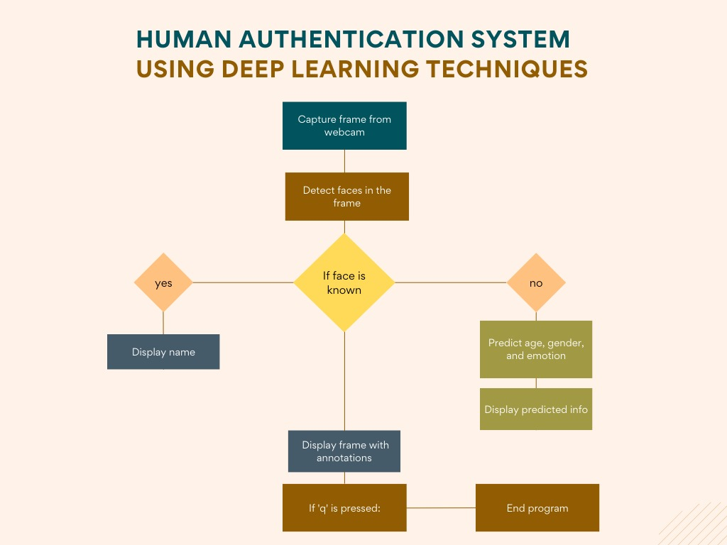
SYSTEM ARCHITECTURE
Capture Frame from Webcam: The system initiates by capturing a frame from a webcam. This frame will be used to identify the user attempting to gain access.
Detect Faces in the Frame: Facial recognition software is employed to detect the presence of faces within the captured frame.
Two possibilities emerge depending on whether a face is recognized within the frame.
Face is Recognized:
Display Name: If a face is recognized, the system retrieves the user’s name from its database and displays it on the screen.
Face is Not Recognized:
Predict Age, Gender, and Emotion: Additional analysis is performed on the recognized face to predict the user’s age, gender, and emotional state.
Display Predicted Info: The system displays the predicted age, gender, and emotion of the recognized user.
The process concludes when the user presses the ‘q’ key on the keyboard

Slide 11
Internal Working Of Models And Their Network Architectures:
Face Detection using Haar Cascade Classifier:
The face detection system described utilizes a sophisticated 38-layer cascaded classifier designed specifically for detecting frontal upright faces. During training, 4916 hand-labelled faces are meticulously aligned and scaled to a base resolution of 24 by 24 pixels, sourced from diverse images obtained through a random crawl of the World Wide Web. This diverse face training set ensures variability in facial expressions, lighting conditions, and angles, essential for training a robust and generalizable face detection system. Additionally, approximately 350 million non-face subwindows are utilized during training, sourced from 9544 images manually inspected to exclude facial features. These carefully selected non-face subwindows serve as negative examples, enhancing the classifier's discriminative power and minimizing false positives during face detection.
The network architecture comprises a 38-layer cascaded classifier, with each layer featuring a varying number of features. The initial layers contain a minimal number of features, gradually increasing in subsequent layers. For example, the first five layers have 1, 10, 25, 25, and 50 features respectively. These features, known as Haar-like features, capture differences in pixel intensities between adjacent regions of the image. Examples include Horizontal Edge, Vertical Edge, Diagonal Edge, Two Rectangle Edge, and Three Rectangle Edge features.

Slide 12
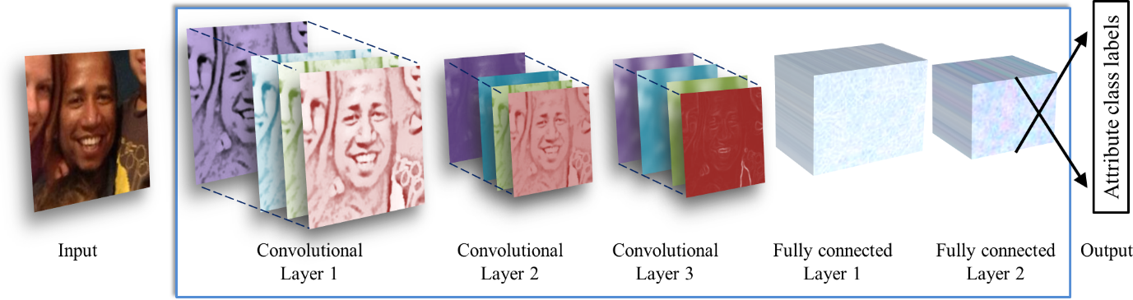
Age and Gender Prediction
In this system, we used pre-trained models for age and gender prediction from images of unknown individuals. These models, trained on the Adience benchmark dataset, run on the Caffe deep learning framework for efficient and easy deployment in image classification tasks.
Fig : Illustration of CNN Architecture

Slide 13
Network Architecture Workflow
This network architecture is used throughout our experiments for both age and gender classification. A more detailed, schematic diagram of the entire network design is additionally provided in Figure. The network comprises of only three convolutional layers and two fully- connected layers with a small number of neurons.
The first convolutional layer applies 96 filters of size 3×7×7 pixels, followed by ReLU activation, max pooling, and local response normalization.
The second layer processes the output of the first layer with 256 filters of size 96×5×5 pixels, also followed by ReLU, max pooling, and normalization.
The third layer utilizes 384 filters of size 256×3×3 pixels.
Fully connected layers follow, including two layers with 512 neurons each, ReLU activation, and dropout regularization.
The final fully connected layer maps to age or gender classes, with predictions made via a softmax layer based on maximal class probability.

Slide 14
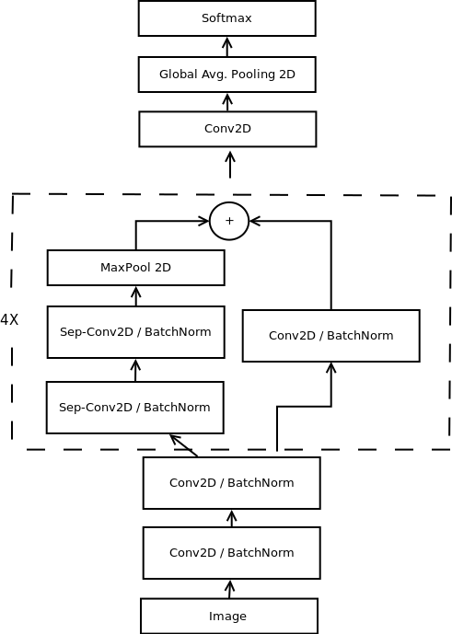
Emotion Prediction
In our project, human emotion detection is crucial for obtaining demographic information about an unknown person. We use a pretrained model from the "emotion_model.hdf5" file, trained on the FER-2013 emotion dataset, which includes facial images with various emotional labels. This model helps us accurately detect emotions such as anger, disgust, fear, happiness, sadness, surprise, and neutrality, enabling nuanced emotion detection capabilities in our system.
Network Architecture :
The emotion prediction model uses a modified CNN architecture inspired by Xception, with 4 residual depth-wise separable convolutional layers for efficient feature extraction and minimal computational complexity. Global average pooling replaces fully connected layers, reducing parameters and computational burden.
The architecture balances model complexity, efficiency, and performance for real-time emotion prediction. Guided back-propagation visualization highlights high-level features learned by the model, aiding interpretability. This streamlined design achieves high accuracy while preserving real-time performance
Fig : Illustration of Emotion prediction Network Architecture

Slide 15



OVERVIEW OF SYSTEM EXECUTION:
To test the performance of proposed system, all the modules are implemented using python 3.8.1 and is executed using Jupyter as IDE on desktop system with 16GB RAM and i7 processor with 4.6GHz processor speed. Proposed Human Authentication system captures the user video through web cam with 1080 pixels. The captured video is divided into sequence of frames and are supplied as input to the proposed architecture. The main three stages of execution of Proposed system is as follows:
➢ Initially. Capture faces from web cam
➢ Then, load every individual authorised user image(s) in separate directory/folder as shown in Fig
➢ Finally, Captured images given as input to the system
➢ If face is recognized as authorized system will display his/her name as shown in Fig
➢ If NOT Authorized user System will predict, and display Age Gender and Emotion of the User as shown in Fig
Fig : Existing authorised users images stored in Folders
Fig : Recognition of authorised user
Fig : Recognition of Unauthorised user

Slide 16
RESULTS ANALYSIS:
System Modules | Accuracy | Recall | Precision | F1 Score
Face Recognition | 90% | 90% | 90% | 90%
Age Prediction | 86% | 89% | 94% | 93%
Gender Prediction | 95% | 95% | 95% | 94%
Emotion Prediction | 94.4% | 71% | 73% | 75%
Average | 91.35% | 86.25% | 88% | 88%
After conducting experiments, it is evident that the face recognition achieved an accuracy rate of 90% using the dlib library , The reduction of accuracy by 10% is because of hardware limitations such as CPU and GPU effecting the accuracy of the face recognition process. The age and gender prediction both uses the same CNN algorithm, it was found that both Age and Gender performance is between the range of 86-95% as shown in the Table and the defficiency in this algorithm is may be impacted by using few convolutional layered architecture of the pre-trained model, as it doesn’t extract required features. For emotion prediction , it uses Guided back-propagation visualization of mini-Xception model and it produces 94.4% of accuracy and the major reductions are come across other metrics. It is concluded that the overall accuracy[91.35%] of this proposed system as mentioned in the Table.

Slide 17
CONCLUSION:
Based on the experiments conducted, it is concluded that the system offers a robust and versatile solution with an average accuracy of 91.35% for various applications, including security and personalized user experiences. By integrating Age and Gender and Emotion prediction models with Face Detection the proposed human authentication system posses considerable impact on security system. Moreover, Age and Gender prediction models achieved an accuracy of 86% and 90% respectively. Regarding Emotion prediction, nearly 95% accuracy is achieved. Finally, it is concluded that it can be used in various security needed places such as offices , colleges for security reasons . For further any implementations and refinement we can use this system and modify for our needs.

Slide 18
REFERENCES
M. Khan, S. Chakraborty, R. Astya, and S. Khepra (2019). Face Detection and Recognition Using OpenCV explores the use of PCA (Principal Component Analysis) for facial recognition in pictures and videos. PCA reduces the size of the feature space for efficient data representation using a 1-D pixel vector from 2-D face images. Drawbacks include the inability to distinguish male and female faces.
Algorithms Used: OpenCV Haar Cascade, Eigenface, Fisher Face, and LBPH (Local Binary Pattern Histogram)
Gil Levi et al. “Age and Gender Classification using Convolutional Neural Networks draws inspiration from Gil Levi et al.'s work on Age and Gender Classification using Convolutional Neural Networks. By leveraging deep CNNs, we aim to enhance automated face recognition and age/gender estimation methods. Our approach emphasizes a simplified network structure to address data scarcity issues, yielding comparable benefits to previous studies.
Algorithms Used: CNN
Octavio Arriaga et al. “Real-time Convolutional Neural Networks for Emotion and Gender Classification presented Real-time Convolutional Neural Networks for Emotion and Gender Classification, introducing a CNN architecture for instant program creation. Their research verified algorithms using a real-time expression detection system, ensuring human-level reliability. Two models were developed to optimize efficiency, with drawbacks including misclassification of some subjects.
Algorithms Used: CNN

Slide 19
Reference Links
https://github.com/aakashjhawar/face-recognition-using-deep-learning/tree/master/face_detection_model
https://github.com/priyanshkedia04/Face-Detection-and-Recognition/blob/master/README.md
https://drive.google.com/file/d/1_H1jzXS02aZuPaum8TL1q1ZUF1mKWcQ2/view?usp=sharing
https://drive.google.com/file/d/1X33kxK1Ubxe0xcUdu2q_PsUvggnTZ6B4/view?usp=sharing
Reference Books
Neural Networks and Deep Learning by Michael Nielsen
Deep Learning From Scratch: Building with Python from First Principles by Seth Weidman
Face Recognition: Methods, Applications, and Challenges" by Fouad Sabry

Slide 20
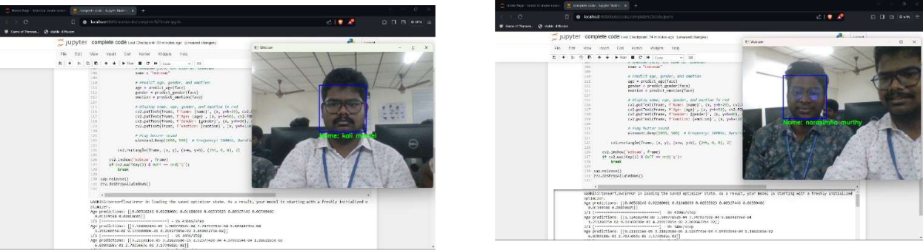
OUTPUT SCREENS:

Slide 21
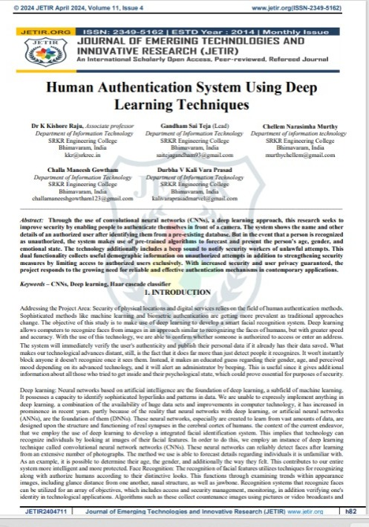
Published Paper :
We're delighted to share that our paper has been successfully published in the JETIR Journal. This achievement reflects the dedication and perseverance of our team and signifies the recognition of our research within the academic sphere. We look forward to the continued impact and discussion our work will inspire in the field.

Slide 22
THANK YOU

