Slide 1



Budget
PREDECTION

Slide 2
Problem Statement
An Overview Of Problem Statement
BUDGET PREDICTION OF CONSTRUCTION - Budget management is a critical function for any organization.As the client/customer cannot predict overall budget for the project.So this model takes the clear budget for each factor and predicts the overall budget of the project.so it is easy for the customer/client to manage his finance.

Slide 3

Model Selection
Feature Creation
Feature Selection
Problem Statement
Feature Engineering
Feature Extraction
Feature Transformation

Slide 4

Features
Intrest Rates Market Demand Project Management
Material Cost Time
Technological Advancements Labour Cost
Cost Over runs Access to funding Complexity
Outcome: Forecasted Budget Value

Slide 5
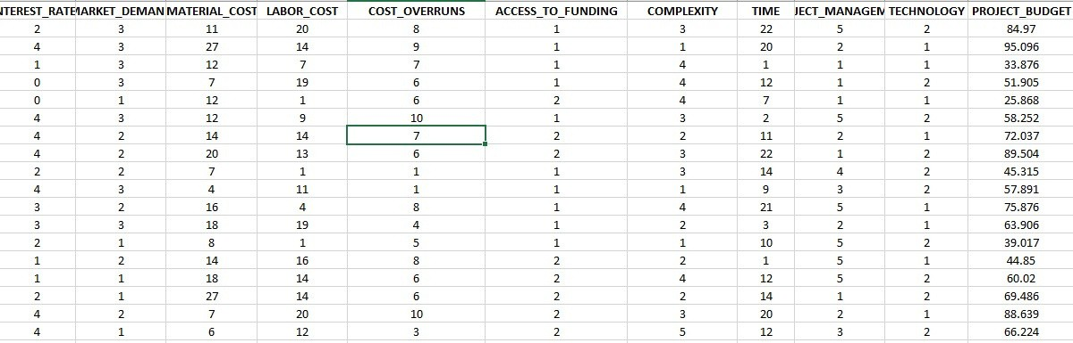

About Data Set
This Data set is analyzed using machine learning algorithms to develop a budget prediction system for the construction department.

Slide 6
Model Selection
Feature Creation
Feature Engineering
Feature Selection
Feature Extraction
Feature Transformation
Problem Statement
Random Forest
Predicted Numeric

Slide 8
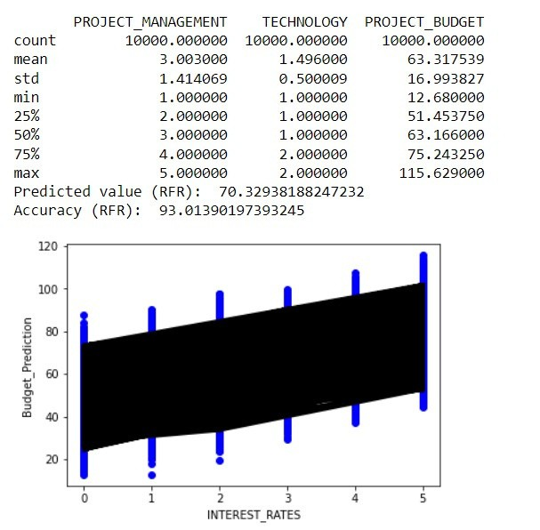
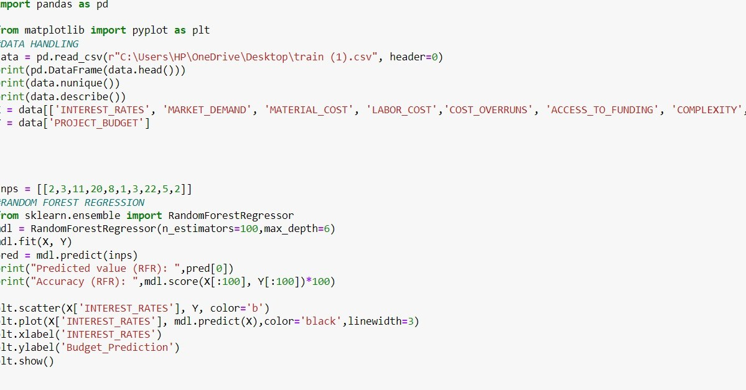
Code and Observations

Slide 9
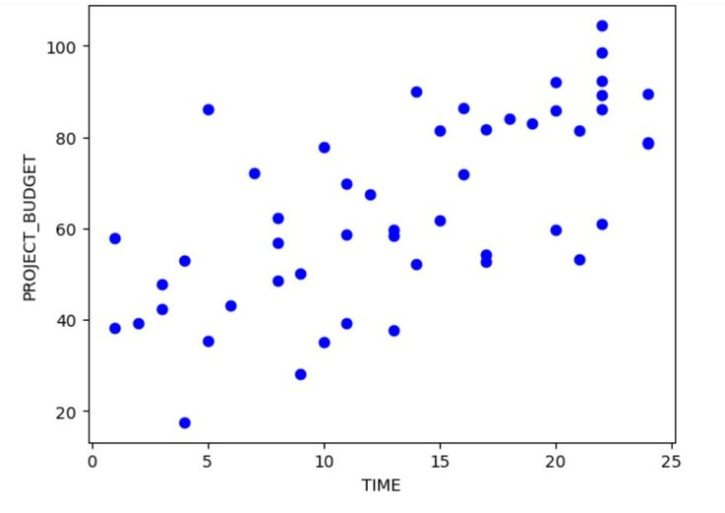
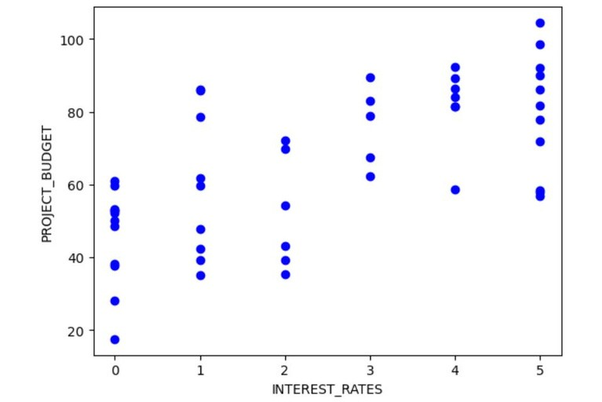
Observations
Graph here infers that as time increases the overall project_budget increases.
Graph here infers that as intrest_rates increases the project_budget increases.

Slide 10
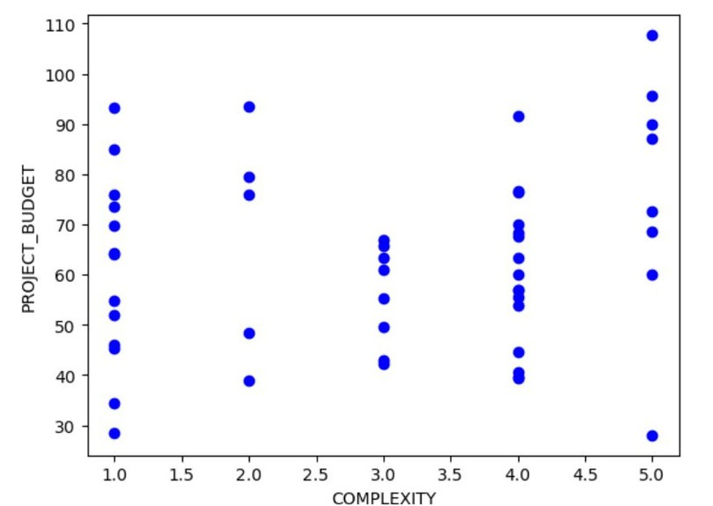
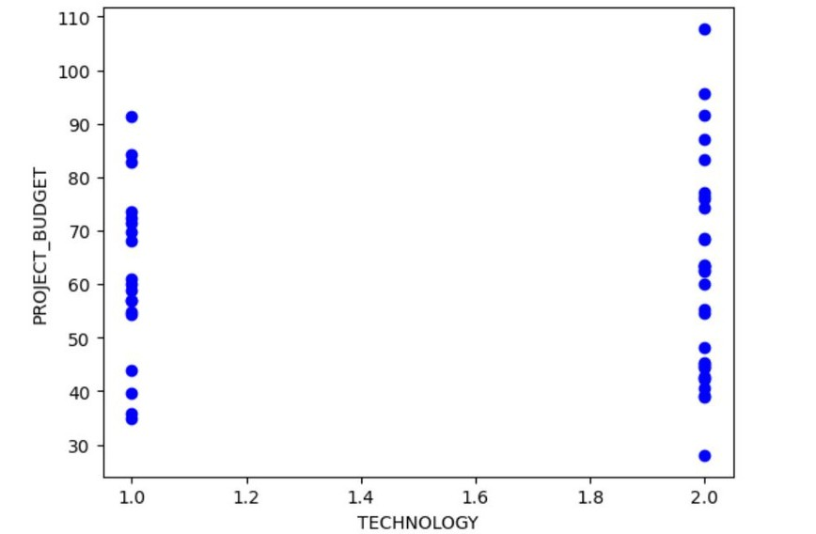
Observations
The feature "technology" was scaled as 1 with trending technology which results in low budget of the project and vice versa.
The feature "Complexity" is directly proportional to the budget of the
project.

Slide 11
Applications
House price prediction
Use to estimate the Bid price in any tender.
Can be used to regulate the cost of each feature.

Slide 12
THANK YOU

