Slide 1
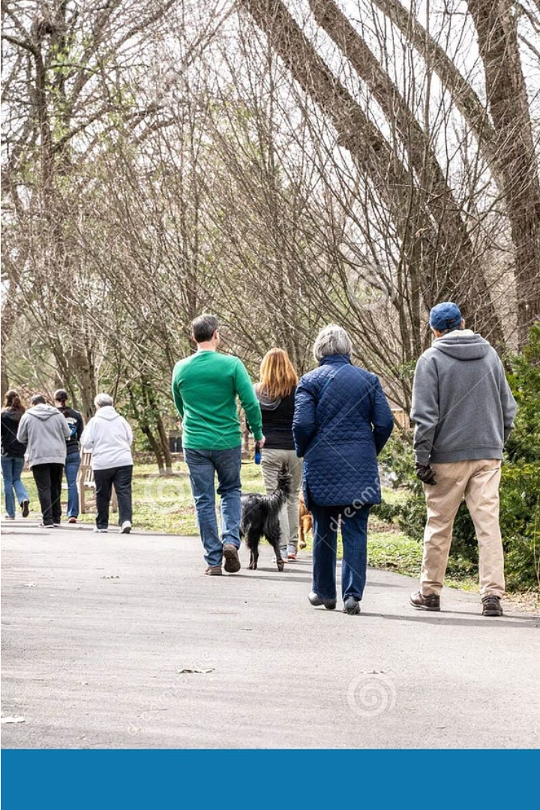
Introduction to Human Action Recognition
Human Action Recognition (HAR) is a field of computer vision that focuses on identifying and classifying human actions in videos or images. This technology has various applications, ranging from security systems and smart home devices to healthcare monitoring and sports analysis.
HAR algorithms analyze various visual cues, such as the movement of limbs, body posture, and the interaction of objects, to understand the actions being performed. These algorithms often employ deep learning techniques, particularly convolutional neural networks, to extract relevant features from video frames and predict the actions with high accuracy.

Slide 2
Team Members
Chinuri Sai Vardhan Reddy
Gollapalli Naga Mukesh
Akula Sheshu

Slide 3
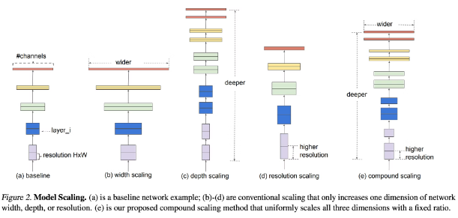
Efficient Net Architecture
EfficientNet is a convolutional neural network architecture that is designed to be efficient and accurate. The architecture is based on a compound scaling method that scales the width, depth, and resolution of the network in a balanced way. This allows the network to achieve better accuracy with fewer parameters and less computational cost.
EfficientNet is a family of models that are optimized for different resource constraints. The family includes EfficientNet-B0, EfficientNet-B1, EfficientNet-B2, and so on, with each model having a different number of parameters and computational cost. EfficientNet-B0 is the smallest model in the family, and EfficientNet-B7 is the largest. The EfficientNet architecture has been used to achieve state-of-the-art results on a variety of image classification benchmarks, including ImageNet and CIFAR-10.

Slide 4
Efficient Net Architecture
EfficientNet is a convolutional neural network architecture that is designed to be efficient and accurate. The architecture is based on a compound scaling method that scales the width, depth, and resolution of the network in a balanced way. This allows the network to achieve better accuracy with fewer parameters and less computational cost.
EfficientNet is a family of models that are optimized for different resource constraints. The family includes EfficientNet-B0, EfficientNet-B1, EfficientNet-B2, and so on, with each model having a different number of parameters and computational cost. EfficientNet-B0 is the smallest model in the family, and EfficientNet-B7 is the largest. The EfficientNet architecture has been used to achieve state-of-the-art results on a variety of image classification benchmarks, including ImageNet and CIFAR-10.

Slide 5




Video to Frame Conversion
Video File Input
We begin with the video file. It's the raw data we'll process. This file is in a format like .avi or .mp4. It contains all the frames in sequence. We'll need this video to be a good quality, to produce high-quality frames.
Frame Extraction
The key is to take each frame from the video file. We're essentially taking snapshots of the video at different time points. This process creates a set of images. Each image corresponds to a specific moment in the video.
Saving the Frames
We save the extracted frames in a consistent format. This could be JPEG, PNG, or another suitable image format. The frames are saved in a directory. We'll use these images for training the model to recognize human actions.

Slide 6
Frame to GIF Conversion
1
2
3
Conversion Process
Frame Sequencing
GIF Optimization
The next step in our project involved converting the extracted frames into animated GIFs. This conversion process allowed us to effectively capture the temporal dynamics of the human actions. The GIFs provided a more visual representation of the actions, enhancing our understanding and analysis.
The GIFs were created by arranging the extracted frames in a specific sequence, reflecting the chronological order of the action. This sequencing was crucial for preserving the temporal integrity of the action and ensuring that the GIF accurately depicted the movement.
To ensure optimal performance and efficient storage, we optimized the GIFs. This optimization involved compressing the image data without compromising the visual quality. The optimized GIFs were then used for training the model, ensuring a balance between image fidelity and file size.

Slide 7



Training the AVI Files
Data Augmentation
1
We employed data augmentation techniques to increase the size and diversity of our training dataset.
Model Selection
2
We carefully selected a suitable deep learning model architecture, considering its efficiency and effectiveness for human action recognition.
Model Training
3
The selected model was trained on our augmented dataset using a suitable optimization algorithm and loss function.
Training the AVI files involved a series of crucial steps. We began by preprocessing the AVI files, converting them into individual frames and then extracting features from these frames. We then applied data augmentation techniques to expand the dataset and enhance its diversity, which improved the model's ability to generalize to unseen data. This was followed by the selection of an appropriate deep learning model architecture for human action recognition, considering factors such as efficiency and effectiveness. The model was then trained on the augmented dataset using a suitable optimization algorithm and loss function, minimizing the prediction error and achieving high accuracy. The model was periodically evaluated during the training process, allowing us to monitor its performance and adjust parameters as needed.

Slide 8
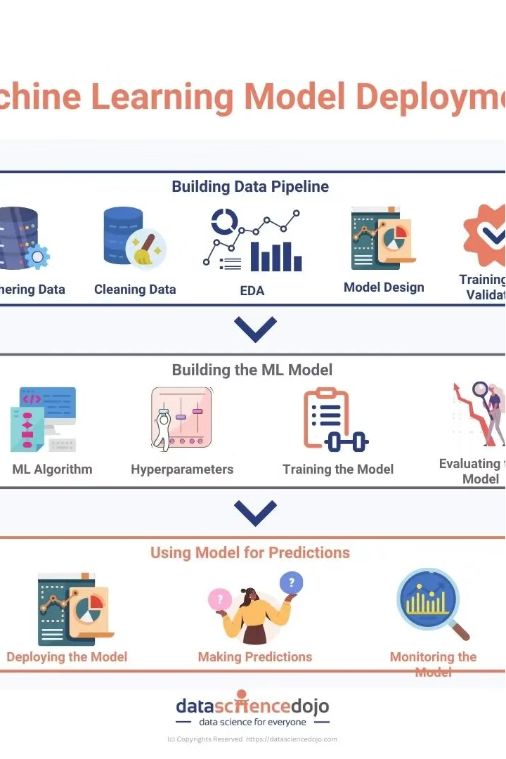
Saving the Model
After training the model on the processed video frames, it's crucial to save the trained model for future use. This allows us to reuse the model for predicting actions in new, unseen videos without retraining the model from scratch. This saves significant time and computational resources, making the system more efficient and scalable.
The saved model encapsulates the learned knowledge from the training data and can be easily loaded and used for prediction. We leverage a robust model saving mechanism that ensures the integrity and accuracy of the saved model. This is critical for reliable and accurate action recognition in real-world applications.

Slide 9

Flask Web Application Development
1
Backend Setup
The Flask framework provides a robust foundation for building web applications. Flask's simplicity and flexibility allow for rapid development and deployment of web services.
2
Front-end Integration
We used HTML, CSS, and javaScript to create a user-friendly interface. This interface interacted with the main python code to display action predictions and provide a smooth user experience.

Slide 10
Prediction
After the model is trained, the web application can be used to predict the actions in real-time using a live video stream. The user can start the application and direct the webcam or upload a video file to be analyzed.
The application processes the video frames using the trained model and generates a prediction for the action being performed. The predicted action is then displayed on the screen, providing immediate feedback to the user.
Action Detection
1
The model analyzes each frame of the video
Prediction Output
2
The detected action is displayed to the user
Real-Time Feedback
3
The user receives immediate results

Slide 11

Conclusion
We successfully developed a human action recognition system using the EfficientNet architecture. The system was trained on a dataset UCF101 containing which are further converted into videos converted into frames and GIFs. This allowed the system to identify different actions with high accuracy. The trained model was then made as a web application using Flask, enabling users to upload videos and receive predictions about the actions performed within them.
The system's performance was evaluated using various metrics, demonstrating its effectiveness in recognizing different actions. Future improvements could include expanding the dataset with more diverse videos and incorporating advanced techniques for handling real-time video analysis. The developed system has the potential to be utilized in various applications, including security monitoring, and entertainment.

