Slide 1





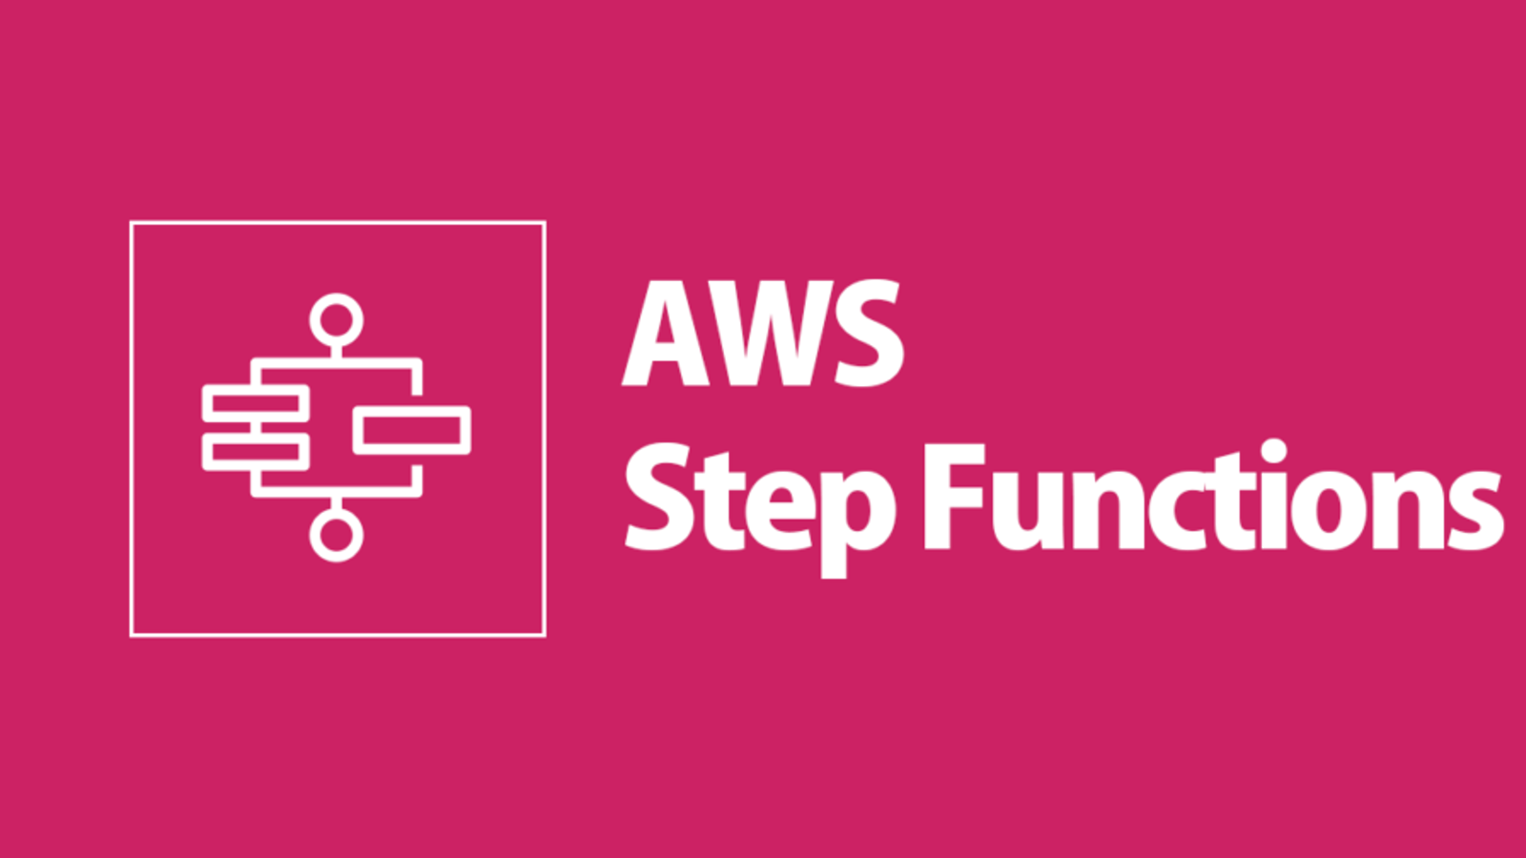






Data Pipeline Architecture
ETL Glue Job
Trigger
Flights Data
Load
Event bridge Rule
Success
Failure
Notifies User

