Slide 1






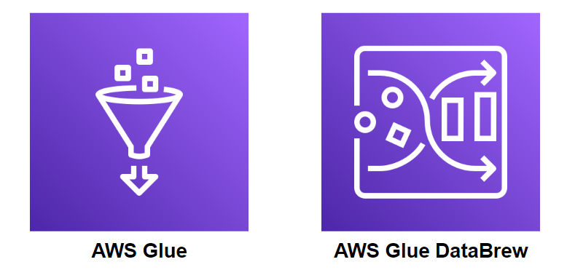


Data Processing Architecture
AWS Glue Catelog
Generates Data
Transform
Glue job ETL Dataflow

