Slide 1

On-Prem: Medical Equipment Supply and Maintenance
Group: 8
Sai Varun Kumar Namburi
Pooja Ramesh

Slide 2
Project Statement & Objective
A real-world challenge faced by the healthcare domain is the continuous and reliable equipment availability. We integrate supply chain principles in healthcare facilities to address comprehensive medical equipment management.
This project seeks to develop a data-driven solution to implement a medical equipment supply and maintenance system that ensures consistency of availability, and operational efficiency, improves patient care quality, and reduces operational costs.

Slide 3
End-Goal
How medical equipment is used (whether it is overutilized or underutilized) across various departments within the facilities.
Predict maintenance requirements in advance to avoid delays
Monitor the supply chain process
Resource allocation and cost optimization
Impact on patient care
Identify any breaches of access and usage of equipment

Slide 4
Data Sources:
https://data.world/johnsnowlabs/utilization-and-payment-data-medical-equipment-and-supplies-2013
https://data.world/johnsnowlabs/medically-unlikely-edits-durable-medical-equipment-supplier-services
https://data.world/johnsnowlabs/bsa-durable-medical-equipment-line-items-puf
https://synthetichealth.github.io/synthea/
https://www.kaggle.com/datasets/mohdkhidir/medical-equipment-spare-parts-inventories-datasets

Slide 5
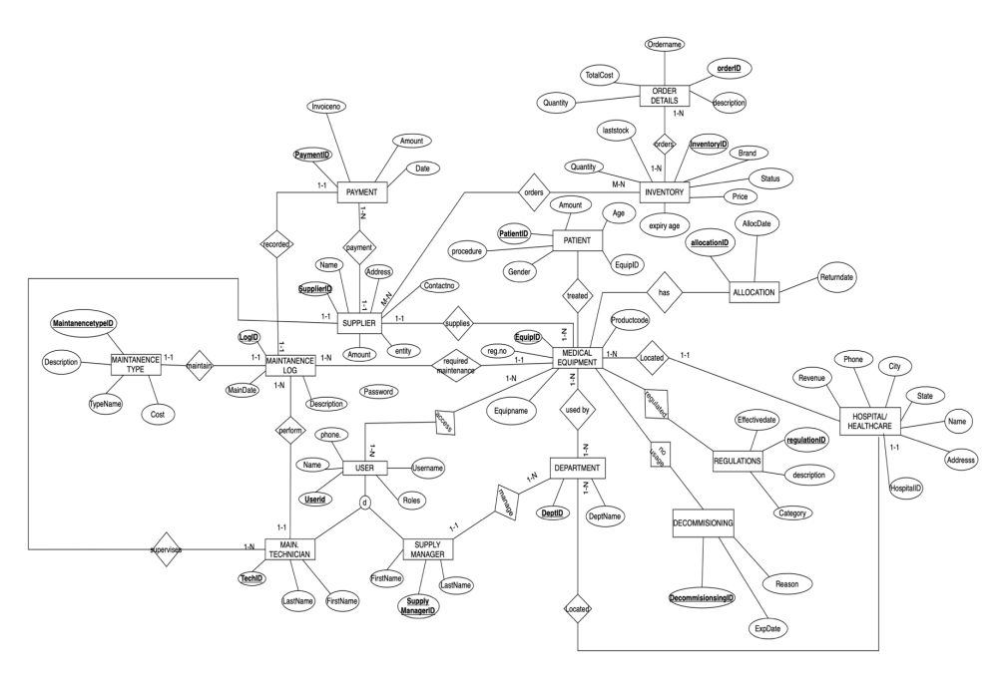
EER Diagram of Transactional Database

Slide 6
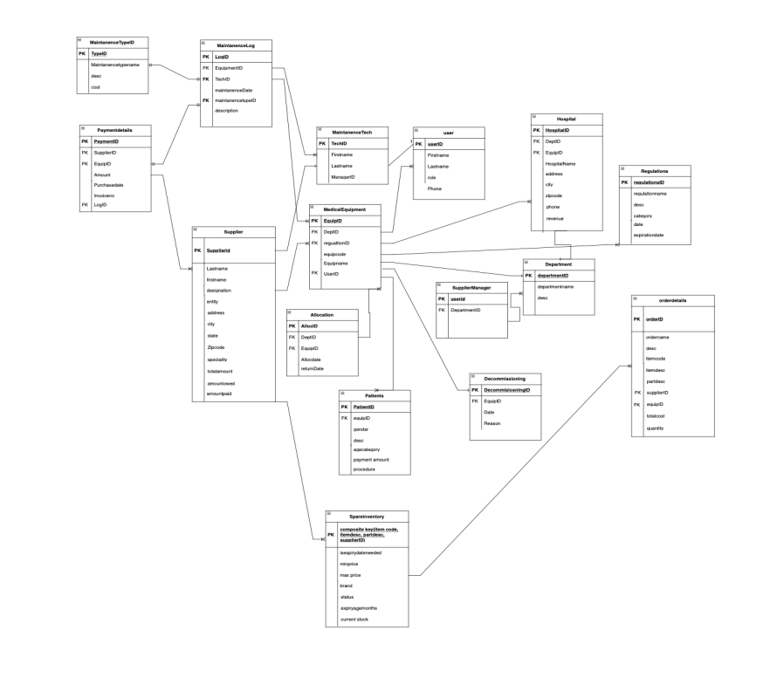
Relational Schema

Slide 7
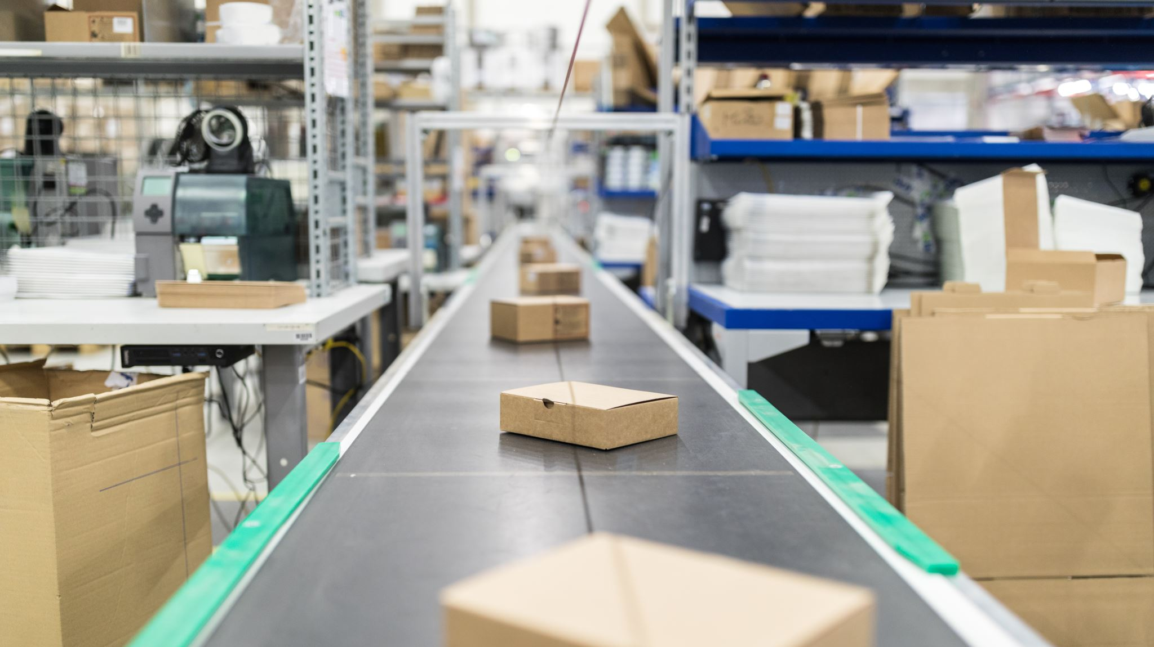
Warehouse Design Proposal
Our main aim is to implement a comprehensive data solution to by creating a centralized repository for all equipment-related data.
This will help in ensuring proactive maintenance, cost control, inventory optimization, and regulation of compliance.
Here, we further aim to create a scheduling table that will regularize maintenance schedules for each piece of equipment and follow the regulations

Slide 8
Facts and Dimensions
The centralized data warehouse will contain key dimensions like Time Dimensions, Geographical Dimensions, Equipment Dimensions, User Dimensions
To ensure that we provide optimum maintenance and scheduling, we create a Maintenance fact and a Supplier fact
This multi-dimensional model allows easy exploration of equipment data for analysis from various perspectives

Slide 9
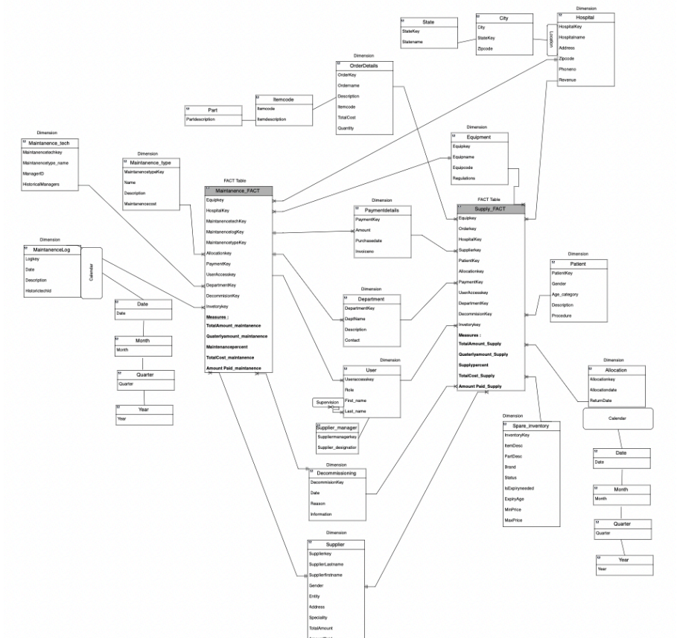
Conceptual Model

Slide 10
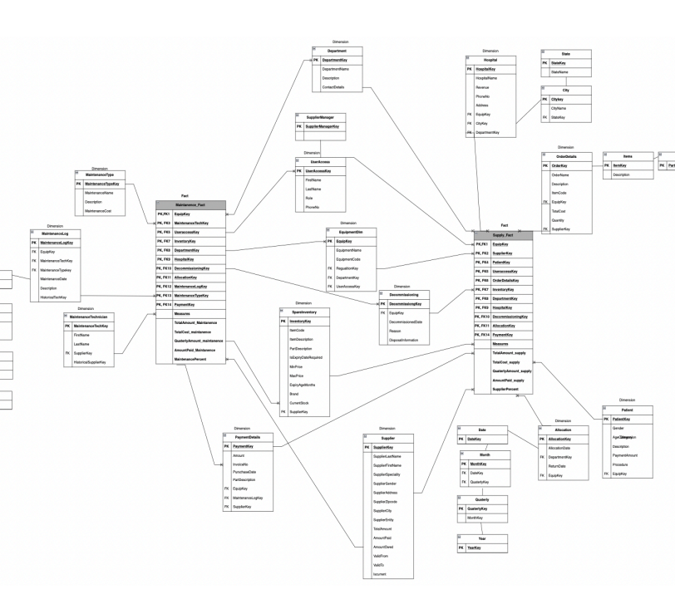
Logical Model

Slide 11

OLAP Operations
What is the quarterly revenue generated by each supplier, and how does it vary over the months?
Ans: Res1 <- ROLLUP*(Supply_FACT, Supplier-> Name, Supplier -> OrderDate , Sum(TotalCost) as MonthlyRevenue)
How does the equipment maintenance cost vary across different types of equipment?
Ans: Res1 <- DRILLACROSS (Supply_FACT, Maintanence_FACT)
ROLLUP* (Res1, Equipmentname -> Name, maintanencetype-> maintanencetypename, AVG(maintanencecost))

Slide 12
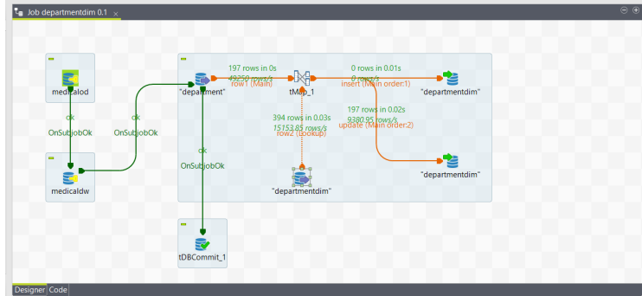
Talend-ETL Sample Demonstration

Slide 13
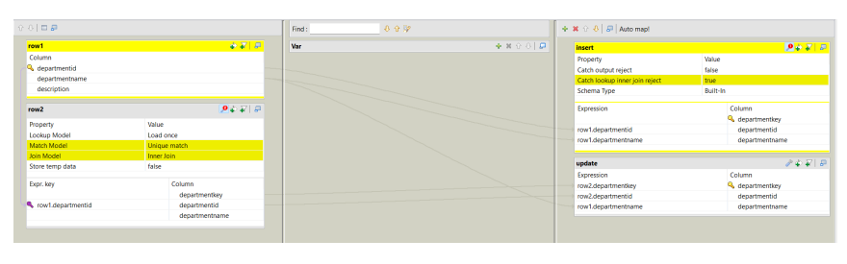
Sample T-map

Slide 14
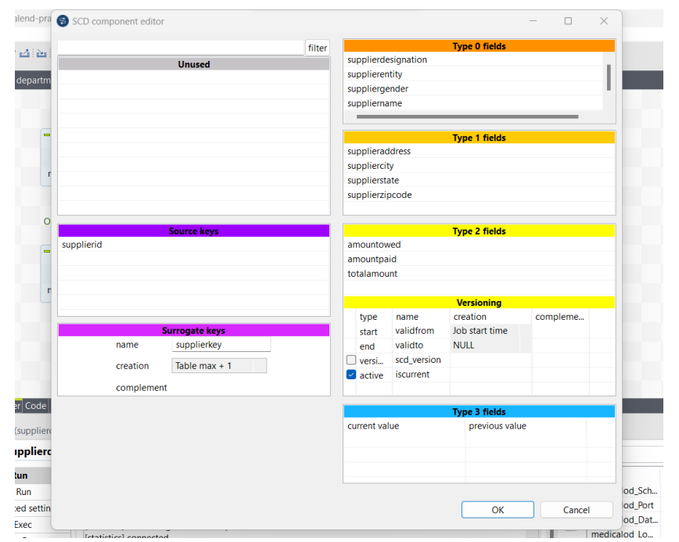
Type-2 SCD Implementation

Slide 15
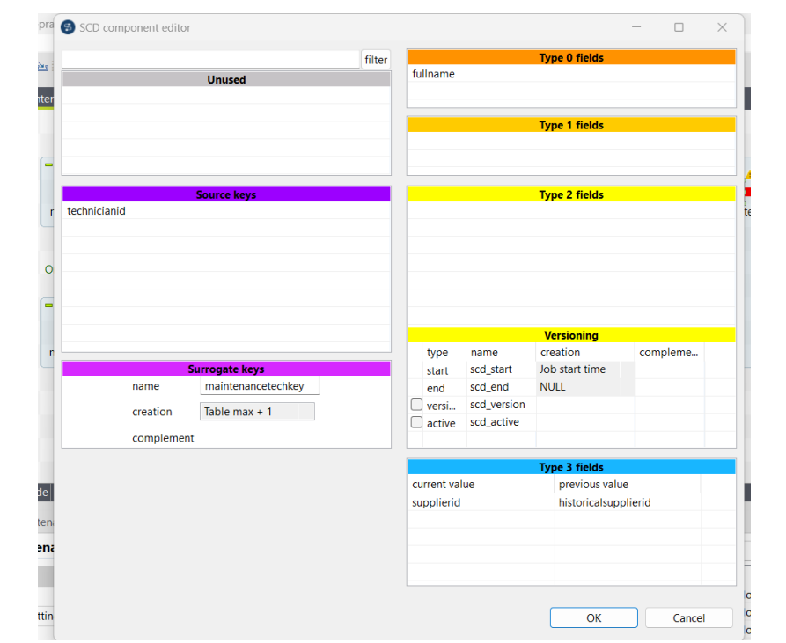
Type-3 SCD Implementation

Slide 16
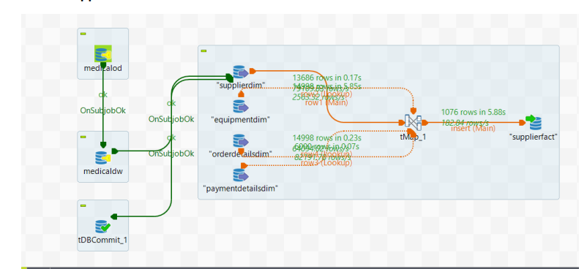
Fact Table Implementation in Talend

Slide 17
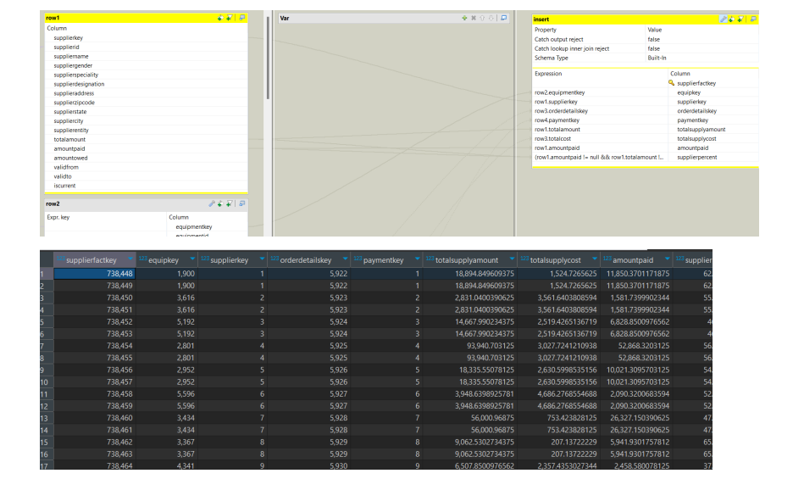
Supplier Fact Output

Slide 18
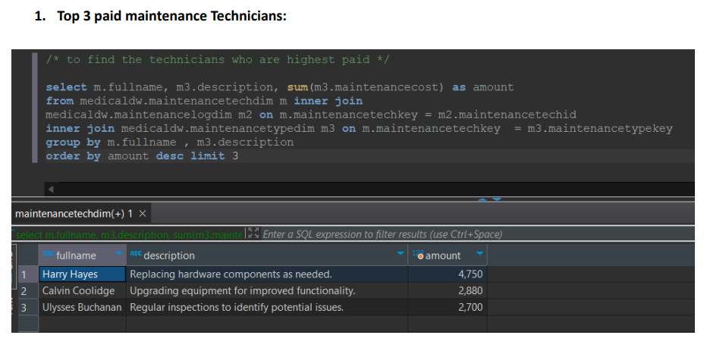
Analytical Queries

Slide 19
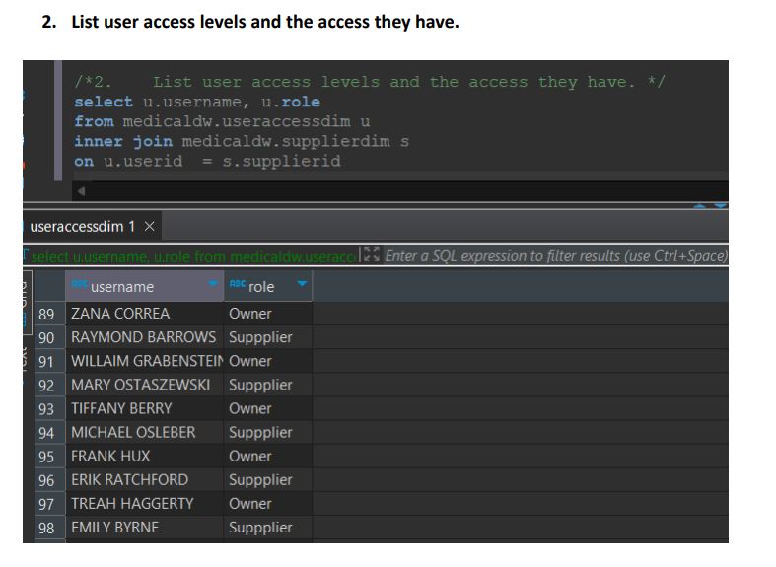
Cont.

Slide 20
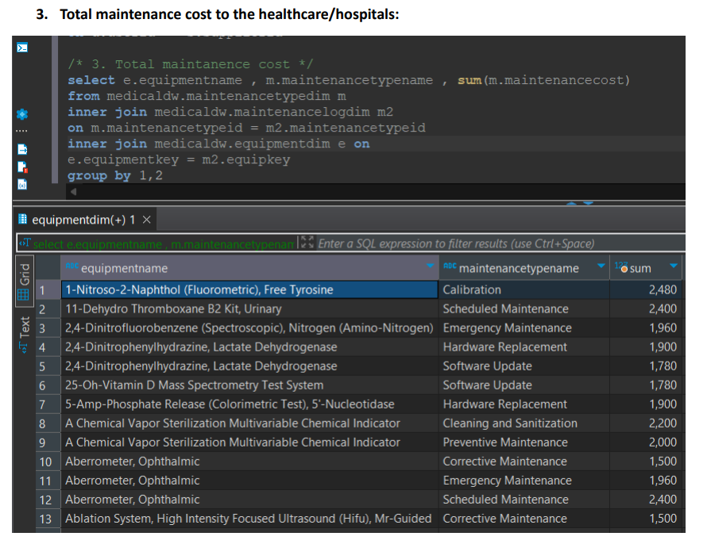
Cont.

Slide 21
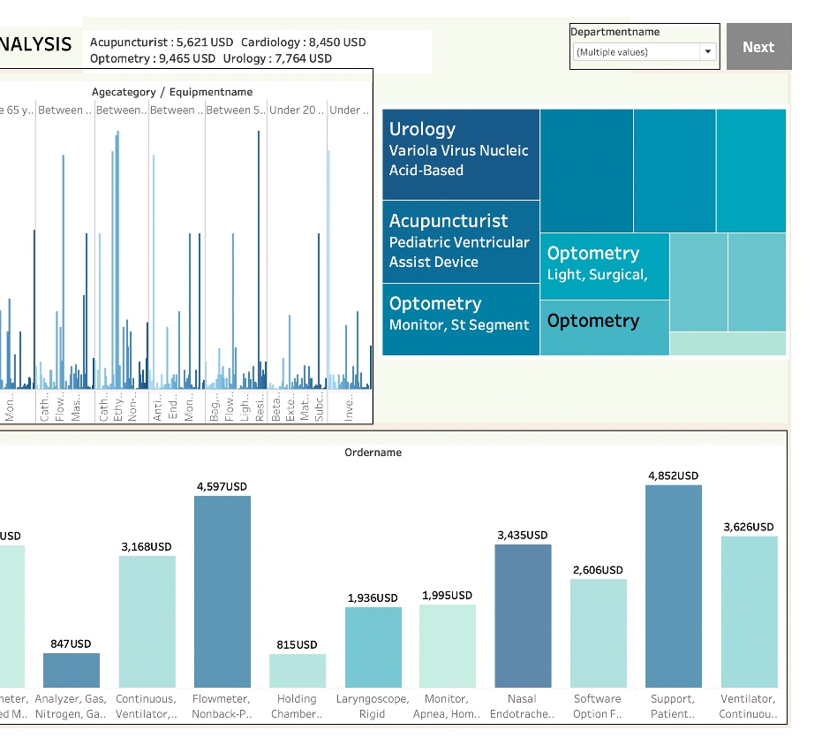
Tableau Dashboard Supply Revenue Analysis

Slide 22
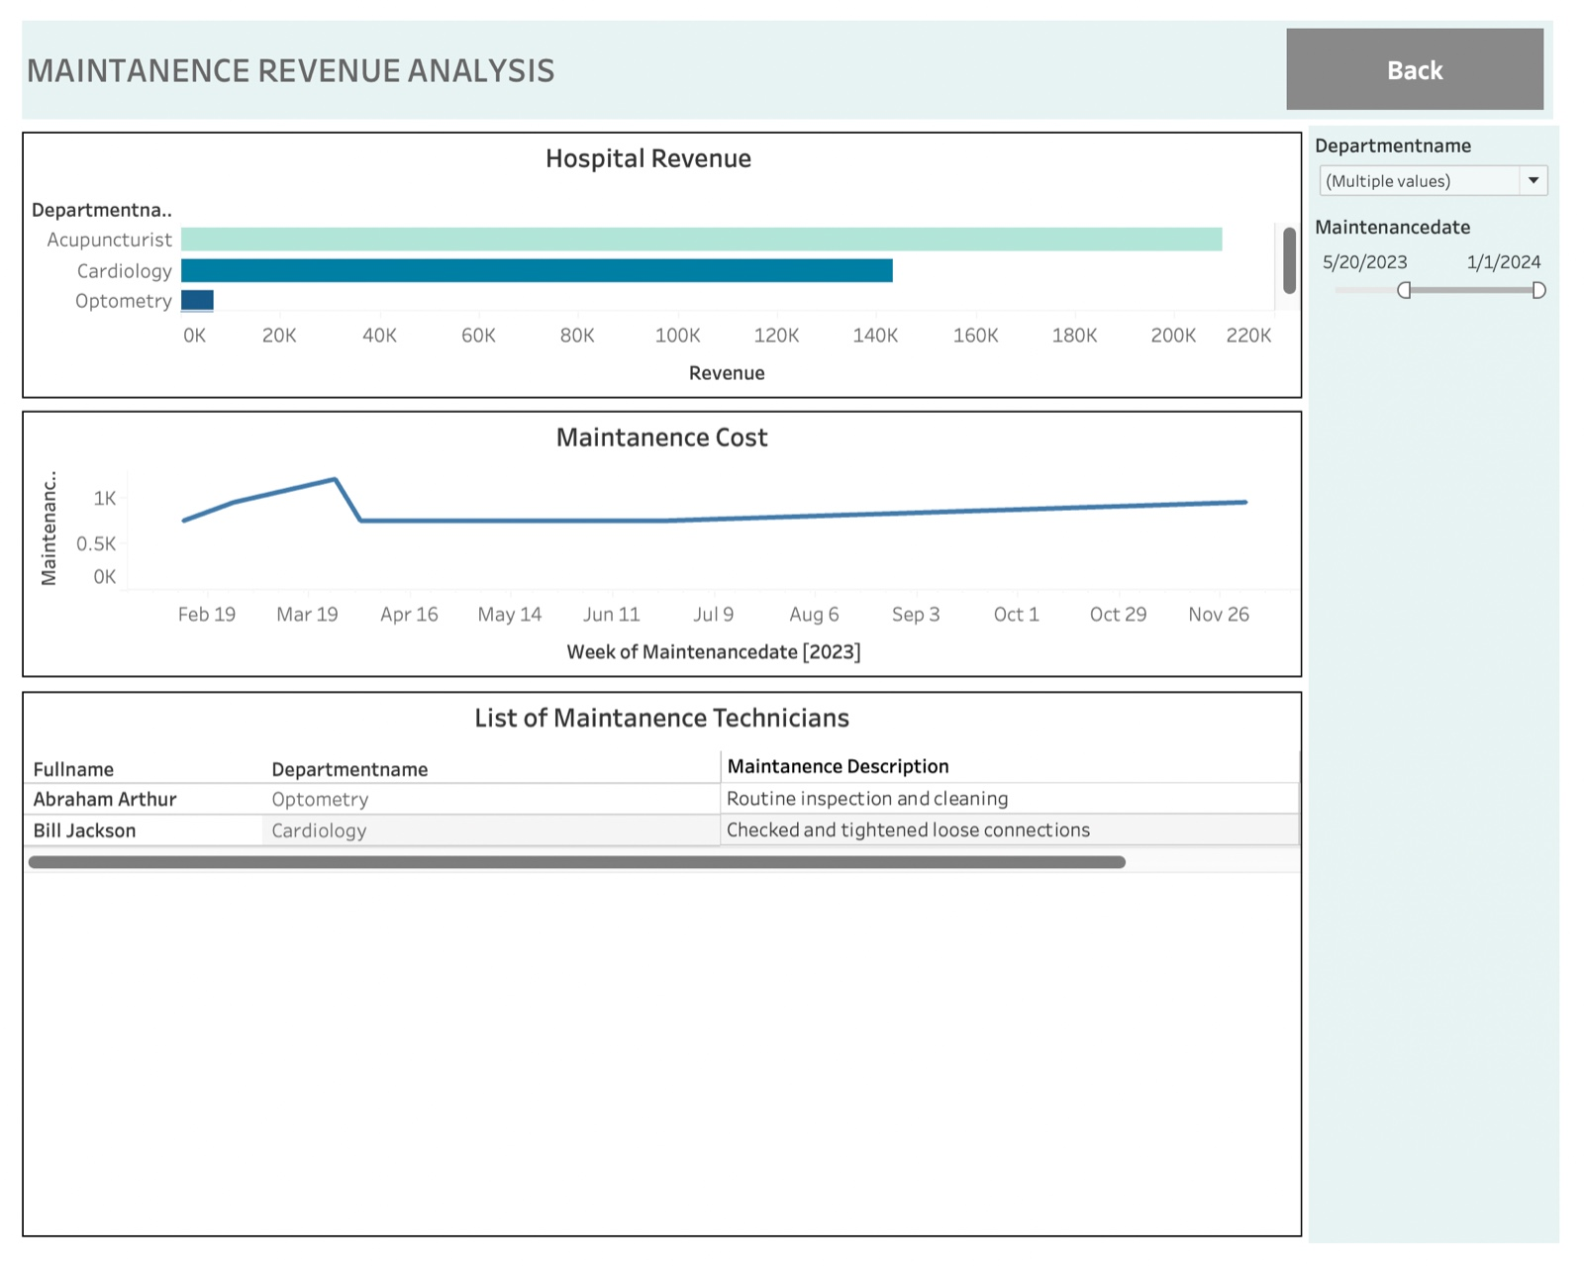
Tableau Dashboard – Maintenance Revenue Analysis

