Slide 1

Group 5Analyzing Retail Sales Data: Uncovering Purchasing Trends and Patterns
Heet Manesh Khatri
Sai Varun Kumar Namburi
Harsh Yogeshbhai Panchal
Madupu Srilekha Reddy
Tejaswi Yaramada

Slide 2
Project Overview
The problem statement for this dataset could be: "To understand customer purchasing behavior and identify trends and patterns in order data from a retail store that sells Men's fashion and Mobile & Tablets.“
The goal of this analysis is to gain insights into customer purchasing patterns, such as the most common payment methods used, the average value of an order, and the distribution of order dates

Slide 3
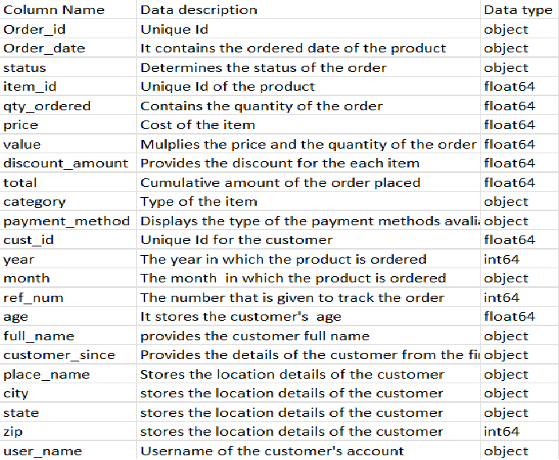
Data Dictionary

Slide 4
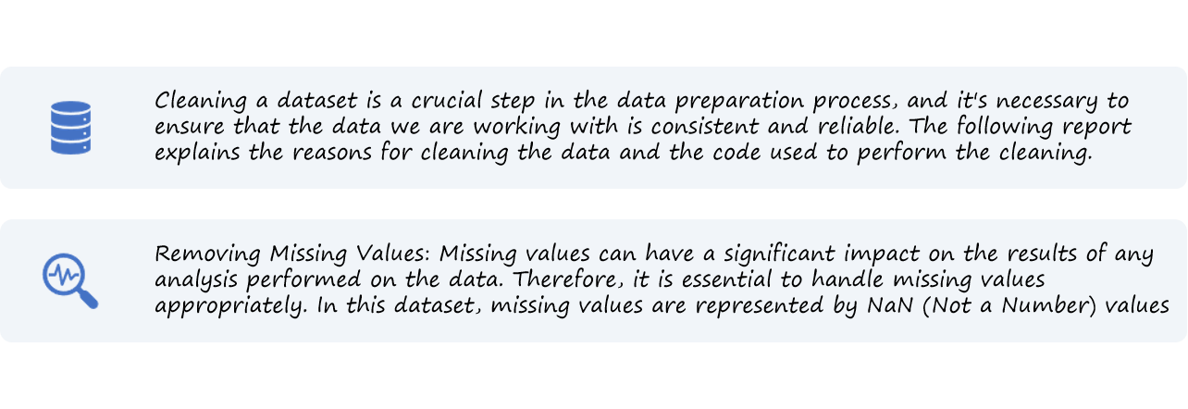

Data Pre-processing:

Slide 5

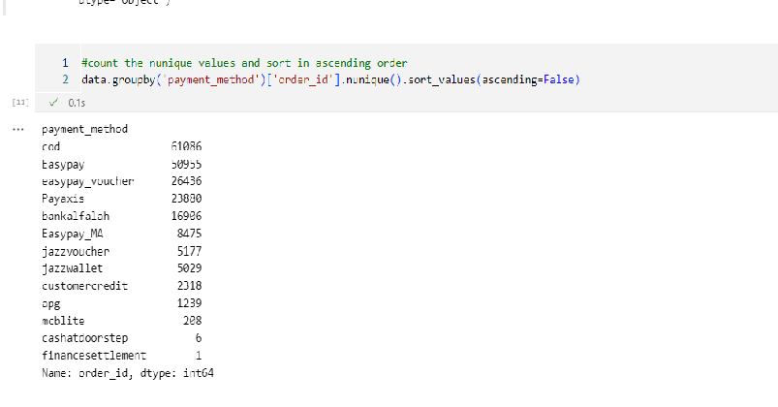
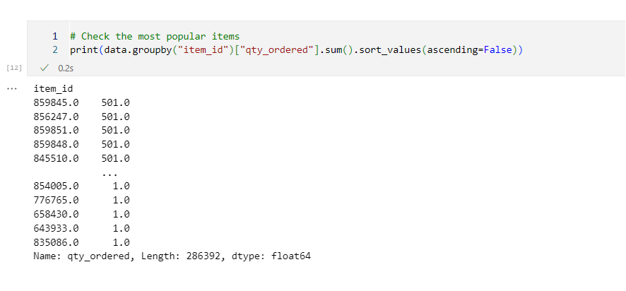
Pre-Processing

Slide 6
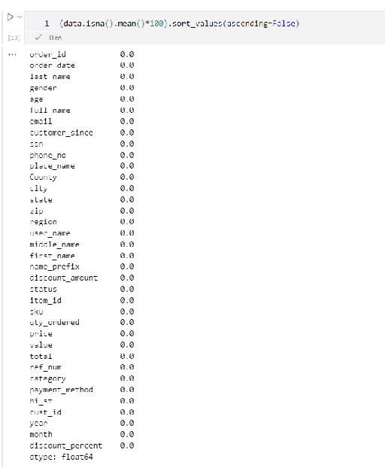
Cleaned Dataset

Slide 7
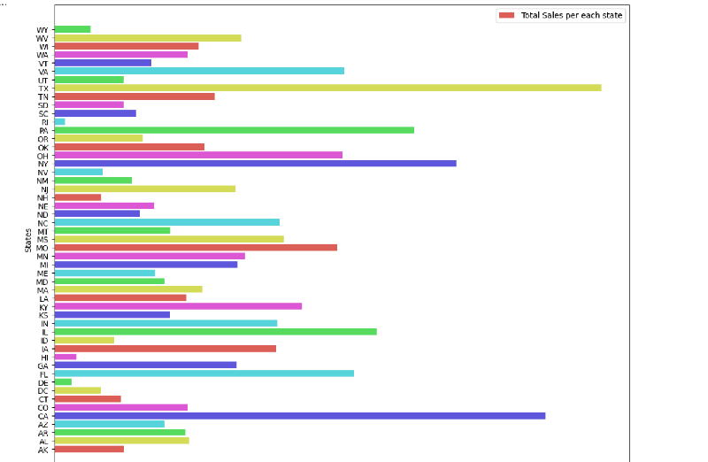
Bar plot : Total sales per each state

Slide 8
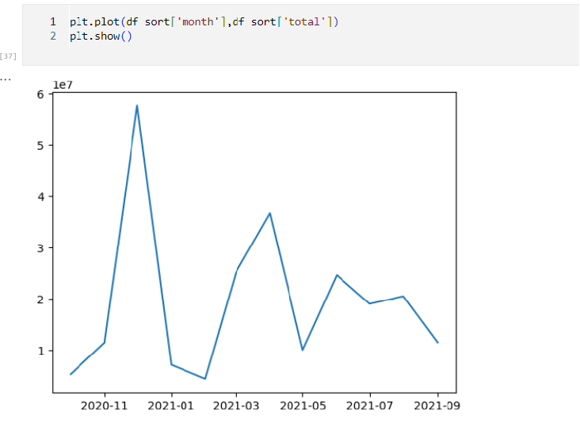
Line plot :Total number of purchases each year

Slide 9
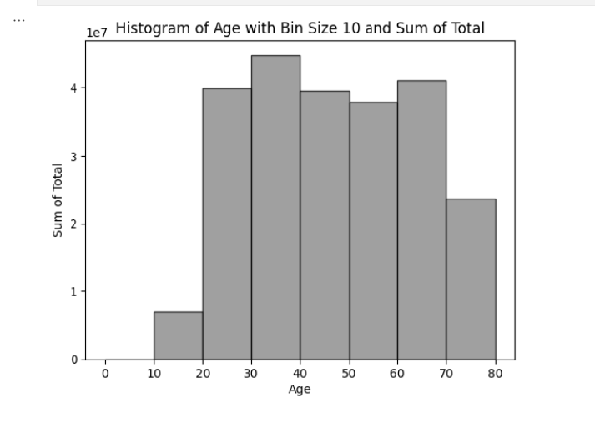
Histogram :

Slide 10
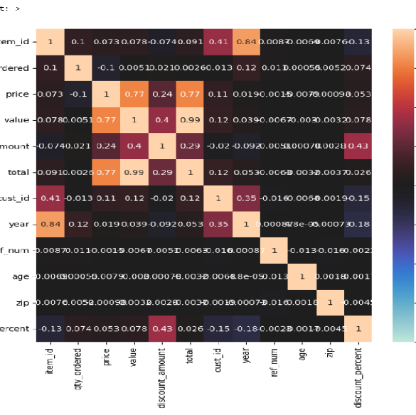
Heatmap :

Slide 11

OBJECTIVE
KNOW YOUR AUDIENCE
RELEVANT DATASET
CHOOSING THE RIGHT ANALYSIS
CHOOSING RIGHT CHARTS FOR DASHBOARD

Slide 12
CUSTOMER ANALYSIS
REVENUE PER STATE
REVENUE BASED ON MONTH OF THE YEAR
REVENUE BASED ON AGE
QUANTITY-DISCOUNT PERCENTAGE CO RELATION
PERCENTAGE OF REVENEU PER REGION
REVENUE PER CATEGORY PER GENDER
BUILDING THE DASHBOARD

Slide 13
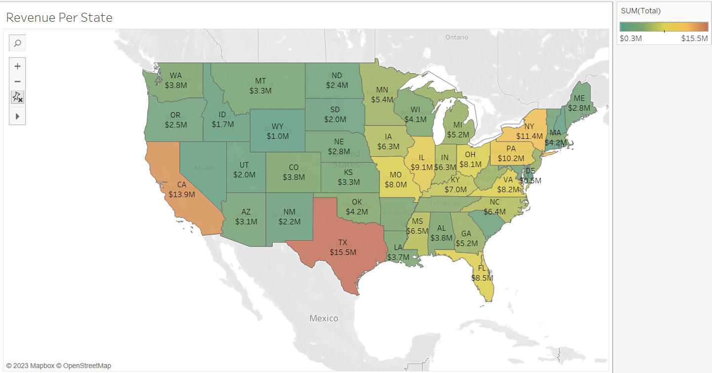
REVENUE PER STATE

Slide 14
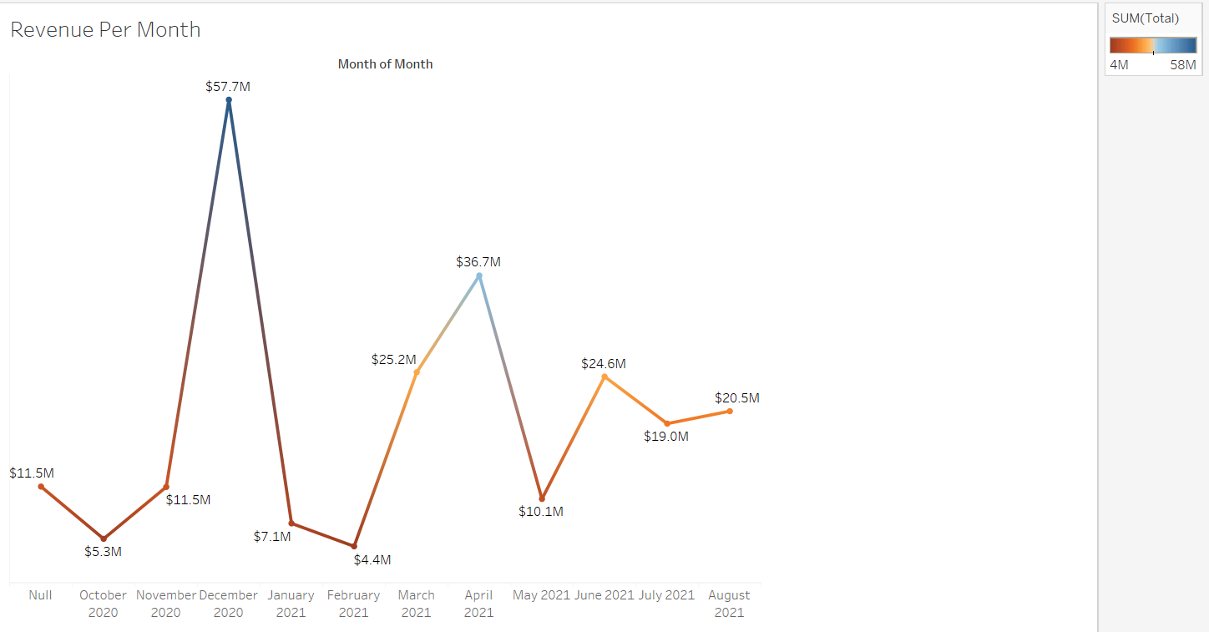
REVENUE BASED ON MONTH OF THE YEAR

Slide 15
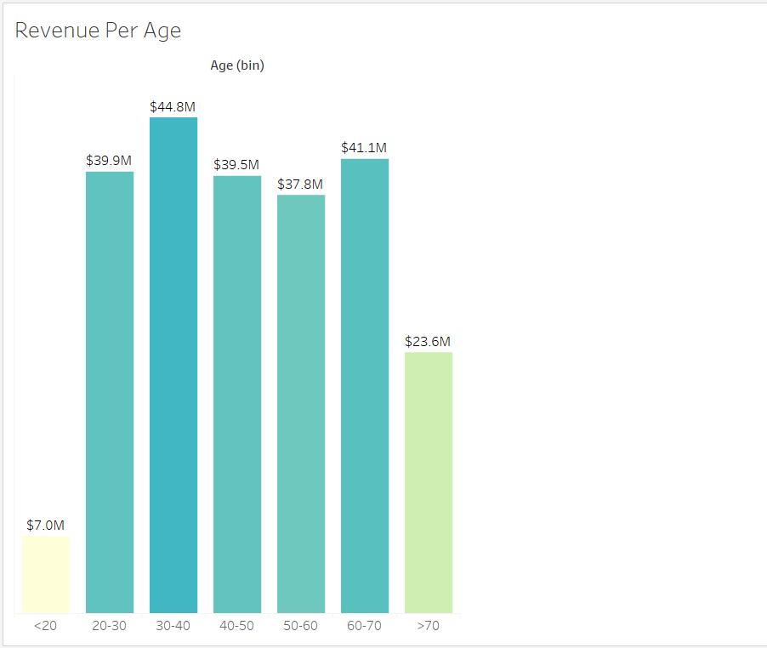
REVENUE BASED ON AGE

Slide 16
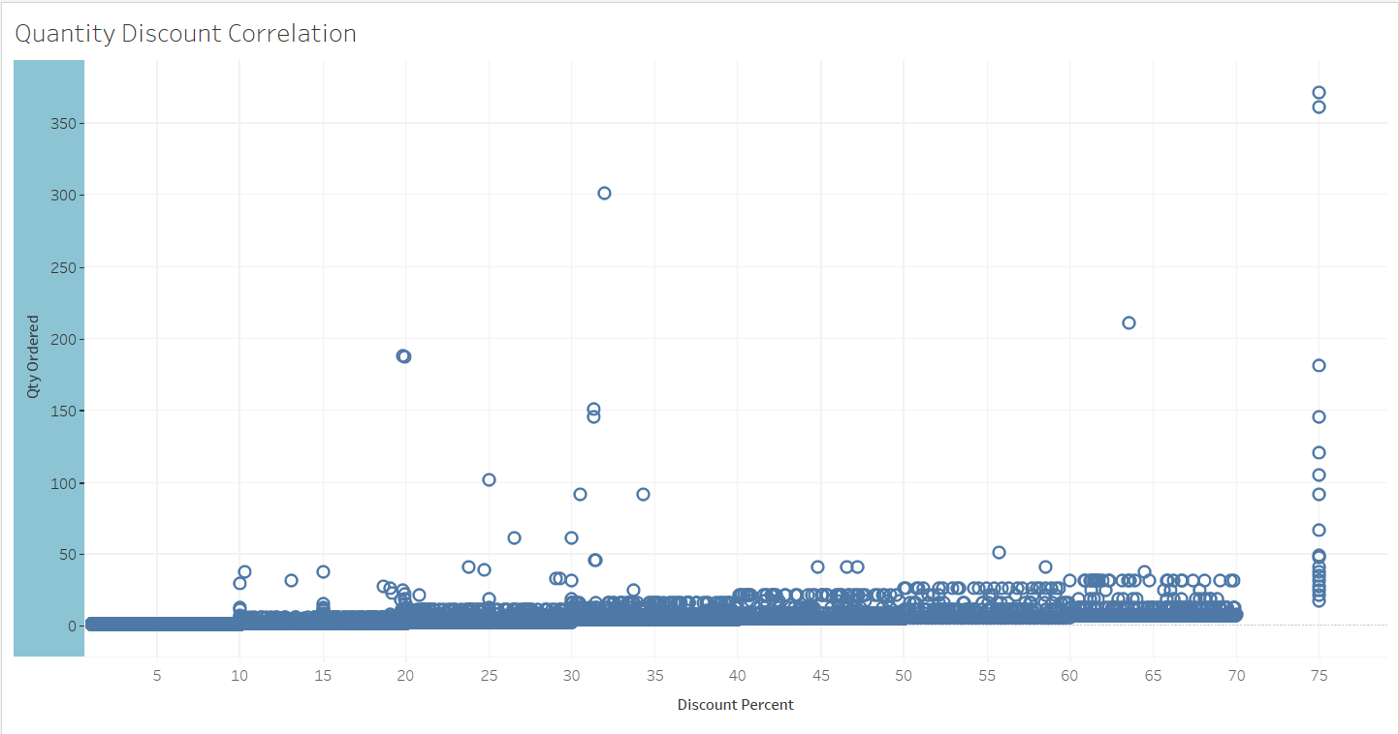
QUANTITY- DISCOUNT PERCENTAGE CO- RELATION

Slide 17
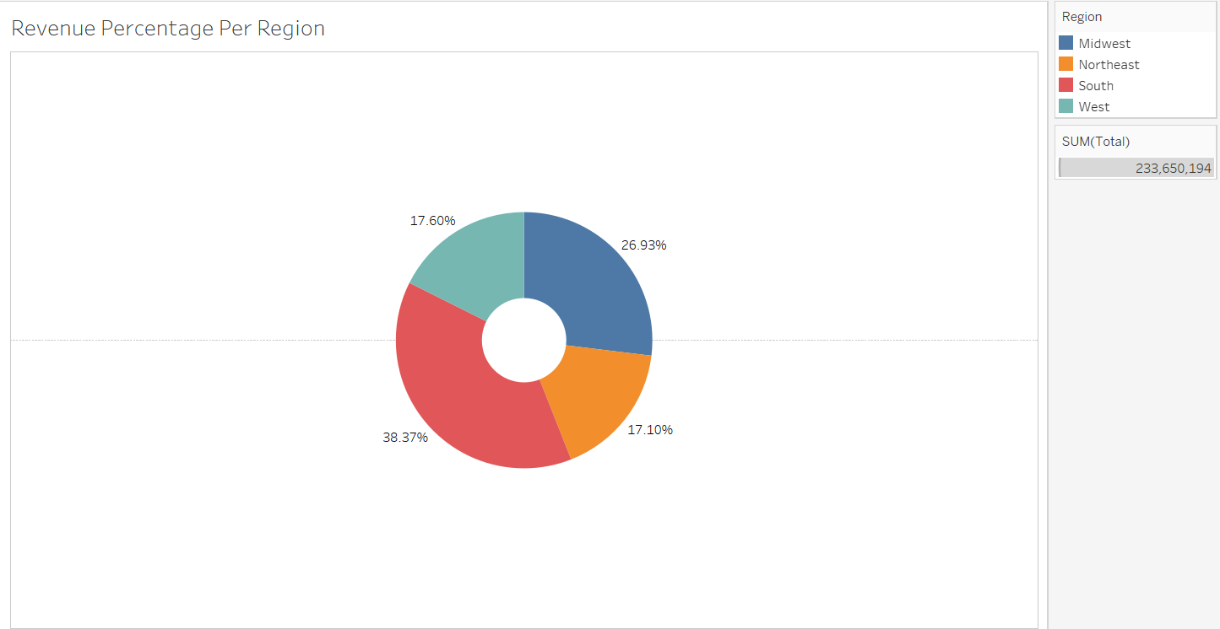
PERCENTAGE OF REVENUE PER REGION

Slide 18
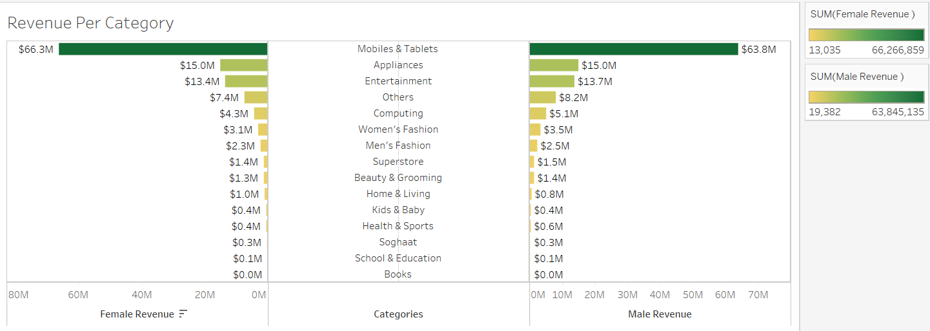
REVENUE PER CATEGORY PER GENDER

Slide 19
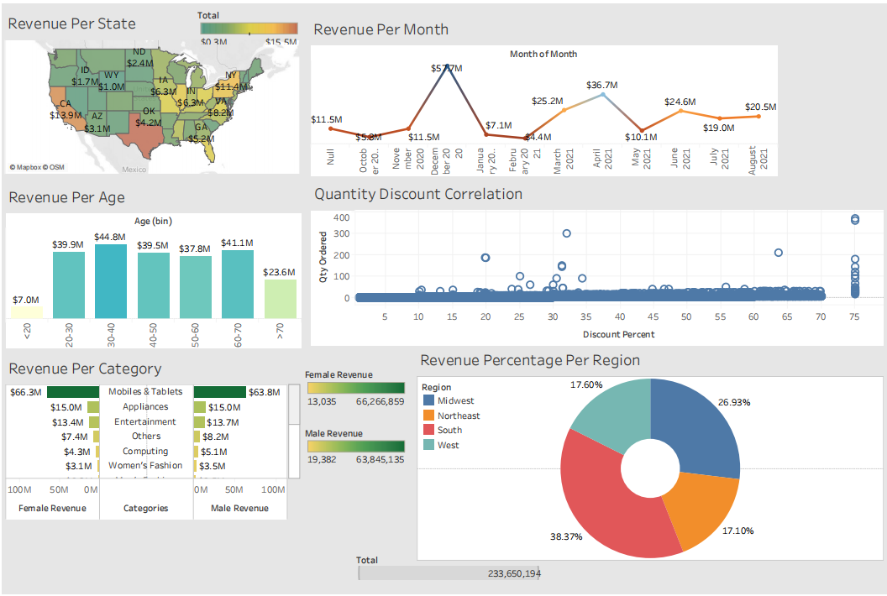
DASHBOARD

Slide 20
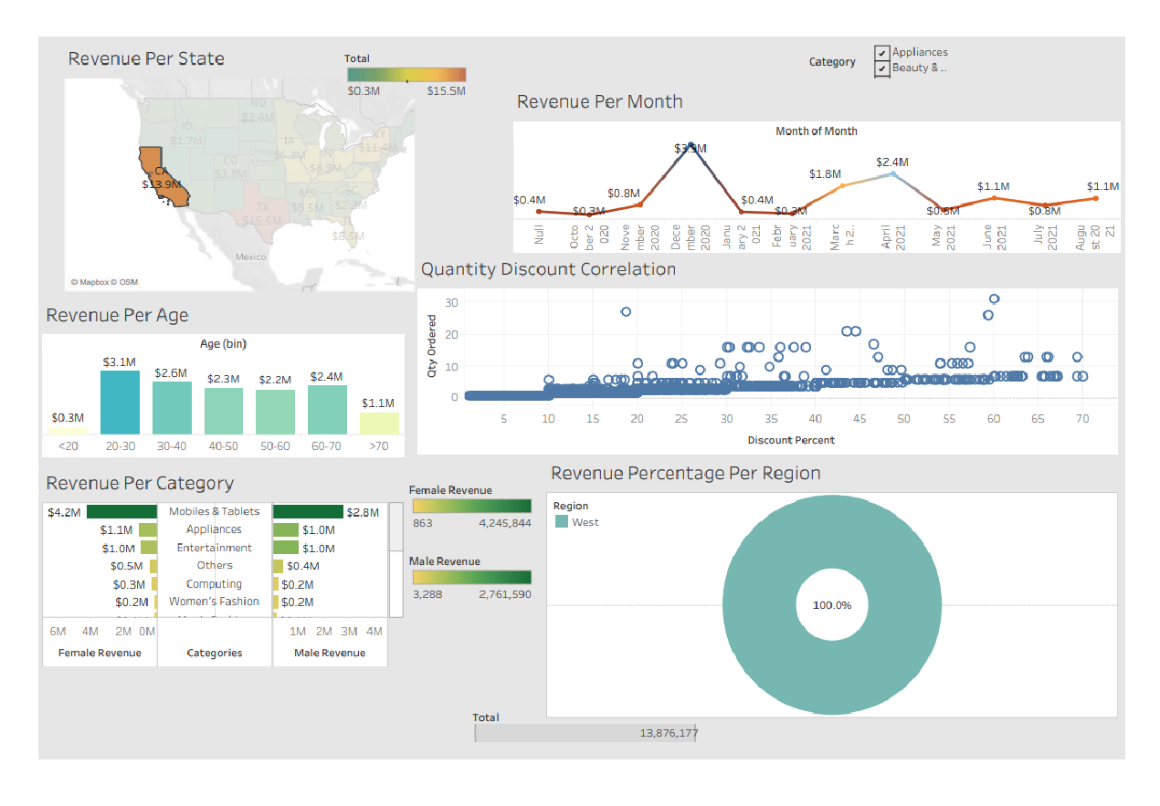

Slide 21
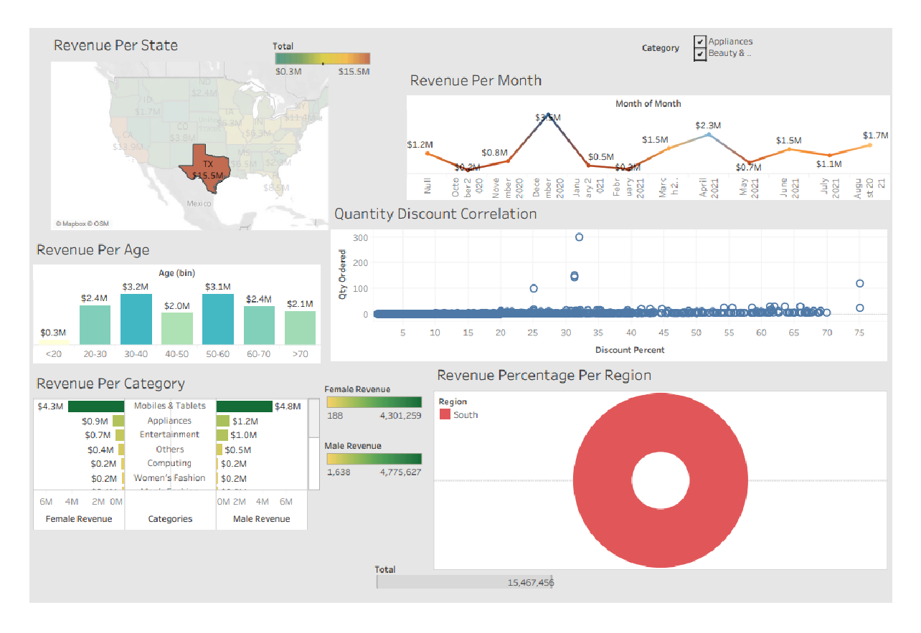

Slide 22
Conclusion:
In conclusion, our analysis of customer data using Tableau has provided valuable insights into our customer base and their behavior. By focusing on key metrics such as total revenue, number of customers, and average order value, we were able to identify trends and patterns that can help us make better business decision

Slide 23

Thank you

