Slide 1
Group 5
Analyzing Retail Sales Data:
Uncovering Purchasing
Trends and Patterns
Heet Manesh Khatri
Sai Varun Kumar Namburi
Harsh Yogeshbhai Panchal
Madupu Srilekha Reddy
Tejaswi Yaramada

Slide 2
Objective
Know your audience
Relevant dataset
Choosing the right dataset
Choosing right charts for dashboard

Slide 3
Project Overview
The problem statement for this dataset could be: "To understand customer purchasing behavior and identify trends and patterns in order data from a retail store that sells Men's fashion and Mobile & Tablets.“
The goal of this analysis is to gain insights into customer purchasing patterns, such as the most common payment methods used, the average value of an order, and the distribution of order dates.

Slide 4
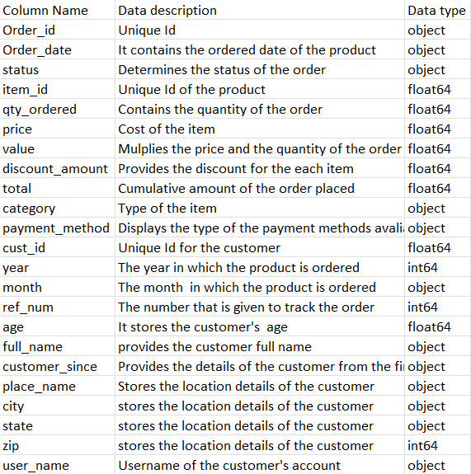
Data Dictionary

Slide 5
Data Pre-processing:
Cleaning a dataset is a crucial step in the data preparation process, and it's necessary to ensure that the data we are working with is consistent and reliable. The following report explains the reasons for cleaning the data and the code used to perform the cleaning.
Removing Missing Values: Missing values can have a significant impact on the results of any analysis performed on the data. Therefore, it is essential to handle missing values appropriately. In this dataset, missing values are represented by NaN (Not a Number) values

Slide 6
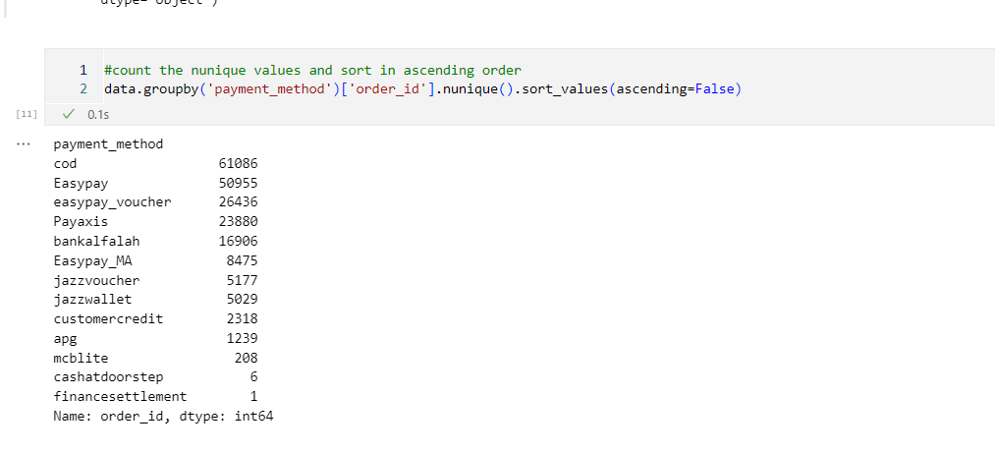
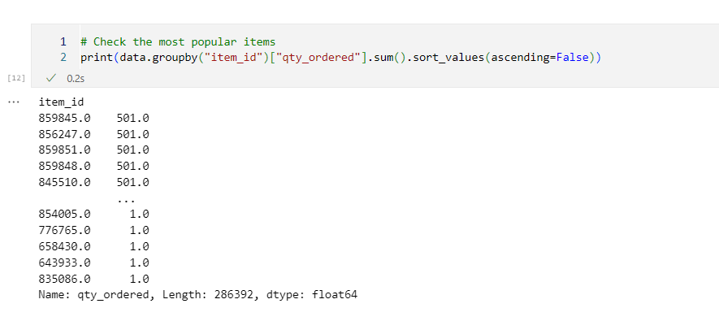
Pre-Processing

Slide 7
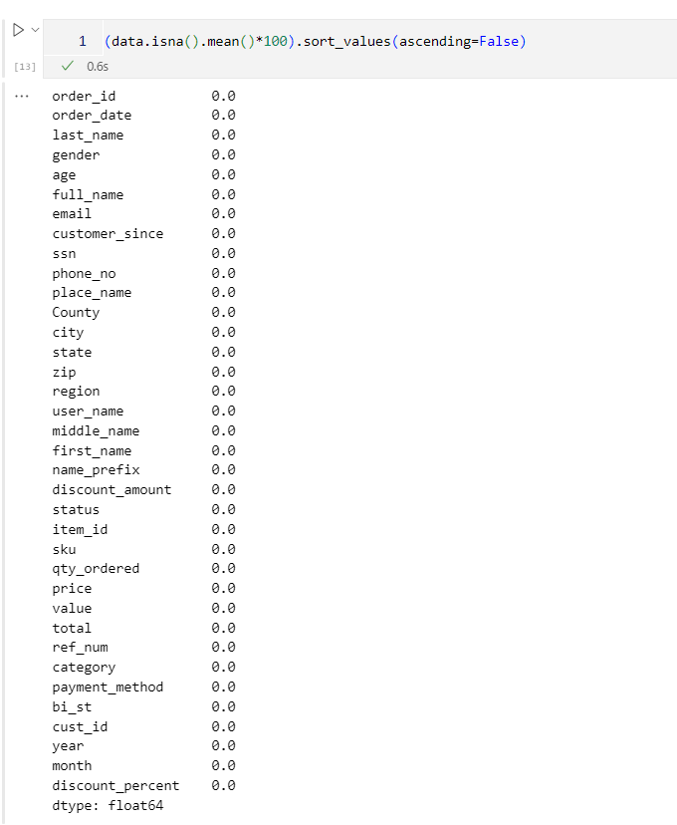
Cleaned Dataset

Slide 8
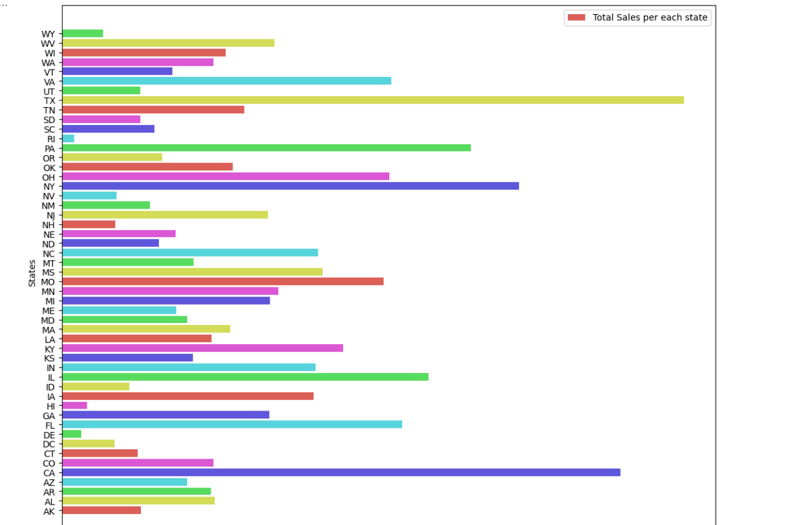
Bar plot :
Total sales per each state

Slide 9
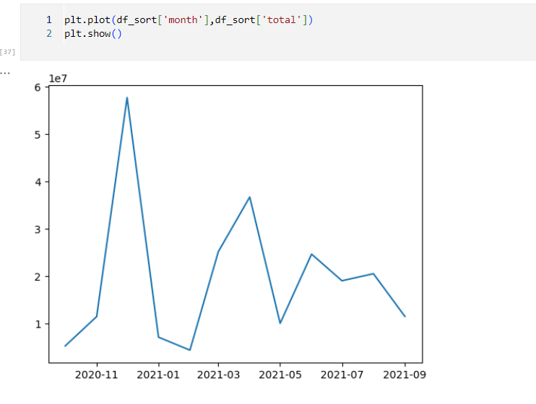
Line plot :
Total number of purchases each year

Slide 10
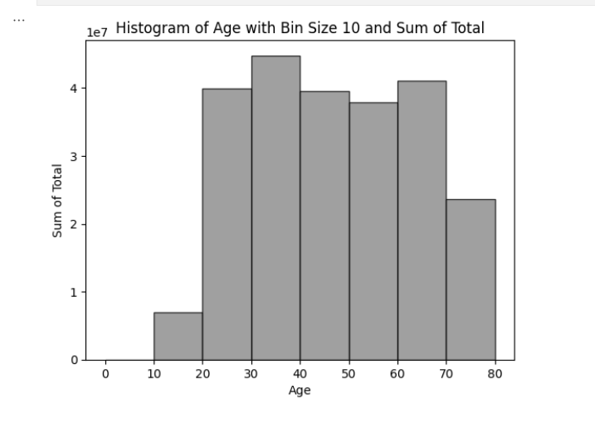
Histogram :

Slide 11
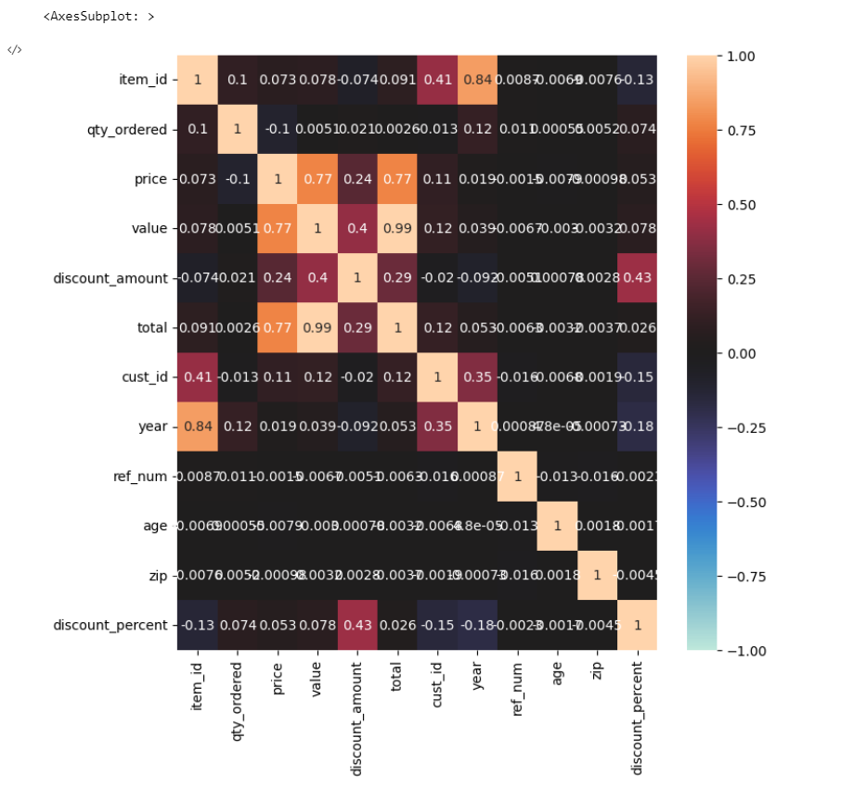
Heatmap :

Slide 12
Customer Analysis
REVENUE PER STATE
REVENUE BASED ON MONTH OF THE YEAR
REVENUE BASED ON AGE
QUANTITY-DISCOUNT PERCENTAGE CO RELATION
PERCENTAGE OF REVENEU PER REGION
REVENUE PER CATEGORY PER GENDER
BUILDING THE DASHBOARD

Slide 13
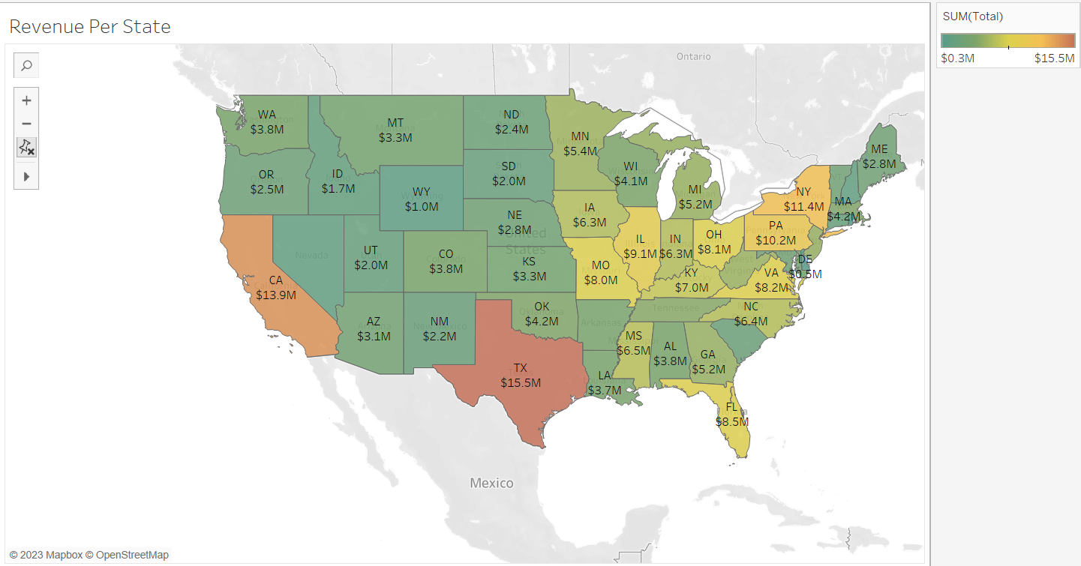
Revenue per State

Slide 14
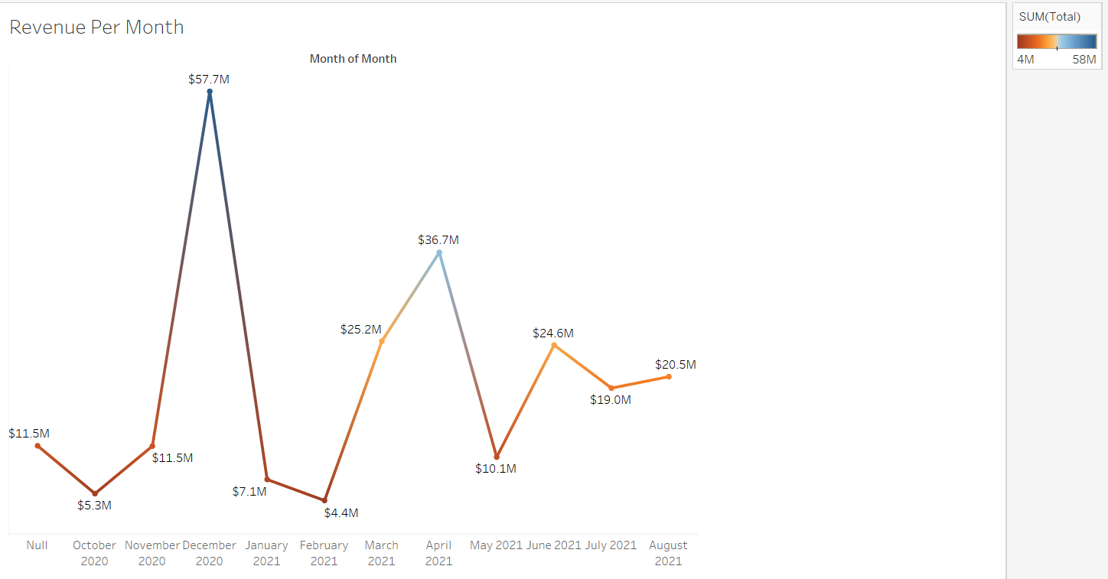
Revenue based on month of the year

Slide 15
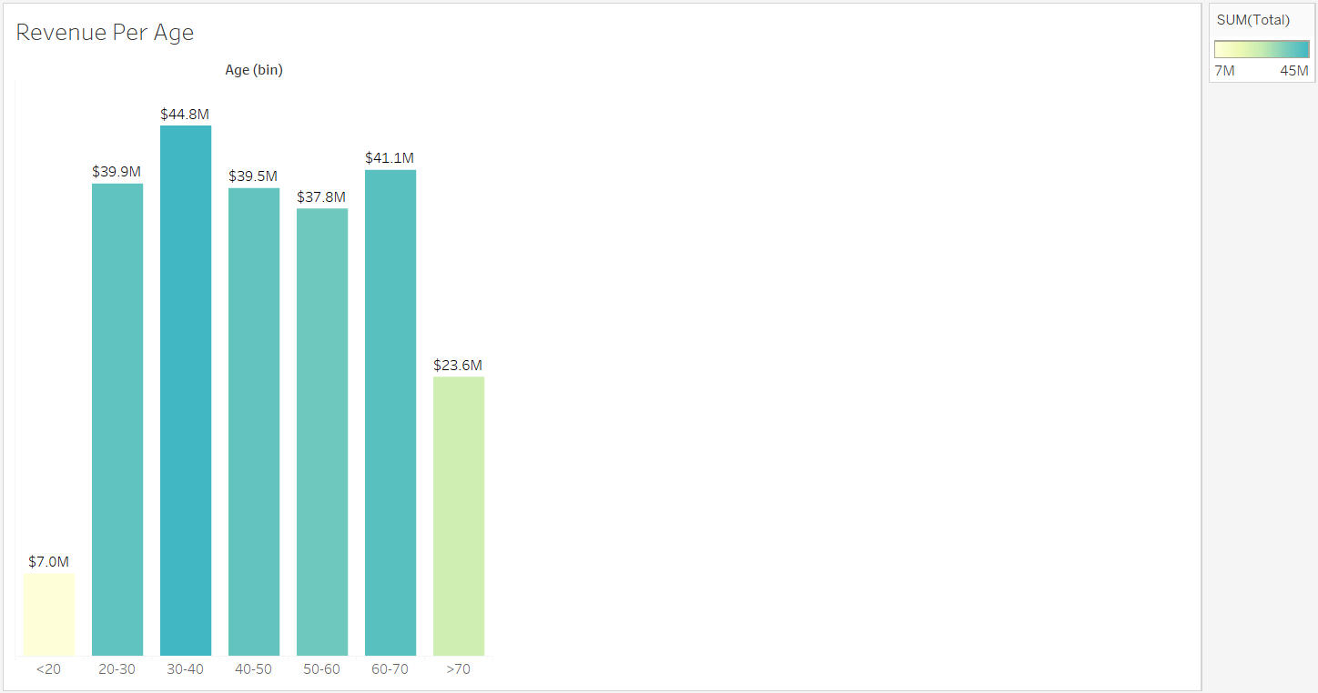
Revenue based on age

Slide 16
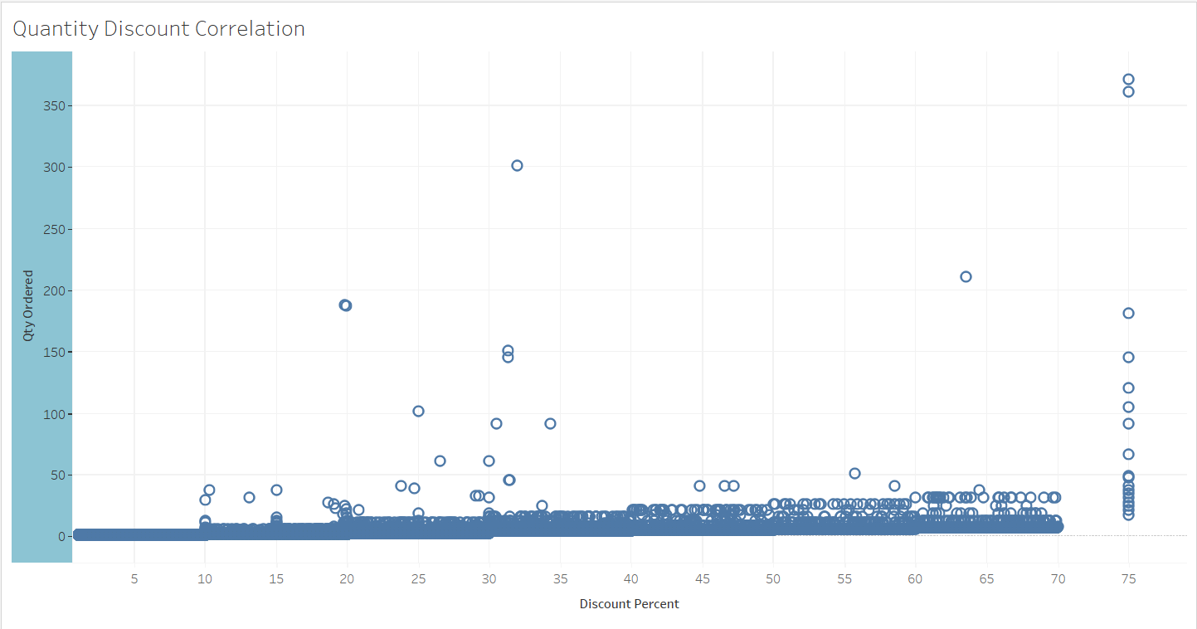
Quantity-Discount Percentage correlation

Slide 17
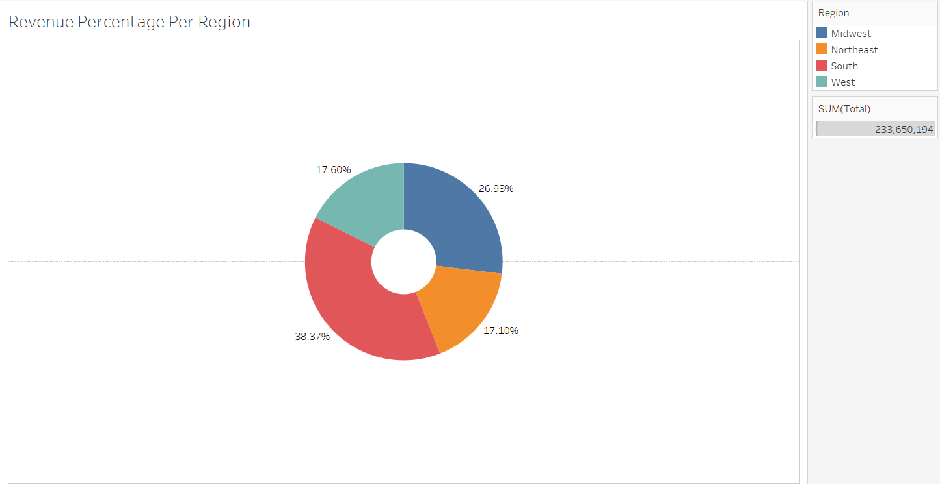
Percentage of Revenue per region

Slide 18
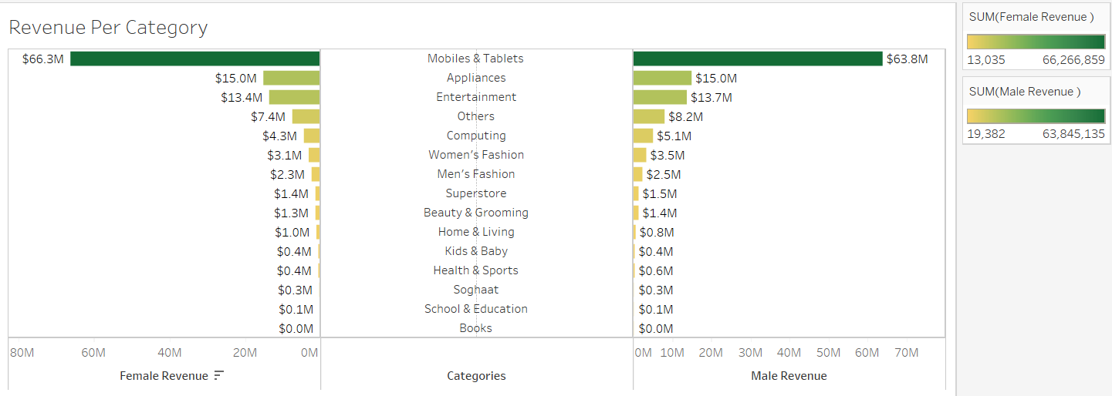
Revenue per category per gender

Slide 19
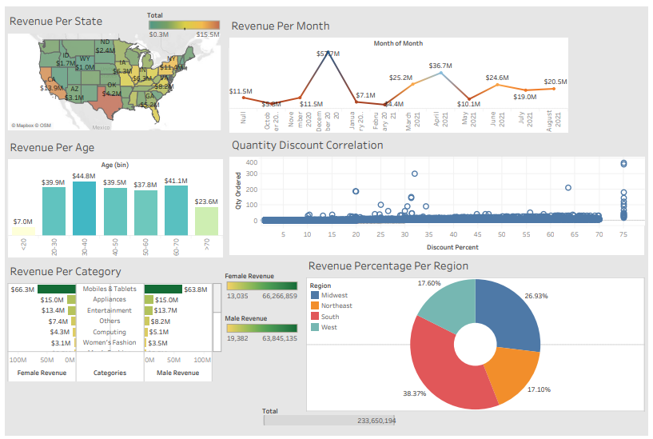
Interactive Dashboard in Tableau

Slide 20
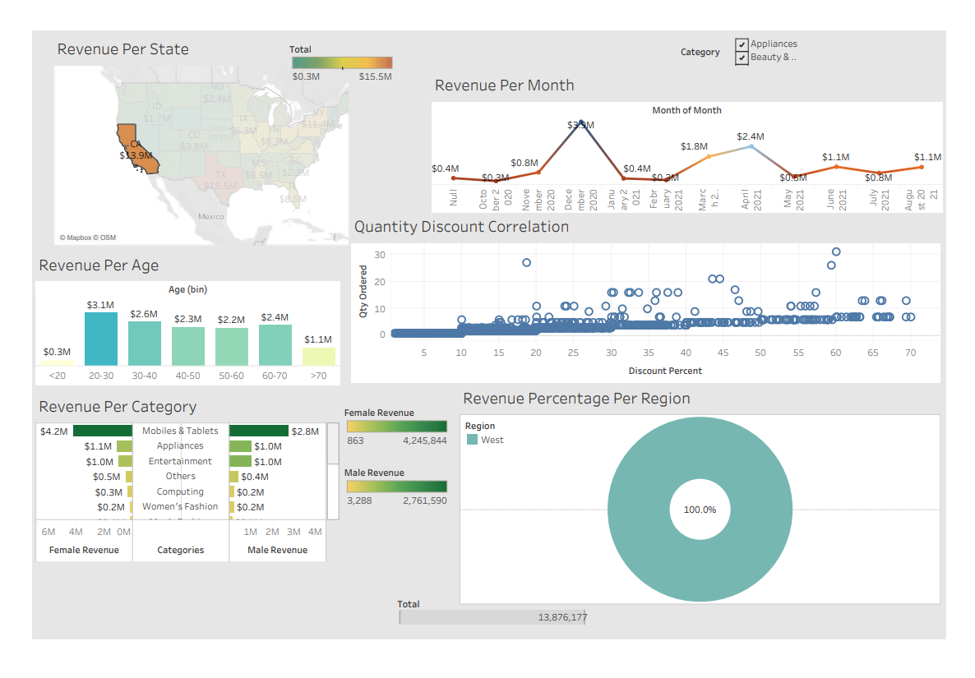

Slide 21
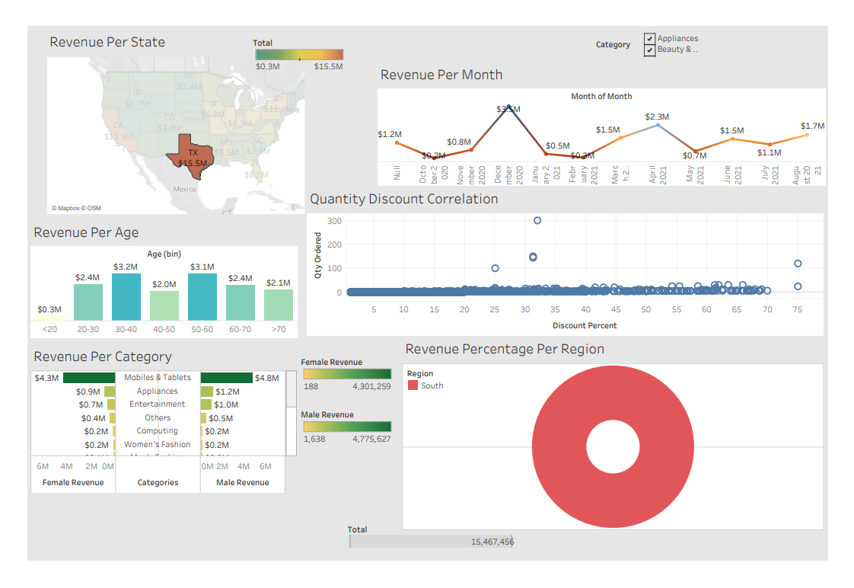

Slide 22
Conclusion :

Slide 23
Thank you

