Slide 1
Analyzing Retail Sales Data: Uncovering Purchasing Trends and Patterns
Heet Manesh Khatri, Sai Varun Kumar Namburi, Harsh Yogeshbhai Panchal, Madupu Srilekha Reddy, Tejaswi Yaramada

Slide 2
Agenda
Project Overview
Introduction
Dataset and Methodology
Expected Results
Timeline

Slide 3
Project Overview
The problem statement for this dataset could be: "To understand customer purchasing behavior and identify trends and patterns in order data from a retail store that sells Men's fashion and Mobile & Tablets.“
The goal of this analysis is to gain insights into customer purchasing patterns, such as the most common payment methods used, the average value of an order, and the distribution of order dates.

Slide 4
Dataset and Methodology
Additionally, the analysis could also identify any trends or patterns in the data that indicate certain items or categories are more popular than others. The findings of this analysis could be used to inform business decisions, such as which products to stock more of or when to run promotional campaigns
Dataset References: https://www.kaggle.com/

Slide 5
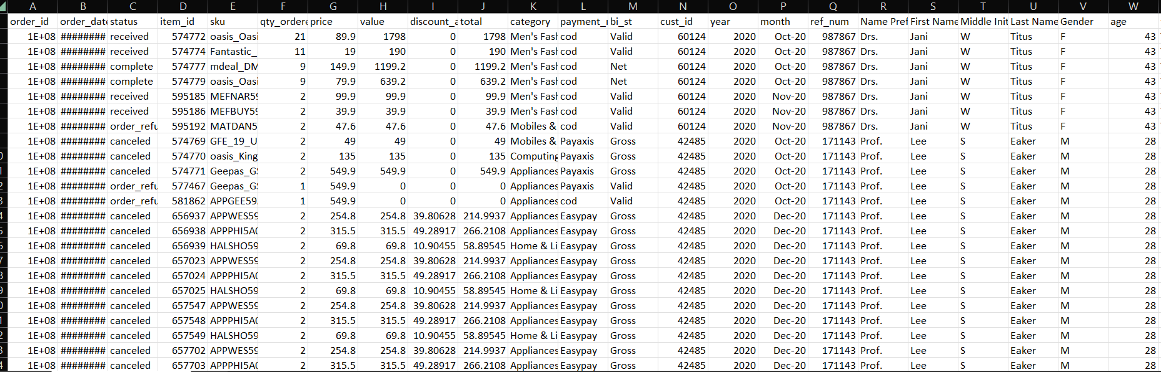
Basic Analysis

Slide 6
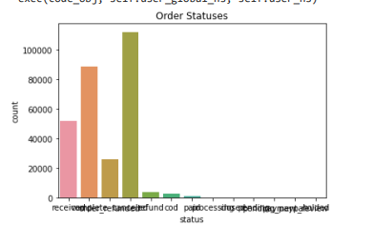
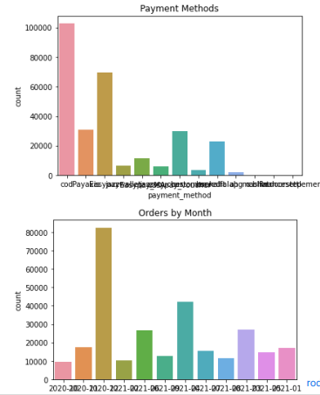
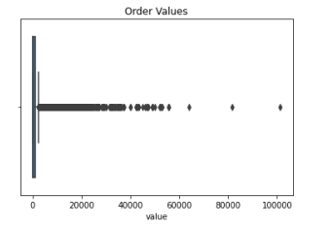
Basic Analysis

Slide 7
Expected Results
Able to find the most popular product from all the sales data
Will be able to predict the browsing behavior of the customer
Trained to estimate the product’s rate of malfunction based on the status of the order.
Capable of forecasting the product's rate of malfunction based on the status of the order

Slide 8
Project Timeline
Presentation(Interactive Dashboards and Final Output)
Jan 2023
Exploration (Finding the Datasets)
1st Half of Feb 2023
Analysis (Cleaning and Preprocessing the data)
2nd Half of Feb 2023
Synthesis (Organize Data and Perform some predictions)
March 2023
Visualization(Connect the datasets to the Tableau Server)
April 2023

Slide 9
Thank you

