Slide 1
Group 5 Analyzing Retail Sales Data: Uncovering Purchasing Trends and Patterns
Heet Manesh Khatri
Sai Varun Kumar Namburi
Harsh Yogeshbhai Panchal
Madupu Srilekha Reddy
Tejaswi Yaramada

Slide 2
Agenda
Project Overview
Data Dictionary
Data Pre-processing
Expected Results
Gantt chart

Slide 3
Project Overview
The problem statement for this dataset could be: "To understand customer purchasing behavior and identify trends and patterns in order data from a retail store that sells Men's fashion and Mobile & Tablets.“
The goal of this analysis is to gain insights into customer purchasing patterns, such as the most common payment methods used, the average value of an order, and the distribution of order dates.

Slide 4
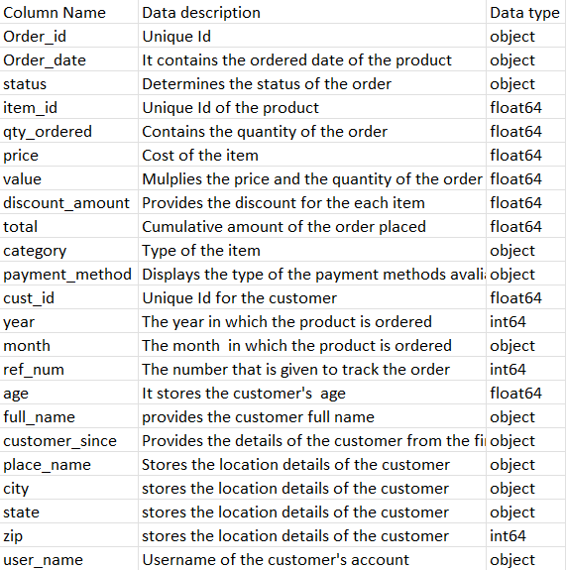
Data Dictionary

Slide 5
Data Pre-processing:
Cleaning a dataset is a crucial step in the data preparation process, and it's necessary to ensure that the data we are working with is consistent and reliable. The following report explains the reasons for cleaning the data and the code used to perform the cleaning.
Removing Missing Values: Missing values can have a significant impact on the results of any analysis performed on the data. Therefore, it is essential to handle missing values appropriately. In this dataset, missing values are represented by NaN (Not a Number) values

Slide 6
Expected Results
Able to find the most popular product from all the sales data
Will be able to predict the browsing behavior of the customer
Trained to estimate the product’s rate of malfunction based on the status of the order.
Capable of forecasting the product's rate of malfunction based on the status of the order

Slide 7
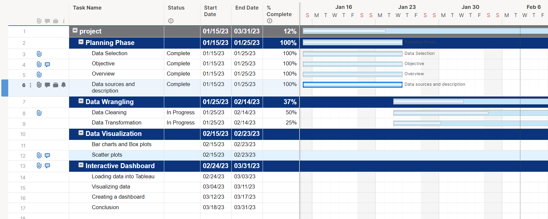
Project Timeline

Slide 8
Thank you

