Slide 1
Group 5 Analyzing Retail Sales Data: Uncovering Purchasing Trends and Patterns
Heet Manesh Khatri
Sai Varun Kumar Namburi
Harsh Yogeshbhai Panchal
Madupu Srilekha Reddy
Tejaswi Yaramada

Slide 2
Agenda
Project Overview
Data Pre-processing
Data Cleaning
Data Visualization
Expected Results

Slide 3
Project Overview
The problem statement for this dataset could be: "To understand customer purchasing behavior and identify trends and patterns in order data from a retail store that sells Men's fashion and Mobile & Tablets.“
The goal of this analysis is to gain insights into customer purchasing patterns, such as the most common payment methods used, the average value of an order, and the distribution of order dates.

Slide 4
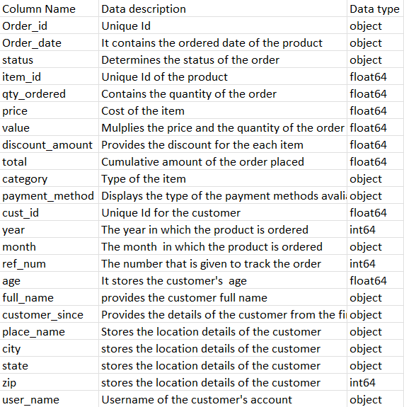
Data Pre-Processing

Slide 5
Data Pre-processing:
Cleaning a dataset is a crucial step in the data preparation process, and it's necessary to ensure that the data we are working with is consistent and reliable. The following report explains the reasons for cleaning the data and the code used to perform the cleaning.
Removing Missing Values: Missing values can have a significant impact on the results of any analysis performed on the data. Therefore, it is essential to handle missing values appropriately. In this dataset, missing values are represented by NaN (Not a Number) values

Slide 6
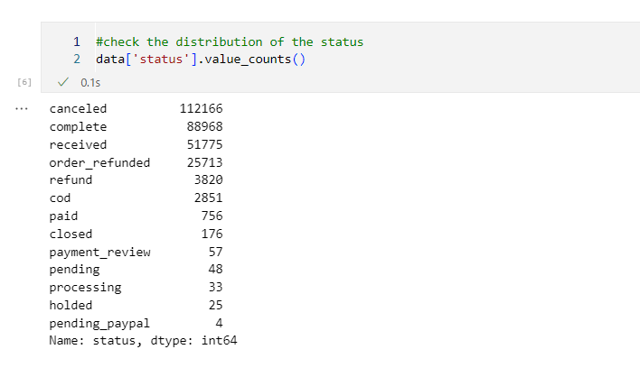
Pre-Processing

Slide 7
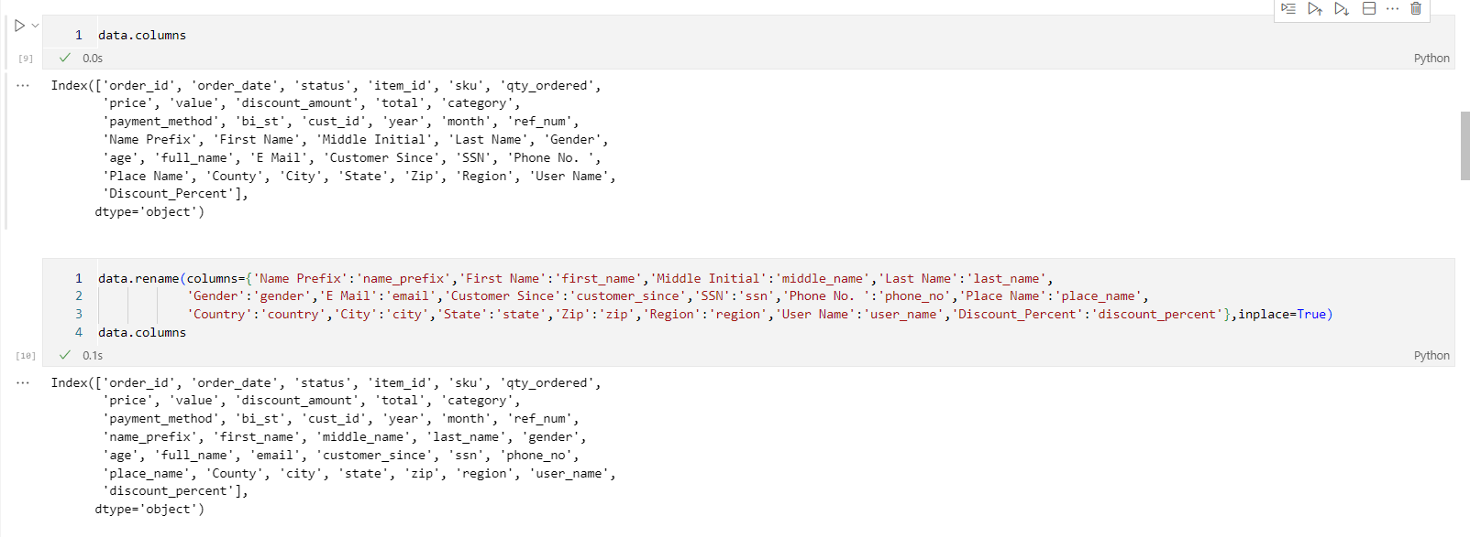
Pre-Processing

Slide 8
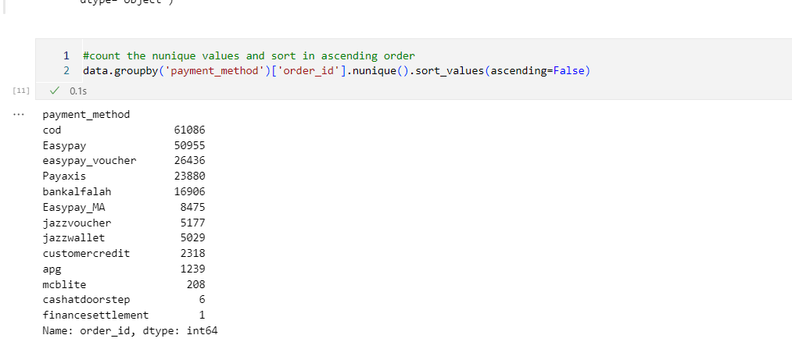
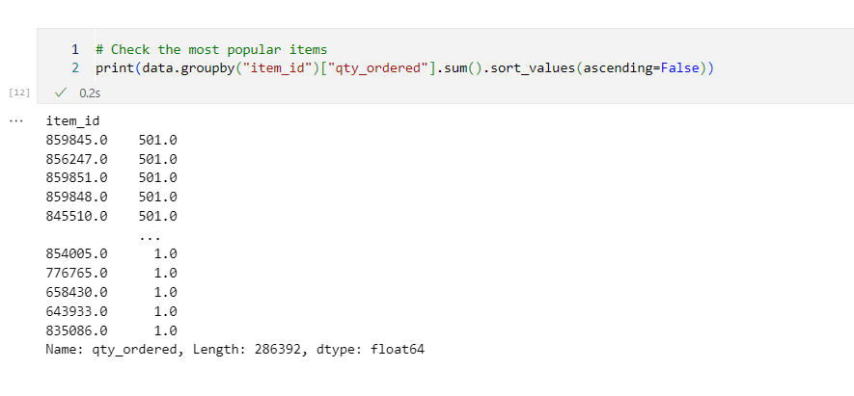
Pre-Processing

Slide 9
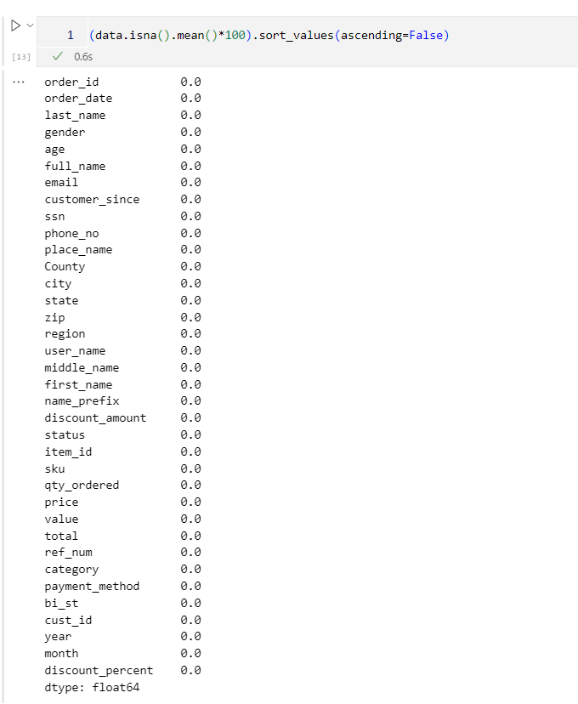
Cleaned Dataset

Slide 10
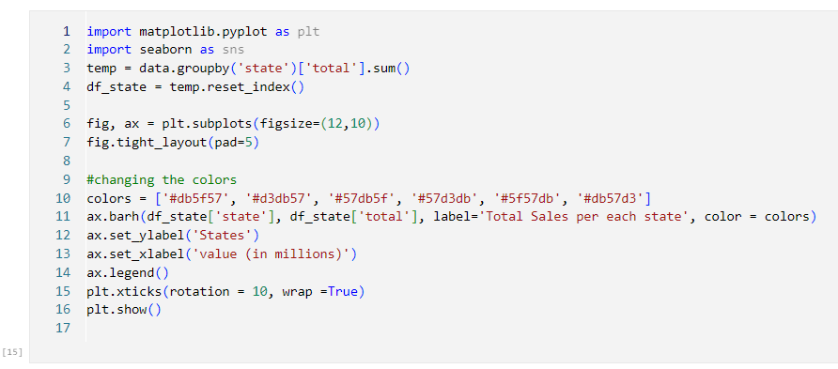
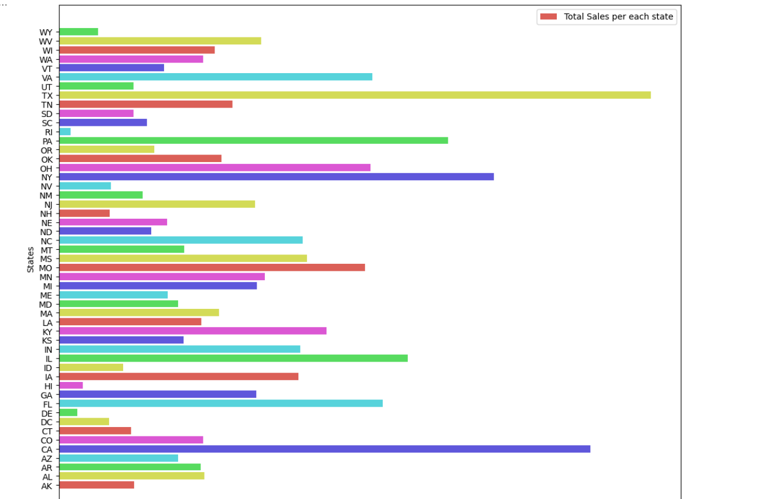
Data Visualization

Slide 11
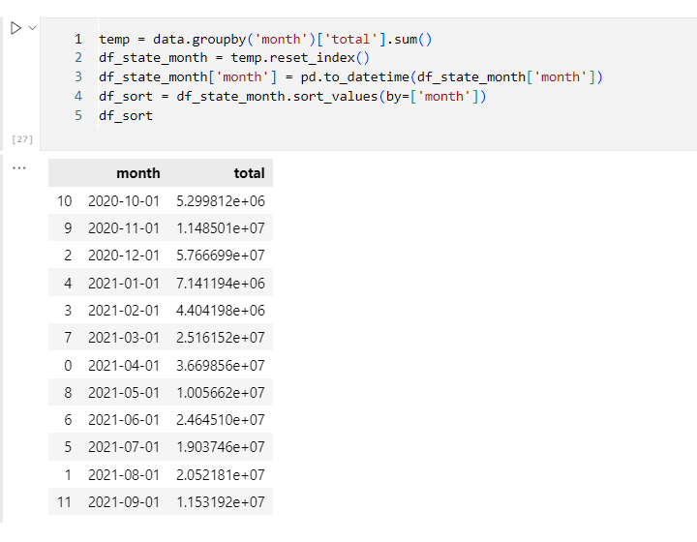
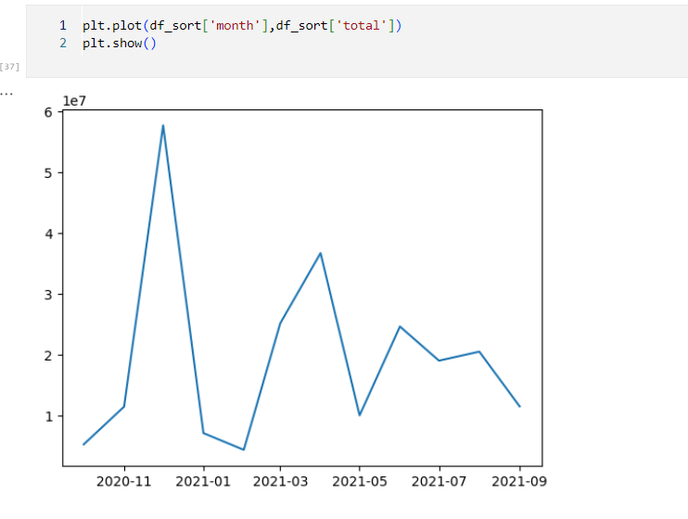
Data Visualization

Slide 12
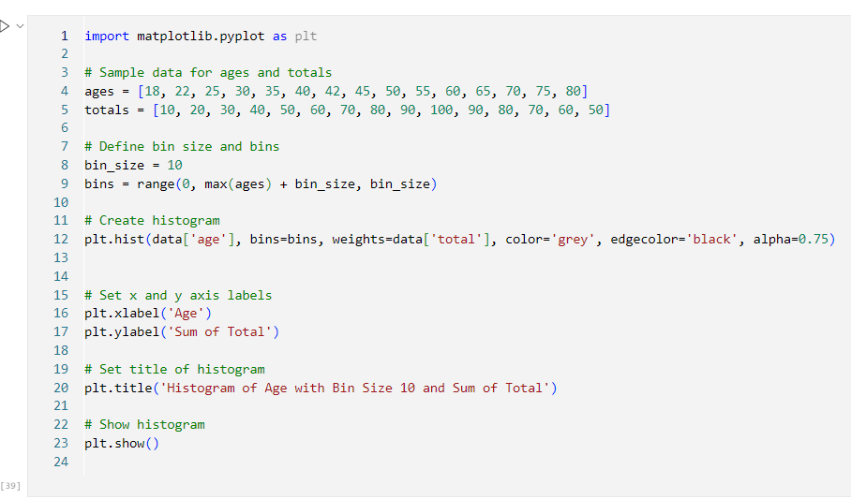
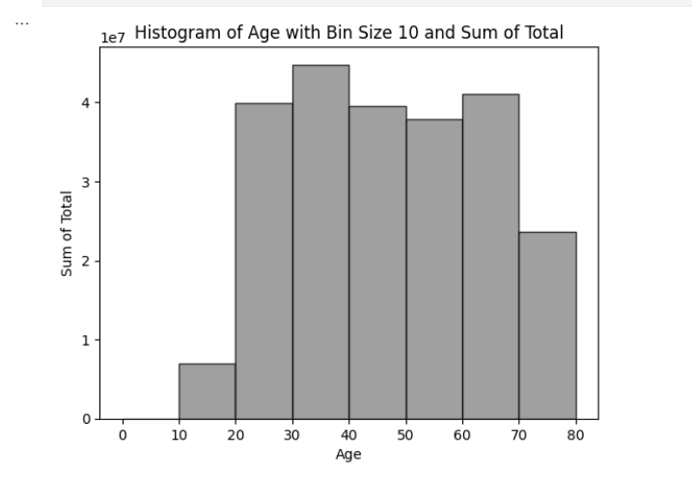
Data Visualization

Slide 13
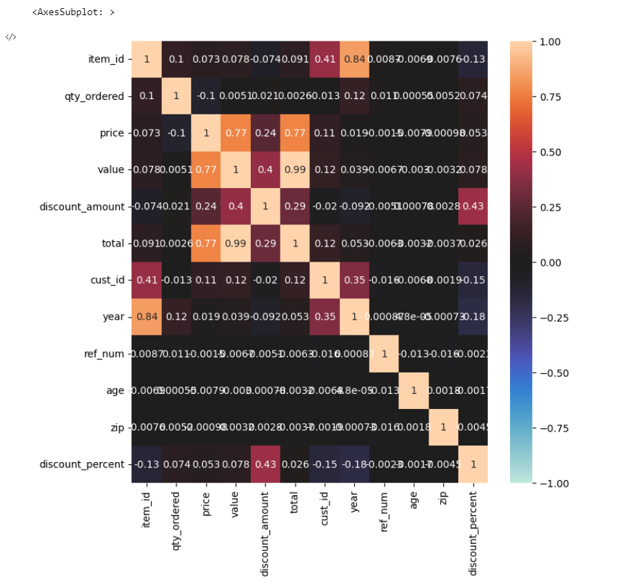
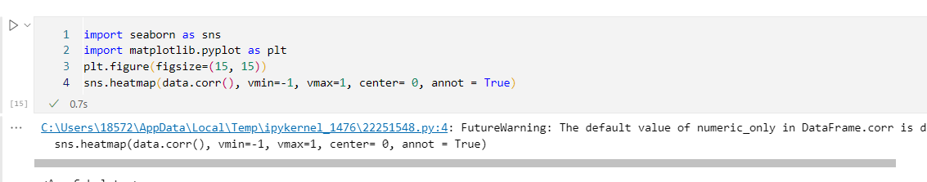
Data Visualization

Slide 14
Thank you

