Slide 1

Group 5 Analyzing Retail Sales Data: Uncovering Purchasing Trends and Patterns
Heet Manesh Khatri
Sai Varun Kumar Namburi
Harsh Yogeshbhai Panchal
Madupu Srilekha Reddy
Tejaswi Yaramada

Slide 2

OBJECTIVE
KNOW YOUR AUDIENCE
RELEVANT DATASET
CHOOSING THE RIGHT ANALYSIS
CHOOSING RIGHT CHARTS FOR DASHBOARD

Slide 3
Project Overview
The problem statement for this dataset could be: "To understand customer purchasing behavior and identify trends and patterns in order data from a retail store that sells Men's fashion and Mobile & Tablets.“
The goal of this analysis is to gain insights into customer purchasing patterns, such as the most common payment methods used, the average value of an order, and the distribution of order dates

Slide 4
Dataset
The provided data is a transactional dataset capturing online customer purchases. It contains information on order ID, order date, item ID, SKU, quantity ordered, price, payment method, and customer information like name, gender, age, email, etc. Additionally, the data includes information on the order's status, such as received, complete, canceled, and order refunded, which can help to identify potential issues in the purchasing process.
Moreover, the data includes details on the item categories purchased, allowing for the identification of popular items and trends among customers. The dataset can be used for various purposes, such as analyzing customer purchase behavior, identifying the most popular products, and understanding payment preferences.
By analyzing this data, businesses can gain insights into the shopping preferences of their customers, optimize their sales strategy, and improve customer satisfaction. For example, businesses can identify which products sell better during certain times of the year, which payment methods are preferred, and which marketing strategies are most effective.

Slide 5
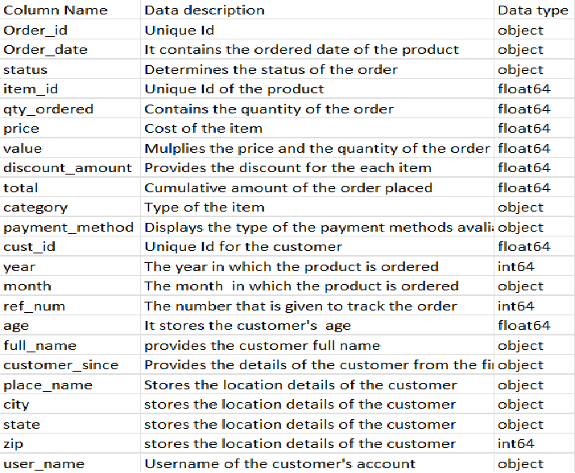
Data Dictionary

Slide 6
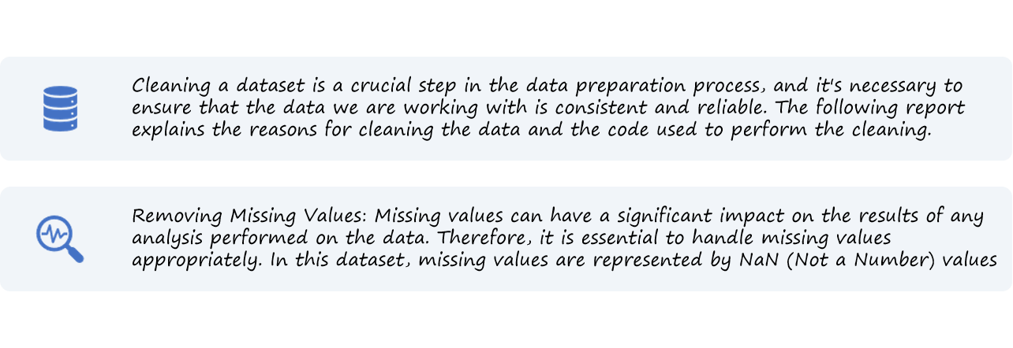
Data Pre-processing:

Slide 7

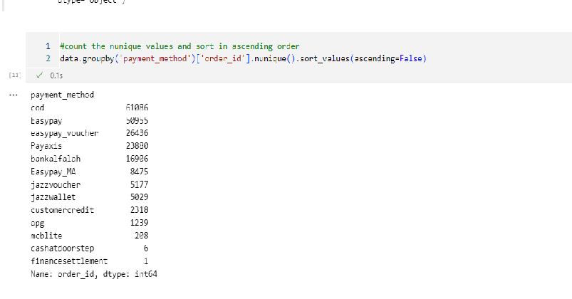
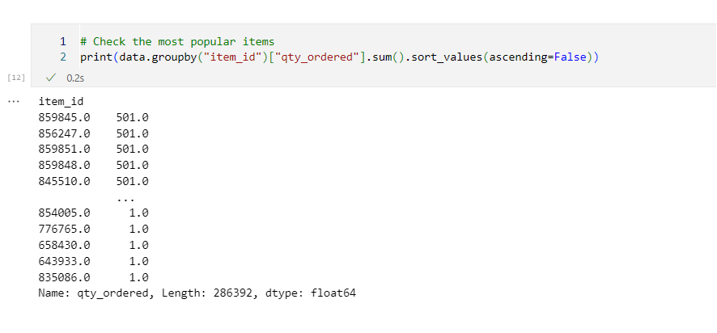
Pre-Processing

Slide 8
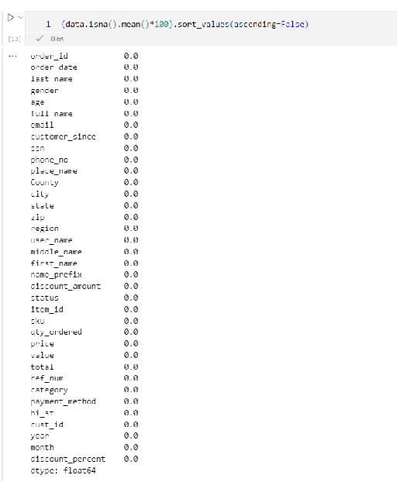
Cleaned Dataset

Slide 9
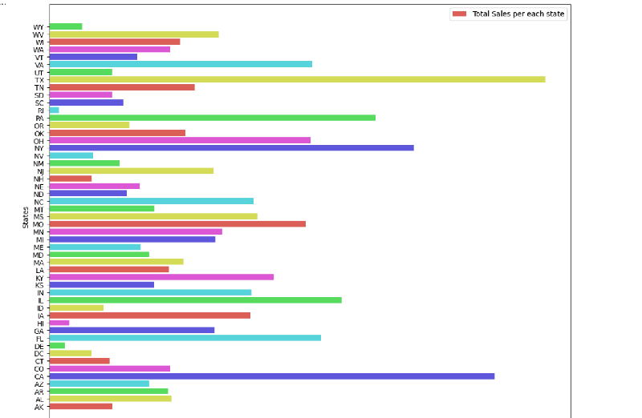
Bar plot : Total sales per each state

Slide 10
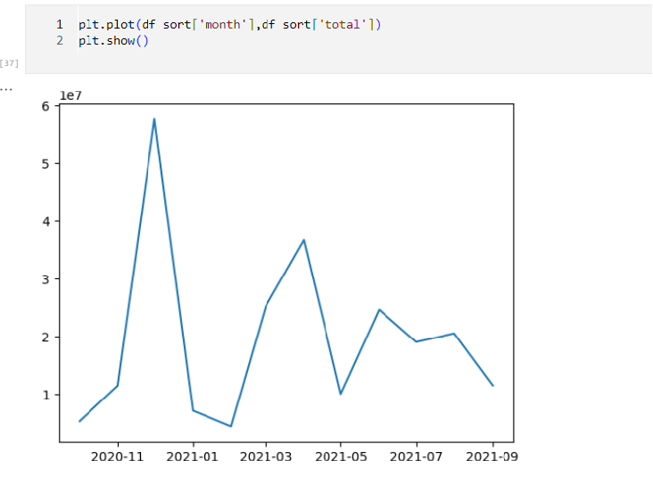
Line plot :Total number of purchases each year

Slide 11
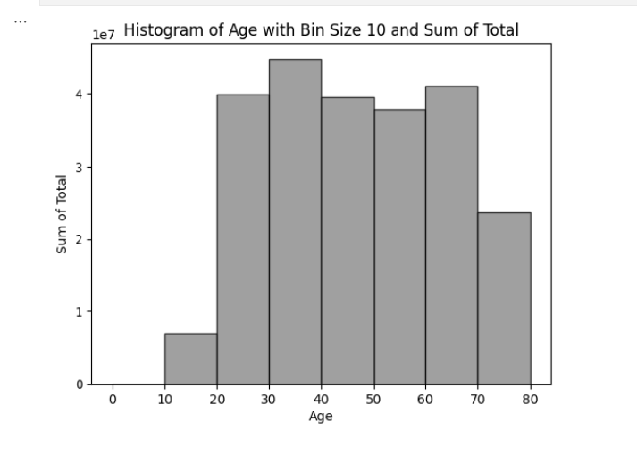
Histogram :

Slide 12
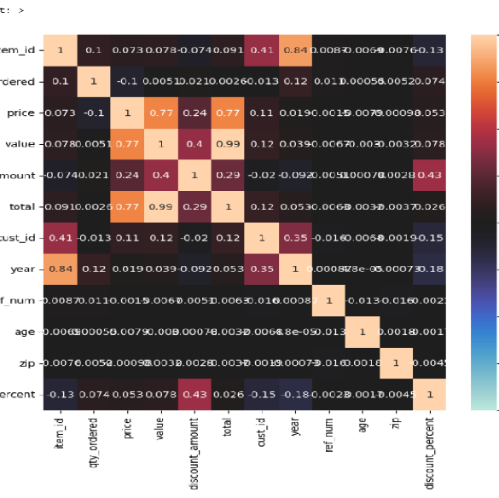
Heatmap :

Slide 13
CUSTOMER ANALYSIS
REVENUE PER STATE
REVENUE BASED ON MONTH OF THE YEAR
REVENUE BASED ON AGE
QUANTITY-DISCOUNT PERCENTAGE CO RELATION
PERCENTAGE OF REVENEU PER REGION
REVENUE PER CATEGORY PER GENDER
BUILDING THE DASHBOARD

Slide 14
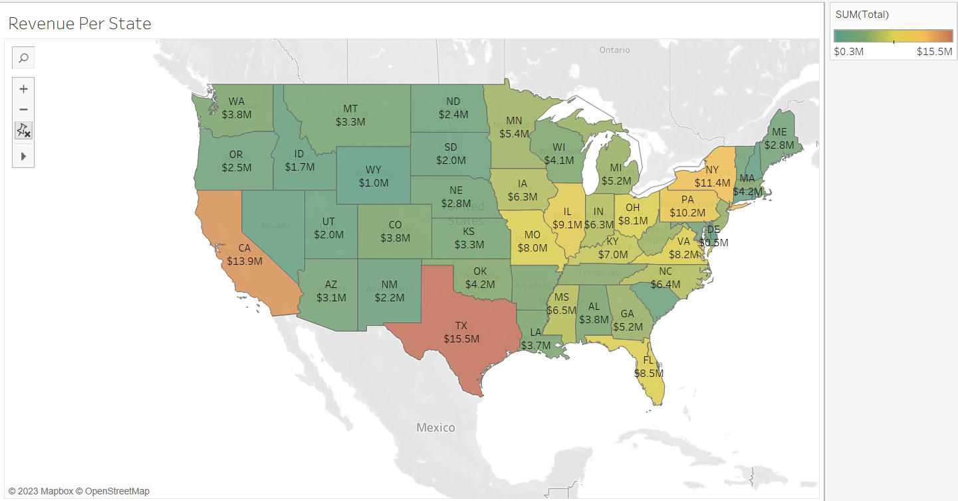
REVENUE PER STATE

Slide 15
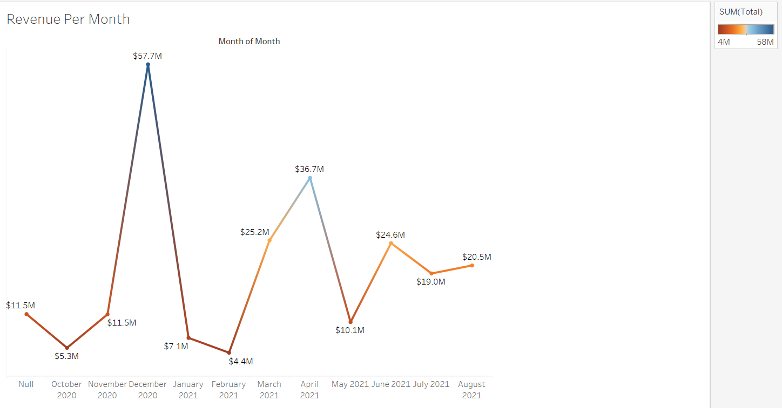
REVENUE BASED ON MONTH OF THE YEAR

Slide 16
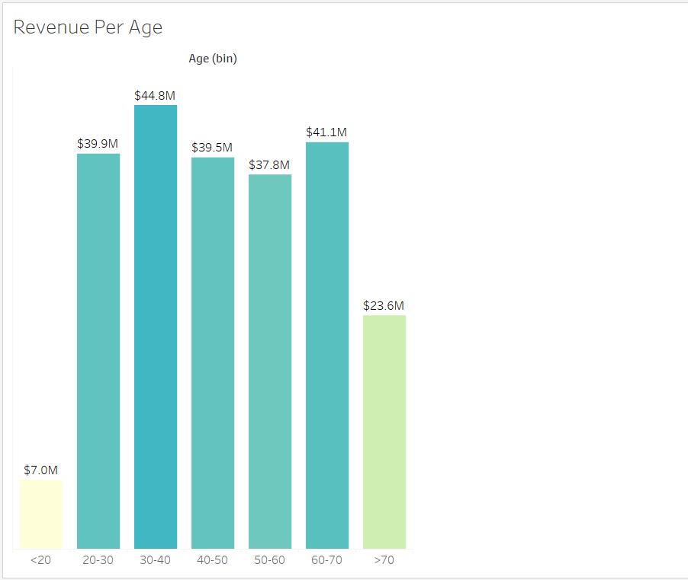
REVENUE BASED ON AGE

Slide 17
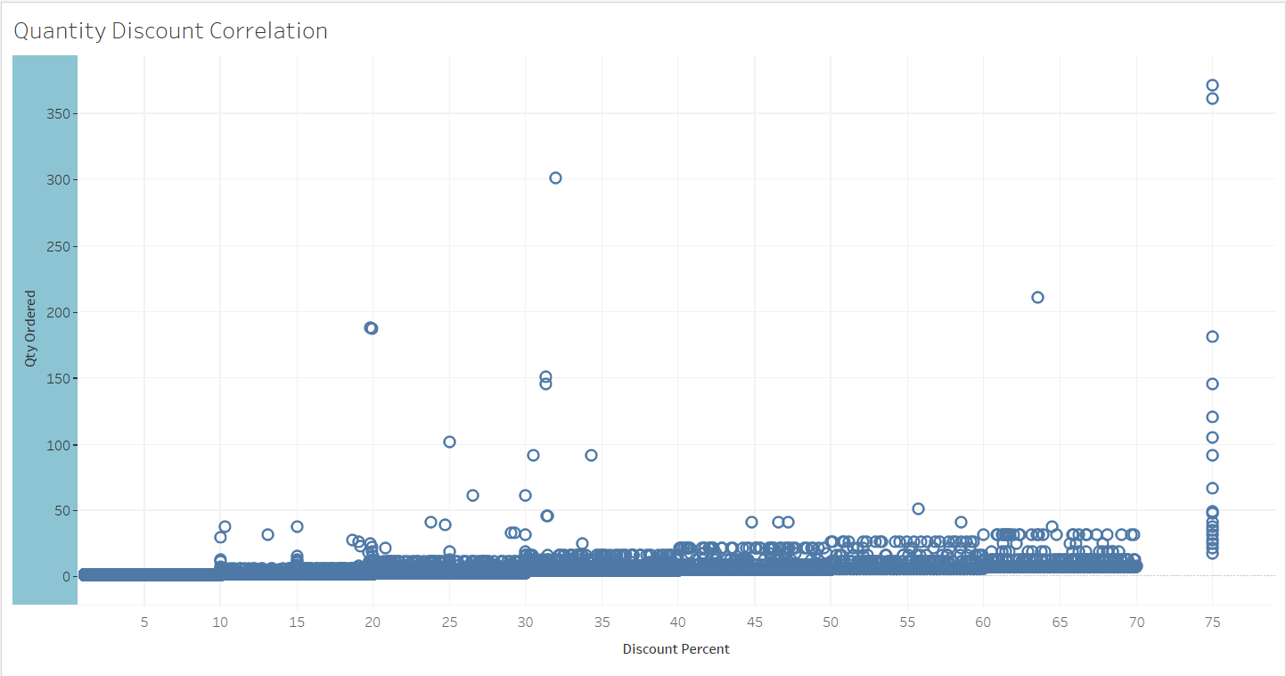
QUANTITY- DISCOUNT PERCENTAGE CORRELATION

Slide 18
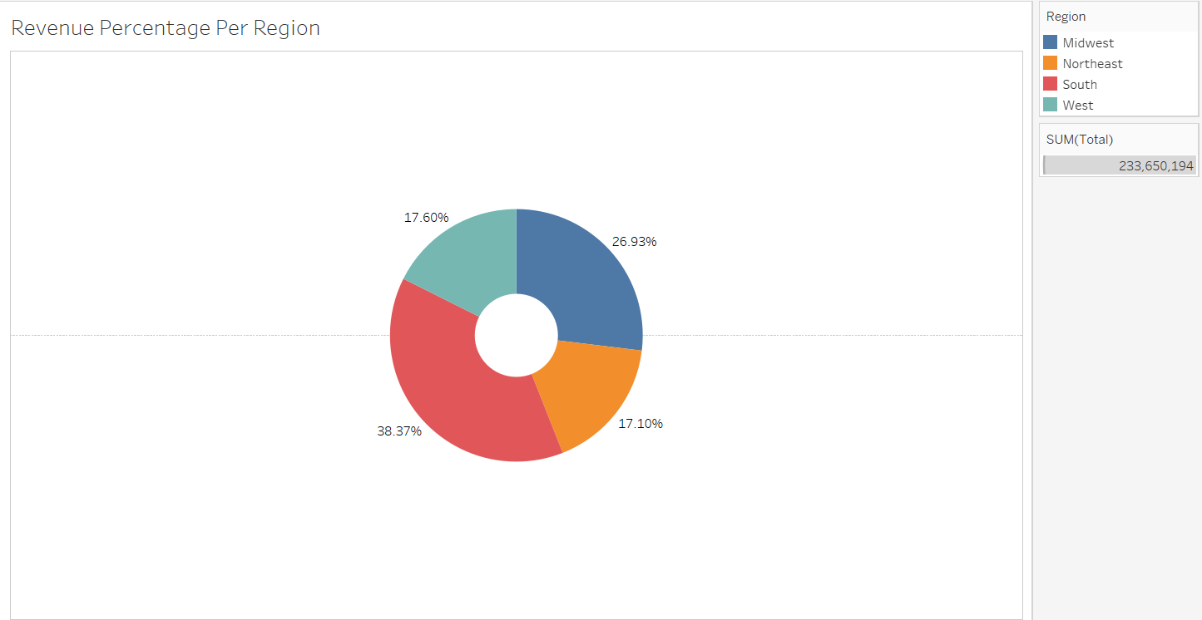
PERCENTAGE OF REVENUE PER REGION

Slide 19
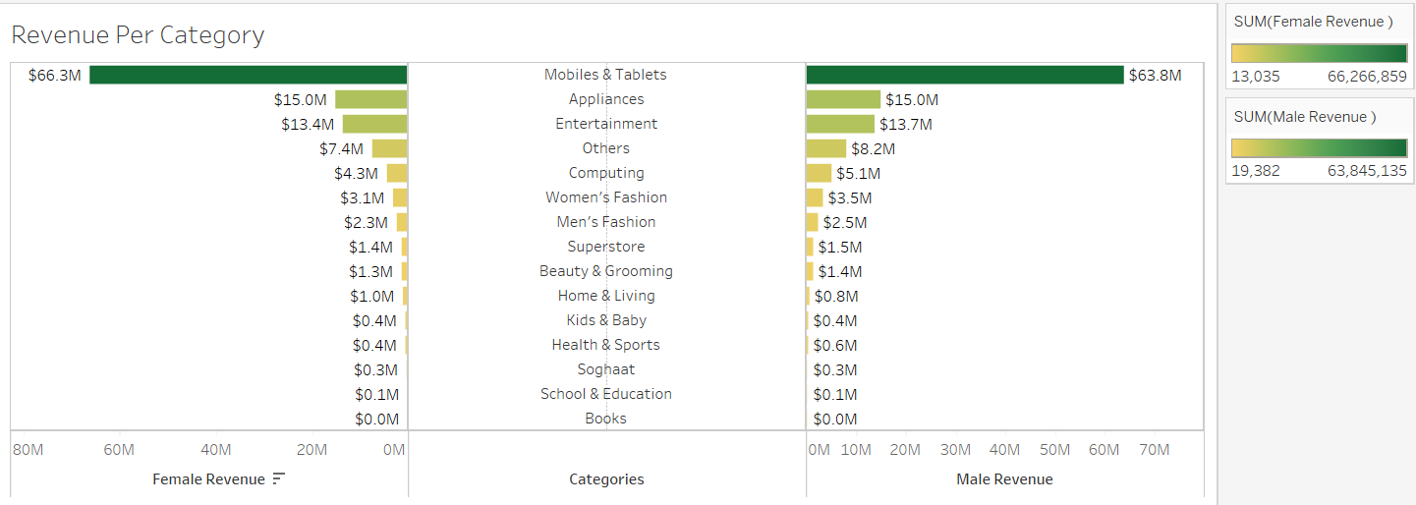
REVENUE PER CATEGORY PER GENDER

Slide 20
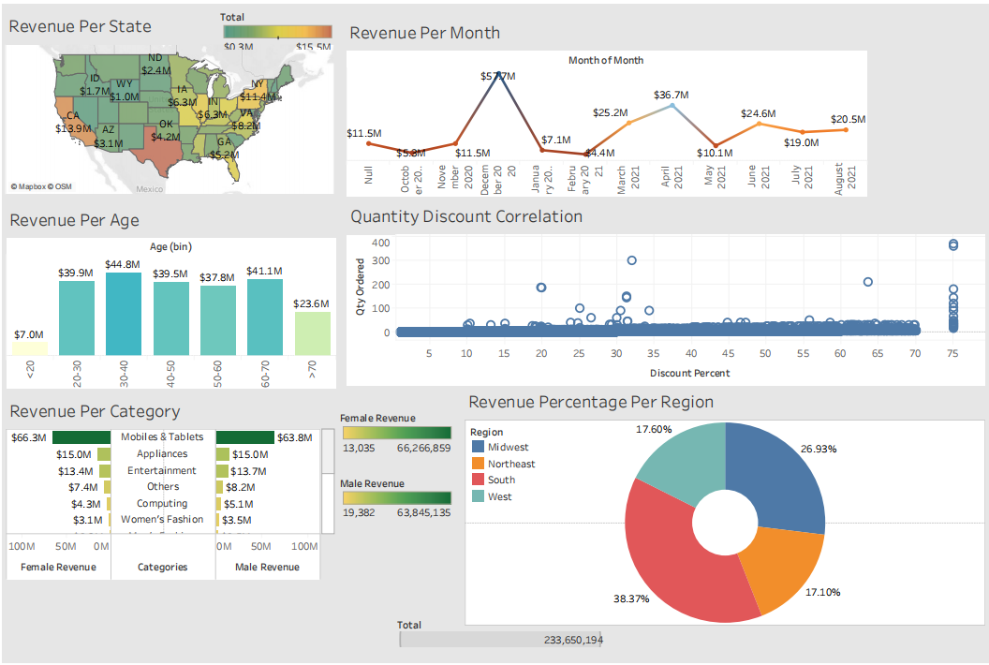
DASHBOARD

Slide 21
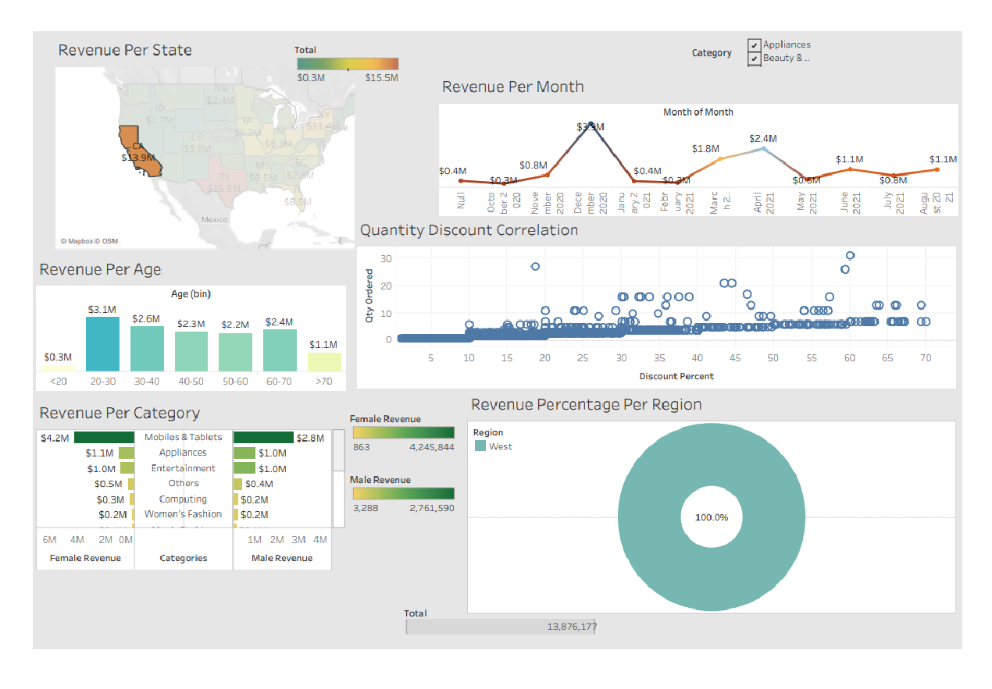

Slide 22
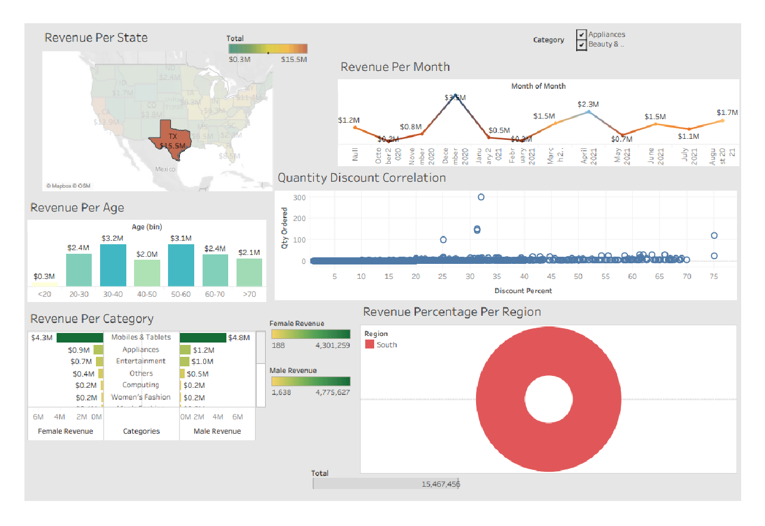

Slide 23
Conclusion:
In conclusion, our analysis of customer data using Tableau has provided valuable insights into our customer base and their behavior. By focusing on key metrics such as total revenue, number of customers, and average order value, we were able to identify trends and patterns that can help us make better business decision.

Slide 24
Thank you

