Slide 1


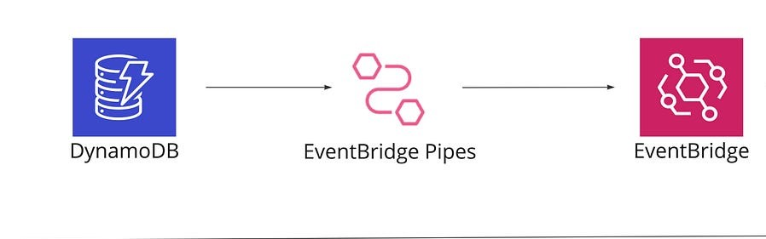
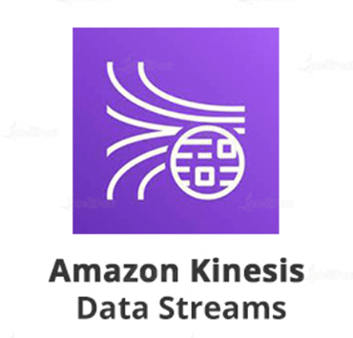









CDC Real-time Data Processing Architecture
Source
Target
CDC
Orders Data
Consume Batch Data
Mock Data Generation
Send
Receive
Visualization
AWS Lambda
Glue Catalog
Visualization
Store Transformed Data
Query S3

