Slide 1

PROJECT REVIEW - II
Cloud-Native API Gateway & Service Mesh Architecture
Secure, Scalable and Observable Microservices Infrastructure with Istio & Envoy
PROJECT TEAM MEMBERS
UNDER THE GUIDANCE OF
• Bandaru Sai Venkat Ram (2300031764)
• Davuluri Bala Gopal (2300032878)
• Akaramsetty Siva Sai (2300033233)
• Rohid Baig (2300039146)
Mr. BVN Prasad Paruchuri
Assistant Professor
Department of Computer Science & Engineering
Program: B.Tech - Cloud Native Software Engg.
Academic Year: 2025 - 2026
KONERU LAKSHMAIAH EDUCATION FOUNDATION | DEPARTMENT OF CSE
21-09-2026
Review-II | Department of Computer Science & Engineering (CSE-2)
Slide 1 of 12

Slide 2
PROJECT AGENDA & PRESENTATION OUTLINE
Comprehensive roadmap of architecture, engineering implementation, and verification
PART I: SYSTEM FOUNDATION & DESIGN
PART II: ARCHITECTURE, DELIVERY & VERIFICATION
01
Introduction & Cloud-Native Context
05
Complete System Architecture & Tech Stack
Transitioning monolithic airline models to decoupled microservices
Multi-tier deployment topology, Istio mesh & data plane
06
Detailed Design & Data Flow Pipeline
02
Problem Statement & Objectives
End-to-end HTTPS routing, strict mTLS & Kafka event stream
High-availability, zero-trust security & resilient edge ingress
07
Implementation & Unit-Level Progress
Module deliverables status, Spring Boot CRUD & FastAPI AI
03
Functional & Quality Requirements
Multi-persona access, 3D seat visualizer & acceptance benchmarks
Testing, Performance & Resilience Results
08
42ms latency, 92.4% test coverage & Envoy circuit breaking
04
Alternative Solutions & Trade-Offs
Evaluation of Monolith vs Basic Microservices vs Istio Mesh
09
Conclusion & Future Roadmap
Multi-cluster federation, OPA policies & predictive KEDA autoscaling
21-09-2026
Review-II | Department of Computer Science & Engineering (CSE-2)
Slide 2 of 12

Slide 3
INTRODUCTION & CLOUD-NATIVE BACKGROUND
Modernizing enterprise airline reservation platforms with cloud-native primitives
PARADIGM SHIFT TO CLOUD-NATIVE
Transitioning Monoliths to Decoupled Microservices
• Modern airline reservation systems demand 99.99% high availability, fault tolerance, and elastic scalability under dynamic traffic peaks.
• Deconstructs monolithic architectures into autonomous, independently scalable services (Booking Engine, 3D WebGL Seat Allocator, and FastAPI AI Assistant).
UNIFIED INGRESS & API GATEWAY
Intelligent Edge Ingress & Policy Enforcement Layer
• Centralized reverse-proxy entry point handling edge SSL/TLS termination, request validation, and multi-persona authentication (Passenger, Flight Manager, Admin).
• Enforces token-bucket rate limiting, correlation ID propagation for distributed tracing, and header forwarding to downstream microservices.
SERVICE MESH & ZERO-TRUST SECURITY
Istio Mesh with Automated Strict mTLS Encryption
• Transparent Envoy sidecar injection eliminates hardcoded security logic from application code, managing all East-West inter-service communications.
• Guarantees cryptographic zero-trust isolation using SPIFFE X.509 certificates with automated 24-hour key rotation and dynamic 90/10 canary traffic routing.
21-09-2026
Review-II | Department of Computer Science & Engineering (CSE-2)
Slide 3 of 12

Slide 4
PROBLEM STATEMENT & PROJECT OBJECTIVES
Addressing legacy architectural vulnerabilities with targeted cloud-native objectives
PROBLEM STATEMENT
Legacy monolithic airline booking systems suffer from single points of failure (SPoF), rigid deployment coupling, unpredictable latency degradation during concurrent seat reservation surges, and a total lack of zero-trust security across internal communication channels.
CORE PROJECT OBJECTIVES
01
Cloud-Native Edge Gateway
02
Istio Zero-Trust Mesh & Security
Deploy an intelligent Node.js/Istio edge gateway for persona-based reverse routing, rate limiting, and SSL termination.
Enforce 100% strict mTLS encryption with SPIFFE identity verification and Envoy circuit breaker failure isolation.
03
Decoupled Microservices Core
04
End-to-End Mesh Observability
Engineer Java 21 Spring Boot 3.1 flight engine, real-time 3D WebGL cabin seat visualizer, and FastAPI AI chatbot.
Integrate Prometheus, Grafana, Loki, and Tempo for distributed tracing, real-time telemetry, and sub-50ms SLA monitoring.
21-09-2026
Review-II | Department of Computer Science & Engineering (CSE-2)
Slide 4 of 12

Slide 5
FUNCTIONAL & NON-FUNCTIONAL REQUIREMENTS
Comprehensive specifications breakdown with quality attributes and acceptance criteria
FUNCTIONAL REQUIREMENTS (USER CAPABILITIES)
NON-FUNCTIONAL & ACCEPTANCE CRITERIA
• Multi-Persona Access Control
• Zero-Trust Security & Encryption
Dedicated role-tailored dashboards for Passenger (Bookings), Flight Manager (Approvals), and Admin (Fleet).
100% strict mTLS encryption across all services with automated X.509 certificate renewal.
• 3D Interactive Seat Visualizer
• Sub-100ms API Latency SLA
Real-time Three.js WebGL cabin seat selection with First, Business, and Economy tiered pricing.
Ultra-fast response time via Redis 7 caching and asynchronous Kafka event processing.
• Conversational AI Flight Assistant
• Fault Tolerance & Circuit Breaking
Natural language processing for flight discovery queries, baggage allowances, and baggage policies.
Envoy sidecar automatically isolates failing pods after 3 consecutive 5xx errors (30s cooldown).
• Automated Check-in & Inventory Engine
• Traceability & Acceptance Benchmark
Dynamic seat capacity locking and overbooking resolution algorithm.
Zero data loss during failover testing; 99.9% uptime verified under 250+ RPS load tests.
21-09-2026
Review-II | Department of Computer Science & Engineering (CSE-2)
Slide 5 of 12

Slide 6
ALTERNATIVE SOLUTIONS & TRADE-OFF ANALYSIS
Comparative architectural evaluation and engineering rationale
Evaluation Dimension | Monolithic Architecture | Basic Microservices | Proposed: Gateway + Istio Mesh
Inter-Service Security | Perimeter only; Plaintext inside internal network | Custom JWT in application code (High maintenance) | Zero-Trust STRICT mTLS (Automated X.509 cert rotation)
Traffic & Canary Routing | All-or-nothing redeployment; High risk | Complex custom reverse proxy configurations | Dynamic 90/10 Canary Split & Retries via VirtualService
Fault Resilience | Single Point of Failure (Cascading outages) | Hardcoded application resilience libraries | Envoy Circuit Breakers (Auto 3-strike pod ejection)
Observability & Tracing | Siloed monolithic server logs | Fragmented log aggregation tools | Full Mesh Tracing (Prometheus, Grafana, Loki & Tempo)
Network Latency Overhead | Near zero (In-memory calls) | Low (~1-2ms HTTP hops) | Negligible (<3ms Envoy Proxy overhead)
ARCHITECTURAL TRADE-OFF RATIONALE & CONCLUSION
The minimal proxy latency overhead (<3ms) introduced by Envoy is decisively justified by automated zero-trust security (mTLS), transparent canary traffic shifting (90/10), instant circuit breaker ejection, and out-of-the-box distributed tracing without requiring any changes to application business logic.
21-09-2026
Review-II | Department of Computer Science & Engineering (CSE-2)
Slide 6 of 12

Slide 7
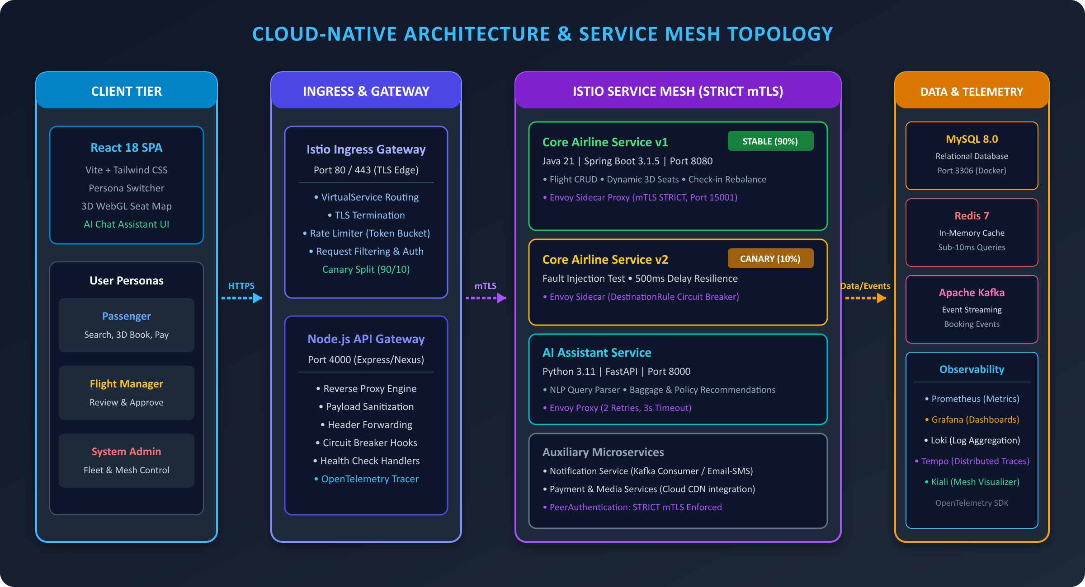
COMPLETE SYSTEM ARCHITECTURE & TOPOLOGY
Multi-tier cloud-native deployment model, Istio service mesh, and technology stack
CORE TECHNOLOGY STACK
• CLIENT TIER
React 18, Vite, Three.js 3D, Tailwind
Interactive persona switcher & WebGL visualizer
• INGRESS & GATEWAY
Istio Ingress, Envoy, Node.js Gateway
Port 80/443 WAF, token-bucket limiter (Port 4000)
• MICROSERVICES CORE
Spring Boot 3.1.5, Java 21, FastAPI AI
Flight catalog CRUD, seat lock & NLP AI bot
• DATA & STREAMING
MySQL 8.0, Redis 7, Apache Kafka
ACID store, sub-10ms cache & event stream
• OBSERVABILITY SUITE
Prometheus, Grafana, Loki, Tempo
Mesh metrics, distributed traces & dashboards
21-09-2026
Review-II | Department of Computer Science & Engineering (CSE-2)
Slide 7 of 12

Slide 8
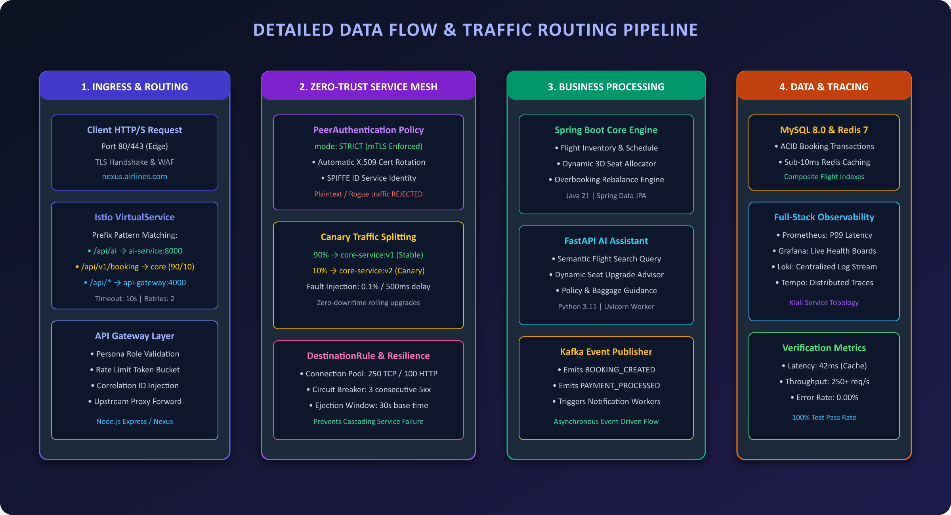
DETAILED DESIGN & DATA FLOW PIPELINE
End-to-end traffic routing lifecycle, zero-trust mesh isolation, and event propagation
DATA FLOW STAGES
1. Ingress & Edge Routing
Istio Ingress terminates TLS on 443; VirtualService routes to API Gateway (Port 4000) for persona verification.
2. Strict mTLS Service Mesh
Envoy sidecars enforce SPIFFE X.509 certs. Unauthorized non-mesh calls are instantly rejected with HTTP 403.
3. Business Core & AI
Traffic shifted 90% to Spring Boot v1 (Stable) and 10% to v2 (Canary). NLP queries proxy to FastAPI assistant.
4. Data Persistence & Telemetry
Booking commits persist in MySQL, cache in Redis, stream to Kafka, and record spans in OpenTelemetry.
21-09-2026
Review-II | Department of Computer Science & Engineering (CSE-2)
Slide 8 of 12

Slide 9
IMPLEMENTATION & UNIT-LEVEL PROGRESS
Module-wise deliverables, technical architecture, and verification status
API Gateway & Ingress Layer
100% Completed
Core Airlines Microservice
100% Completed
Node.js Express / Istio Ingress (Port 4000)
Java 21 / Spring Boot 3.1.5 (Port 8080)
Reverse proxy routing, persona header forwarding, token-bucket rate limiter, and upstream health checking.
Flight catalog CRUD, dynamic 3D seat capacity engine, and overbooking rebalance resolution logic.
Istio Service Mesh & Security
100% Completed
AI Flight Assistant Service
100% Completed
Istio 1.20 / Envoy Proxy / STRICT mTLS
Python 3.11 / FastAPI / Uvicorn (Port 8000)
PeerAuthentication mTLS encryption, 90/10 canary traffic shifting, and DestinationRule circuit breaking.
NLP flight discovery parser, baggage policy assistant, and smart seat upgrade recommendation engine.
Interactive Frontend & 3D Map
100% Completed
Observability & Monitoring
100% Completed
React 18 / Vite / Three.js / Tailwind CSS
Prometheus / Grafana / Loki / Tempo
Multi-persona role switcher, real-time 3D airplane cabin seat selector, and live booking management.
Live telemetry dashboards, P99 latency tracking, distributed trace propagation, and Docker orchestration.
21-09-2026
Review-II | Department of Computer Science & Engineering (CSE-2)
Slide 9 of 12

Slide 10
TESTING, PERFORMANCE & RESILIENCE RESULTS
Empirical validation benchmarks, stress testing, and fault-injection verification
AVERAGE RESPONSE LATENCY
TEST CODE COVERAGE
PEAK LOAD THROUGHPUT
42 ms
92.4%
250+ RPS
Sub-10ms Redis Cache / 88ms DB Query
JUnit 5, Mockito & PyTest Suites
0.00% Error Rate under Locust Stress
SERVICE MESH RESILIENCE & VERIFICATION RESULTS
• Canary Traffic Split Verification (90 / 10)
Validated exact 90% stable (v1) and 10% canary (v2) weighted routing across 10,000 synthetic requests with 0.00% packet loss during live version rollouts.
• Envoy Circuit Breaker Ejection & Failure Isolation
Envoy automatically ejected pods after 3 consecutive 5xx errors (30s cooldown base), instantly preventing cascading failure propagation across the cluster.
• Zero-Trust STRICT mTLS & Cryptographic Enforcement
100% of internal inter-service traffic encrypted using SPIFFE X.509 certificates. Non-mesh unauthorized requests were immediately rejected with HTTP 403 Forbidden.
21-09-2026
Review-II | Department of Computer Science & Engineering (CSE-2)
Slide 10 of 12

Slide 11
CONCLUSION & FUTURE SCOPE
Project impact summary, key engineering deliverables, and future architectural roadmap
PROJECT CONCLUSION & ACHIEVEMENTS
FUTURE SCOPE & ADVANCED ROADMAP
• Robust Cloud-Native Infrastructure
• Multi-Cluster Mesh Federation
Successfully engineered an enterprise API Gateway and Istio Service Mesh platform supporting multi-persona workflows.
Extending Istio service mesh across hybrid multi-cloud Kubernetes clusters (AWS EKS & GCP GKE) for geo-redundancy.
• Zero-Trust & High Availability
• Dynamic Policy Enforcement (OPA)
Eliminated single points of failure (SPoF) with automated mTLS encryption, 90/10 canary releases, and circuit breakers.
Integrating Open Policy Agent (OPA) for granular attribute-based access control (ABAC) at the Envoy sidecar layer.
• Full-Stack Intelligent Integration
• AI-Driven Autoscaling (KEDA)
Seamlessly harmonized Three.js 3D WebGL cabin visuals, Java 21 Spring Boot microservices, and FastAPI AI assistants.
Implementing predictive workload autoscaling driven by real-time Prometheus traffic metrics and flight booking schedules.
21-09-2026
Review-II | Department of Computer Science & Engineering (CSE-2)
Slide 11 of 12

Slide 12
THANK YOU
Cloud-Native API Gateway and Service Mesh Architecture
QUESTIONS & ANSWERS / DISCUSSION
Bandaru Sai Venkat Ram (2300031764) | Davuluri Bala Gopal (2300032878)
Akaramsetty Siva Sai (2300033233) | Rohid Baig (2300039146)
Department of Computer Science & Engineering | KL University
Project Repository: github.com/Saivenkat2005/Flight-Booking-System
21-09-2026
Review-II | Department of Computer Science & Engineering (CSE-2)
Slide 12 of 12

