Slide 1


HACKATHON 2024 · DATA SCIENCE
IPLytics
Decoding Match-Winning Patterns in IPL Using Data Science
Python · Pandas · Plotly · Streamlit
Notes:
1

Slide 2


THE PROBLEM
The Data Is There — The Insights Are Not
Data Overload
The IPL generates thousands of data points per season, yet most remain unexplored and unactionable.
Hidden Patterns
Match-winning signals — phase dominance, momentum shifts, venue behavior — are buried in raw statistics.
Outdated Metrics
Traditional cricket statistics fail to capture the nuanced, phase-wise dynamics that truly decide outcomes.
The Gap
Teams, analysts, and fans lack an intelligent, interactive platform to translate data into strategy.
Notes:
2

Slide 3
FOUNDATION
Dataset & Technology Stack
The Data
The Stack
matches.csv
deliveries.csv
Complete match records — teams, venues, toss decisions, results, and player of the match across all IPL seasons.
Ball-by-ball delivery data covering every over, wicket, boundary, and scoring event in IPL history.
Python
Pandas
Plotly
Streamlit
Jupyter
Notes:
3

Slide 4

APPROACH
End-to-End Methodology
A rigorous, seven-stage pipeline transforms raw IPL data into strategic cricket intelligence — from ingestion to interactive insight.
Phase Analysis
Collection
Cleaning
Features
Visualization
Each stage builds upon the last, ensuring analytical rigor and reproducible, explainable results throughout the pipeline.
Notes:
4

Slide 5
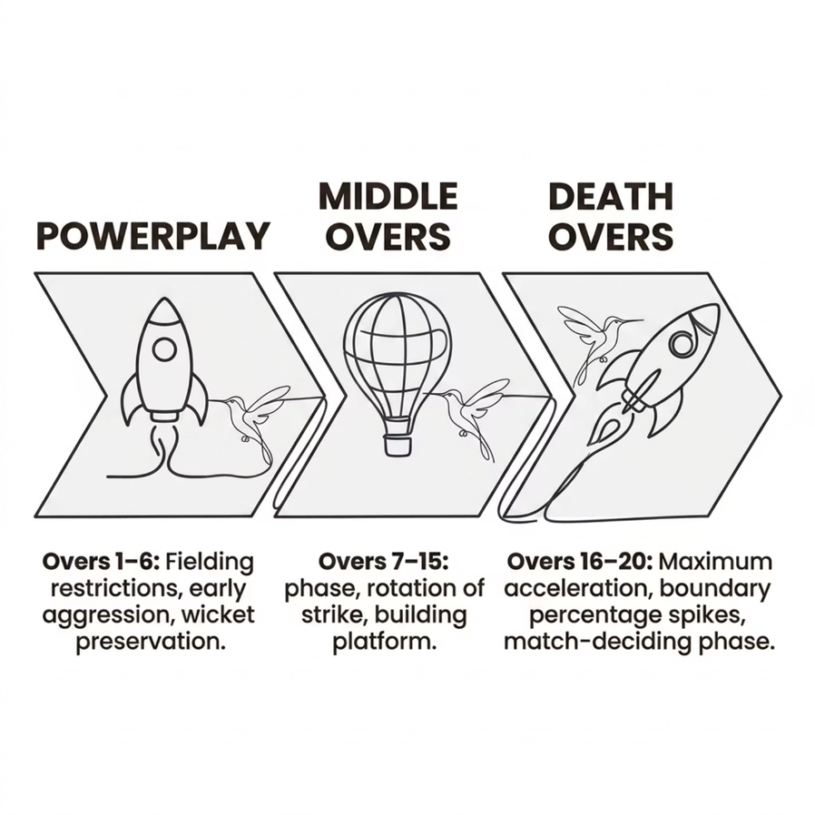

CORE ANALYSIS
Phase-Wise Match Analytics
Key Finding
Middle-over consistency and death-over dominance are the strongest predictors of match victory — far more than powerplay performance alone.
Teams that accelerate in the death overs win 68% of matches where they hold a competitive middle-over platform.
Phase-wise decomposition reveals that sustained momentum across all three phases — not just explosive starts — separates winners from losers.
Notes:
5

Slide 6
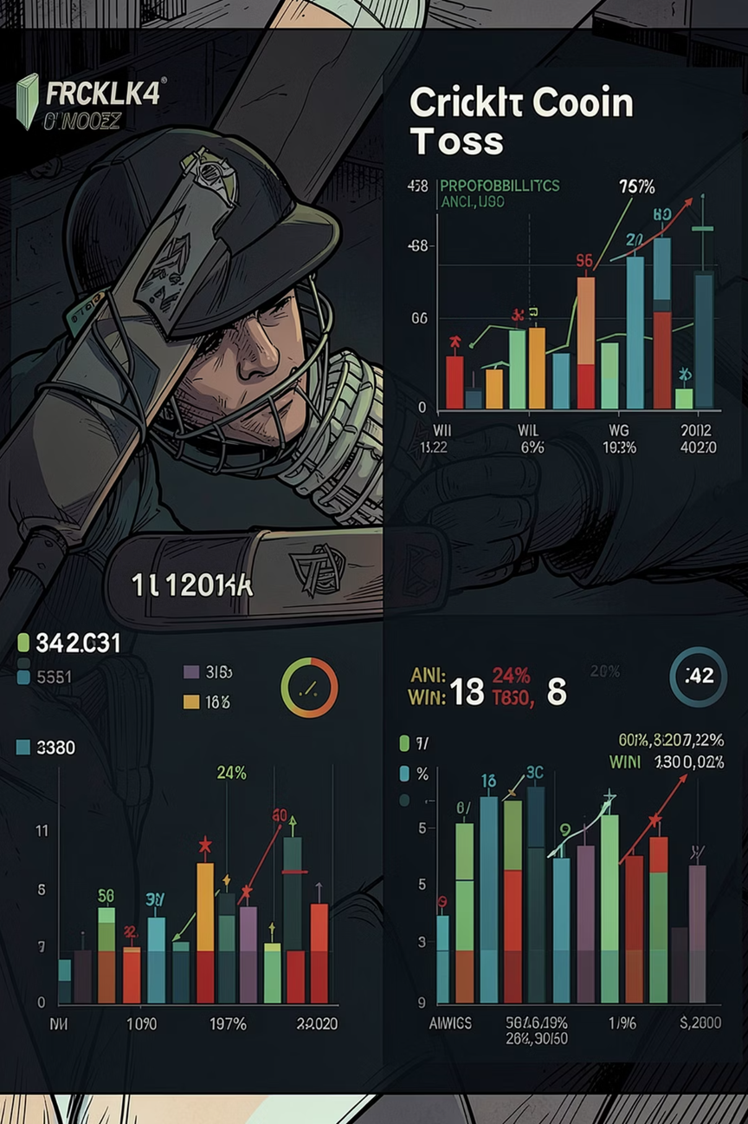
MYTH VS. REALITY
The Toss Myth: Does It Really Matter?
~52%
~54%
Toss Win Rate
Match Win Rate
Marginally above random chance — toss advantage is statistically negligible over a full season.
Teams winning the toss win only slightly more matches — far below the perceived advantage.
~68%
Momentum Impact
Phase-wise momentum and death-over execution are far stronger victory indicators than toss outcome.
Conclusion: Momentum and execution matter significantly more than toss advantage. The "toss factor" is largely a cognitive bias in cricket commentary.
Notes:
6

Slide 7
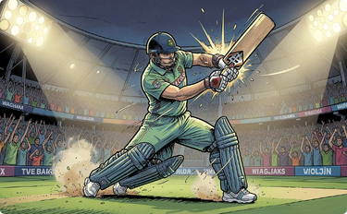


INTELLIGENCE LAYER
Player & Venue Intelligence
Impactful Batters
Impactful Bowlers
Venue Intelligence
Strike rate, boundary percentage, and phase-wise scoring profiles identify players who consistently shift match momentum.
Economy rate, wicket clusters, and death-over containment metrics reveal bowlers who genuinely defend totals.
Scoring behavior, average first-innings totals, and win-batting-first ratios are mapped per venue for strategic planning.
Notes:
7

Slide 8

THE PRODUCT
Interactive Dashboard & Win Predictor
What IPLytics Delivers
Team Comparison Engine
Head-to-head analytics across seasons, venues, and phases.
Interactive Visualizations
Plotly-powered charts with drill-down capability for granular exploration.
Match Win Predictor
Real-time probability scoring based on phase performance and historical patterns.
Analytics Tabs
Dedicated sections for toss analysis, venue behavior, and player intelligence.
Notes:
8

Slide 9

STRATEGIC CONCLUSIONS
What the Data Actually Says
Toss Is Overrated
Winning the toss provides negligible competitive advantage. Execution and momentum dominate outcomes.
Sustained Momentum Wins
Consistent phase-wise performance — particularly across middle and death overs — is the true match-winner.
Death-Over Acceleration Is Critical
Teams that maximize boundary percentage in overs 16–20 win the majority of close contests.
Data-Driven Strategy Works
Organizations leveraging phase analytics and venue intelligence make measurably better tactical decisions.
Notes:
9

Slide 10
WHAT'S NEXT
Future Scope & Thank You
Roadmap
Thank You
01
IPLytics transforms raw IPL data into actionable cricket intelligence — empowering teams, analysts, and fans to see the game differently.
Live IPL Analytics
Real-time data ingestion for in-match phase tracking and live win probability.
Stack: Python · Pandas · Plotly · Streamlit
Dataset: IPL Matches & Deliveries (2008–Present)
02
ML-Based Prediction
Supervised learning models to forecast match outcomes with higher accuracy.
03
Fantasy Cricket Insights
Player form indices and matchup analytics for fantasy league optimization.
04
Auction Intelligence
Value modeling and player performance prediction for IPL auction strategy.
Notes:
10

