Slide 1



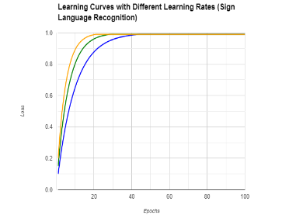
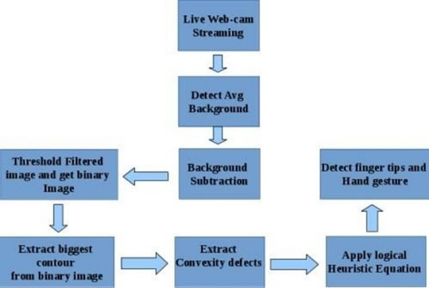
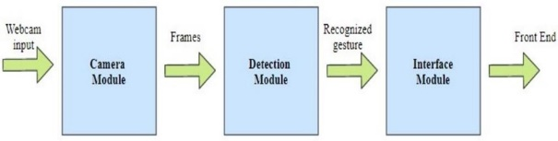
SIGN LANGUAGE RECOGNITION SYSTEM USING DEEP LEARNING
Sai Vikram K
312320104119
Sanjay Ganesh M
312320104123
ABSTRACT
The project proposes a Sign Language Recognition System employing Deep Learning techniques for accurate interpretation of American Sign Language (ASL) gestures. It utilizes Convolutional Neural Networks (CNN) for feature extraction from static ASL images, followed by Recurrent Neural Networks (RNN) for temporal modeling and classification. Incorporating a Long Short-Term Memory (LSTM) layer enables capturing temporal dependencies, achieving high accuracy in ASL recognition, thus bridging communication barriers for the deaf and hard of hearing.
INTRODUCTION
MATERIALS AND METHODOLOGY
D. Model creation and training: The model is created by implementing Convolutional Neural Networks (CNNs) for feature extraction from ASL images, followed by Recurrent Neural Networks (RNNs) for temporal modeling and classification. Training involves optimizing the network parameters using backpropagation with labeled ASL datasets.
RESULT
The project aims to develop software facilitating interaction through hand gestures, particularly American Sign Language (ASL), for applications ranging from gaming to medical equipment control. By enabling understanding of ASL signs, it promotes inclusivity in daily interactions and education systems, bridging communication barriers for the hearing impaired. Additionally, language support is integrated, providing descriptions for enhanced comprehension of ASL signs.
Procurement of dataset: The dataset for this project was acquired from reputable ASL databases, ensuring diverse and representative samples of hand gestures. Rigorous filtering and annotation processes were conducted to compile a high-quality dataset suitable for training the recognition system.
Feature Selection: Feature selection for this project involves identifying pertinent hand gesture attributes like finger positions and motion trajectories, crucial for accurate recognition of American Sign Language (ASL) signs, and optimizing the recognition system's performance.
Data pre-processing: Data pre-processing involves resizing static ASL images with Bicubic interpolation and organizing them into binary format. Additionally, textual descriptions are paired with each ASL sign to enhance understanding.
Performance evaluation demonstrates robustness and efficacy across various applications, from gaming interfaces to medical equipment control.
CONCLUSION
In conclusion, a sign language recognition system can greatly improve communication and accessibility for individuals who are deaf or hard of hearing. We have developed this system by using a convex hull algorithm and several other computer vision techniques, these systems can accurately recognize and translate sign language into text in real-time
Department of Computer Science and Engineering, St.Joseph’s College of Engineering, OMR, Chennai – 119.
Ms. T. Jenitha M.E

