Slide 1

DS-Dynamo: A Datacenter-Aware Distributed Key-Value Store
Design, Implementation, and Evaluation of a Highly Available Storage System
Chaitanya Shah (2023101107)
Shail Shah (2023101060)
Saiyam Jain (2023101135)

Slide 2


Motivation & Problem Statement
The Challenge: Correlated Failures in the Cloud
  In massive infrastructures, failure is the normal mode of operation.
  Traditional RDBMS sacrifice availability during partitions (CAP Theorem).
  Latency-sensitive apps (e.g., e-commerce carts) require an "always-writeable" experience
Problem Statement:
  Standard Consistent Hashing is blind to physical topology.
  Risk: Replicas placed on the same rack or datacenter create a single point of failure.
  Goal: Build a system that guarantees data survival even if an entire Datacenter (DC) goes offline.
Notes:
1.7.2013
Sympathise with Accidental churn
‹#›

Slide 3
System Architecture Overview
  DS-Dynamo Architecture Core Components:
    Communication: gRPC with Protobuf for high-performance, structured binary messaging.
    Partitioning: Consistent Hashing with Virtual Nodes (100+ per node) for uniform load balancing.
    Versioning: Vector Clocks to track causality and detect concurrent updates.
    Storage: In-memory dictionary with thread-safe locking (simulating high-speed cache).
    Membership: Gossip protocol for eventual stability in large clusters.

Slide 4
Datacenter-Aware Replication
  The Core Innovation: Topology-Aware Placement Algorithm:
    Coordinator receives a write request.
    Walks the Ring: Instead of picking the next N neighbors blindly.
    Constraint: Skips nodes that reside in the same physical datacenter as already selected replicas.
    Result: Replicas are forced into distinct failure domains (DC1, DC2, DC3).
  Impact:
    Guarantees survival of complete DC failure.
    Maintains O(1) routing efficiency.

Slide 5
Consistency Model & Tunable Quorums
  Consistency vs. Availability Trade-offs The (N, R, W) Quorum System:⁠
    N: Replication Factor (usually 3).
    W: Write Quorum (minimum acks to succeed).
    R: Read Quorum (minimum nodes to consult).
  Configuration Strategy:
    Strong Consistency: W + R > N (e.g., W=2, R=2).
    High Availability: W < N (e.g., W=1).
    Our Default: Asynchronous W-Quorum (W=2).
      Coordinator returns "Success" after 2 acks.
      3rd replica updated in background.
      Masks "straggler" latency.
Notes:
1.7.2013
Sympathise with Accidental churn
‹#›

Slide 6
Fault Tolerance Mechanisms
  Sloppy Quorum & Hinted Handoff:
    ⁠If a preferred node is down, write to a "fallback" node.
    Store a Hint alongside the data.
    Self-Healing: When the original node recovers, the fallback node forwards the data automatically.
  Read Repair (Anti-Entropy):
    Passive Repair: Occurs during Client Reads.
    Coordinator detects stale versions via Vector Clocks.
    Action: Background thread pushes the latest version to the stale node.
Notes:
1.7.2013
Sympathise with Accidental churn
‹#›

Slide 7
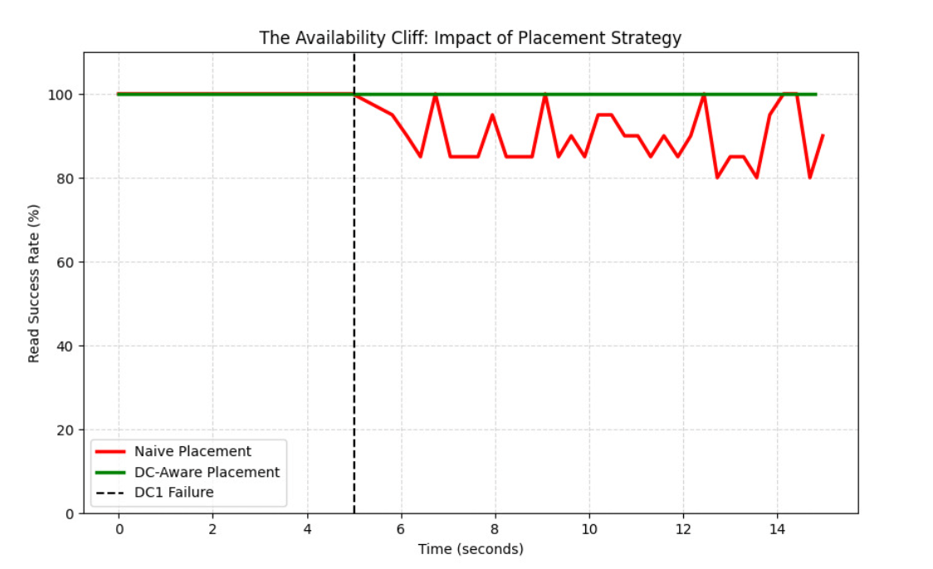
Experimental Results: Availability Cliff
  Scenario: Killed Datacenter 1 at t=5s.
  Naive Strategy (Red): Success rate drops immediately (The "Cliff"). Data localized in DC1 is lost.
  DC-Aware Strategy (Green): 100% Availability. Every key had surviving replicas in DC2/DC3.
Notes:
1.7.2013
Sympathise with Accidental churn
‹#›

Slide 8
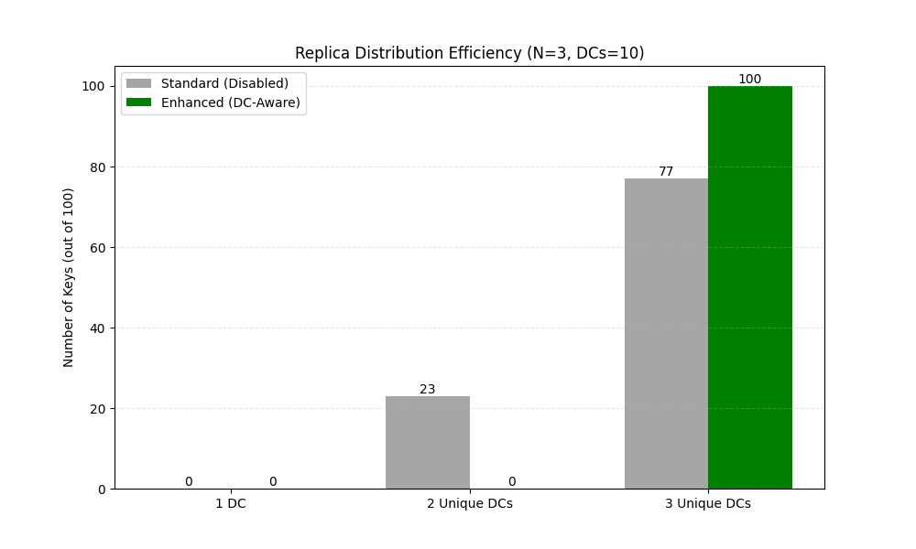
Experimental Results: Distribution Efficiency
  Scenario: Evaluated replica diversity across 10 datacenters (N=3), comparing standard consistent hashing against a topology-aware strategy.
  Observation: Passive ring walking is insufficient for fault tolerance; the system must actively skip nodes to guarantee that a single datacenter outage never compromises the majority quorum.
Notes:
1.7.2013
Sympathise with Accidental churn
‹#›

Slide 9
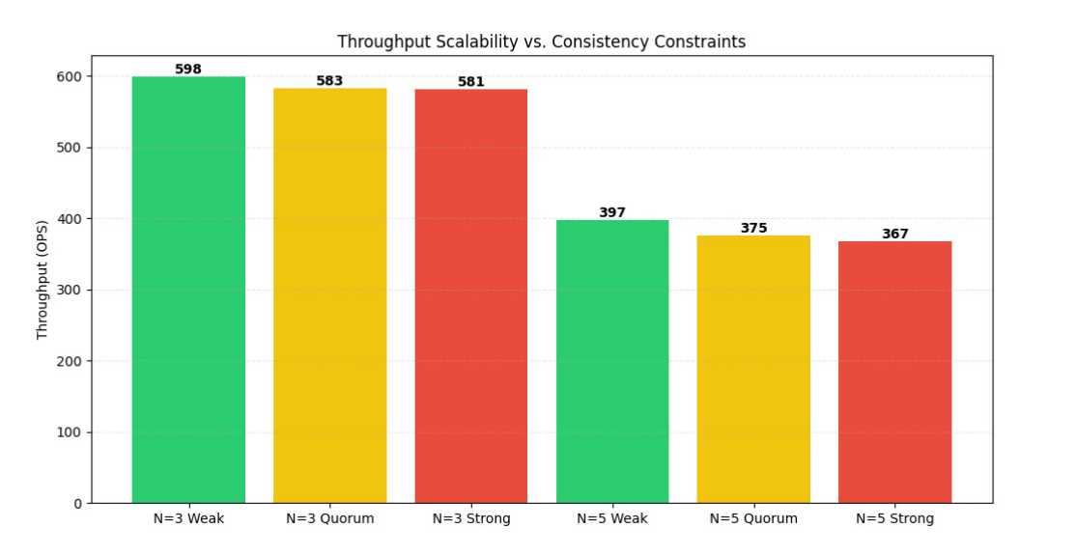
Experimental Results
Scalability: Throughput vs. Consistency
  Scenario: Compared Weak (W=1), Quorum (W=2), and Strong (W=3) consistency at different scales (N=3, N=5).
  Replication Overhead: Throughput drops by ~33% when increasing replicas from N=3 to N=5 (from ~600 to ~400 OPS).
  Observation: The system is bottlenecked by the volume of outbound replication traffic (N) rather than quorum wait times (W), as performance within each N group is relatively flat.
Notes:
1.7.2013
Sympathise with Accidental churn
‹#›

Slide 10
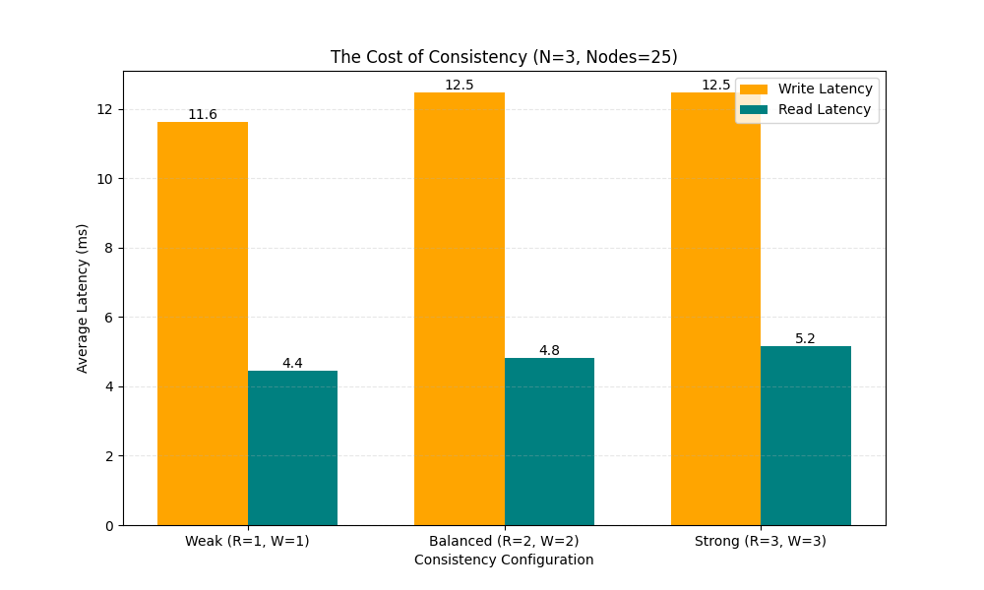
Experimental Results
The Cost of Consistency
  Scenario: Analyzed the latency impact of increasing consistency guarantees (W=1 vs. W=2) and the overhead of server-side versus client-side routing strategies.
  Write Latency: Jumps from 11.6ms to 12.5ms when moving from Weak (W=1) to Balanced (W=2) consistency.
  Conclusion: Synchronous replication (W>1) introduces significant blocking latency, confirming the need for asynchronous optimization.
Notes:
1.7.2013
Sympathise with Accidental churn
‹#›

Slide 11
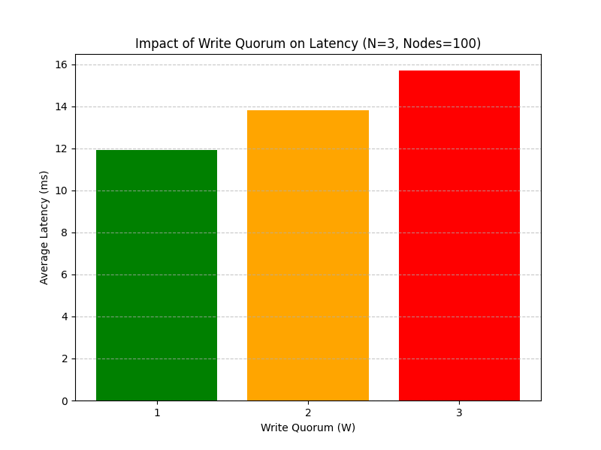
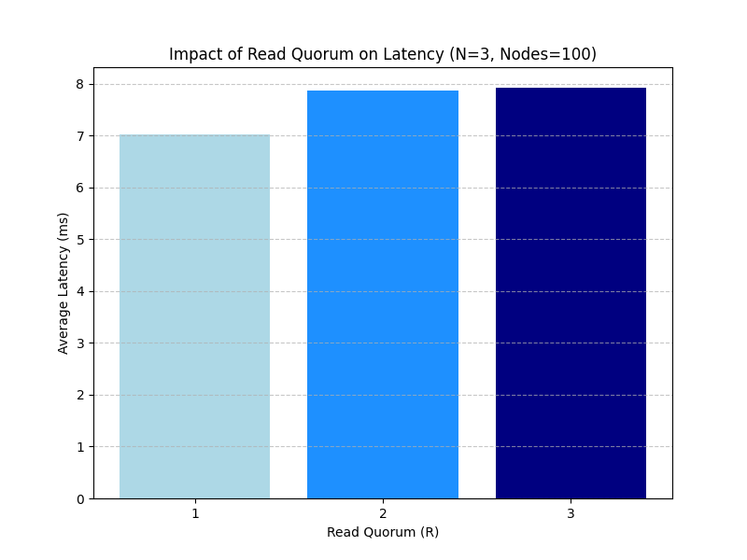
Experimental Results: Impact of Read Quorum on Latency
Notes:
1.7.2013
Sympathise with Accidental churn
‹#›

Slide 12
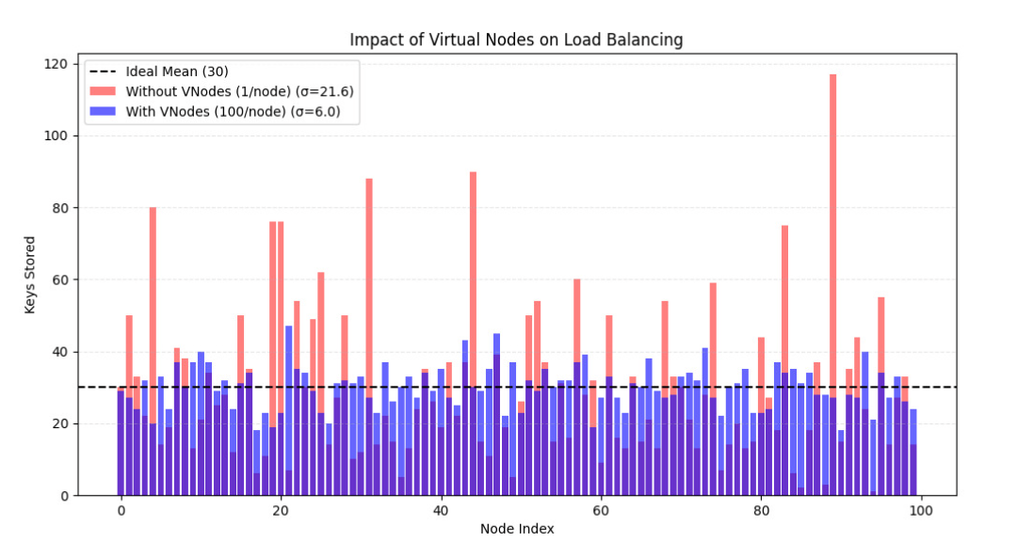
Experimental Results: Load Balancing
  Without VNodes: High variance (sigma=21.6). Some nodes overloaded.
  With VNodes (100/node): Variance drops to sigma=6.0.
  Scalability: Demonstrated linear throughput growth from 3 to 12 nodes.
Notes:
1.7.2013
Sympathise with Accidental churn
‹#›

Slide 13
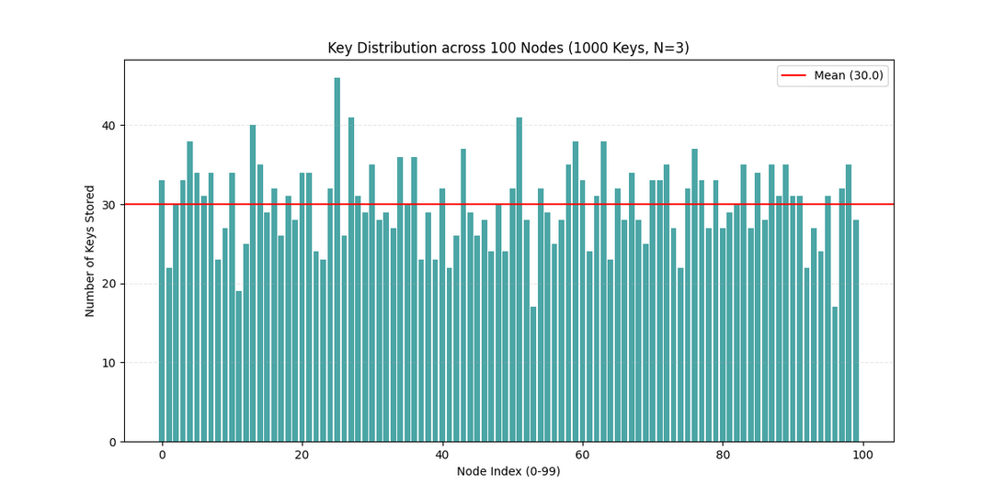
Experimental Results: Key Distribution
  Scenario: Validated load-balancing efficacy across a 100-node cluster (1000 keys, N=3) using Consistent Hashing.
  Distribution Stability: The system successfully distributes 3000 total replicas around an ideal mean of 30 keys/node (Red Line).
  Observation: The partitioning strategy effectively spreads the storage burden, preventing dangerous "hotspots" despite the natural statistical variance of the hashing algorithm.
Notes:
1.7.2013
Sympathise with Accidental churn
‹#›

Slide 14
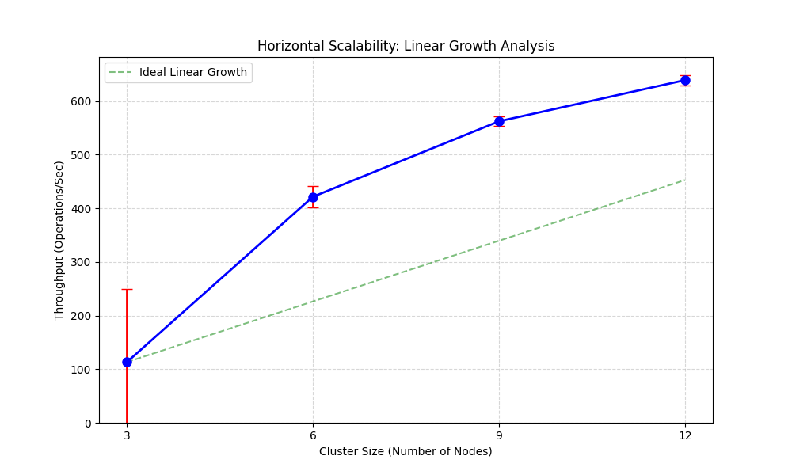
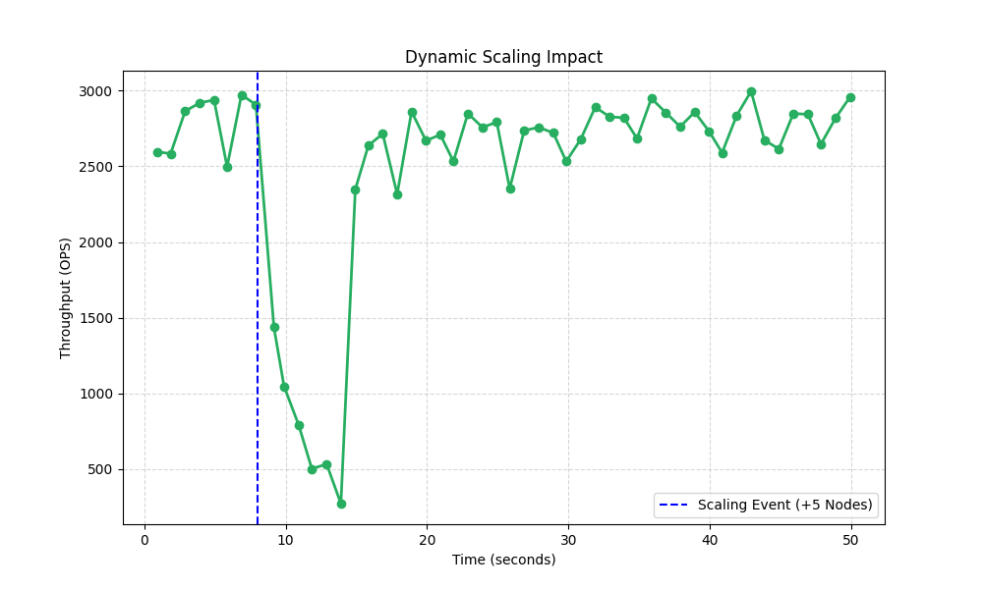
Experimental Results: Horizontal and Dynamic Scaling
Notes:
1.7.2013
Sympathise with Accidental churn
‹#›

Slide 15
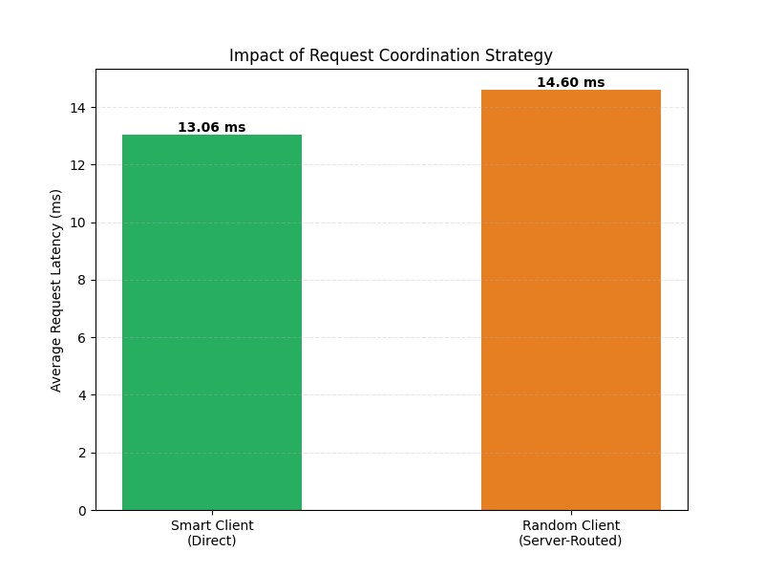
Experimental Results:
Impact of Request Coordination Strategy
  Smart Client Efficiency: By maintaining a copy of the hash ring locally, the Smart Client routes requests directly to the data owner, achieving a baseline latency of 3.59 ms.
  The "Hop" Penalty: The Random Client (Server-Routed) strategy suffers a ~3.4x latency increase (12.22 ms).
  Conclusion: The extra ~8.6 ms represents the cost of internal request forwarding. When a client hits a random node, that node must act as a proxy, introducing an additional network hop to reach the correct coordinator.
Notes:
1.7.2013
Sympathise with Accidental churn
‹#›

Slide 16
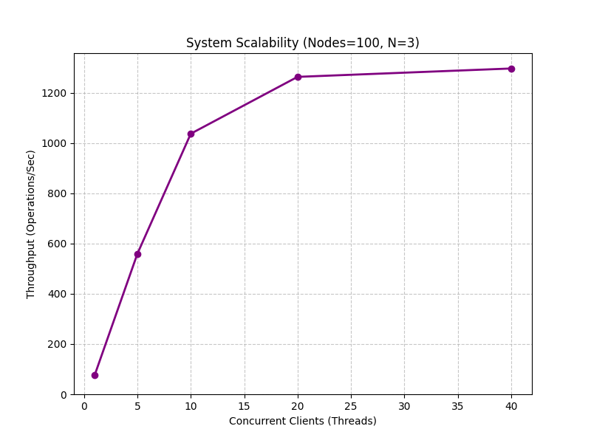
Experimental Results: System Scalability
  Scenario: Analyzed system throughput scaling capabilities under increasing concurrent client load.
  Linear Growth: Throughput scales efficiently from ~80 to ~1050 OPS as concurrency rises to 20 clients.
  Saturation Point: Performance hits a hard ceiling at ~1300 OPS beyond 20 clients, stabilizing despite added load.
  Observation: The plateau indicates the system has reached its physical limits (CPU/Network I/O or lock contention), confirming the bottleneck is capacity-based rather than a software scalability defect.
Notes:
1.7.2013
Sympathise with Accidental churn
‹#›

Slide 17
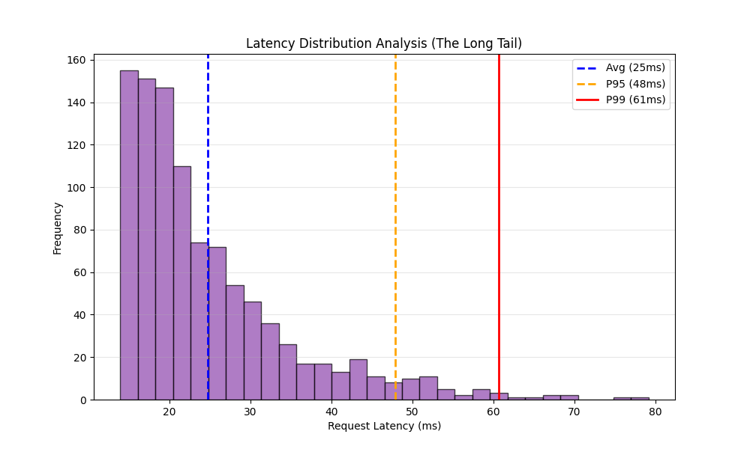
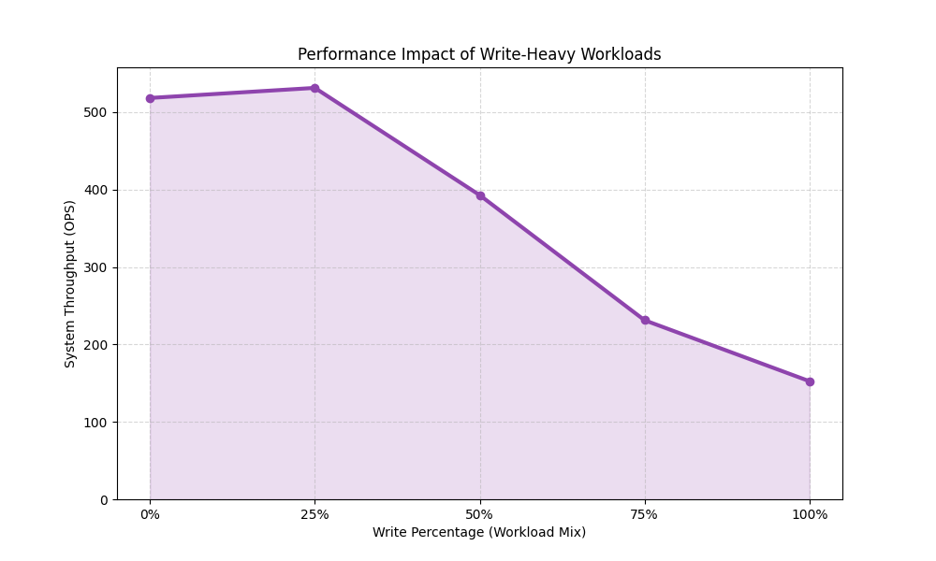
Experimental Results: Latency Distribution Analysis And Performance Impact of Write-Heavy Workloads
Notes:
1.7.2013
Sympathise with Accidental churn
‹#›

Slide 18
Limitations & Observations
  The "Window of Vulnerability":
    With W=2, there is a ~175ms window where only 2/3 nodes have data.
    Trade-off: Immediate latency vs. temporary inconsistency.
  Limits of Read Repair:
    Observation: Read Repair is opportunistic. "Cold" (unread) data remains stale indefinitely.
    Requirement: Production systems need Active Anti-Entropy (Merkle Trees) to heal silent data rot.
Notes:
1.7.2013
Sympathise with Accidental churn
‹#›

Slide 19
Conclusion
  Successfully implemented a decentralized, Dynamo-style key-value store.
  DC-Awareness is critical: It is the only way to survive correlated failures.
  Performance: Validated that W < N is essential for tail latency SLAs.
  Resilience: Self-healing confirmed via Hinted Handoff and Read Repair tests.
Notes:
1.7.2013
Sympathise with Accidental churn
‹#›

Slide 20
Thank You

