Slide 1

Twilyf gifting life
Contributed By
Saiyam Kalra, Mohit Gupta, Akash Anand, Siddhant Verma, Ashish Kumar

Slide 2
UNDERSTANDING THE PROBLEMS
Limited Communication channels for Donors and Recipient
Existing systems suffer from a lack of centralised databases, leading to fragmented Doner and Recipient information.
Duplicative Efforts and Data Entry Errors

Slide 3
Project objective
Facilitate a streamlined process for identifying organ donors, eliminating the need for searching across multiple hospitals.
Procurement of Organ
Centralize Donor and Recipient Information
Integrate Technology Innovations

Slide 4
New Innovations in existing systems
Ease in finding an organ donor rather than searching in multiple hospitals.
Life Saver, Facilitator of better life
Personalized Donor and Recipient Dashboards

Slide 5
System requirements
“
”

Slide 6
Hardware Requirements
Laptop Or PC :
Windows 7 or Higher
I3 Processor System or Higher
4GB RAM or Higher
100GB ROM or Higher

Slide 7
Software Requirements
Front-End Technologies :
HTML
CSS
BOOTSTRAP
JAVASCRIPT
Back-End Technologies :
PYTHON
SQLalchemy
FastAPI
Database :
SQLite
Testing :
PyTest

Slide 8
System modules description
“
”

Slide 9
Admin Module
Login : The Admin can login using credentials
Manage Organs : They can add update and delete organ details from the system
Manage Request : The admin can view the organ request list and they can accept or reject request from users

Slide 10
User module
Register : User can register using their basic details
Login : The user can login using username and password
Organ Search : They can search for organs and see details and make requests.
View Requests : The user can view their organ requests and the status of their requests.

Slide 11
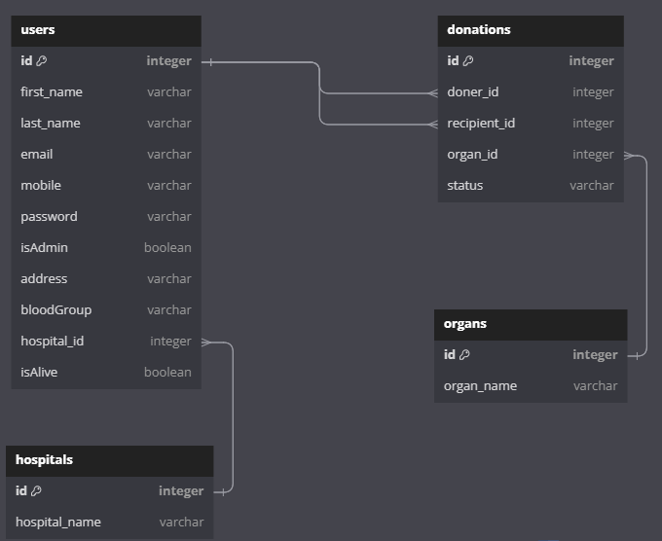
ER-diagram

Slide 12
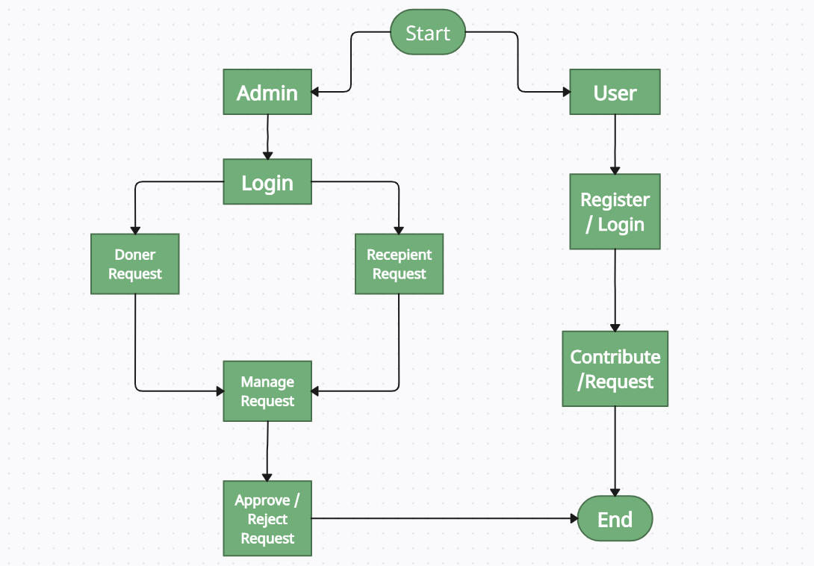
Data flow diagram

Slide 13
Outputs
“
”

Slide 14
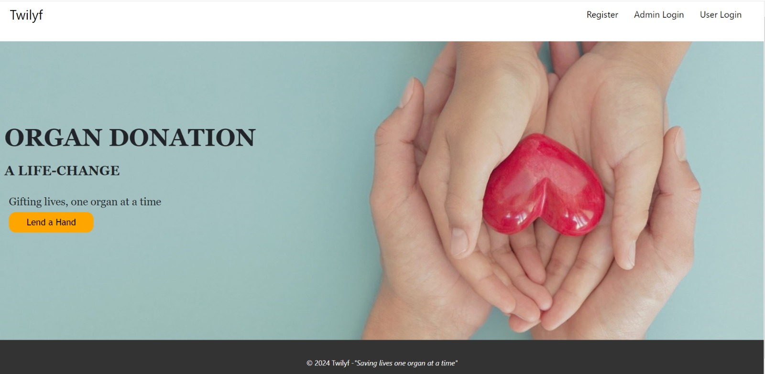
LANDING PAGE

Slide 15
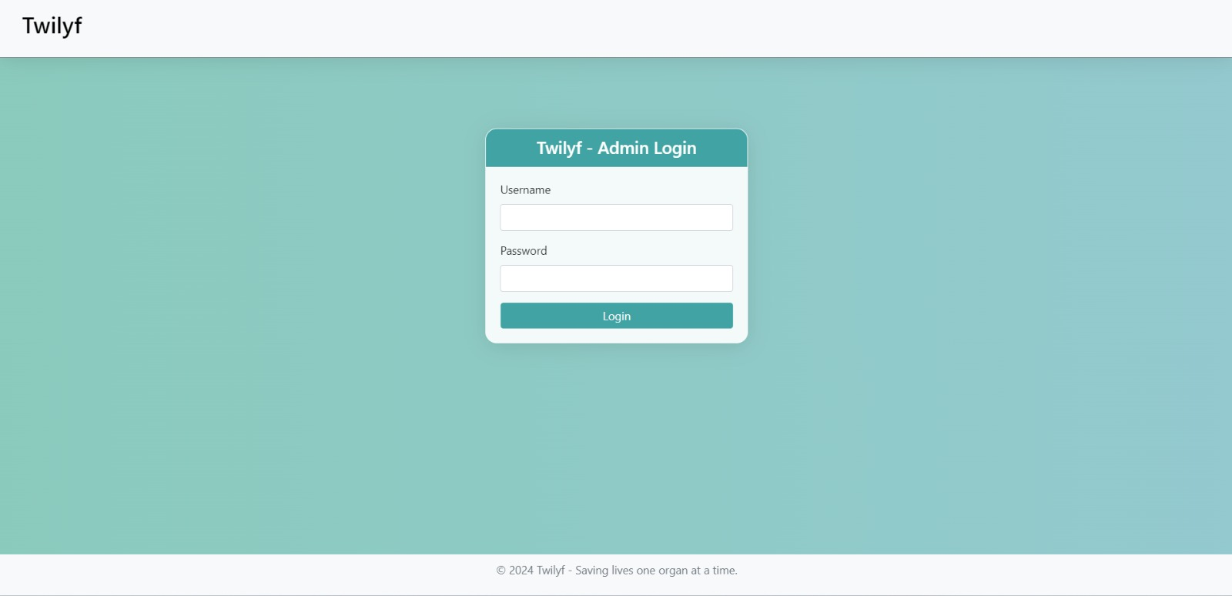
Admin Login

Slide 16
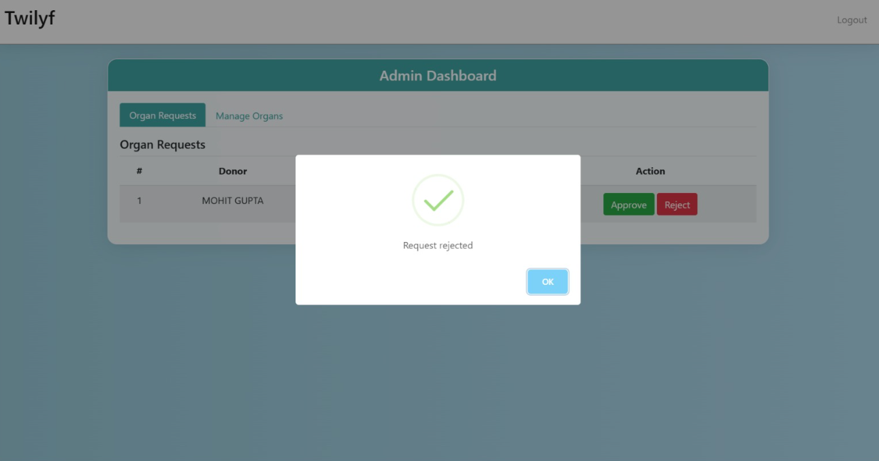
Admin dashboard

Slide 17
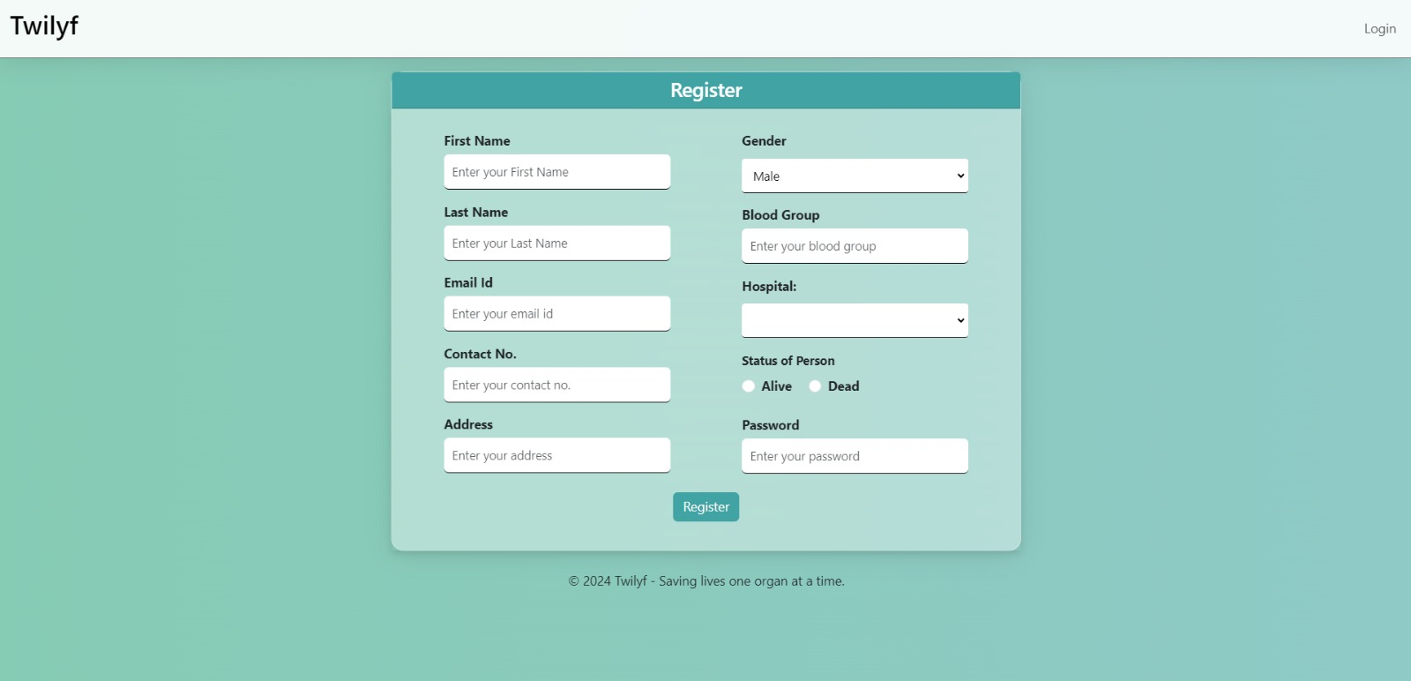
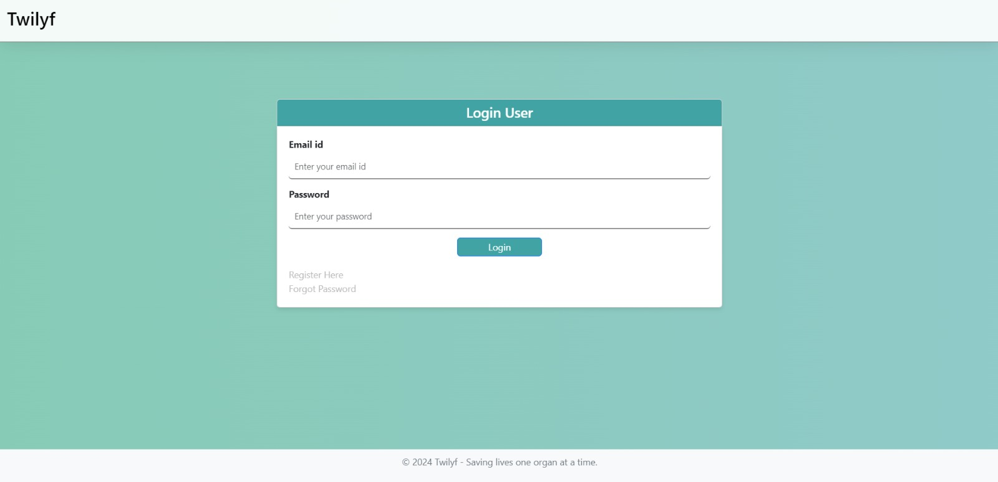
USER REGiSTER AND LOGIN

Slide 18
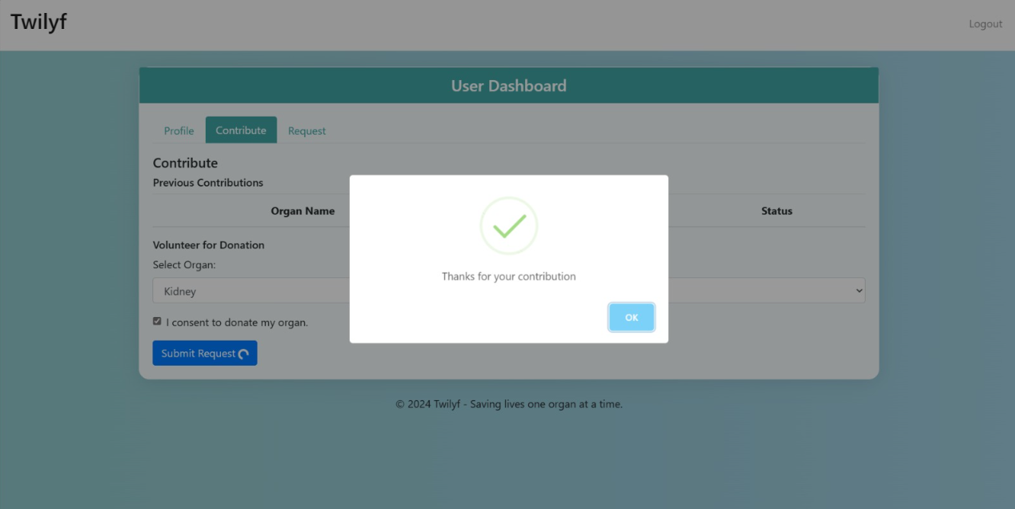
USER DASHBOARD

Slide 19
Future scope
Enhanced Algorithm for Matching using AI
Development of Mobile Applications
Channels for Real-Time Communication
Blockchain Technology Integration for Openness
Users Feedback Mechanisms
Multilingual Support

Slide 20
THANK YOU

