Slide 1

Fire and Smoke detection using images
By
Sarthak Dave(AU2244001)
Yukta Patel(AU2244002)
Saiyam Sanghvi(AU2244003)
Dhaval Makwana(AU2244004)

Slide 2

Introduction
The detection of fire and smoke is of utmost importance in various applications, including building safety, forest fire monitoring, and industrial applications. Traditional methods for detecting fire and smoke rely on manual inspection or human observation, which can be time-consuming, labor-intensive, and sometimes unreliable. In recent years, with the advent of deep learning, computer vision-based methods have emerged as a promising approach for fire and smoke detection.
Problem Statement
Is to develop more reliable, efficient, and effective fire and smoke detection systems to improve safety and minimize the risk of fire-related accidents and fatalities.

Slide 3
Existing body of work
Existing body of work
Deep learning based forest detection approach using UAV and YOLOv3
This paper proposes a CNN algorithm using YOLOv3 on UAV-based aerial images, achieving 83% recognition rate and 3.2 fps detection, with advantages for real-time forest fire detection. A UAV platform is also developed.
Convolution Network and its application in vision
Convolutional Networks (ConvNets) are a trainable architecture that can learn invariant features, which are important for intelligent tasks such as visual perception, auditory perception, and language understanding. New unsupervised learning algorithms and non-linear stages make it possible to train ConvNets with very few labeled samples. Applications include visual object recognition and vision navigation for off-road mobile robots.

Slide 4
Approach
Main Idea
The main idea of fire and smoke detection is to develop and implement reliable and efficient systems that can detect the presence of smoke or fire in buildings and other structures quickly. This helps to improve safety and reduce the risk of fire-related accidents and fatalities.
How we will be implementing
In this project, we will leverage some of these techniques to develop a fire and smoke detector using Keras, Deep Learning, and Computer Vision.

Slide 5
Implementation details
We collected the different types of images of Fire and non-fire area.
2) In libraries we explored about TensorFlow, keras, cv2.
3) This network utilizes depth wise separable convolution rather than standard convolution as depth wise separable convolution:
Is more efficient
Requires less memory
Requires less computation
As we have learned CNN is more efficient, require less memory power, require less computational power, and can perform better than standard convolution in some cases. We built the build method as the model is instantiated.
4) Creating the training script for training the model.

Slide 6
Implementation details
5) Data preprocessing and Exploring the dataset.
6) Training the our CNN model.
7) Explored the Prediction.
8) Tried to implement YOLO for image detection.

Slide 7
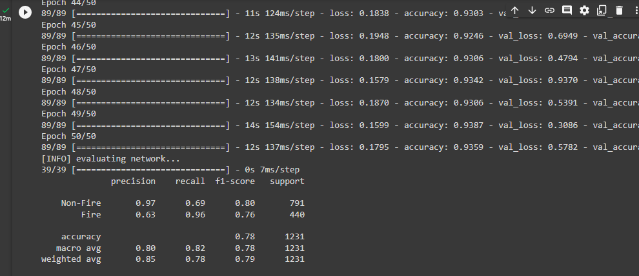
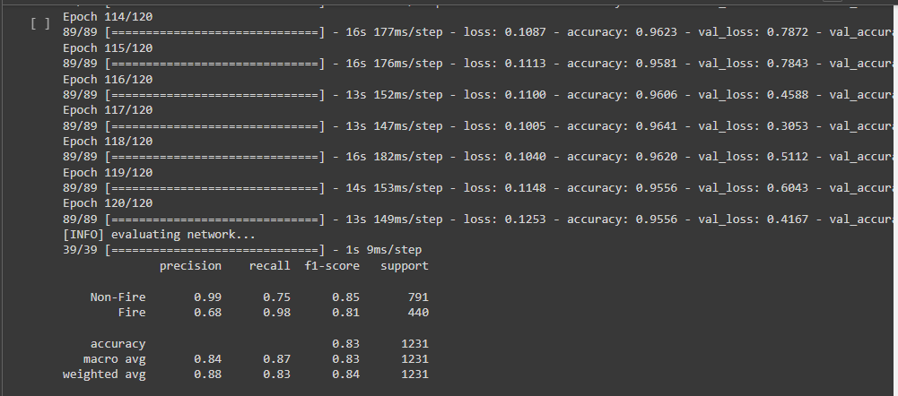
Results
Training the model
Learning rate 1e-2 at 50 Epoch
Learning rate 1e-2 at 120 Epoch

Slide 8
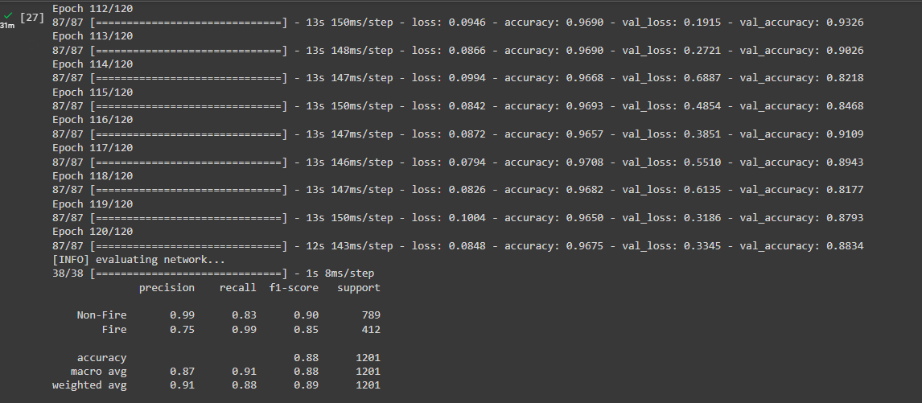
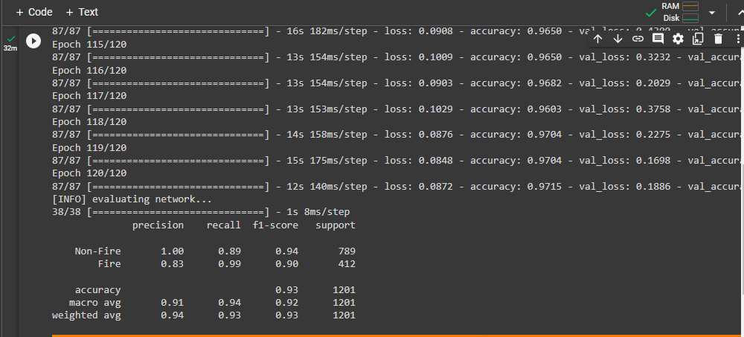
Results
Training the model after cleaning the data
Learning rate 1e-1 at 120 Epoch
Learning rate 1e-2 at 120 Epoch

Slide 9
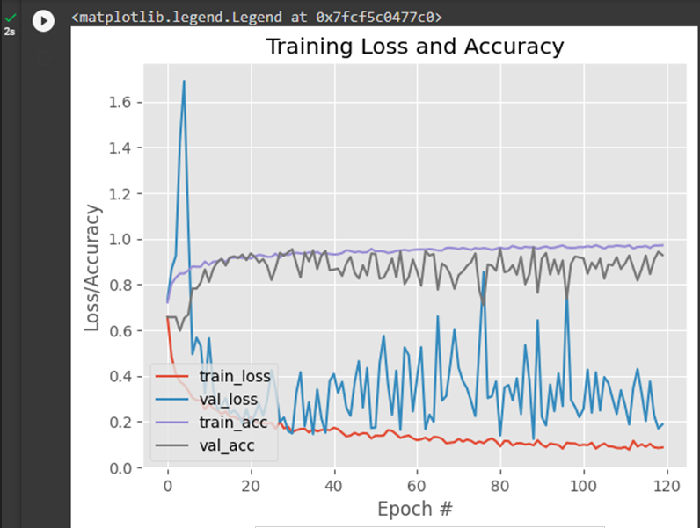
Results
Training loss and accuracy

Slide 10
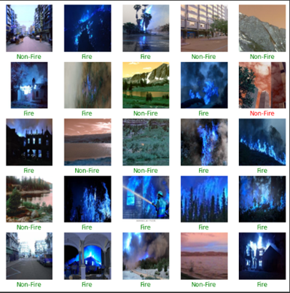
Results
Exploring Predictions

Slide 11
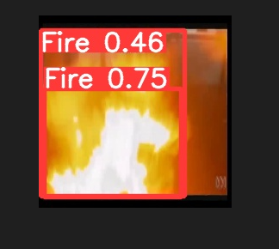
Results
Implemented YOLO Model

Slide 12
Role of each group member
Sarthak Dave
Literature Review
Data Exploration
Implemented CNN model
Implemented YOLO model
Yukta Patel
Literature Review
Data Exploration
Implemented CNN model
Implemented YOLO model
Saiyam Sanghvi
Literature Review
Data Exploration
Implemented CNN model
Data Visualization
Dhaval Makwana
Literature Review
Data Exploration
Implemented CNN model
Data Visualization

Slide 13
Future work
Fire and smoke can be better detected with video, as fires often start off as a smolder, slowly build to a critical point, and then erupt into massive flames. Such a pattern is better detected in video streams rather than still images. Therefore, in the future, we will aim to implement these models using videos.
Additionally, our dataset was too small to create a high accuracy model, so we will also work on implementing it with a larger dataset.

Slide 14
References
Z. Jiao, Y. Zhang, J. Xin, L. Mu, Y. Yi, H. Liu and D. Liu, A Deep learning based forest fire detection approach using uav and yolov3, 1st Int. Conf. Indust. Artif. Intell. (2019) 1–5.
H. Pranamurti, A. Murti and C. Setianingsih, Fire Detection Use CCTV with Image Processing Based Raspberry Pi, J. Phys.: Conf. Ser. 1201(1) (2019) 012015.
S.B. Kukuk and Z.H. Kilimci, Comprehensive analysis of forest fire detection using deep learning models and conventional machine learning algorithms, Int. J. Co
Y. LeCun, K. Kavukcuoglu and C. Farabet, Convolutional networks and applications in vision, ISCAS 2010-2010 IEEE Int. Symp. Circ. Syst.: Nano-Bio Circuit Fabrics Syst. (2010) 253–256.
T. Y. Lin, P. Doll ́ar, R. Girshick, K. He, B. Hariharan and S. Belongie, Feature pyramid networks for object detection, Proc. 30th IEEE Conf. Computer Vision and Pattern Recogn. Janua 2017 936–944.

Slide 15
Thank
You!

