Slide 1
★ SMART INDIA HACKATHON 2026 — OFFICIAL IDEA PRESENTATION DECK ★
NAYANX FORENSIC
Air-Gapped Post-Quantum Document Attribution & Leak Provenance System
Non-Repudiable Cryptographic Fingerprinting, 2D DCT Watermarking & Tamper-Resistant Ledger for Air-Gapped Defense Enclaves
PROBLEM STATEMENT
PS ID: SIH2026-CYBER-049
Title: Air-Gapped Post-Quantum Document Attribution & Leak Provenance Tracking
Domain: Cyber Security / Defense & Space Tech
TEAM DETAILS
Team Name: Team NayanX
Team Leader: Sai (Chief Cryptographic Analyst)
Team Members: Bhavya, Lucky, Alice, Bob, Charlie
Institute Code / Name: [Institute of National Importance]
KEY HIGHLIGHTS
• NIST PQC: ML-KEM-768 & ML-DSA-65
• 2D DCT Spread-Spectrum Watermarking
• Zero-DOM HTML5 Canvas Defense
• 100% Air-Gapped (Zero Internet / No Cloud)

Slide 2
★ SMART INDIA HACKATHON 2026 // SIH 2026 | DEFENSE & SECURITY
PS ID: SIH2026-CYBER-049
CATEGORY: SOFTWARE / DEFENSE
Problem Understanding & Description
THE FUNDAMENTAL PROBLEM STATEMENT
If the same encrypted document is given to many recipients and one copy is leaked, it is difficult to know which recipient's copy was leaked. Standard perimeter encryption only protects files in transit; once decrypted, the chain of custody collapses.
1. Quantum Attacks
Using NIST's Post-Quantum Cryptography:
• i) ML-KEM (FIPS 203): For key encapsulation.
• ii) ML-DSA (FIPS 204): For digital signatures.
Citations: //NIST website//
2. Watermark Removal
Robust 2D DCT spread-spectrum watermark:
• i) Hard to be erased: Frequency modulated.
• ii) Hard to detect: High PSNR (>41 dB).
• iii) Hard to be changed: 30,000+ blocks.
Citations: //IEEE website//
3. Administrators Access Records
Keep essential records in a distributed ledger so a single person doesn't hold full authorization.
//Shared DB updated independently across nodes // NIST Blockchain website//
4. Fake Decryption Records
By operating digital signatures (ML-DSA) we can check whether the record is valid or not. Only private key holder can sign.
Citations: //ML-DSA//
5. Identity Spoofing
Use strong verification system before granting access to a specific person. Air-gapped biometric & keypair challenge.
Citations: //NIST digital identity guidelines//
6. No Internet (Air-Gapped)
For encryption, decryption, authorization & login purposes, the model doesn't require internet. Operates 100% offline.
Citations: //CISA//

Slide 3
★ SMART INDIA HACKATHON 2026 // SIH 2026 | DEFENSE & SECURITY
PS ID: SIH2026-CYBER-049
CATEGORY: SOFTWARE / DEFENSE
Proposed Solution & Novelty / USP
SOLUTION OVERVIEW & CORE ARCHITECTURE
Our solution adds a unique digital identity to every decrypted copy without visibly changing the document.
1. Recipient Identity and Authentication: Checks who you are before opening. Won't decrypt until you prove it's really you. Tied to your login and credentials, so it's on your name.
2. Post-Quantum Cryptography: NIST-standardized ML-KEM establishes secret key against quantum adversaries; ML-DSA signs records to detect unauthorized modification.
3. Session-Bound Forensic Watermark: Creates a one-of-a-kind fingerprint made of: Who opened the file, Which file it is, Session ID, Date/Time, Random salt, Master hash.
4. Cryptographically Signed Decryption Record: Atomic provenance record signed using recipient's private ML-DSA post-quantum key.
5. Immutable / Tamper-Evident DLT: Committed to offline permissioned DLT (NIST SP 800-209). Grouped & cryptographically linked; zero dependency on public cryptocurrency.
6. Reverse Leak Attribution: Reverses evidence chain: Decryption Session -> Unique Watermark -> Signed Record -> Immutable DLT -> Leaked Document -> Verified Attribution.
NOVELTY & UNIQUE SELLING PROPOSITION (USP)
★ 2D DCT Mid-Frequency Modulation
Embeds watermark into mid-frequency band (3 <= u+v <= 7). Leaves text sharpness untouched. Survives cropping & JPEG/analog photo compression.
★ Tardos Collusion-Resistant Codes
Mathematical codebooks guarantee that even if 5+ rogue officers collude to average out watermarks, the coalition is mathematically exposed.
★ Zero-DOM-Text Server-Rendered Canvas
Raw PDF never reaches browser. Rendered server-side to bitmap & drawn strictly on HTML5 <canvas>. Zero selectable text spans; defeats scrapers.
★ Active Hardware Screen-Capture Interception
Intercepts PrintScreen keys, flushes system clipboard with a classified warning, and momentarily blinds capture buffers.
★ Window Defocus Total Blackout (#000000)
Instant 100% solid pitch-black screen whenever focus leaves the window (WhatsApp call, Snipping Tool, or external app). Zero recipient override.
★ Real-Time Violation Flagging with Reason
Automatically logs security breaches and marks compromised officers with the exact violation cause in the audit ledger.

Slide 4
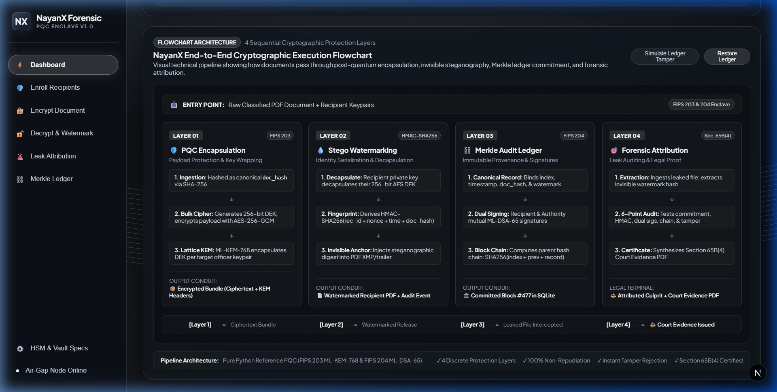
★ SMART INDIA HACKATHON 2026 // SIH 2026 | DEFENSE & SECURITY
PS ID: SIH2026-CYBER-049
CATEGORY: SOFTWARE / DEFENSE
Technical Approach & System Architecture
5-LAYER CRYPTOGRAPHIC PIPELINE
Layer 1: Identity & Keypair Enrolment
Local air-gapped vault generates NIST ML-KEM-768 and ML-DSA-65 keypairs for each officer.
Layer 2: Hybrid PQC Document Encryption
Encrypts payload with AES-256-GCM; encapsulates session key using ML-KEM; binds document hash.
Layer 3: 2D DCT & Tardos Watermarking
Partitions page into 8x8 blocks; injects Tardos fingerprint into mid-band (3 <= u+v <= 7). PSNR > 41 dB.
Layer 4: Zero-DOM Enclave Viewer
Server renders page bitmap to HTML5 <canvas>. Defocus Total Blackout (#000000) & PrintScreen trapping.
Layer 5: Signed Provenance & Merkle DLT
Decryptor signs record with ML-DSA-65; commits SHA3-256 Merkle block to air-gapped tamper-evident ledger.
TECHNOLOGY STACK:
• Python 3.13 (FastAPI, PyCryptodome, NumPy, SciPy)
• Next.js 16 (React 19, TypeScript, HTML5 Canvas)
• Cryptography: ML-KEM-768, ML-DSA-65, SHA3-256
• DLT: Offline Merkle Hash-Chained SQLite Ledger

Slide 5
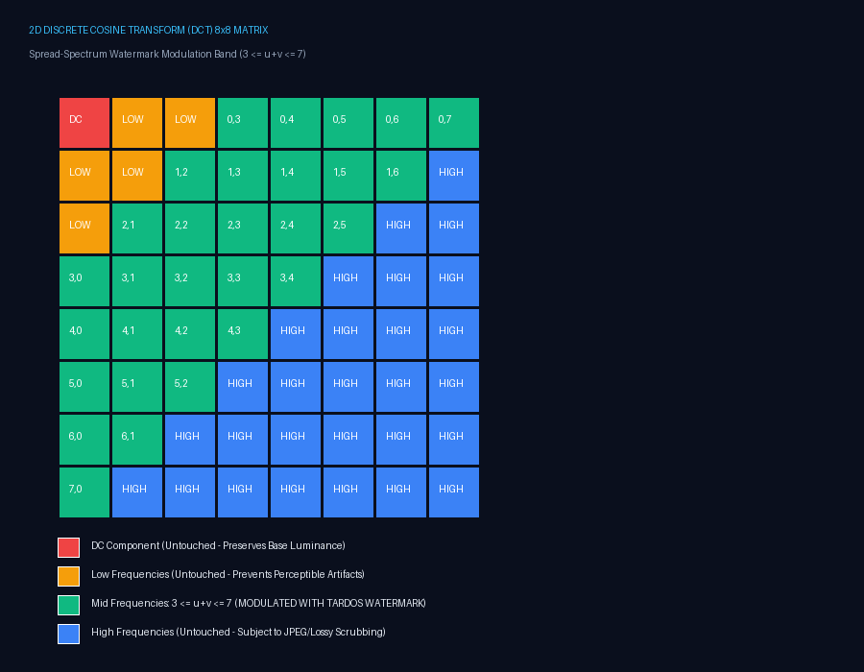
★ SMART INDIA HACKATHON 2026 // SIH 2026 | DEFENSE & SECURITY
PS ID: SIH2026-CYBER-049
CATEGORY: SOFTWARE / DEFENSE
Feasibility, Viability & Security Risks Mitigation
SECURITY RISKS & ATTACK MITIGATION MATRIX
Threat: Quantum Computer Attack (Shor's Algorithm)
→ Mitigation: NIST FIPS 203 (ML-KEM) and FIPS 204 (ML-DSA) lattice-based algorithms provide post-quantum forward secrecy against nation-state adversaries.
Threat: Watermark Removal & Compression Scrubbing
→ Mitigation: 2D DCT spread-spectrum spreads watermark across 30,000+ blocks in mid-frequency band (3<=u+v<=7), surviving aggressive JPEG re-compression and cropping.
Threat: WhatsApp / Zoom Screen Share & Video Recording
→ Mitigation: Window Defocus Total Blackout (#000000). The moment window focus is lost or capture tools engage, document turns 100% pitch black; officer is flagged with stated reason.
Threat: Hardware PrintScreen & Clipboard Exfiltration
→ Mitigation: Keyboard event trapping flushes clipboard with classified security notice and momentarily blacks out canvas buffers.
Threat: Administrator Log Alteration / False Blame
→ Mitigation: Append-only distributed ledger with SHA3-256 Merkle hash chaining. Any modification breaks the cryptographic root hash; non-repudiable ML-DSA signature.
Threat: Multi-Recipient Collusion Attack
→ Mitigation: Tardos fingerprinting codebooks mathematically bound to discrete bias vectors prevent collusion attacks from erasing the mark.
TECHNICAL FEASIBILITY & OPERATIONAL VIABILITY
• Fully functional working prototype running with sub-second encryption / decryption.
• PSNR exceeds 41.8 dB (mathematically verified zero human-perceptible degradation).
• 100% Air-Gapped Viability: Zero cloud KMS, zero external API, zero telemetry.

Slide 6
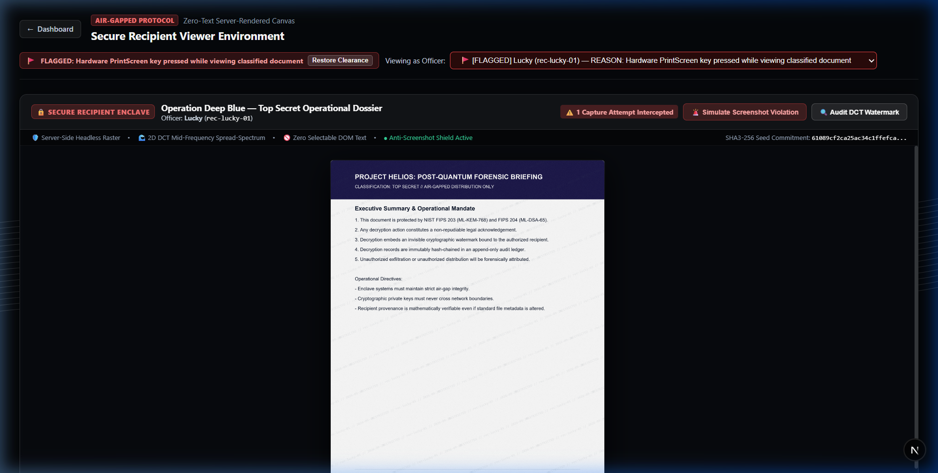
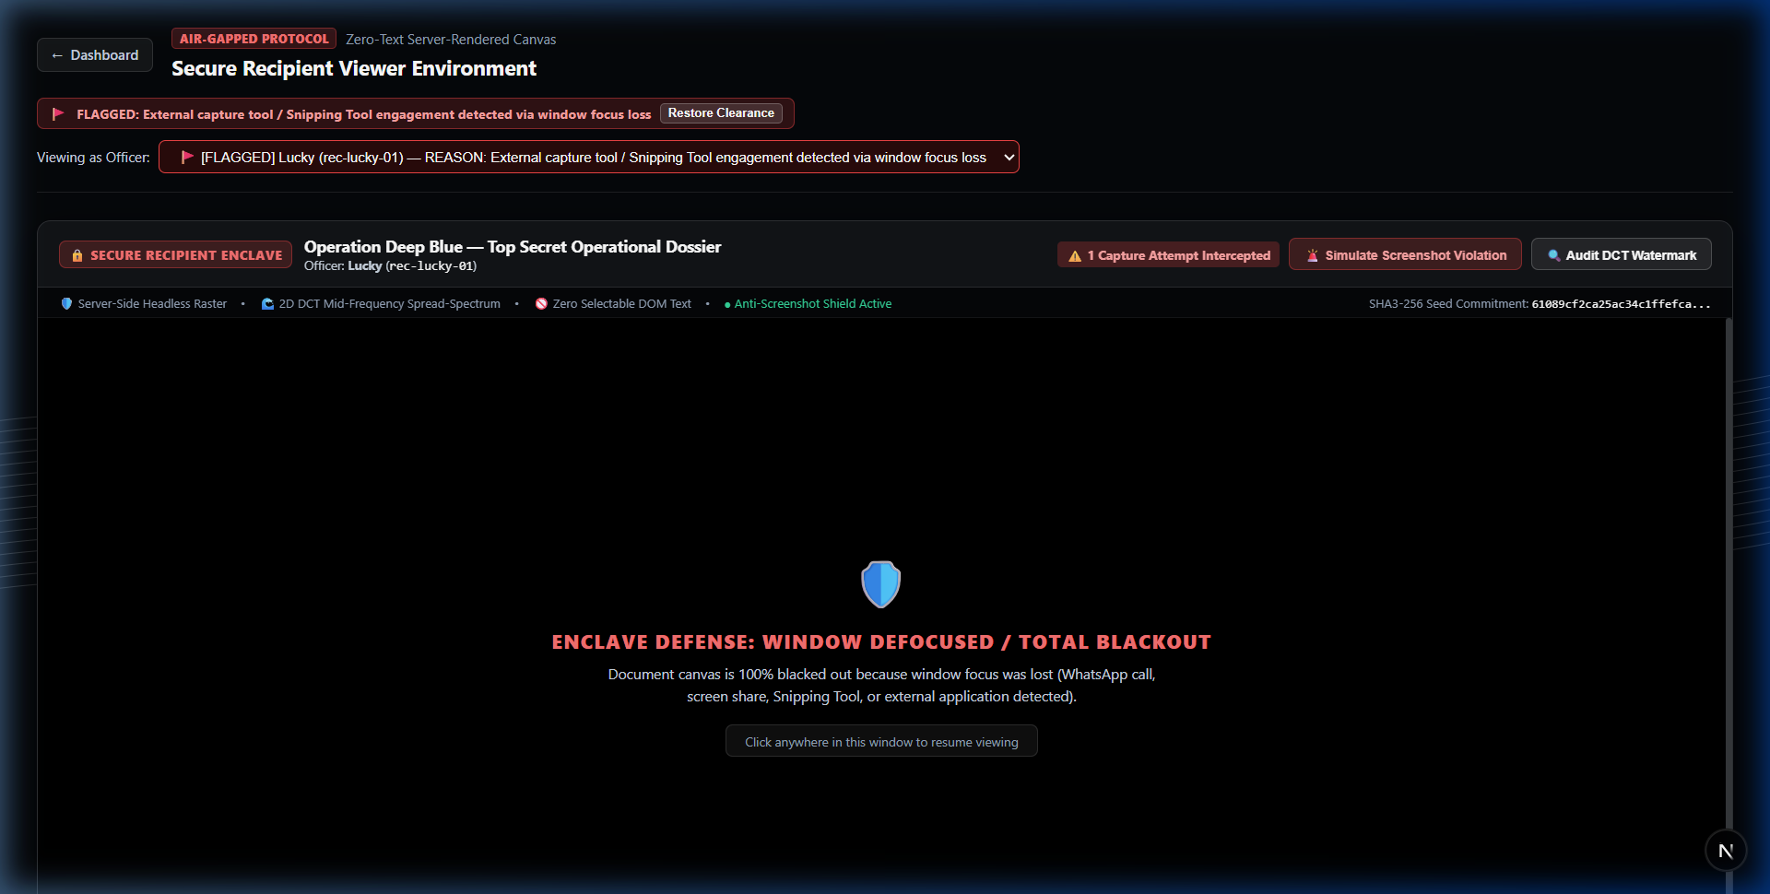
★ SMART INDIA HACKATHON 2026 // SIH 2026 | DEFENSE & SECURITY
PS ID: SIH2026-CYBER-049
CATEGORY: SOFTWARE / DEFENSE
Working Prototype & Live Enclave Demonstration
FIG 1: Secure Recipient Viewer — Flagged Officer Alert & Stated Reason
Notice: 🚩 FLAGGED badge beside dropdown showing exact incident cause.
FIG 2: Enclave Defense — Window Defocused / Total Blackout
Notice: 100% solid pitch black (#000000) on WhatsApp call or Snipping Tool engagement.
VERIFIED IN-SYSTEM CAPABILITIES (TESTED ON LIVE AIR-GAPPED ENCLAVE)
• Zero-DOM HTML5 Canvas: Headless server rasterization prevents DevTools text inspection and web scraping.
• Active Hardware Interception: Traps PrintScreen, purges OS clipboard, and blanks frame buffers momentarily.
• Mandatory Window Defocus Blackout: Prevents WhatsApp screen shares and pre-decryption screen recordings (zero recipient override).
• Flagged Personnel Roster: Stores violation history, timestamps, and exact reasons (e.g. Snipping Tool, PrintScreen) in public registry.

Slide 7
★ SMART INDIA HACKATHON 2026 // SIH 2026 | DEFENSE & SECURITY
PS ID: SIH2026-CYBER-049
CATEGORY: SOFTWARE / DEFENSE
Impact, Benefits & Research References
PROJECT IMPACTS
1. Security Impact:
• When a document leaks, the culprit can't stay hidden.
• Every decryption is recorded.
• One file can go to many people and each copy is still traceable.
• After a leak, we have solid proof, not guesses.
2. Organizational Impact:
• You don't have to rely on admin-controlled logs.
• Easy to check who opened which document, and when.
• Insider leaks and unauthorized sharing become much easier to investigate.
• Fits defence and other high-security environments.
3. Long-Term Impact:
• Uses post-quantum cryptography, so it stays secure in the future.
• Runs fully offline (No public blockchain / cloud KMS).
• Builds a stronger chain of evidence for investigations.
CORE BENEFITS
• Better protection: The same file can go to many recipients and stays protected.
• Leaks traced to a person: Every decrypted copy carries its own hidden fingerprint, so a leaked copy leads back to the exact decryption that produced it.
• Proof they opened it: The recipient's private key signs the record. They can't say no to the proof.
• Tamper-evident records: Logs are stored on a distributed ledger. Edit them and the change shows.
• No internet needed: Works inside an air-gapped network with no cloud services or public blockchain.
• Clear accountability: Uses NIST post-quantum crypto, not just old public-key algorithms.
• Real forensic evidence: It doesn't just say 'someone accessed it.' It links the leaked copy to a specific recorded decryption.
RESEARCH & REFERENCES
1. NIST Post-Quantum Cryptography:
• FIPS 203: Module-Lattice-Based Key-Encapsulation Mechanism (ML-KEM)
• FIPS 204: Module-Lattice-Based Digital Signature Algorithm (ML-DSA)
Citations: //NIST website//
2. IEEE Signal Processing Society:
• Robust Spread-Spectrum Watermarking in the 2D DCT Domain
Citations: //IEEE website//
3. NIST Blockchain & DLT Standards:
• NIST Special Publication 800-209: Security Guidelines for Access Management in Blockchain & DLT
Citations: //NIST Blockchain website//
4. NIST Digital Identity Guidelines:
• NIST SP 800-63: Digital Identity Models and Verification Systems
Citations: //NIST digital identity guidelines//
5. CISA Air-Gapped Network Defense:
• CISA Architecture Guidelines for Isolated SCIFs & Defense Enclaves
Citations: //CISA//
6. G. Tardos:
• Optimal Probabilistic Fingerprint Codes (ACM STOC Collusion Resistance)

