Slide 1
Smart Farming Tehran Polytechnic(AUT) Instrumentation IOT Project
Sajad Ghadiri
Mostafa Hamidifard
Mohammad Barabadi MohammadMahdi Malverdi

Slide 2
Smart Farming
Introduction
Targets
Sensors
Advantages and Disadvantages

Slide 3
Sensors
LM35DZ
DHT11
YL-69
YF-S201
BH1750
More info in appendix

Slide 4
Producing Real Time Data
Why?
Matlab Real Time System
We used UINT32 and encoding

Slide 5
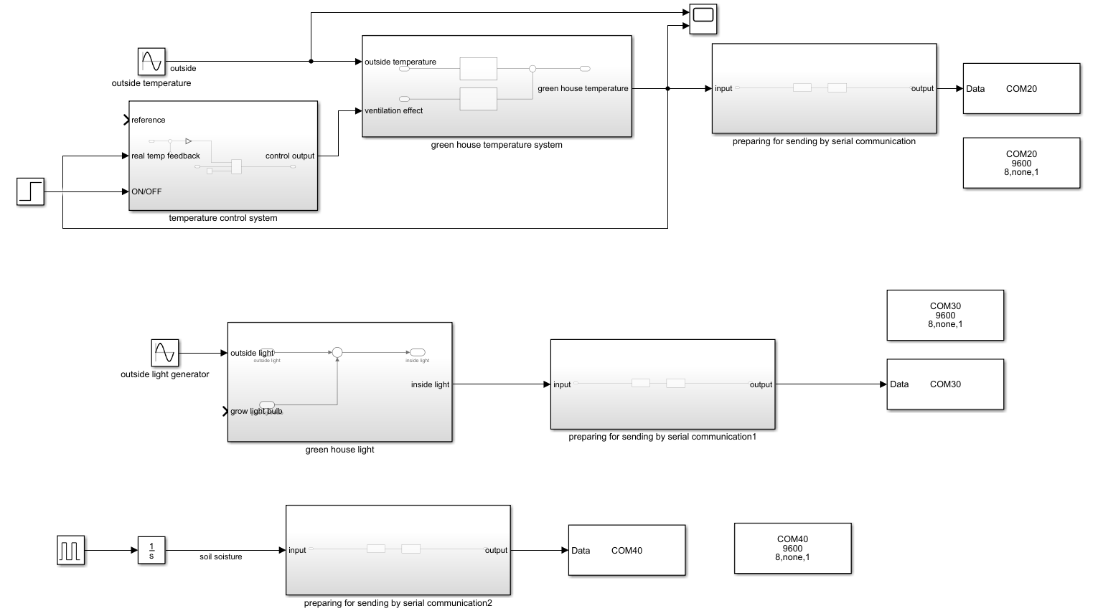
Matlab Real Time System

Slide 6
Arduino Mega or Uno?
Arduino Mega
Arduino Uno
4 UART Serial Ports
More Pins
Higher Cost
1 UART Serial Port
Less Pins
Lower Cost

Slide 7
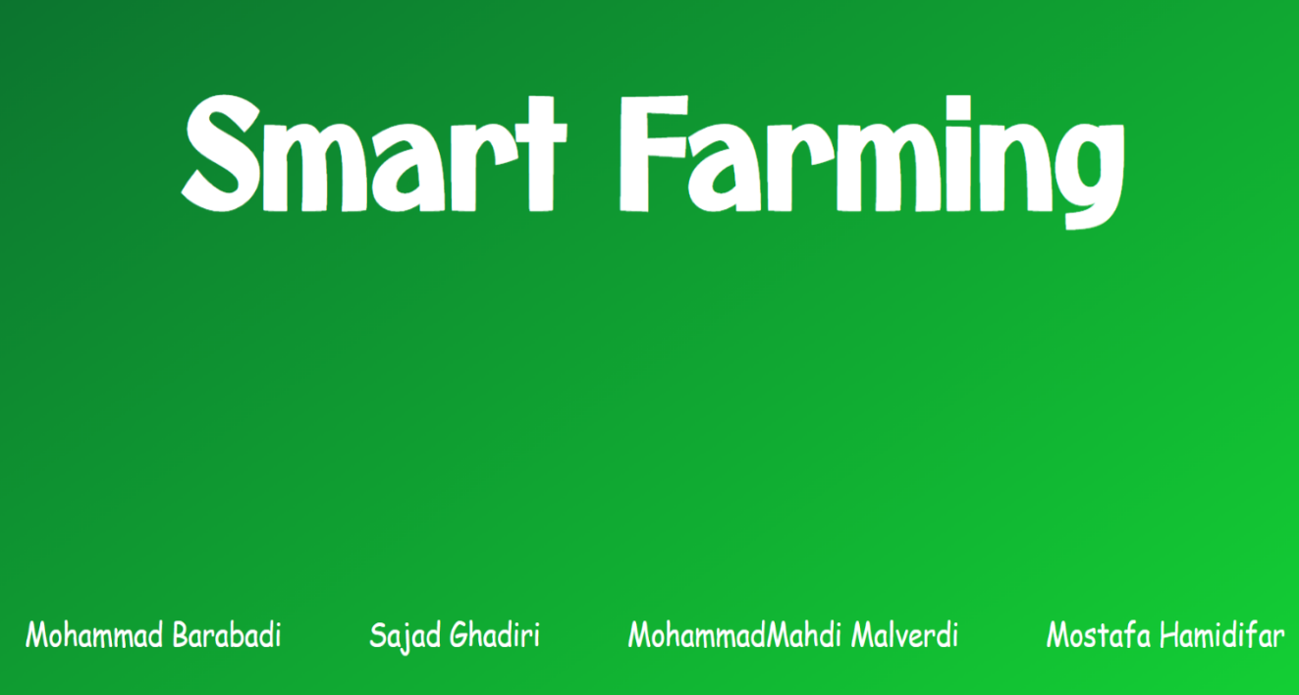
HTML & CSS
Introduction Page
members

Slide 8
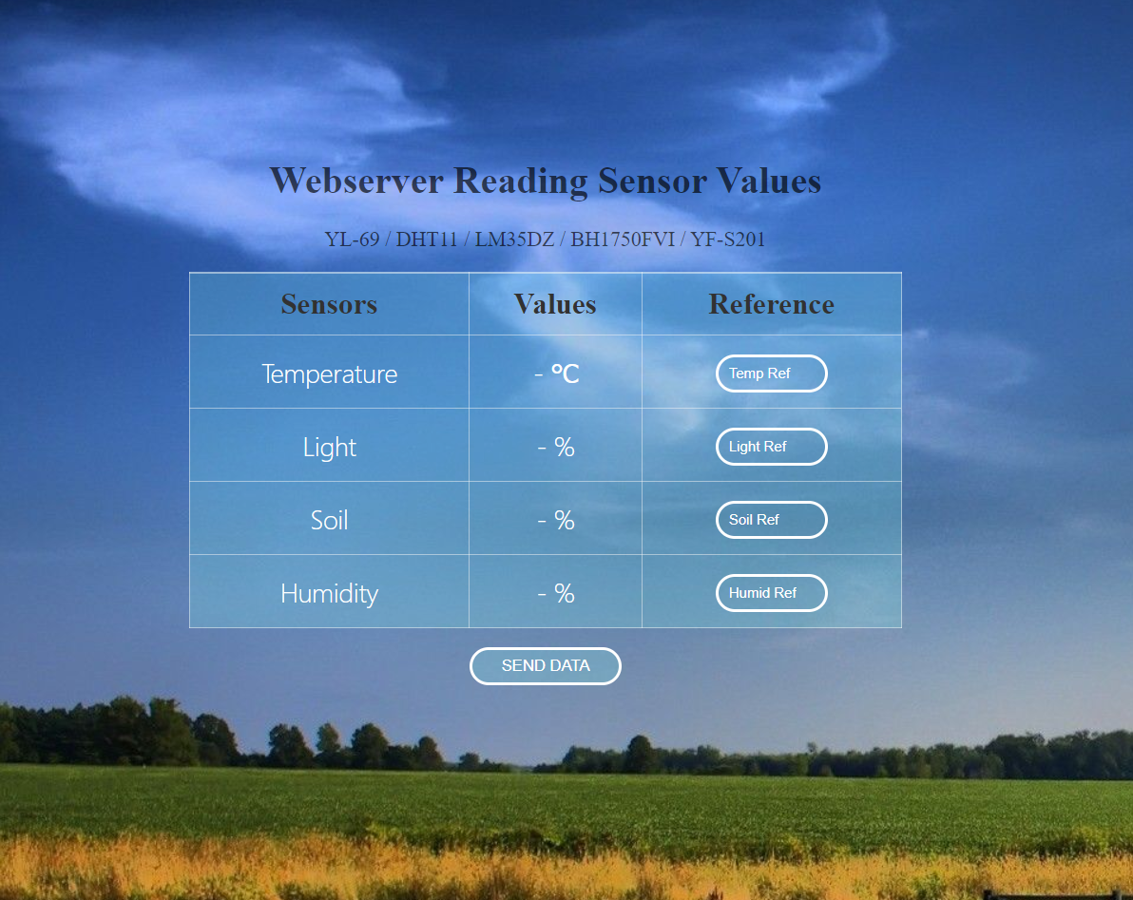
HTML & CSS & javascript

Slide 9
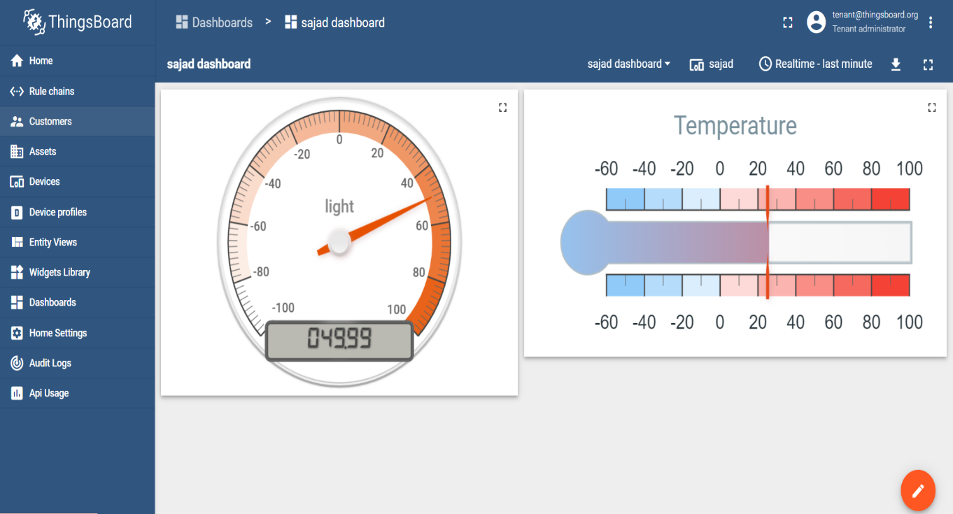
Thingsboard

Slide 10
Altium Designer
Just like a sketch
real implementation ?!

Slide 11
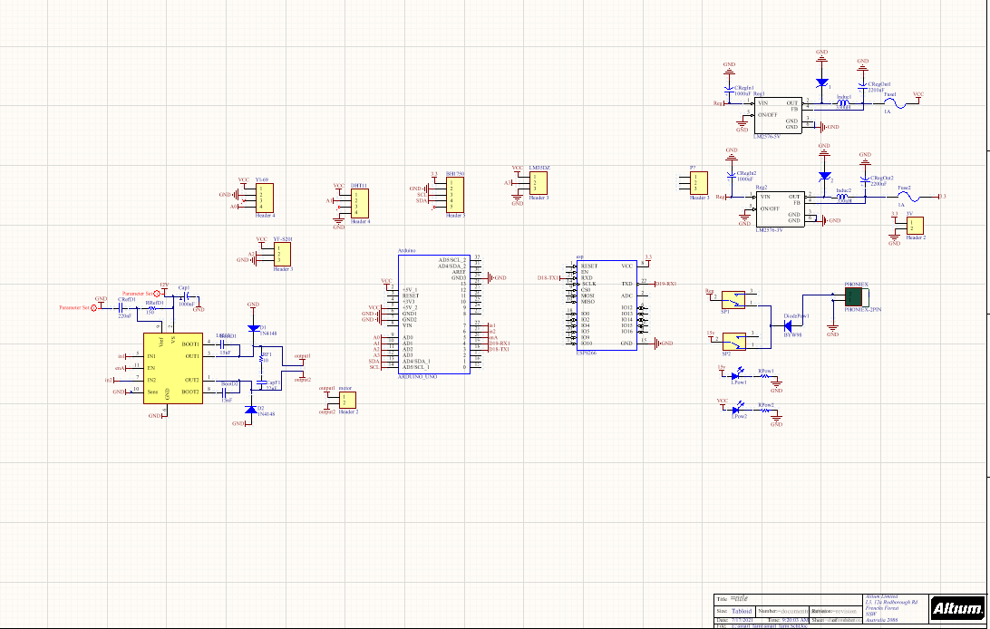
Schematic

Slide 12
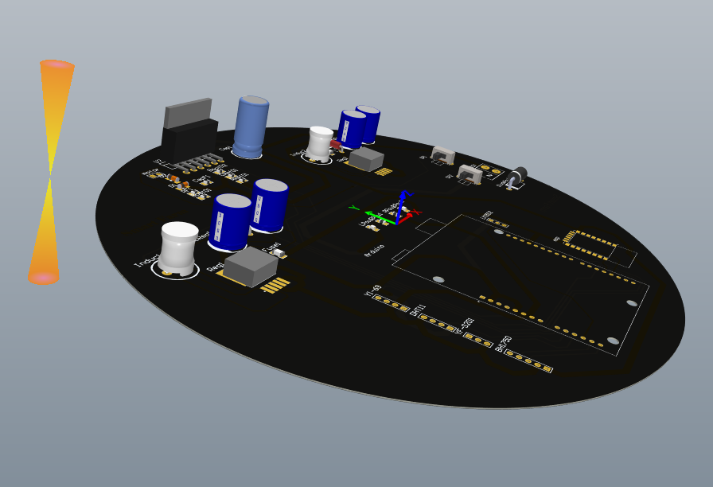
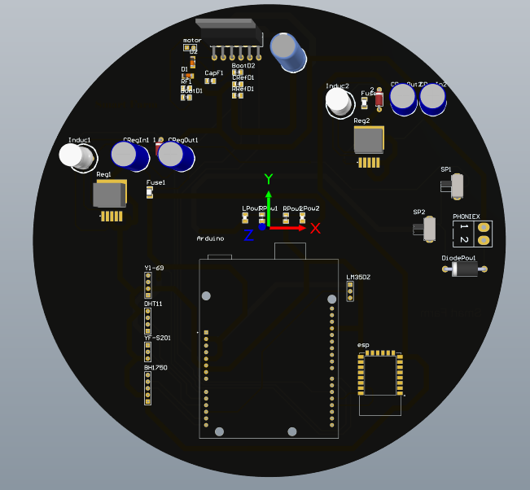
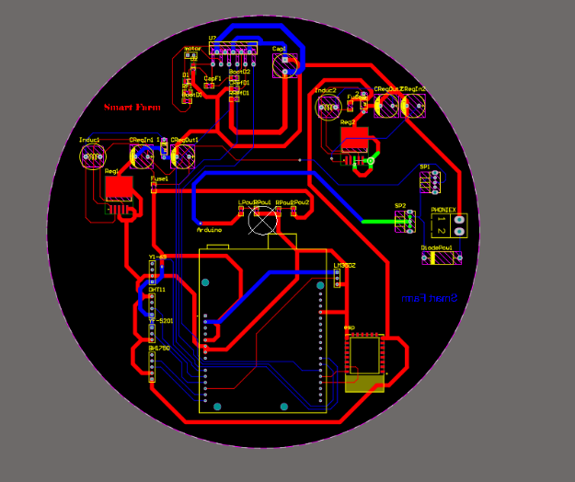
PCB

Slide 13
Thanks for your attention
Any Questions?

Slide 14
Appendix

Slide 15
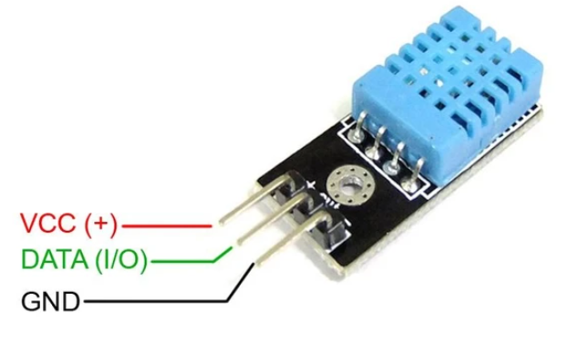
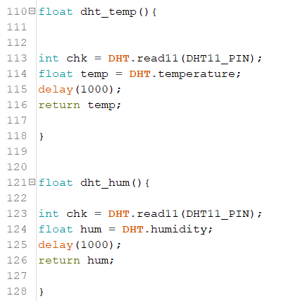
DHT11

Slide 16
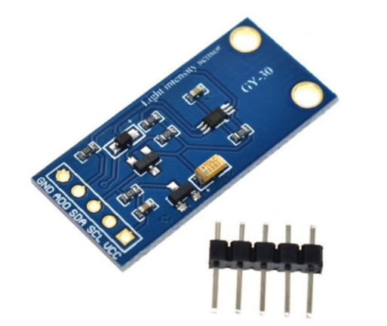
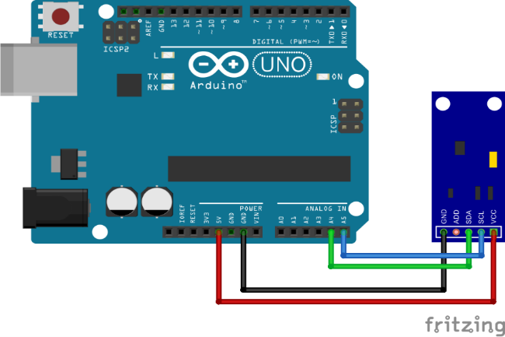
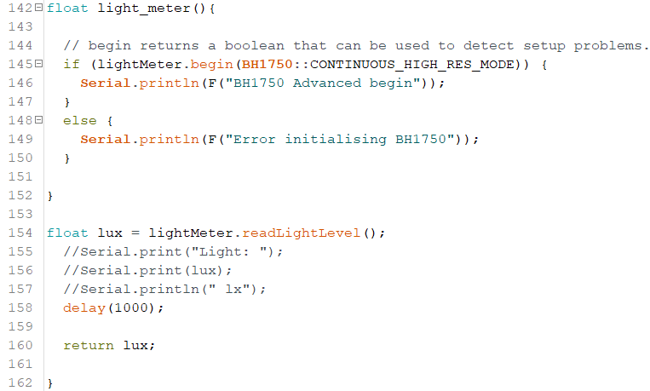
BH1750

Slide 17
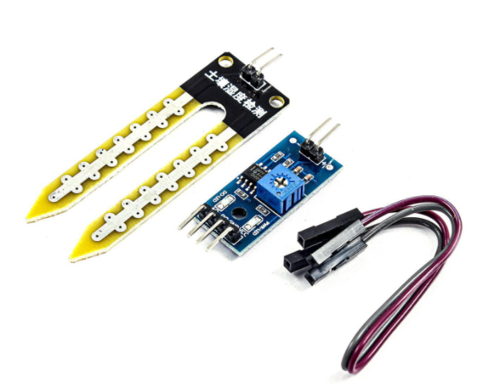
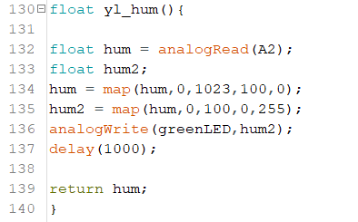
YL-69

Slide 18
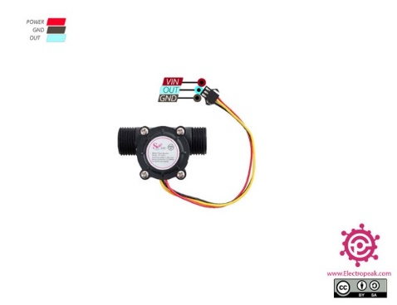
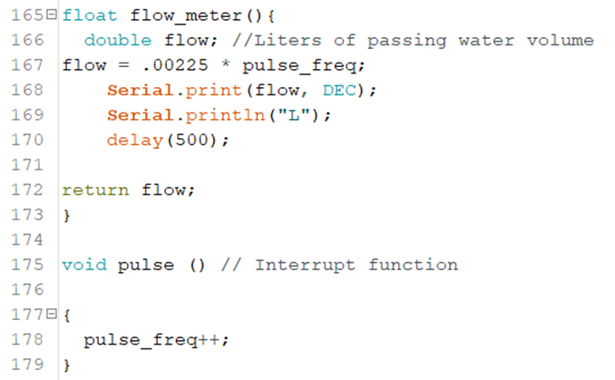
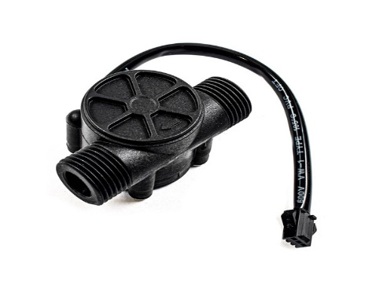
YF-S201

