Slide 1
Optimal Design of Rotating Sliding Surface in Sliding Mode Control
Saeedi, Sajad, MSc Beheshti H., Mohammad, Ph.D.
Tarbiat Modares University Tarbiat Modares University
SMC: Sliding Mode Control

Slide 2
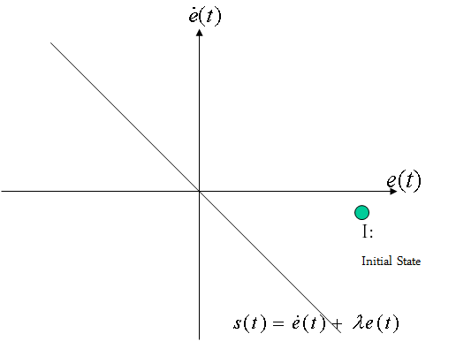
Introduction
Three main phases in SMC design:
Reaching Phase
Sliding Phase
Steady Phase
Our focus:
Reaching Phase
Notes:
The Green Point is the initial state at t = 0

Slide 3
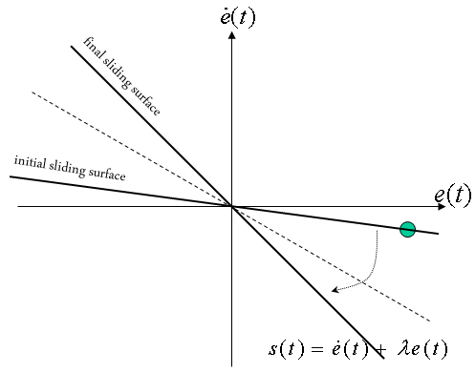
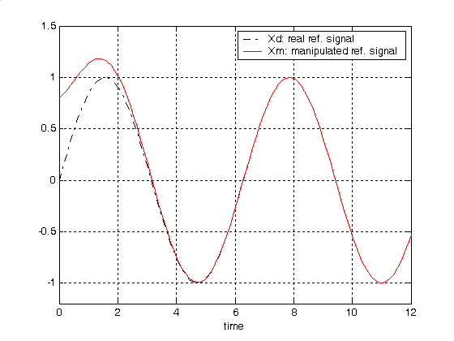
Introduction
During reaching phase the system is sensitive to parameter variation
Different methods to reduce reaching phase:
Rotating Surface method
Mediating method
Intelligent methods
Moving method
etc.
Our Focus: Rotating method
How to rotate: Optimal
Notes:
Rotating Surface method: An improved sliding surface design method for better controller performance is to deploy time-varying linear sliding surfaces instead of constant surfaces of classical methods. The linear sliding surface can be moved by rotating in such a direction that the tracking behavior can be improved.
Hence having the sliding phase and robust behavior from early beginning, the reaching phase can be eliminated or reduced. The initial value of the sliding surface should be designed such that it includes the initial states of the system or if not possible, closer to initial states and the final value should be designed based on system characteristics.
Mediating methods: In this method, initial tracking signal is changed to fit to the system initial values. The tracking signal gradually tends to its ideal state to have a perfect sliding phase.

Slide 4
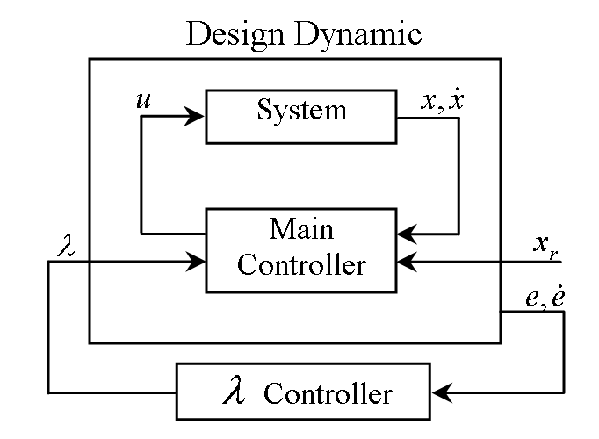
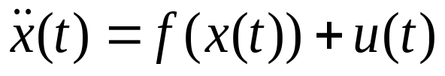
Design
Main idea: using error dynamics to design an optimal sliding surface.
System:
Notes:
Main idea: Sliding surface start to rotate from the given initial value to stop rotating on reaching to the final value of the sliding surface, but it rotates in such a way that the error dynamics keeps the minimum value based on a given criterion.
In the main Controller, Landa (the slope of the sliding surface), is used as a design parameter and in the Landa controller, Landa is designed based on the optimality criteria

Slide 5
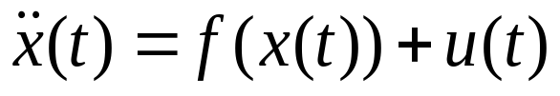
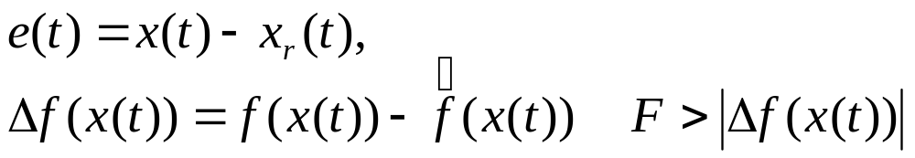
Design
System:
Sliding Surface:
q is the design parameter
Notes:
Main idea: Sliding surface start to rotate from the given initial value to stop rotating on reaching to the final value of the sliding surface, but it rotates in such a way that the error dynamics keeps the minimum value based on a given criterion.

Slide 6



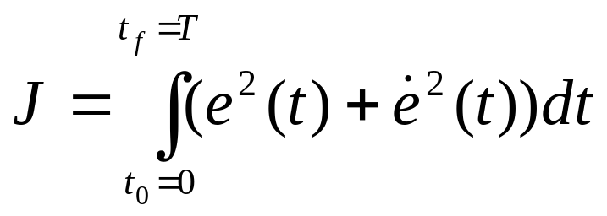
Design
Supposing that initial value of is such that sliding starts on the sliding surface, then we will have:
Now the target is to design , such that we can minimize the following performance index:
T is the reaching time to the final sliding surface, it can be fixed or free.
Applications: robotics, welding of metallic surfaces with welding robots where optimal design is important.

Slide 7
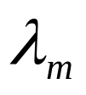
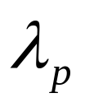

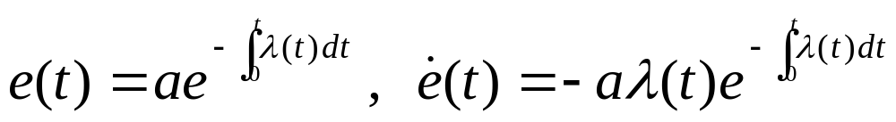
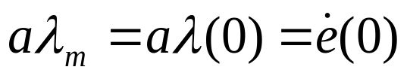
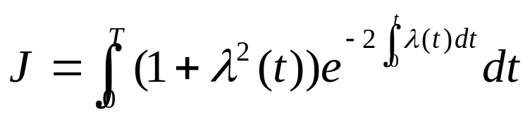
Design
is the initial value of
is the final value of
Solving results in:
a is related to the system initial value
Substitution will result in:
New form of the problem:
Find with known borders to minimize J.

Slide 8
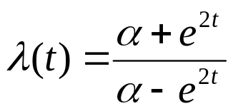
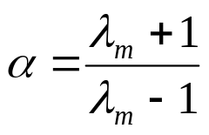
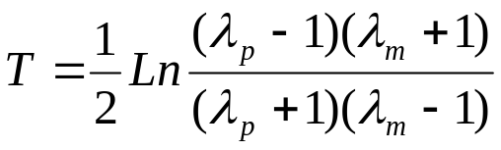
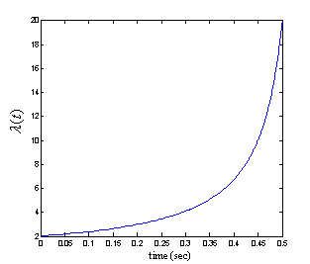


Design
Using Euler equation for optimization the solution is:
For ,
T will be 0.499 and : ➔

Slide 9

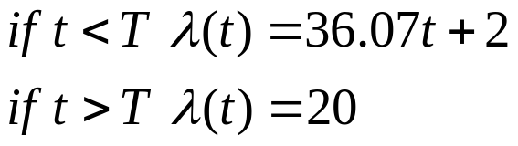

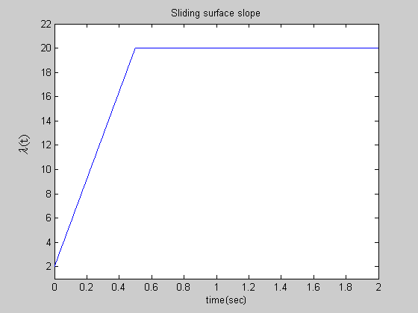
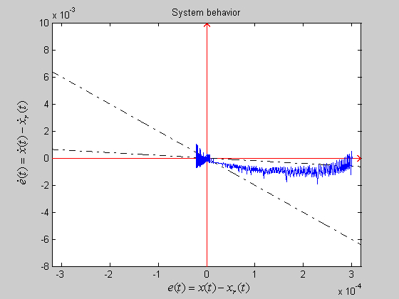
Simulation
Linear rotating sliding surface:

Slide 10
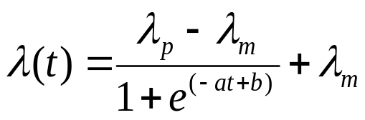
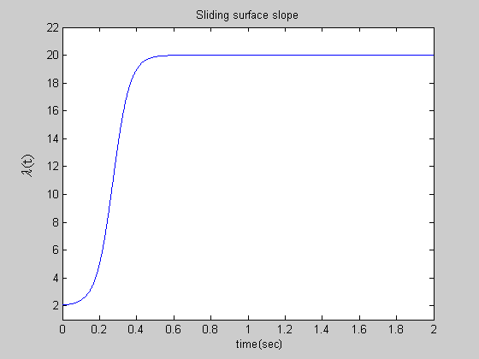
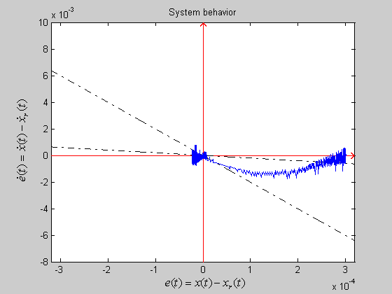
Simulation
Nonlinear rotating sliding surface
a and b are design parameters(a=22, b=6)

Slide 11
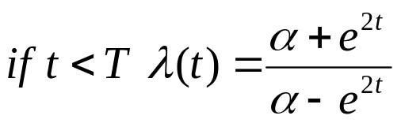
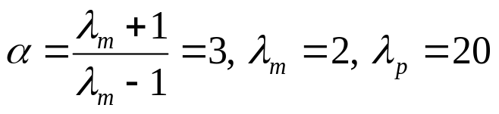

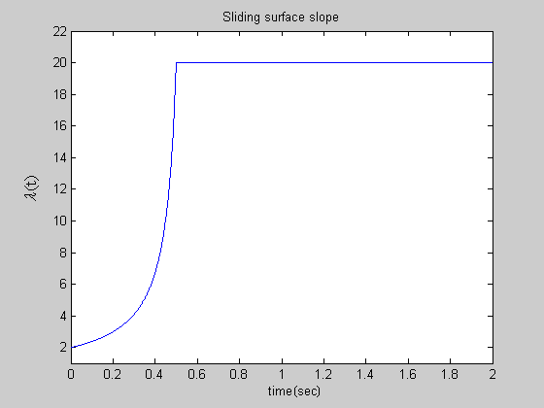
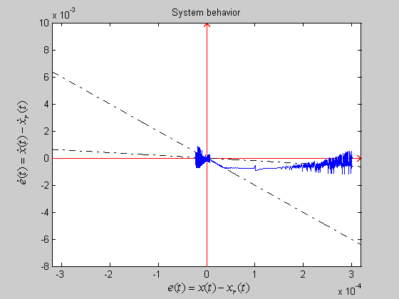
Simulation
Optimal rotating sliding surface

Slide 12
Simulation
Optimal Index values with following Index:
where T (reaching time to the final slope) is the same for all of the cases
Linear: J = 2.523e-4
Nonlinear: J = 3.063e-4
Optimal: J = 2.049e-4

Slide 13
Conclusion
Optimal method has better Index value
Combining optimal rotating with moving method can give a global solution (including all initial points in the Cartesian plane)

