Slide 1
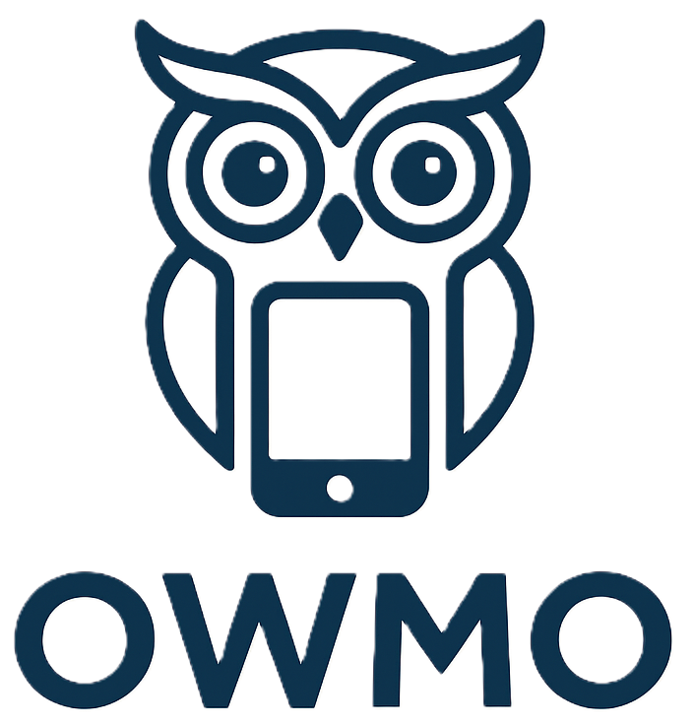
OWMO
One World Mobile Operation
Submitted By
Sajal Verma
Batch Year: 2024–2026
Enrolment No.: U244901
Project Guide: Ms. Sunita Tripath

Slide 2
INTRODUCTION
OWMO (One World Mobile Operation) is a centralized web-based platform that manages mobile repairing and diagnostics efficiently and transparently.
It connects users, technicians, and administrators to streamline communication, automate workflow, and maintain repair records digitally.
The system addresses common issues like poor tracking, manual record handling, and customer dissatisfaction by introducing an intelligent, role-based management approach.

Slide 3
Problem Definition
Traditional mobile repair services face several challenges:
Lack of transparency in repair status and delivery.
Unorganized technician workflow and poor job tracking.
Communication gap between users, technicians, and admins.
Inefficient record and inventory management.
Low customer trust due to hidden charges and delays

Slide 4
Objective
The objective of OWMO is to develop a smart, secure, and efficient system that:
Simplifies repair requests and automates job assignment.
Ensures real-time repair updates with OTP verification.
Integrates AI-based diagnostics and secure online payments.
Connects all stakeholders on a single digital platform.

Slide 5
System Features
User Module: Registration, repair tracking, OTP verification, invoice history.
Technician Module: Accept/Reject jobs, upload repair images, progress updates.
Admin Panel: Manage users, technicians, service requests, inventory.
AI Diagnostic Tool: Suggests possible issues based on user input.
OTP & SMS System: Secure verification using Twilio + nodemailer.

Slide 6
System Architecture
Frontend: React.js + Tailwind CSS
Backend: Node.js + Express.js
Database: MongoDB Atlas
Authentication: JWT (Role-based Access)
Cloud Services: Cloudinary (Image storage), Twilio (OTP)
Deployment: Vercel (Frontend), Render/Heroku (Backend)

Slide 7
Advantages
Real-time tracking of repair status.
Reduced manual dependency and paperwork.
Faster communication between user, technician, and admin.
AI-powered repair prediction improves diagnostic accuracy.
Secure OTP-based verification ensures data security.

Slide 8
Future Scope
Integration of advanced AI/ML for automated fault detection.
Mobile app version for Android/iOS.
Push notifications via PWA.
QR-based invoice scanning system.
Enhanced analytics and report generation.

Slide 9
Conclusion
OWMO provides a smart, automated, and scalable solution for mobile repair management.
It ensures transparency, real-time updates, secure transactions, and efficient coordination between all users.
With AI-based diagnostics and OTP verification, it transforms mobile repair services into a fully digital experience.

Slide 10
References
W3Schools – React.js Tutorial
Tailwind CSS Documentation
Express.js and MongoDB YouTube Tutorials
Twilio and Nodemailer npm Docs
NaturalNode (NLP for Node.js)
Razorpay and Cloudinary SDKs
Recharts Documentation

