Slide 1
Credit card fraud detection: A Machine learning Approach
Md Al Imran H Sharker, Sajal Das Shovon, and Sunil Tamang

Slide 2

Motivation
Credit-card fraud leads to significant financial losses for banks, merchants, and customers every year.
Fraud incidents reduce consumer trust in online and contactless payments, slowing digital adoption.
Detecting fraud quickly helps prevent chargebacks, legal disputes, and operational overhead
Strong fraud detection improves transaction security, protects customer data, and supports a safer financial ecosystem.

Slide 3
Problem Definition
Goal: Automatically classify transactions as legitimate or fraudulent using historical transaction data.
Challenge: Fraud behavior is complex and constantly changing, making patterns hard to capture with fixed rules.
Real-world constraints: Decisions must be fast and scalable (high transaction volume, near real-time screening).
Error impact:
  False negatives (missed fraud) → direct financial loss and security risk
  False positives (legit flagged) → customer frustration and operational cost
Requirement: The model should be reliable and explainable so analysts can trust and act on the alerts.

Slide 4
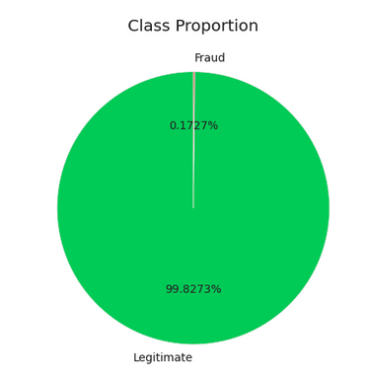
Dataset Description
Source: Kaggle “Credit Card Fraud Detection” dataset (European card transactions).
Size: ~284,807 transactions with 492 fraud cases (~0.17%).
Features: V1–V28 (anonymized numerical features) + Amount + Time.
Label: Class (0 = legitimate, 1 = fraud).
Why it’s useful: Realistic benchmark for testing fraud models on large-scale transaction data.

Slide 5
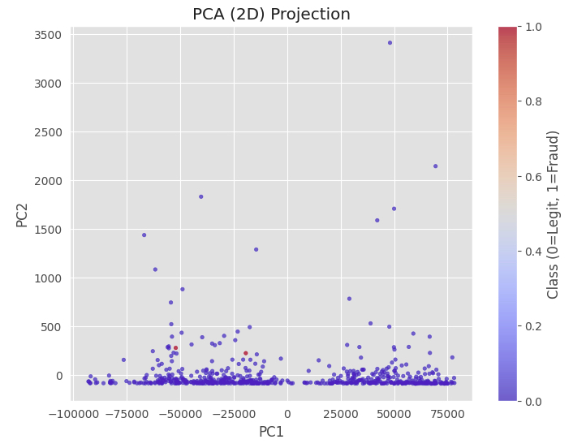
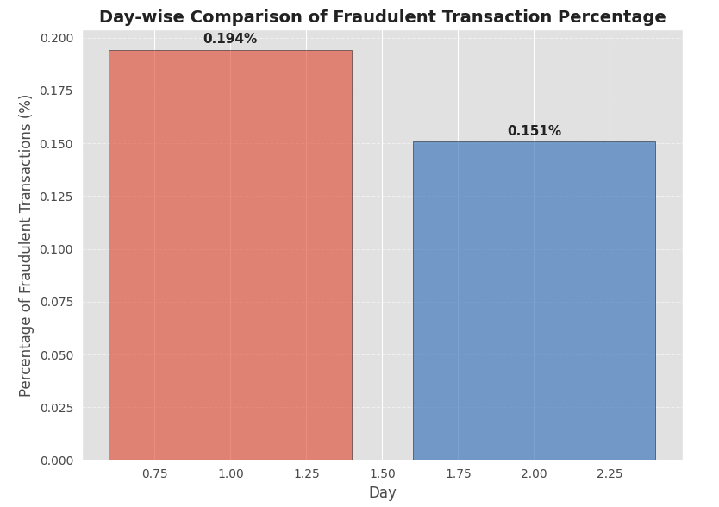
Dataset Description

Slide 6
Challenge
Extreme class imbalance: fraud is only ~0.17% (492 out of ~284K), so models can look “accurate” while missing fraud.
Minority-class learning is difficult: very few fraud examples to learn stable patterns compared to massive legitimate class.
Misleading metrics: overall accuracy is not meaningful; performance must focus on fraud precision/recall and PR curves.
High false-alarm risk: imbalance can cause models to either ignore fraud (low recall) or over-flag legitimate transactions (low precision).
Threshold sensitivity: small threshold changes can strongly affect fraud capture vs false positives due to the skewed class distribution.

Slide 7
Related works
Imbalanced-learning work recommends rebalancing / cost-sensitive / ensemble strategies and cautions that accuracy is misleading on skewed data [1].
SMOTE is a common oversampling method to strengthen minority-class learning [2].
For evaluation, PR curves are often more informative than ROC under heavy imbalance, and calibration/Brier score supports reliable thresholding [3,4].
Many studies find tree ensembles / boosting (RF, XGBoost) perform strongly on transaction data [4,5,6,7].
Gap: limited threshold optimization and fewer unified comparisons of class weighting vs SMOTE vs undersampling with interpretability.

Slide 8
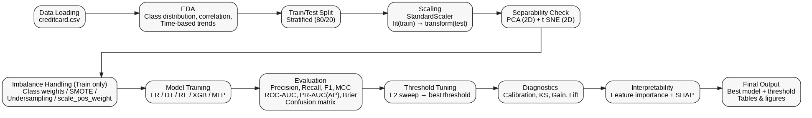
Methodology
Data prep: load dataset, clean labels, and perform a stratified train/test split.
Feature processing + exploration: standardize features (train-only fit) and visualize structure using PCA and t-SNE.
Imbalance-aware modeling: apply class weights/SMOTE/undersampling and train LR, DT, RF, XGB, and MLP models.
Model selection: evaluate with PR/ROC + key metrics, tune decision threshold, and interpret results using feature importance + SHAP.

Slide 9
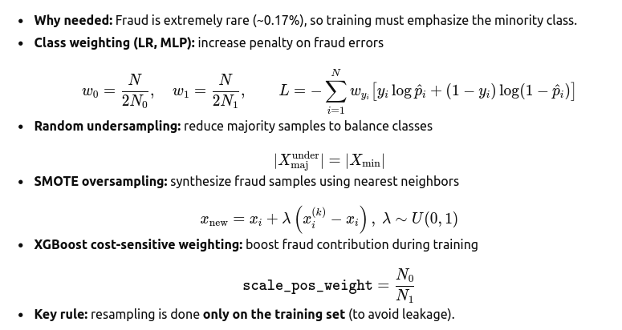
Imbalance Techniques

Slide 10
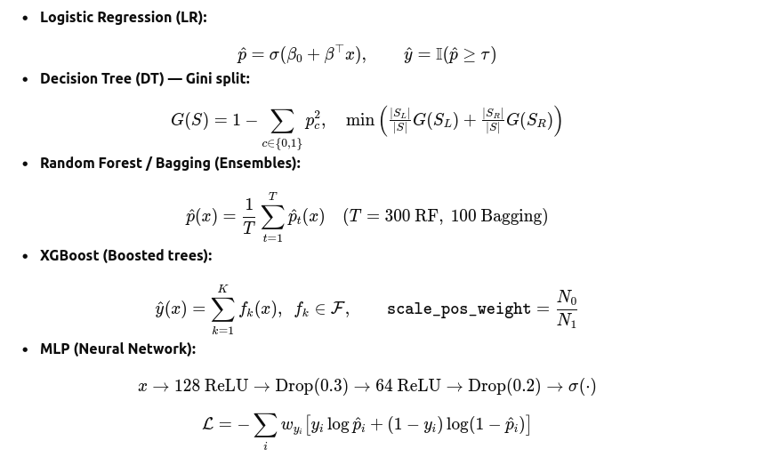
Model architecture

Slide 11
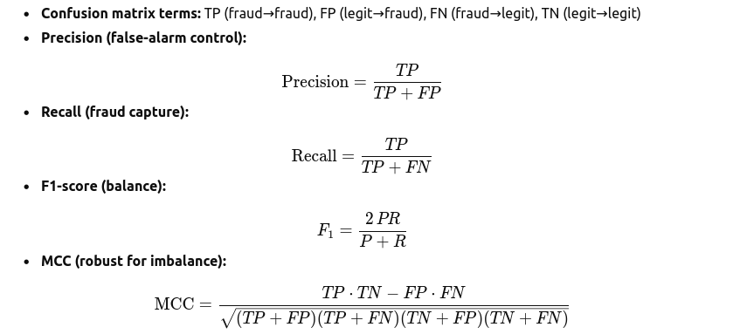
Evaluation Matrix

Slide 12
Result Analysis
We evaluated multiple ML models:
Logistic Regression (LR), Decision Tree, Random Forest (RF), Balanced RF, XGBoost, MLP
Metrics:
Precision, Recall, F1, MCC, ROC–AUC, Brier Score, Confusion Matrix
Dataset is extremely imbalanced → metrics must be interpreted carefully.
Tree-based ensembles dominate the performance landscape; linear and neural models behave very differently under imbalance.

Slide 13
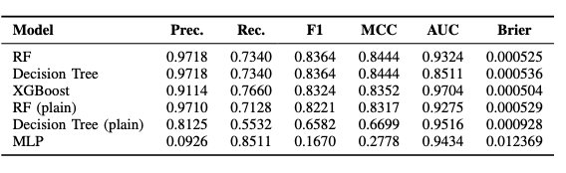
Result Analysis
Random Forest & Decision Tree
F1: 0.8364, MCC: 0.8444
High TP detection with almost zero false positives
XGBoost
Best ROC–AUC (0.9704)
Best Recall (0.7660)
Very strong at capturing the fraud class
Models with the balanced dataset outperforms the plain models
Capture the dataset imbalance problem perfectly which is the main goal of this project
Thanks to SMOTE technique

Slide 14
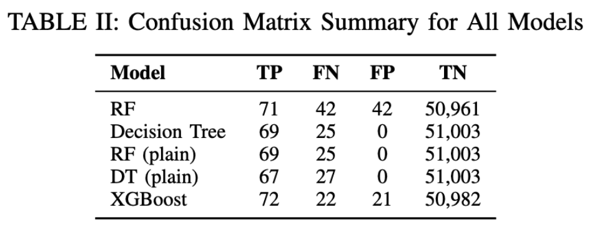
Result Analysis
Decision Tree:
TP = 69, FN = 25
FP = 0
→ Excellent operational reliability
Decision Tree (plain):
​
TP = 67, FN = 27
FP = 0​
→ No FP but we need a trade-off
​

Slide 15
SHAP (Shapley Additive Explanation) Interpretability
SHAP analysis (Balanced RF & XGBoost) identifies the top contributing features as:
V14, V4, V12, V17, V11, V10, V16, and Amount.
V14 and V17 show the largest SHAP magnitudes, meaning extreme values in these PCA-derived components strongly push predictions toward fraud.
SHAP plots show fraud is driven by multi-dimensional outlier patterns, not by a single variable—high deviations in V4, V12, V11, and V10 consistently increase fraud probability.
Amount does have SHAP impact: unusually high transaction amounts increase fraud risk, but its influence is weaker than the PCA components.

Slide 16
Conclusion
Built a complete fraud-detection pipeline capable of handling extreme class imbalance, achieving reliable detection of rare fraud cases.
Ensemble models—especially Random Forest and Decision Tree—proved most effective, capturing complex nonlinear fraud patterns with high precision–recall performance.
SHAP interpretability confirmed that fraud signals arise from extreme values across multiple PCA-derived features, validating the use of nonlinear tree-based models.
Reliable detection of extremely rare fraudulent transactions in a highly imbalanced dataset which was our primary goal.

Slide 17
References
[1] Haibo He and Edwardo A Garcia. “Learning from imbalanced data”. In: IEEE Transactions on knowledge and data engineering 21.9 (2009), pp. 1263–1284
[2] Nitesh V Chawla et al. “SMOTE: synthetic minority over-sampling technique”. In: Journal of artificial intelligence research 16 (2002), pp. 321–357.
[3] Jesse Davis and Mark Goadrich. “The relationship btween Precision-Recall and ROC curves”. In: Proceedings of the 23rd international conference on Machine learning. 2006, pp. 233–240.
[4] Alexandru Niculescu-Mizil and Rich Caruana. “Predicting good probabilities with supervised learning”. In: Proceedings of the 22nd international conference on Machine learning. 2005, pp. 625–632.
[5] Gajula Lakshmi Sahithi et al. “Credit card fraud detection using ensemble methods in machine learning”. In: 2022 6th International conference on trends in electronics and informatics (ICOEI). IEEE. 2022, pp. 1237–1241.
[6] Dejan Varmedja et al. “Credit card fraud detection machine learning methods”. In: 2019 18th International Symposium Infoteh-Jahorina (Infoteh). IEEE. 2019, pp. 1–5.

Slide 18
Thank You
Open for feedback

