Slide 1
Association Rule Mining Assignment SUBMISSION
Sajal Roychowdhury (DDA1610082)

Slide 2
Business Problem
“Global Mart” is an online store super giant having worldwide operations. It takes orders and delivers across the globe and deals with all the major product categories - consumer, corporate & home office.
As the marketing manager of the store, you want to figure out the most frequently occurring combination of the items that are bought together. This would enable you to recommend the related items to a customer, once he makes a purchase in the store.

Slide 3
Flow through
Data Understanding
Loading data in R
understanding format and values of the attributes
Transform the original dataset into transaction level dataset
Convert the transaction level data into transaction format using "arules"
Association Rule Mining
Mine association rules from the data
Optimise the minimum support, confidence, lift threshold level or the minimum floor on the number of items required in a transaction to qualify for consideration
Rule Evaluation
The numerical value of the support, confidence and the lift level for the itemsets/rule
How logical/relevant/viable are the rules from the store's point of view
Explain and analyse the business implications of the rule

Slide 4
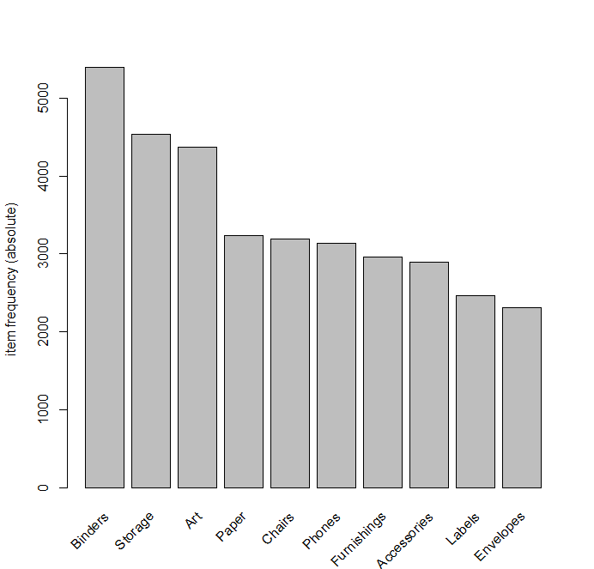
Plots

Slide 5
Frequent Items
Binders | Storage | Art | Paper | Chairs | Other
5392 | 4534 | 4366 | 3234 | 3187 | 26690

Slide 6
Conclusion
We can infer that global store should send recommendations for category
"Binders“ for every purchase of Accessories/Bookcases and office supplies
Recommendations for "Art" items if the customer buys Chair/Furnishings /Bookcases/Fasteners.
Minimum Support | Lift Value | Confidence
0.00016 | 4 and Above | 75% and Above

