Slide 1
Capstone Project - 2
Seoul Bike Sharing Demand Prediction

Slide 2
OverView
1. Defining Problem Statement
2. Cleaning Data and EDA
3. Preparing Data set for modelling
4. Applying Model
5. Feature Selection
6. Model Selection and Validation

Slide 3

Problem Description
Due to global warming, increasing pollution and depletion of energy resources, many countries are focused on using renewable sources of energy where ever they can. South Korea is among them.
Seoul being the capital of South Korea has a Rented Bike Sharing system, which allows user to rent bike for certain amount of period for certain amount of money.
We have been provided with Bike Sharing data of two years and we are expected to build a model which can predict further demand of bikes.

Slide 4
Data Pipeline
1. Data Cleaning :- In this we go through features to check if null values were present in them and either to replace or drop them.
2. Outlier Detection :- Most the time, data do contain outliers in them, so it is necessary to check them as well.
3. EDA :- We did Exploratory Data Analysis (EDA) to gain important insights.
4. Create a Model :- In this we tried different model in-order to show the approach towards solving a problem and simultaneously increasing it productivity.

Slide 5
Data Summary
The dataset contains 8760 rows and 14 columns
Out of 14 columns, we have 2 categorical column and rest numerical column
Date : year-month-day
Rented Bike count - Count of bikes rented at each hour
Hour - Hour of he day
Temperature-Temperature in Celsius of that particular day
Humidity - %
Windspeed - m/s
Visibility - 10m
Dew point temperature - Celsius
Solar radiation - MJ/m2
Rainfall - mm
Snowfall - cm
Seasons - Winter, Spring, Summer, Autumn
Holiday - Holiday/No holiday
Functional Day - No Func (Non Functional Hours), Fun(Functional hours)

Slide 6
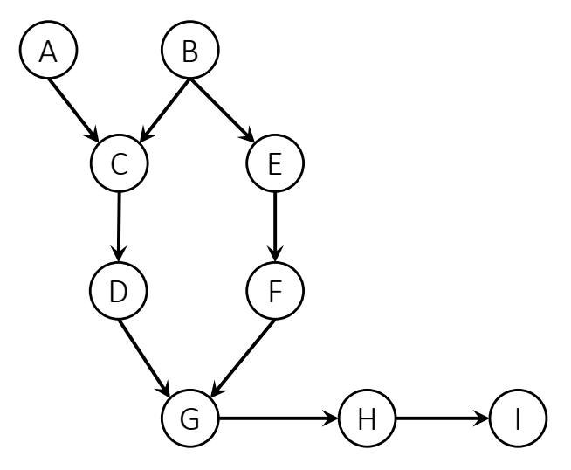
Independent Parameters
Month :- Month of the year
Season :- Type of season
No Holiday :- If holiday is there then 0, else 1
Night :- If Bike is rented in night or day.
Yes :- If the day is functional day or not.
Hour :- Hour of the day
Temperature :- In degree Celsius
Humidity
Rainfall :- If any
Snowfall :- If any
Visibility :- Due to rainfall and snowfall
Windspeed :- in m/s
Day of week

Slide 7
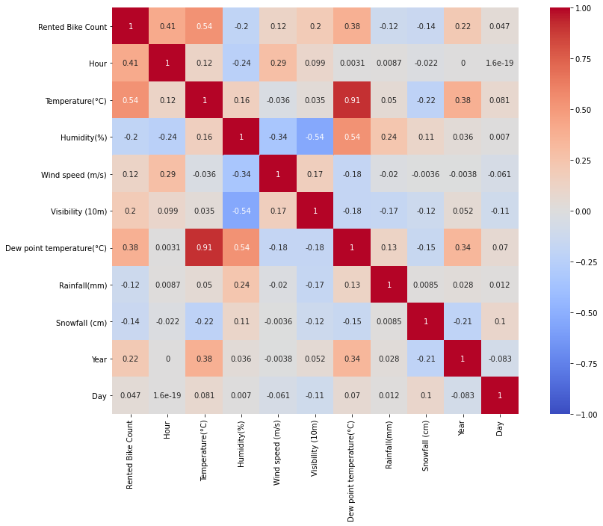
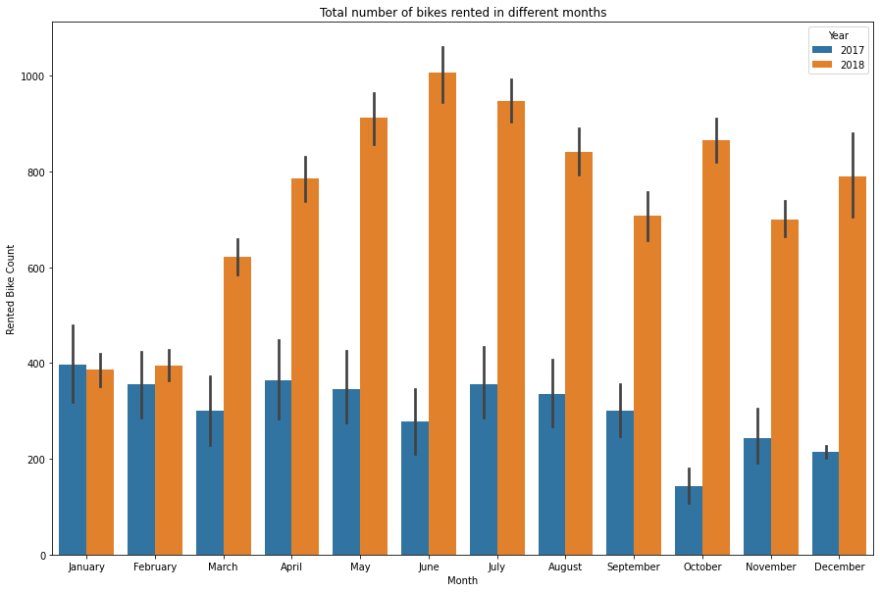
Exploratory Data Analysis (EDA)
Correlation heat map
Total Number of Bikes rented in different months

Slide 8
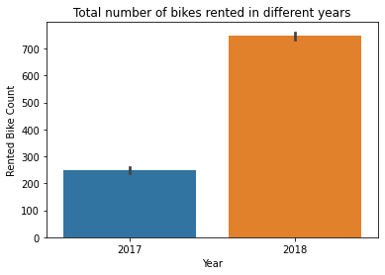
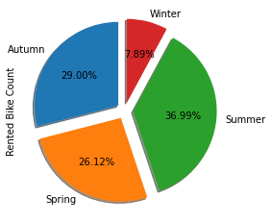
EDA (contd.)

Slide 9
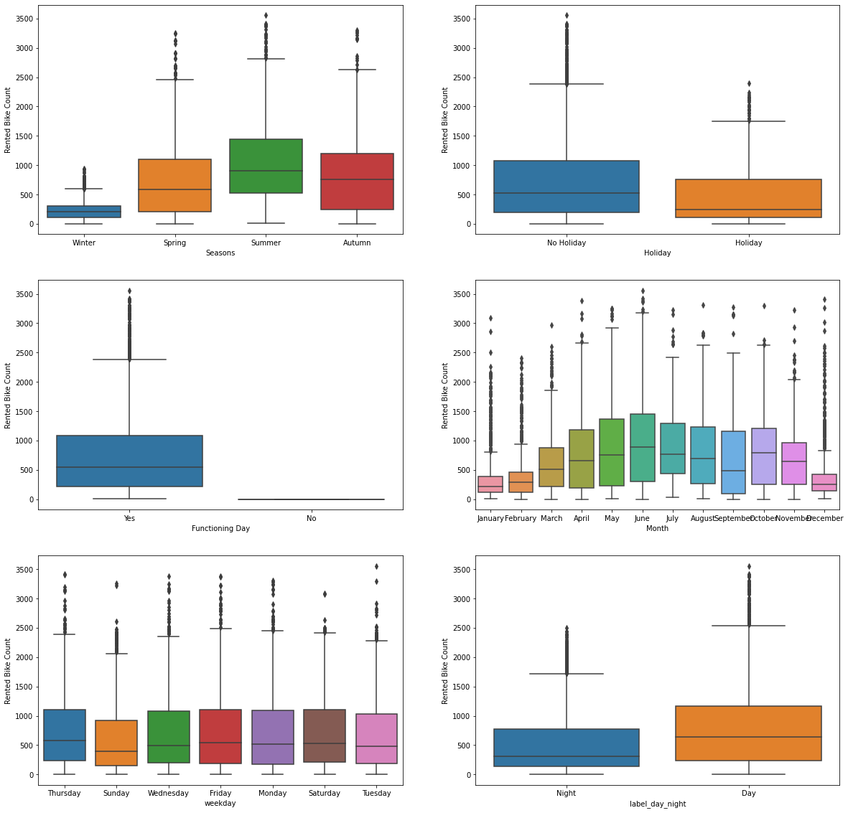
EDA (contd.)

Slide 10
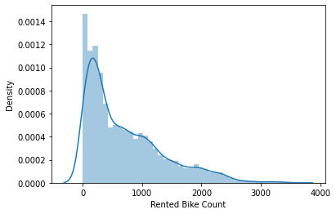
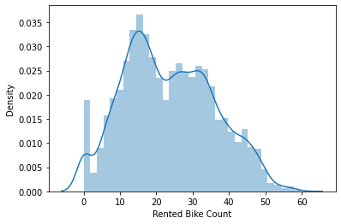
Dependent Variable - EDA (contd.)

Slide 11
Insights
Temperature and dew point temperature are highly correlated so there is no point of considering both the features. We drop dew point temperature
From the month of march in 2018 there is high increase in sales as compared to 2017.
We can conclude that the people prefer summer seasons to rent bikes.
Winter is the least favourable season
Temperature affects the the number of rented bike directly, People prefer to rent bikes in a hotter days.
Humidity does not affect the number of rented bikes much
If the windspeed is high, people are less likely to rent a bike
When the visibility is low, the number of rented bikes is also low
When there is a heavy snowfall people are less likely to rent a bike

Slide 12
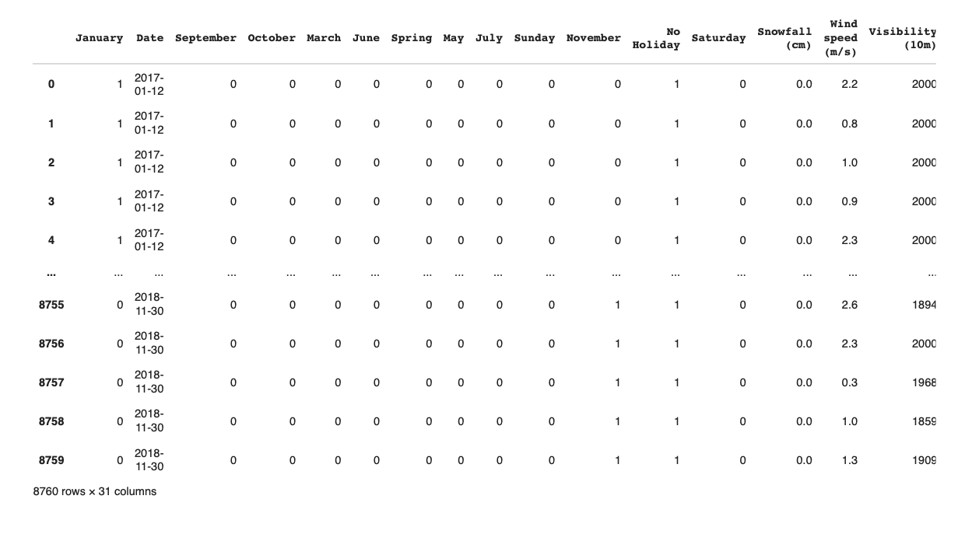
Preparing Data for Modelling
Train set :- (6132, 31)
Test Set :- (2628, 31)
Task :- Linear Regression

Slide 13
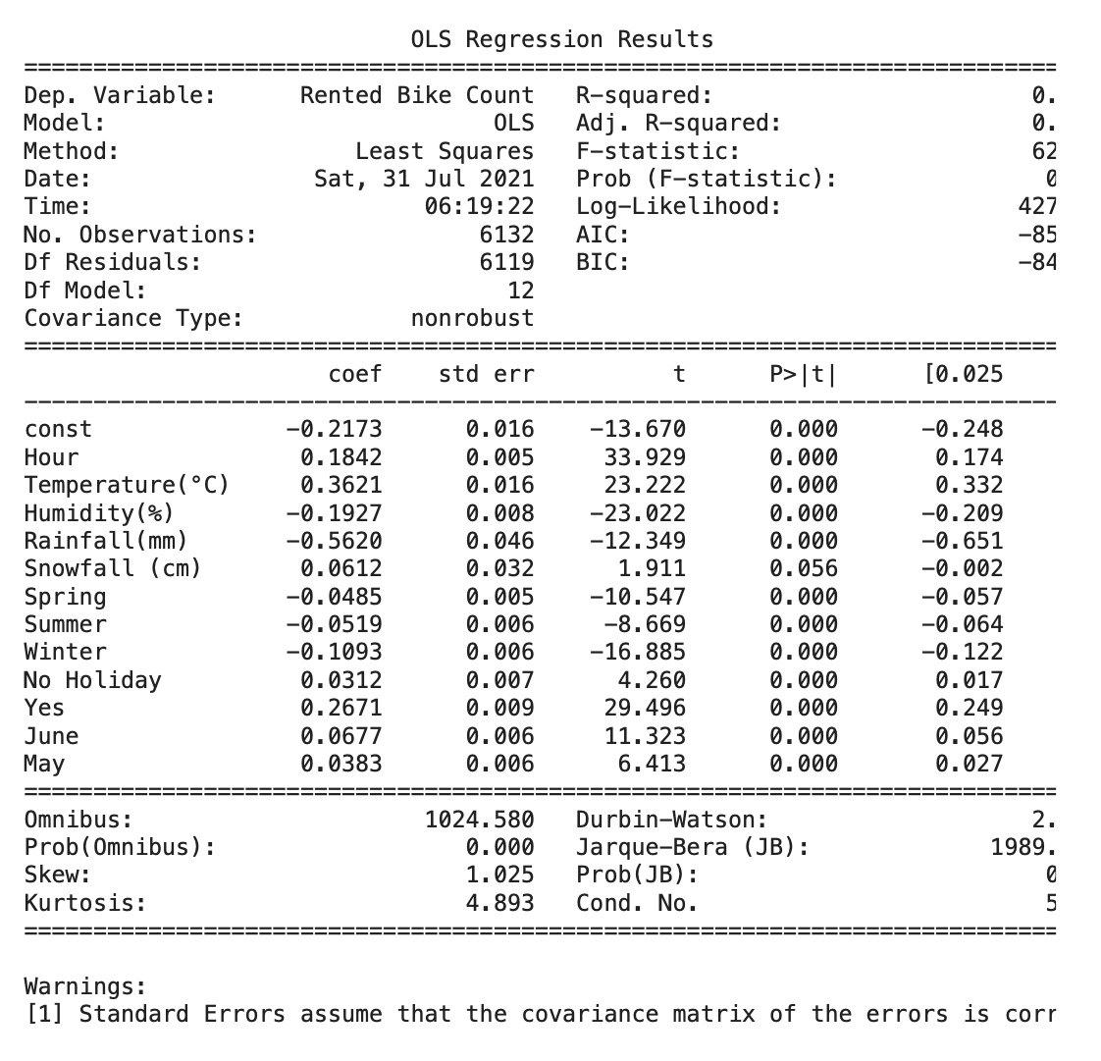
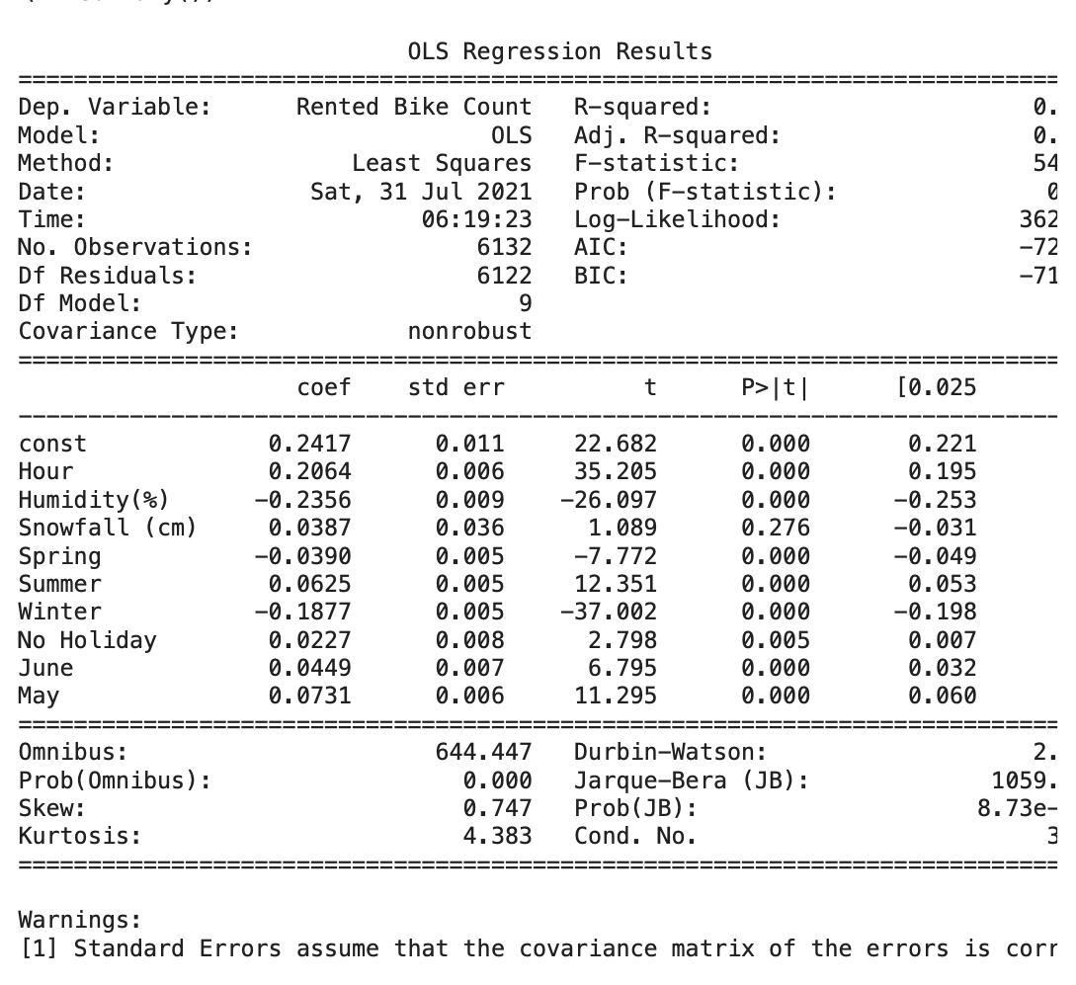
Rescaling
First OLS Regression Result
Final OLS Regression Result

Slide 14
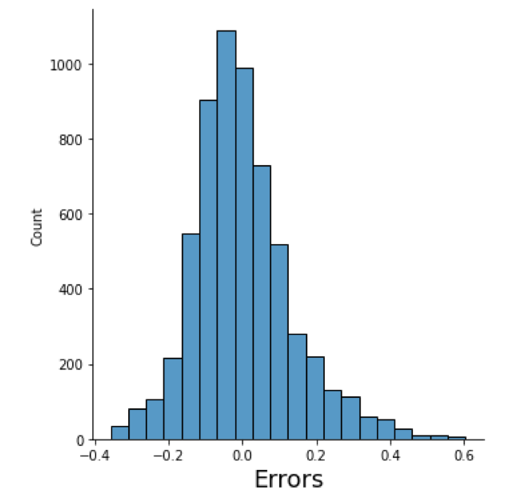
Linear Regression
MAE (Mean Absolute Error): 0.10226959662134852
MSE(Mean Square Error): 0.018590287145430807
RMSE(Root Mean Square Error): 0.13634620326738403
R-square value: 0.4542245058541948
Conclusion from Linear Regression
We tried to add more features to make the model better but linear regression is still too general
We need more complex model

Slide 15
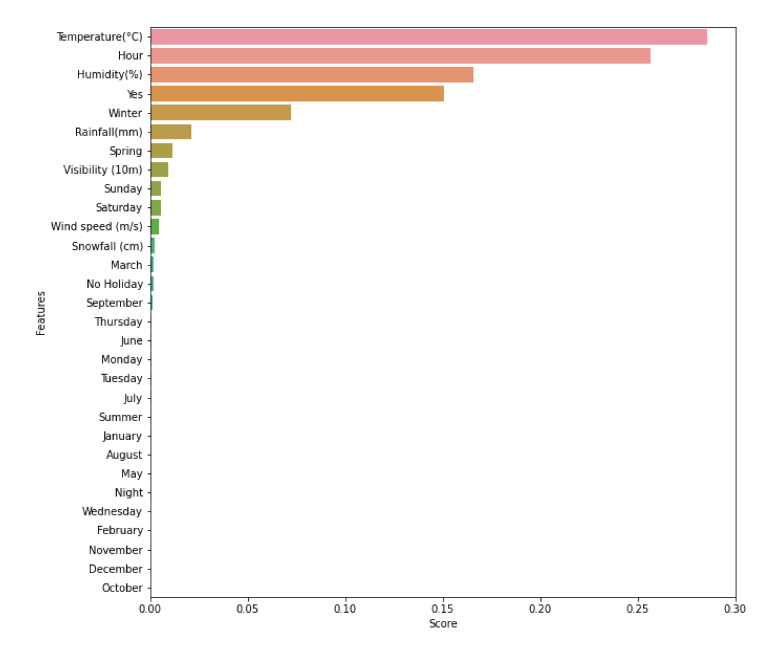
Decision Tree Regression
Feature Score
r-square score on test data :0.8627875530521529
adjusted r-square score on test data :0.8603957033087274
homogeneity score on test data :0.8536419828090458
mean squared error score on test data :21.609074707974006

Slide 16
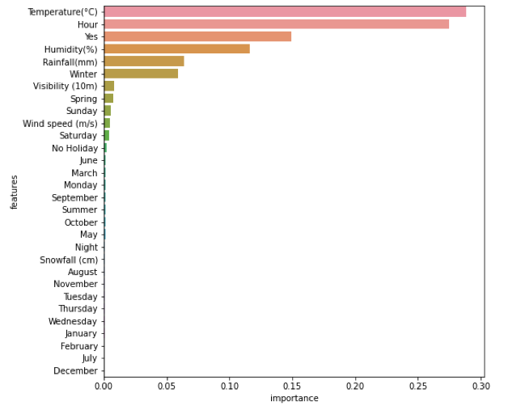
Boosting the Model (Gradient Boost)
Gradient boost score on train data: 0.9539400456545698
Gradient boost score on test data: 0.9190353708501229
r-square score on test data : 0.9190353708501229
adjusted r-square score on test data: 0.9176240176400727
homogeneity score on test data :0.9999999999999999
mean squared error score on test data :12.750816408573327
Feature Score

Slide 17
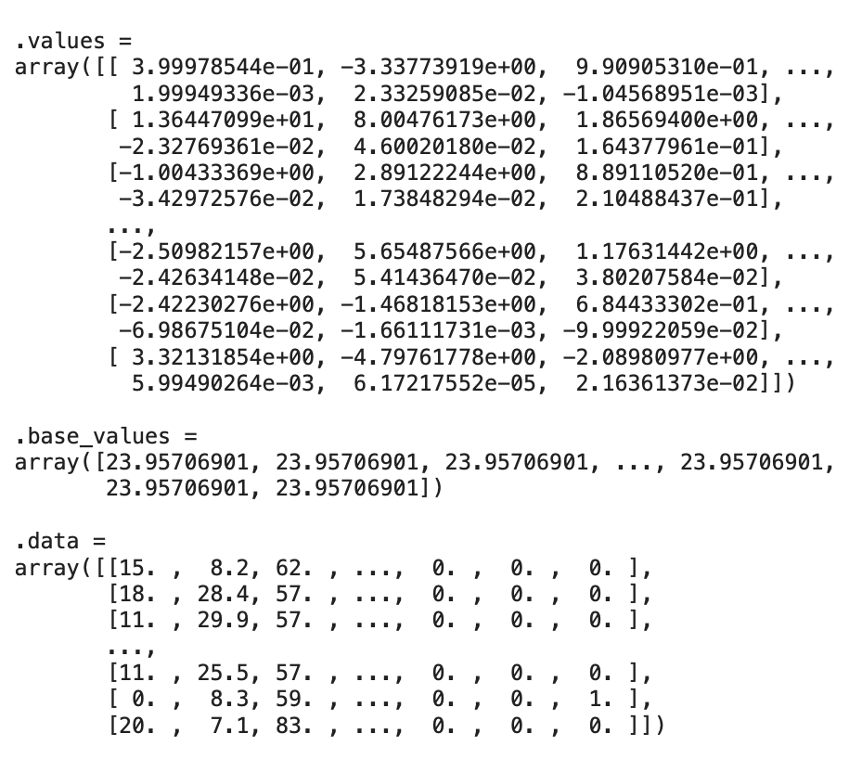
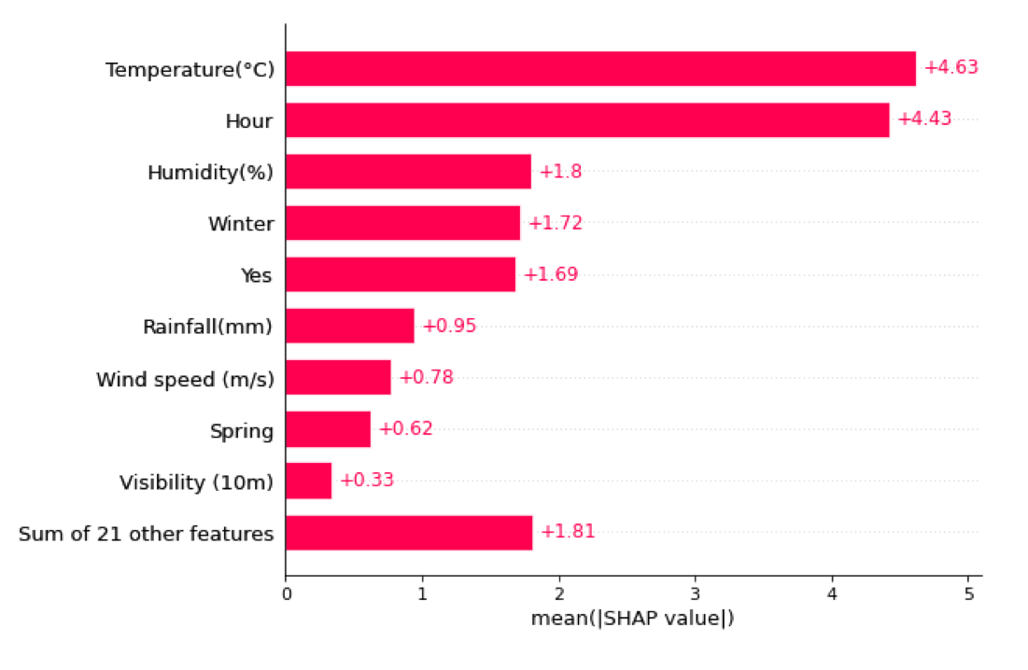
SHAP
Shap Values
Shap Values Bar-plot

Slide 18
Conclusion
In the problem statement it is mentioned that the company started in the year 2017 that's why the sales are low in the 2017 and higher in 2018.
The Hour of the day affects the bike sales which is because of the probably office hours
The temperature humidity windspeed also plays a crucial role in the the sales of rented bikes
higher temperature tends to attract more customer that is why we see peak in sales in the summer seasons
After trying combinations of features with linear regression the model underfit. It seemed obvious because data is spread too much. It didn't seem practical to fit a line.
With Decision tree we reached at the model R squared value of 0.86. We only fitted with minimum number of leaf hyper-parameter. With default parameters it overfitted and reached R-squared at 1 with train dataset but 0.86 with test.
Lastly Gradient boost gives the best results with R squared value for train data 0.95 and test data 0.92
The Feature_importance is almost the same in both the tree based models. Gradient boost fine-tunes with error of the prior trees this is why it gets better accuracies.

