Slide 1
Carbon fibre reinforced plastic composite panel delamination detection using Deep learning Neural Network and Transient thermal conduction profiles

Slide 2
Introduction:
Carbon Fibre Reinforced Plastic Composites
Transient Thermal conduction profiles
Experimental Setup - Transmission based thermography techniques
Introduction to Machine learning and Deep learning techniques
Classification Models – Compare and Contrast

Slide 3
Abstract:
Delamination within composites are of particular concern, presenting within composite laminate structures without visible surface indications.
Transmission based thermography techniques using contact temperature sensors and surface mounted heat sources are able to detect reductions in thermal conductivity and in turn impact damage and large dis bonds can be detected.
The use of transient thermal conduction profiles induced from zonal heating of a CFRP laminate to ascertain inter-laminate differences has been demonstrated
The method utilises a supervised Support Vector Classification (SVC) algorithm and Artificial Neural Network with TensorFlow to detect delamination using balanced dataset.
Thereby developed Models are compared and the best one with respect to performance metric will be selected.

Slide 4
Objective:
1. Understanding basic ply and composition of typical Carbon Fibre reinforced plastic composites.
2. Understanding how delamination relates to defect in terms of failure analysis
3.Understanding Transmission based thermography techniques, thermal conduction profiles and how this experiment outputs are becoming features of the dataset which will be fed into Artificial Intelligence Unit to make prediction (defect).
4.Develop AI model using Support Vector Machining Algorithm
5.Develop AI model using Deep Neural Network using TensorFlow
6.Compare and Contrast both models’ performance using Accuracy score.
7.Save the best model for further Exploration on inference.

Slide 5
Literature Review:
Paper Title | Author name | Journal, Year and Volume | Inference
Composite laminate delamination detection using Transient Thermal Conduction Profiles and Machine Learning Based Data Analysis. | David I. Gillespie et.al | www.mdpi.com/journal/sensors 2020, 20, 7227 | Through the paper clearly understood how CFRP is composed of and importance of transient thermal conduction profiles towards dataset preparation for AI modelling.
Machine learning approach for delamination detection with feature missing and noise polluted vibration characteristics | Yushu Li et al | Volume 287, 1 May 2022, 115335 Composite Structures | Understanding how machine learning models are supporting defect detection through various fundamental statistical algorithms.

Slide 6
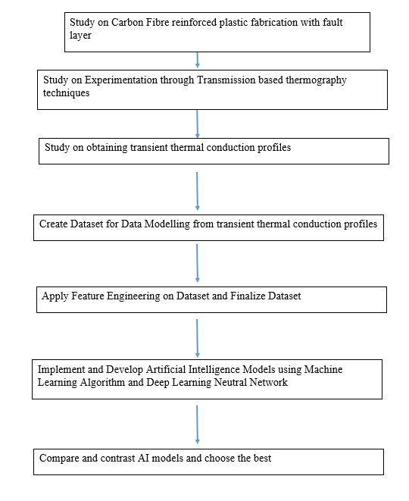
Methodology:

Slide 7
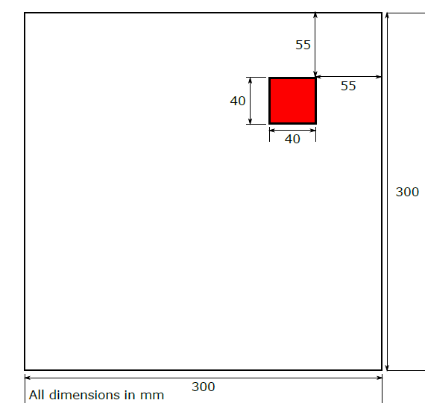
Study on Fabrication of CFRP with fault layer ( Defect )
1. A CFRP sample laminate of 300 X 300 mm in size was created from bi-axial CFRP 5 harness ply with density 1589 kg /m.
2. Two plies were laid up with orientation 0/90/0/90, 0/90/0/90 to produce non-symmetrical and balanced laminate samples of 0.7366 mm in thickness.
3. Creation of a delamination within the sample was achieved through the insertion of two Polytetrafluoroethylene (PTFE) squares
40 x 40 mm, of 0.01 mm thickness between the ply boundary of the two plies of the laminate sample at the top and right edges 55 mm from the top and right hand edges.
4. The Sample was cured within Nitrogen pressurised Autoclave at 180 C for 2 h at 35 psi.

Slide 8
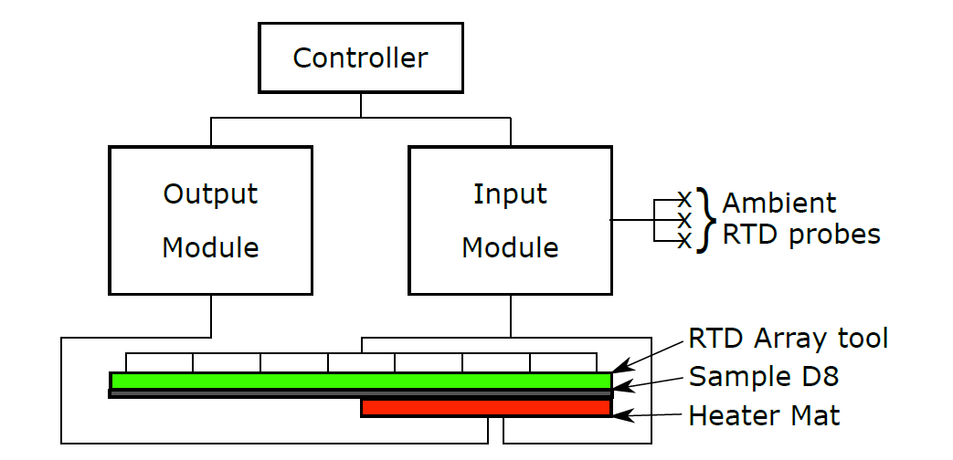
Study On Experimentation through transmission based thermography techniques and thermal conduction profiles
Sample D8 is the CFRP panel and which is placed in between Heater Mat and RTD Array tool
Heater Mat is receiving power from Controller through Output Module to dissipate heat
RTD Array tool is designed to give temperature variation through RTD probes.
Heater Mat is positioned in different co – ordinates, and heat dissipation is measured according to that.
The readings are as follows:
Temp Change ∘ C = The change in degrees Celsius from the starting temperature of the sample.
x_heat_dist = The distance in mm from the centre of the 150 mm by 150 mm square heater mat in the x axis.
y_heat_dist = The distance in mm from the centre of the 150 mm by 150 mm square heater mat in the y axis.
Time: time in seconds from start.
6. These readings from random number of experiments are helping to create Dataset.

Slide 9
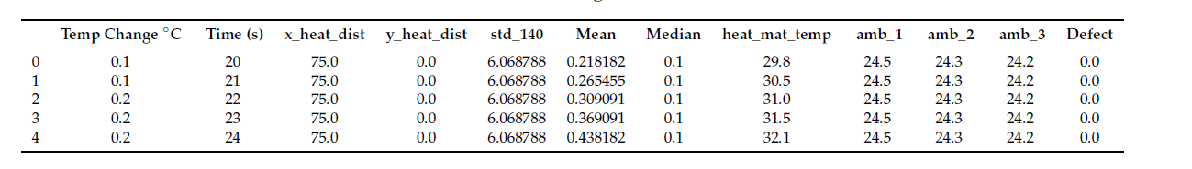
Create Dataset for Data Modelling using thermal conduction profiles:
As the primary readings are considered as primary features of a dataset, Other features like Std 140 , Mean , Median can be statistically calculated and added with primary features.
Heat_mat_temp is other observation from heat mat that can also be added.
Amb_1, Amb_2,Amb_3 is node power readings which can also be considered as a features.
Preliminary tests clearly depicts how delamination defect occurs here. By considering that , we can introduce target features with labels.
The labels are, '0' - no defect; '1' - delamination, outer area; '2' - delamination, centre, '3' - no defect with defect between centre of heater mat and probe. The size of dataset is more than one lakh instances with 12 features

Slide 10
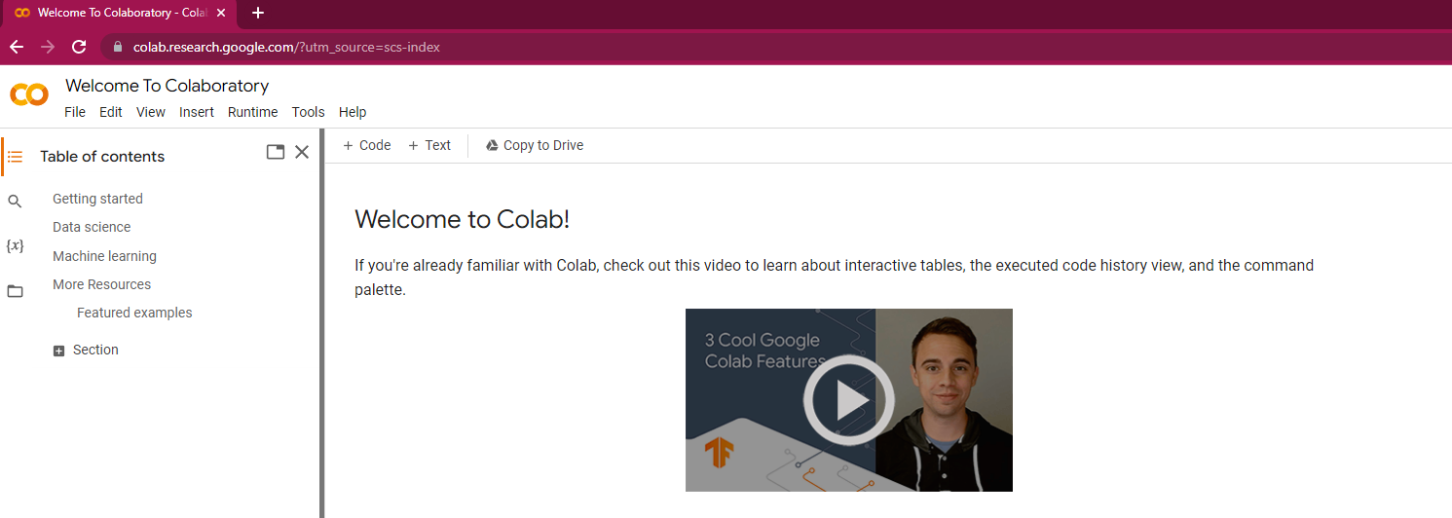

IDE and Programming Language:
IDE: Google Collaboratory
Programming Language : Python

Slide 11
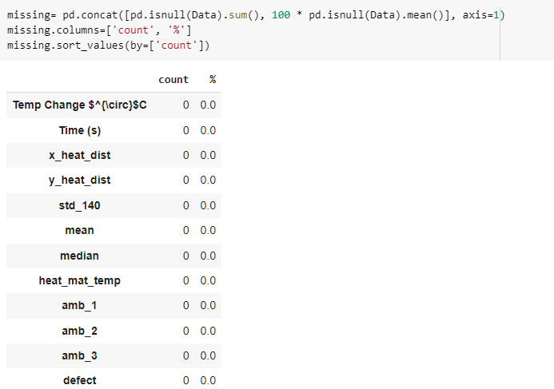
Apply Feature Engineering to finalize Dataset:
Step 1: Missing Value Check on dataset:
Findings : All the given instances of the dataset is filled with values

Slide 12
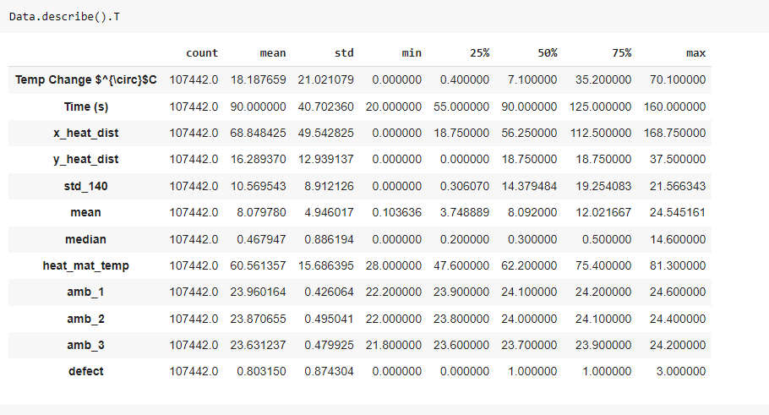
Step 2: Describe dataset with respect to Statistical terminologies:
Findings : All the given instances of the dataset is filled with healthy correlation

Slide 13
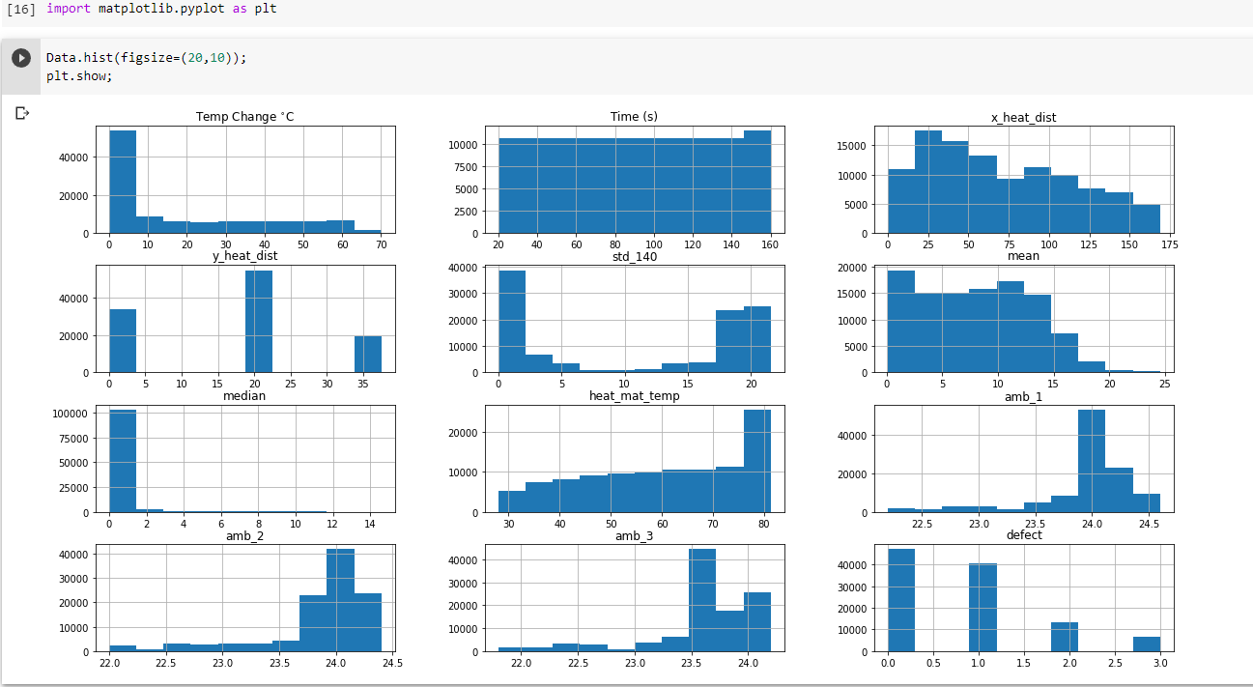
Step 3: Describe dataset with respect to Histogram Plot:
Findings : All the given instances of the dataset is continuous one and distribution is healthy

Slide 14
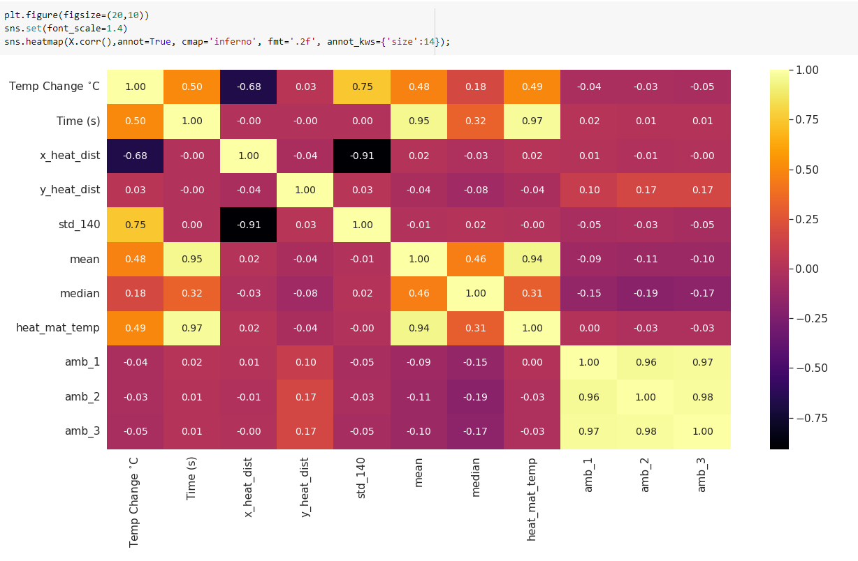
Step 4: Describe dataset with respect to Heat Map
Initial Phase:
Findings :
1.As High Correlation occurs between amb_1, amb_2, amb_3 , it is recommended to keep any one among three and which is amb_3
2.Even though Time(s) and heat_mat_temp is highly correlated, Keeping both features supports the context of experiment.
3.mean , time(s) , heat_mat_temp is highly correlated and mean is eliminated here as it is derived from other features.

Slide 15
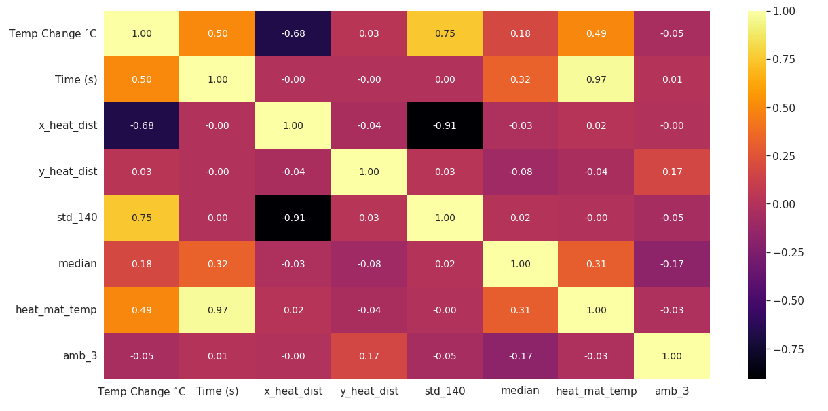
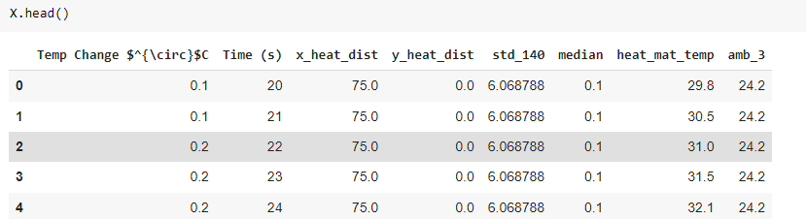
Second Phase:
Seaborn New Heat map after removed noted features in previous slide
Reduced Final Dataset

Slide 16

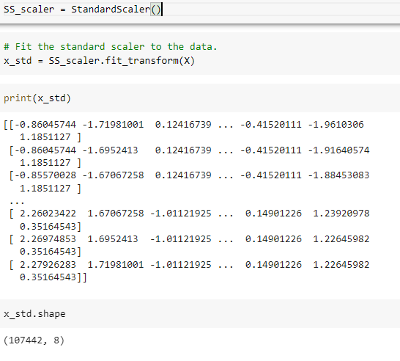
Data Modelling (Training data and Test data split):
Step 1: Split the data into features and target:
Step 2: Apply Standard Scalar to flatten the features into standard scale:

Slide 17

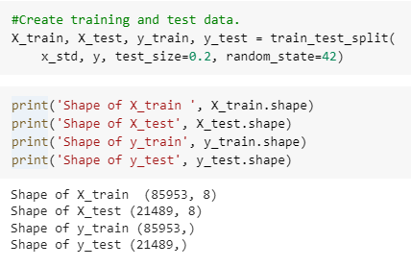
Step 3: Create training and test data with the help of Sklearn Framework functionality:

Slide 18
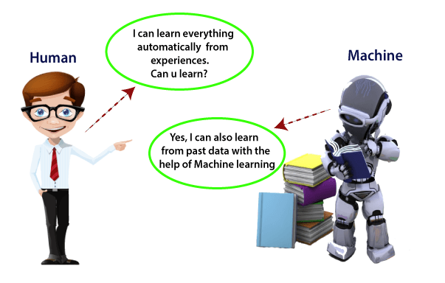
Introduction to Machine Learning Algorithm (SVM)
In the real world, we are surrounded by humans who can learn everything from their experiences with their learning capability, and we have computers or machines which work on our instructions. But can a machine also learn from experiences or past data like a human does? So here comes the role of Machine Learning.

Slide 19
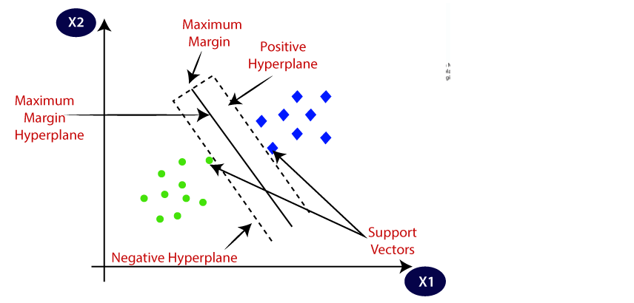
Support Vector machining – ML algorithm
Support Vector Machine or SVM is one of the most popular Supervised Learning algorithms, which is used for Classification as well as Regression problems. However, primarily, it is used for Classification problems in Machine Learning.
The goal of the SVM algorithm is to create the best line or decision boundary that can segregate n-dimensional space into classes so that we can easily put the new data point in the correct category in the future. This best decision boundary is called a hyperplane.
SVM chooses the extreme points/vectors that help in creating the hyperplane. These extreme cases are called as support vectors, and hence algorithm is termed as Support Vector Machine.

Slide 20
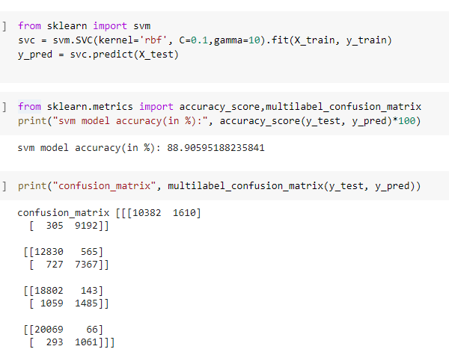
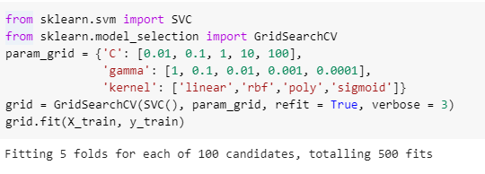

Implementation of SVM on Dataset:
Step 1: Import, Train and Test the Model:
Step 2: Hyper parameter tuning of the Model:
Step 2: Saving the Model for Inference:

Slide 21
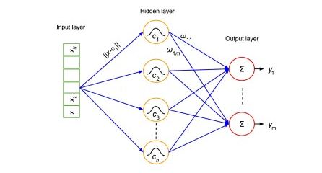
Introduction to Deep Learning
Deep learning can be defined as the method of machine learning and artificial intelligence that is intended to intimidate humans and their actions based on certain human brain functions to make effective decisions.
It is a very important data science element that channels its modelling based on data-driven techniques under predictive modelling and statistics. To drive such a human-like ability to adapt and learn and to function accordingly, there have to be some strong forces which we popularly called algorithms.

Slide 22
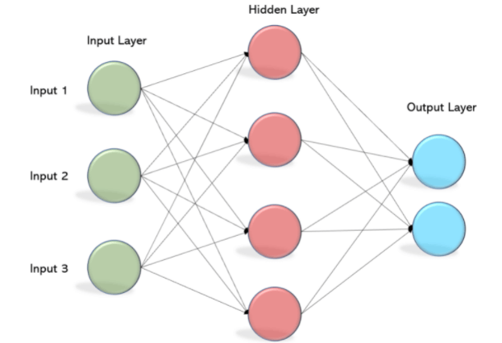
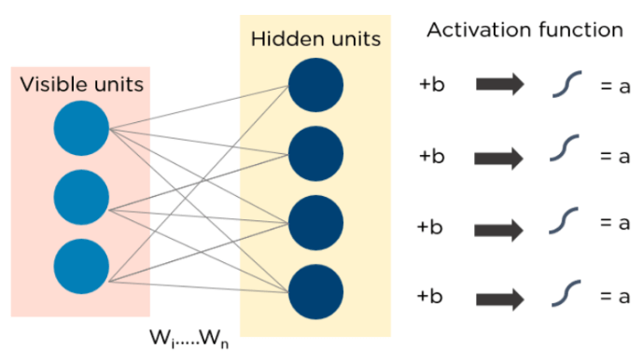
Artificial Neural Network– DL technique:
The working of ANN starts by feeding the data in the input layer. The neurons present in the layer form a graph to establish a connection that passes in one direction. The weight of this input data is found to exist between the hidden layer and the input layer. ANNs use activation functions to determine which nodes are ready to fire.
These activation functions include tanh function, sigmoid and ReLUs. MLPs are mainly used to train the models to understand what kind of co-relation the layers are serving to achieve the desired output from the given data set. See the below image to understand better.

Slide 23
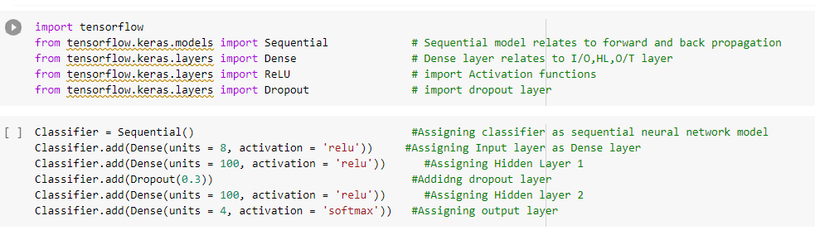
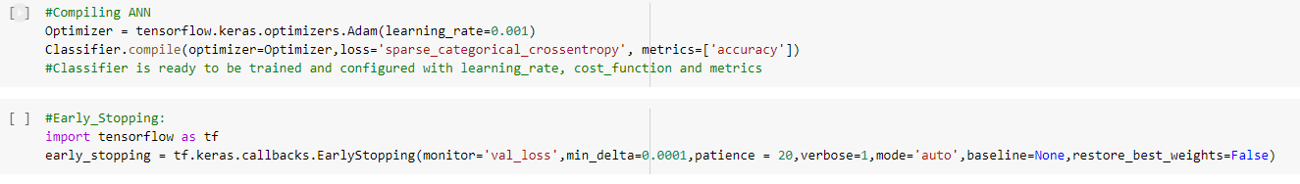
Implementation of ANN on Dataset:
Step1: Model importing and defining
Step 2: Model Compiling and Early Stopping

Slide 24

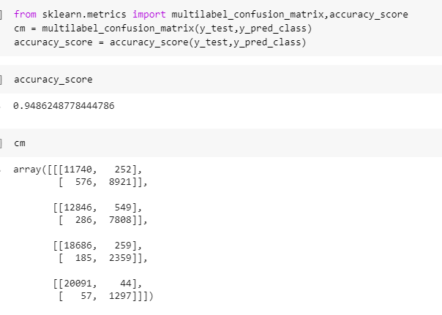

Step 3: Model Training and Testing
Step 4: Checking Performance Metrics
Step 4: Saving the model for inference

Slide 25
Result and Discussion:
Machine learning Model | Deep Learning Model
Accuracy: 88% | Accuracy: 94%
Low Complexity | High Complexity
Low performed metrics | High performed metrics
Sklearn Framework used | TensorFlow framework is used
Saved through .pkl format | Saved through .h5 format
Low Inference potential on defect analysis | High Inference potential on defect analysis.

Slide 26
Future Works:
Convert Developed Python Script into Application using Flask Web App.
Do More feature engineering and bring in tuned dataset.
Make Complete Inference logic for new data prediction on defects.
Extend the research and find another test scenario data and do the AI defect automation.

