Slide 1




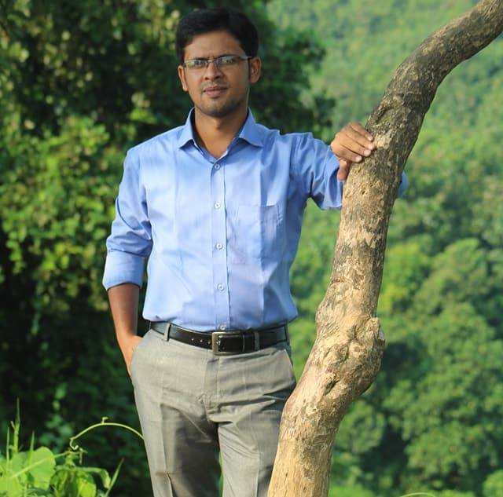
Introduction
Rony Chakraborty
Assistant Teacher (English)
South Shilok M Shah Alam Chowdhury High School
E

Slide 2



Slide 3
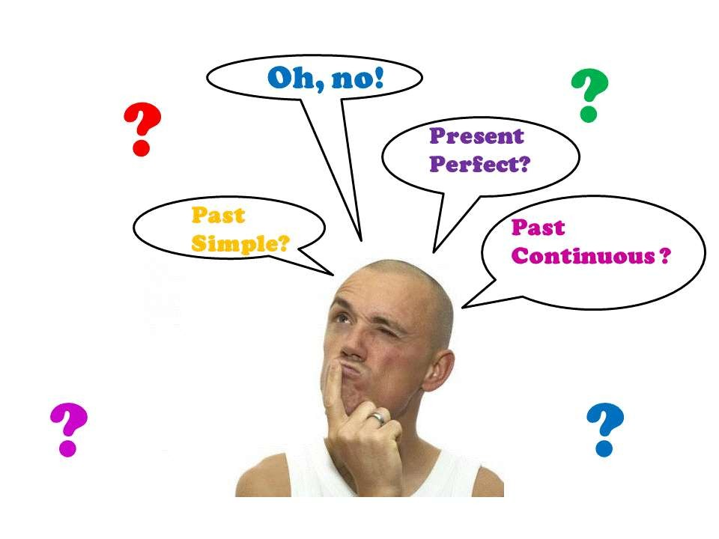

Slide 4

Rules of the Right Form of Verb
RULE 1: Singular Subject = Singular Verb, Plural Subject = Plural verb
Example: Shahin is a meritorious student.
Vehicles create traffic jam.
RULE 2: Preposition: (in, at, on, of, for, from, by, with, without, before, after, into, across, about ) + noun or Verb + ing.
Example:
Television is an important source of entertainment or entertaining.
Children are fond of using mobile Phone.
RULE 3: To + Verb1 but (Addicted to, Adverse to, Be used to, With a view to, Look forward to, Get used to, Be accustomed to) + Verb + ing. Example: Shimu went to London to get a good job.
Shamim tried to join the Navy.

Slide 5

Continued
 RULE 4: (Can, could, may, might, Shall, should, will, would, must,
used to, have to, need, dare, ought to) + V1
Example: He can do the Sum.
It may rain today.
Tamim must study tonight.
RULE 5: While + Verb + ing
Example: While walking in the garden, I saw a snake.
While sleeping I dreamt a good dream.
RULE 6: (have, has, had, get, got, getting, having ) + V3 or Adjective.
Example: She got married yesterday.
I had my car cleaned.
Having taken the money, the thief ran away. Our Culture is getting westernized.

Slide 6

Continued
RULE 7 : Passive Voice : (Can be, could be, may be , might be, Shall be, should be, will be, would be, must be, used to be, have to be, ought to be ) + V3 Example: The work ought to be done.
He will be helped by me.
RULE 8: (Each, every , one, any) + one or more singular Sub. + Singular Verb.
Example: Each boy and each girl was present there.
Every boy and girl has been given 100 tk.
RULE 9: ( Population, public, crowd, army, congress, committee, team, government, family, pair, dozen, scenery, knowledge, hundred, thousand, furniture, machinery, information, bread, money, advice, poetry, gallows, ethics, mathematics, physics, news, electronics, dynamics, 2/3….dollars, 2/3….miles, ) + singular verb.
Example: Ill news runs a pace .
Physics is a critical subject.

Slide 7

Continued
RULE 10: (People, spectacles, trousers, scissors, benches, cloths, goods, headquarters, vegetables, laws, police, cattle, folk, circumstances, gentry.) + Plural verb.
Example: His circumstances are not good.
People don’t eat the same food. Vegetables contain vitamin.
RULE 11: (who, whose, whom, which, that) follow only their before subject to choose a verb.
Example: It is I who am your friend. It is you who are my friend.

Slide 8

Continued
RULE 13: (Feel, love, hear, like, hate, see, forget, consist, seem, sound, smell, believe, know, wish, doubt, prefer, imagine, fear, taste, astonish, please, understand) they are used in present Indefinite tense not in continuous tense. Example: I see the bird.
I hear news.
I forget everything.
RULE 14: Distance/money/time + singular verb Example: Thirty miles is a long way.
100 years is a long time. Money begets money.
RULE 12: Prefer to + verb + ing
Example: Lata prefers to reading newspaper.
Joynal prefers to eating betel.

Slide 9

Continued
RULE 15: (mind/worth/without/get used to/got used to/ be used to/past, can’t
help, couldn’t help, would you mind) + verb + ing Example: Would you mind having a cup of tea?
He can’t help smoking.
RULE 16: (had better, had rather, would better, would rather, let, must, need,
dare, make, would sooner, had sooner) + verb1 Example: He had better read newspaper regularly.
I will not let you enter the classroom.
RULE 17: ( It is time, It is high time, wish, fancy) = Past Indefinite Example: I fancy I turned a pale.
It is high time we developed our country.

Slide 10

Continued
RULE 18: Lest…. Should…
Example: Walk fast lest you should miss the train.
Read attentively lest you should fail in the exam.
➢
RULE 19: Present Indefinite or Present perfect tense + since + Past Indefinite tense.
Example: It is many years since I came to Dhaka.
Many years have passed since I had met her.
RULE 20: Past Indefinite tense + since + Past perfect tense. Example: Many years passed since I had seen her last.

Slide 11

Continued
RULE 21: Past Perfect + before + past Indefinite.
Past Indefinite + after + past perfect Example: The patient had died before the doctor came.
The patient died after the doctor had come.
RULE 22: Uncountable noun (water, air, tea, sugar, environment, furniture, kindness, rainfall, reputation, wood, paper, gum, courtesy, earth, bread, oxygen, smoke, Bangla, English.) + Singular verb.
Example: Air is very important element of the environment.
Water plays a vital role in agriculture.
RULE 23: Arithmetical Operations (singular verb) Example: Five plus five is ten.
Ten minus five is five.
Ten divided by two is five.

Slide 12

Continued
RULE 21: (Always, regularly, generally, usually, occasionally, normally, naturally, frequently, everyday, daily, often) = Present Indefinite Tense. Example: Organizations frequently need employees who speak a standard form of English.
English usually helps to get good job. He always prays his prayer.
RULE 22: (now, at this/the moment, at present, day by day, increasingly, rapidly.) = Present continuous Tense.
Example: Mobile Phone users are increasing day by day.
He is eating now.
RULE 23: (yesterday, one day, ago, once, last, after a few days, last night, once
upon a time, in the past, previously.) = Past Indefinite Tense.
Example: I received your letter yesterday.
One day I borrowed a book from you.

Slide 13

Continued
RULE 24: (Just, just now, already, yet, ever, lately, recently,
immediately.) = present Perfect Tense.
Example: He has transferred from Dhaka recently.
We have shifted to safe place immediately.
RULE 25: No sooner had….then
Scarcely had…..when,
hardly had…before/when.
Example: No sooner had he seen the police than he ran away.

Slide 14

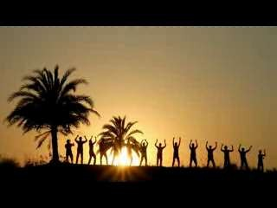
Thank you

