Slide 1
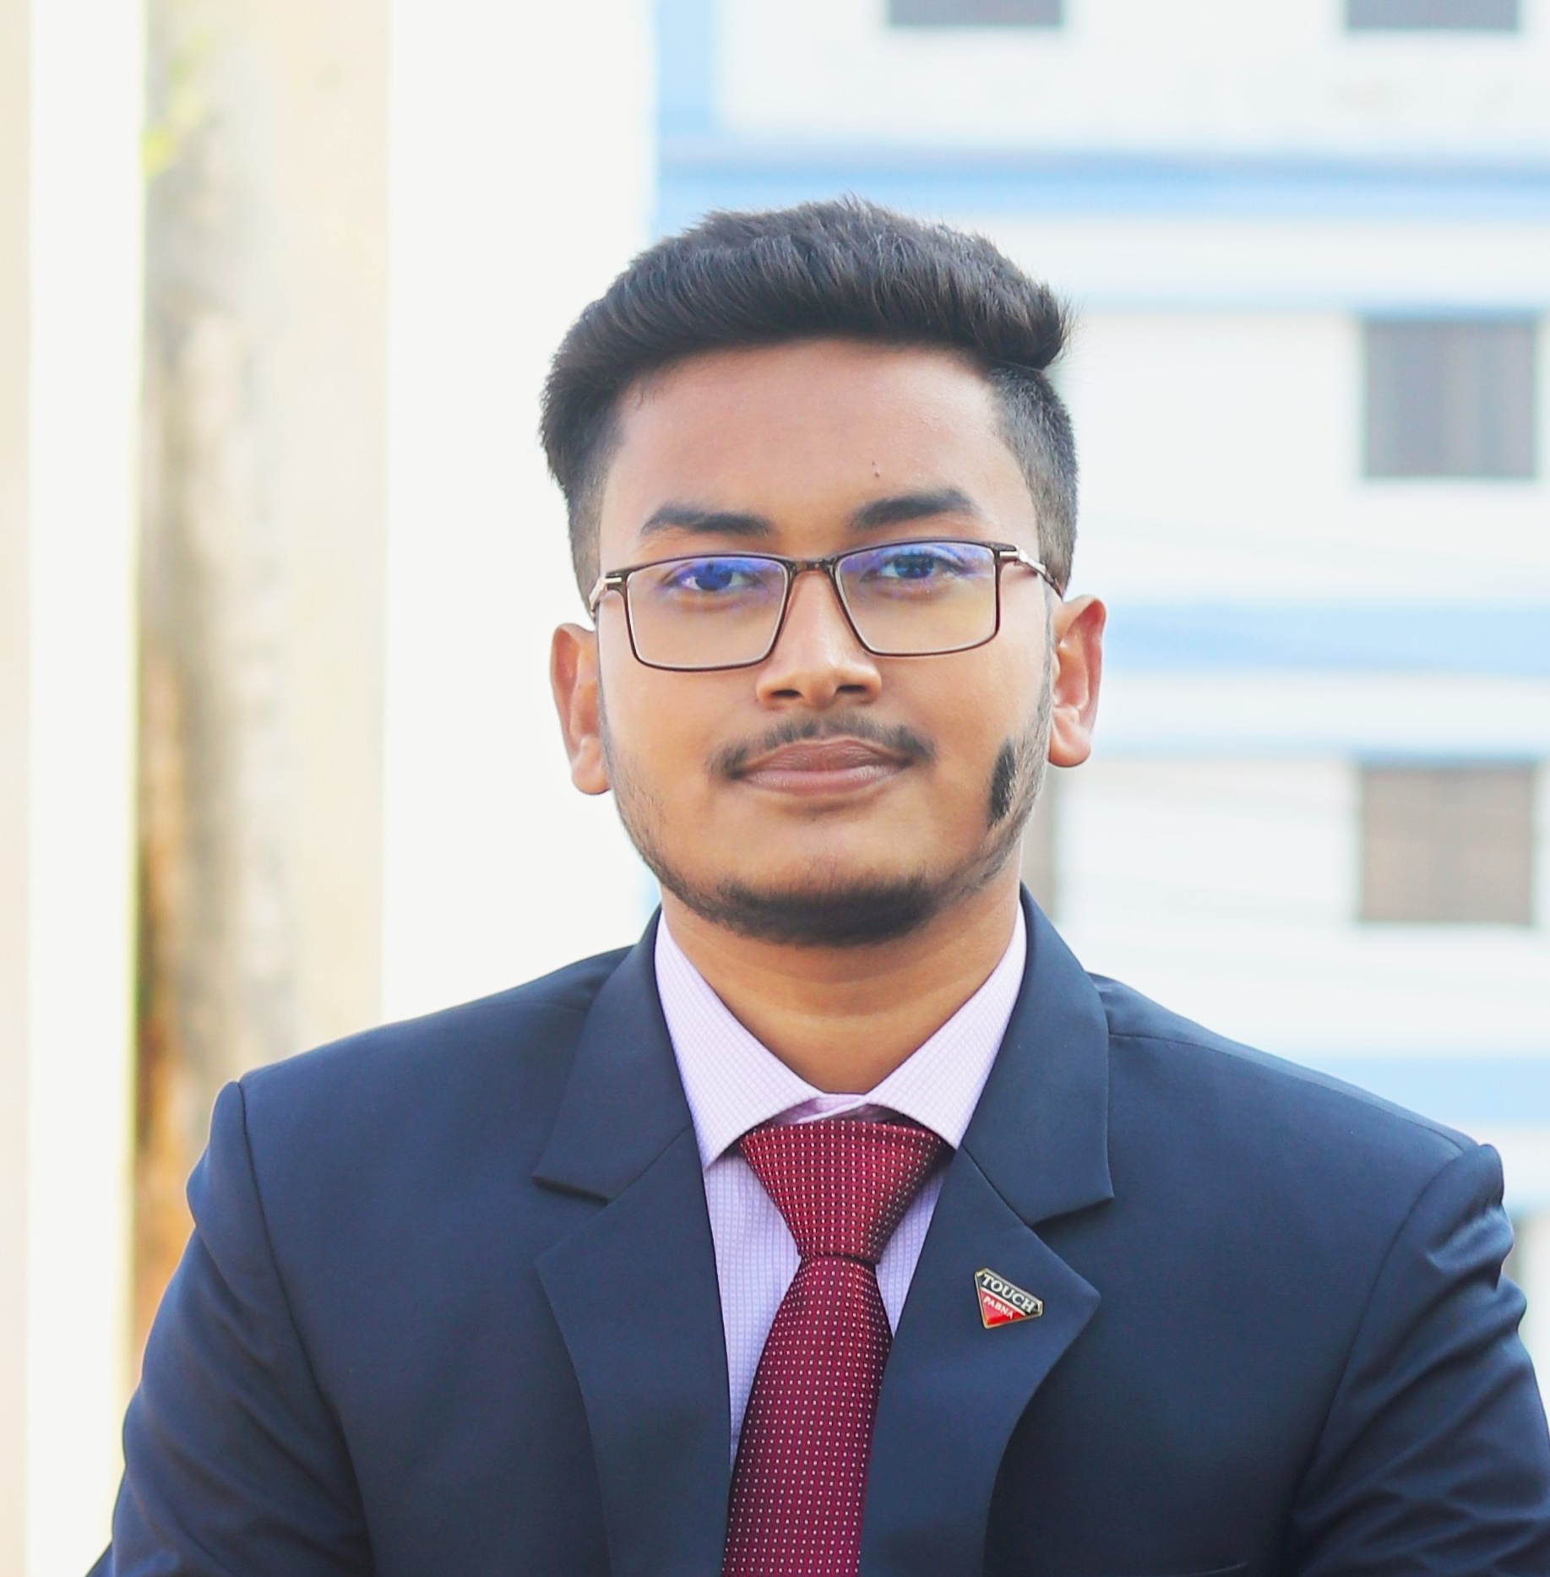


General Secretary
Nilphamari Students Welfare Association

