Slide 1

Generating Bangla Image Captions with Deep Learning Techniques
Md. Anwar Hossain, Mirza AFM Rashidul Hasan, Sajeeb Kumar Ray, Naima Islam
2024 6th International Conference on Sustainable Technologies for Industry 5.0

Slide 2
Table of Contents
Introduction
Materials
Methods
Results
Discussion

Slide 3
Bangla Image Captioning
Input Image
Automatic Text
একটি গোলাপী পোশাক পরা ছোট্ট মেয়ে একটি কাঠের ঘরে যাচ্ছে
Introduction

Slide 4
Bangla Image Captioning
Natural Language Processing
Textual Description
Computer Vision
Bridging the gap between visual content and Bengali textual descriptions
Introduction

Slide 5
Our Contributions
Developed a system for generating Bangla image captions.
Employed deep learning techniques integrating computer vision and NLP.
Used EfficientNetB4 and ResNet-50 for feature extraction.
Introduced the BanglaView with the Flicker30k dataset for training and validation.
Introduction

Slide 6
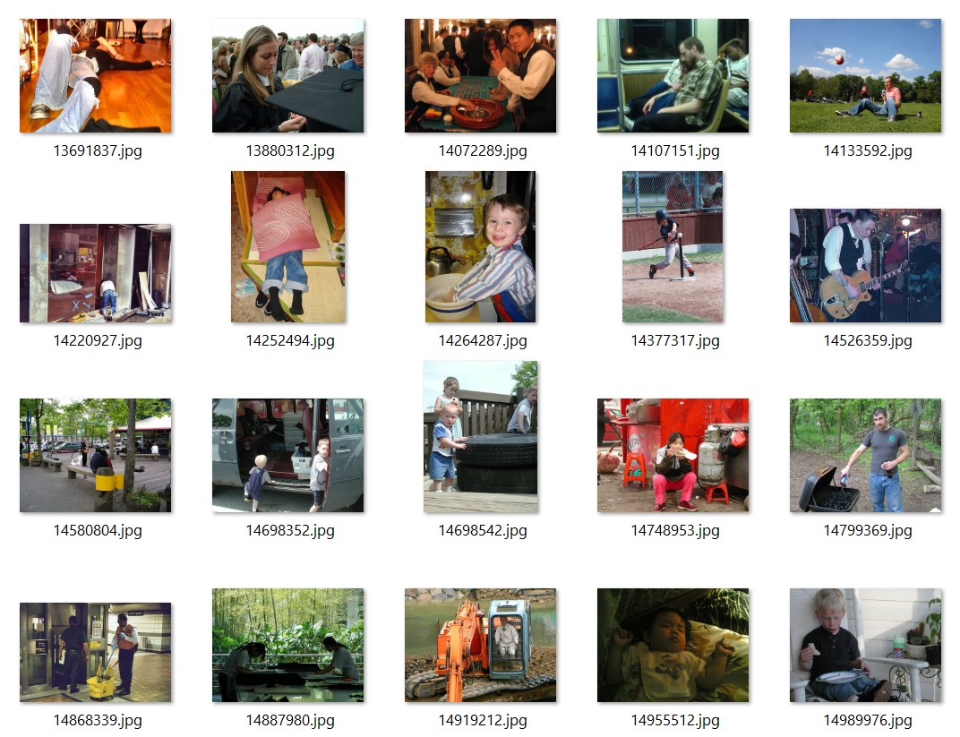
Images from
A well known Flickr30k dataset
Total image: 31,783
Materials

Slide 7
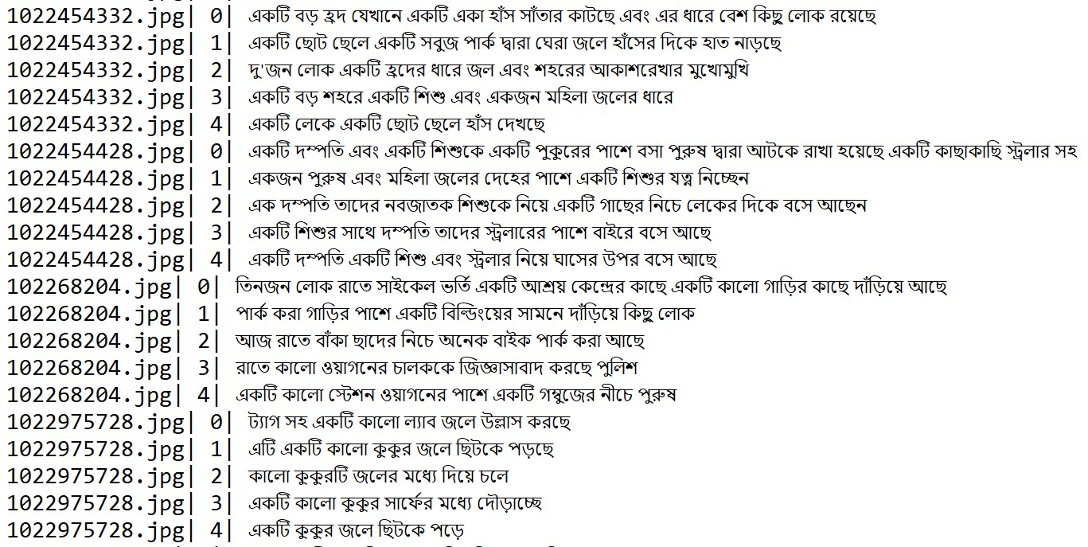
Bangla captions from
Recently introduced BanglaView dataset
Total Caption: 158,915
Materials

Slide 8
Related Works
References | Dataset | Images | Captions
Khan et al. [1] | BanglaLekhaImageCaptions | 9,154 | 18,308
Ami et al. [2] | Flickr8k, BanglaLekha, and Bornon | 21,414 | 42,828
Bhuiyan et al. [3] | Bornon | 4,100 | 20,500
Palash et al. [4] | BanglaLekhaImageCaptions | 9,154 | 18,308
Faruk et al. [5] | BNATURE | 8,000 | 40,000
Proposed | Flicker30k, BanglaView | 31,783 | 1,58,915
Materials

Slide 9
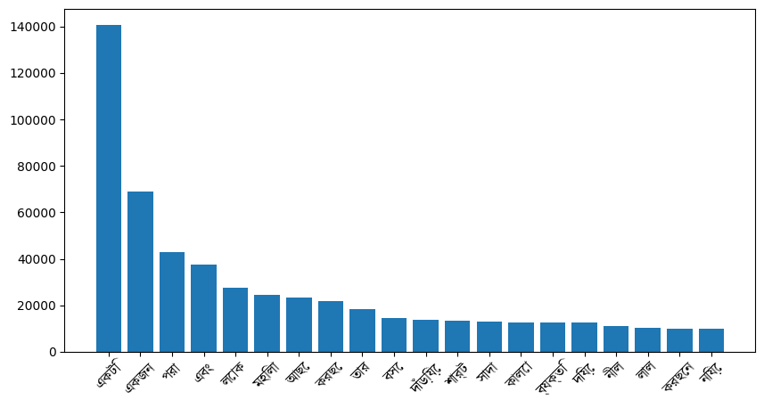
BanglaView: A Bangla Image Captioning Dataset
Vocabulary size: 25,444 words
Captions per image: 5
Maximum length: 67 words
Figure: Most frequent words in BanglaView dataset
Materials

Slide 10
Split Configuration
־ Training Data (90%):
28,604 images and
143,023 captions
־ Test Data (10%):
3,179 images and
15,892 captions
Materials

Slide 11
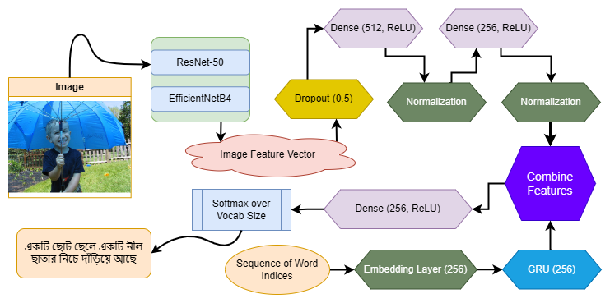
System Architecture
Methods

Slide 12
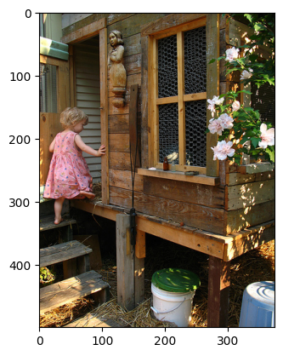
Training
Image Features
Bengali Tunes
EfficientNetB4
CNN_Encoder
RNN_Decoder
Caption: একটি গোলাপী পোশাক পরা ছোট্ট মেয়ে একটি কাঠের ঘরে যাচ্ছে
Text Embedding
Methods

Slide 13
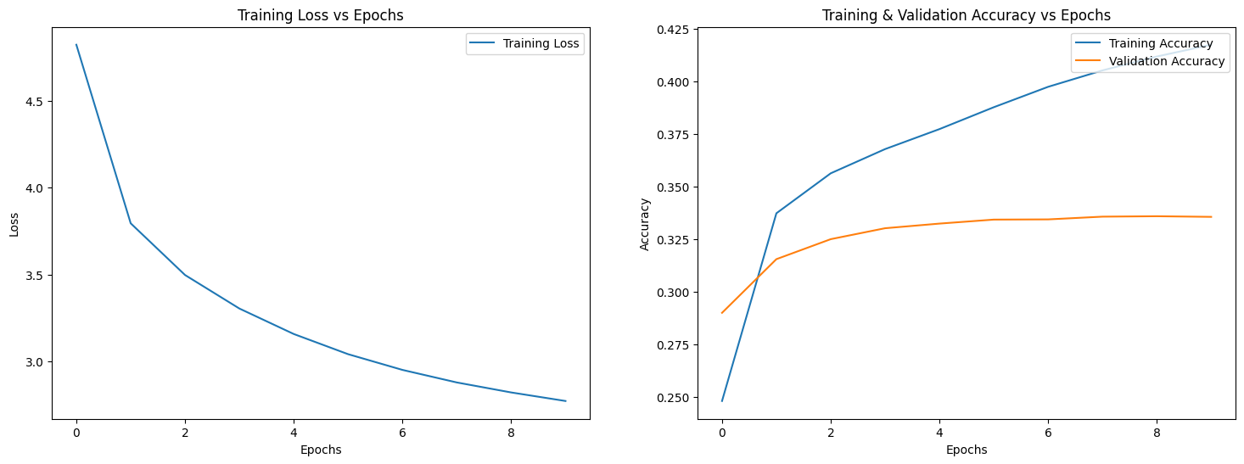
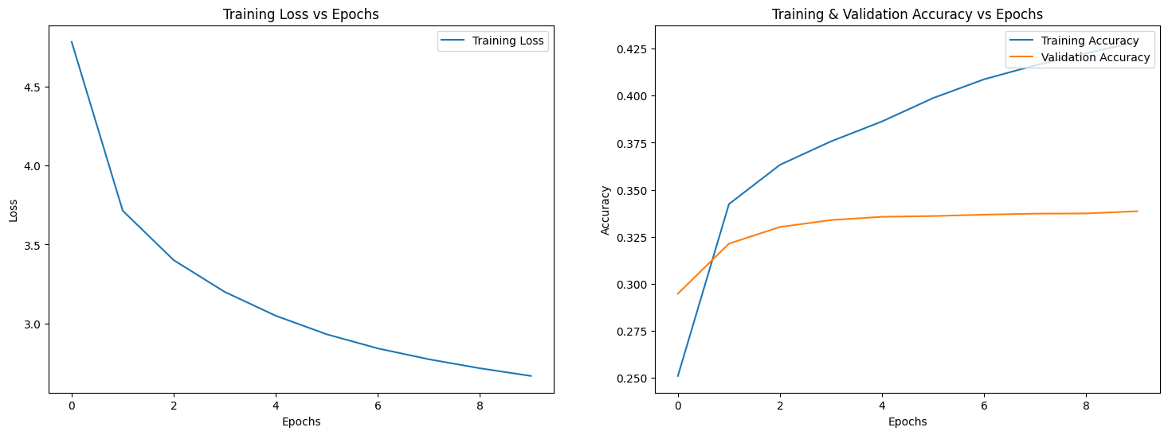
Training Curves
ResNet50 training and validation graph
EfficientNetB4 training and validation graph
Methods

Slide 14
Evaluation (After 10 Epochs of Training)
Test Scores
Models | BLEU-1 | BLEU-2 | BLEU-3 | BLEU-4 | ROUGE-1 | ROUGE-2 | ROUGE-L
EfficientNetB4 | 0.5396 | 0.3442 | 0.2044 | 0.1163 | 0.9896 | 0.9621 | 0.9893
ResNet-50 | 0.5011 | 0.3101 | 0.1763 | 0.0944 | 0.9861 | 0.9517 | 0.9861
BLUE Scores and its Meaning
Score Range | Quality Description | Score Range | Quality Description
0.00 - 0.10 | Very Poor | 0.50 - 0.60 | Excellent
0.10 - 0.20 | Poor | 0.60 - 0.70 | Outstanding
0.20 - 0.30 | Fair | 0.70 - 0.80 | Near Perfect
0.30 - 0.40 | Good | 0.80 - 0.90 | Exceptional
0.40 - 0.50 | Very Good | 0.90 - 1.00 | Perfect
Results

Slide 15
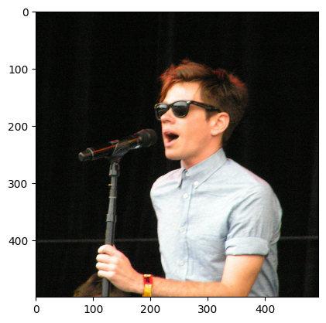
Evaluation
Flicker30k Image | BanglaView Captions C1: একটি বোতামযুক্ত শার্ট এবং ভিনটেজ-স্টাইলের সানগ্লাস পরে মঞ্চে একজন তরুণ অভিনয়শিল্পী তার গান গাইছেন (A young performer wearing a buttoned shirt and vintage-style sunglasses is singing his song on stage) C2: সানগ্লাস এবং হালকা নীল শর্ট-হাতা শার্ট পরা একজন শ্যামাঙ্গিনী ব্যক্তি একটি মাইক্রোফোনে গান গাচ্ছেন C3: হালকা নীল শার্ট পরা একজন যুবক মাইক্রোফোনে কথা বলছে বা গান করছে C4: সানগ্লাস পরা একজন সাদা লোক মাইক্রোফোন নিয়ে গান গাইছে C5: একজন তীক্ষ্ণ পোশাক পরা লোক মাইক্রোফোনে গান গাইছে
 | Model Generated EfficientNetB4: একজন লোক মাইক্রোফোনে গান গাইছে (A man is singing into a microphone) ResNet50: একটি কালো এবং সাদা মাইম এবং একটি সাদা শার্ট পরা একজন ব্যক্তি একটি মাইক্রোফোনে গান গাইছেন
Results

Slide 16
Comparative Study
References | Model | BLUE-1
Khan et al. [1] | CNN-Merge | 0.65
Ami et al. [2] | Visual-Attention | 0.59
Bhuiyan et al. [3] | ResNet50+Attention+BIGRU | 0.85
Palash et al. [4] | ResNet101 | 0.69
Faruk et al. [5] | CNN + RNN | 0.43
Proposed | CNN + RNN | 0.54
Discussion

Slide 17
Applications
1
Accessibility for visually impaired individuals
2
Photo search enhancement
3
Robot Interaction
Discussion

Slide 18
References
[1] Faiyaz Khan, M., Sadiq-Ur-Rahman, S., & Saiful Islam, M. "Improved bengali image captioning via deep convolutional neural network based encoder-decoder model," Proceedings of International Joint Conference on Advances in Computational Intelligence: IJCACI 2020
[2] Ami, A. S., Humaira, M., Jim, M. A. R. K., Paul, S., & Shah, F. M. “Bengali image captioning with visual attention,” 2020 23rd International Conference on Computer and Information Technology (ICCIT)
[3] Ahatesham Bhuiyan, Eftekhar Hossain, Mohammed Moshiul Hoque, M. Ali Akber Dewan, Enhancing image caption generation through context-aware attention mechanism, Heliyon, Volume 10, Issue 17, 2024, e36272, ISSN 2405-8440
[4] Palash, M.A.H., Nasim, M.A.A., Saha, S., Afrin, F., Mallik, R., Samiappan, S. (2022). Bangla Image Caption Generation Through CNN-Transformer Based Encoder-Decoder Network. In: Hossain, S., Hossain, M.S., Kaiser, M.S., Majumder, S.P., Ray, K. (eds) Proceedings of International Conference on Fourth Industrial Revolution and Beyond 2021 . Lecture Notes in Networks and Systems, vol 437. Springer, Singapore.
[5] A. M. Faruk, H. A. Faraby, M. M. Azad, M. R. Fedous and M. K. Morol, "Image to Bengali Caption Generation Using Deep CNN and Bidirectional Gated Recurrent Unit," 2020 23rd International Conference on Computer and Information Technology (ICCIT), DHAKA, Bangladesh, 2020, pp. 1-6

Slide 19


