Slide 1

MERO SCHOOL
PRESENTED BY :
Mr. SAJIT GURUNG
Mr. NISCHAL POKHREL
Mr. KSHITIJ GURUNG
Mr. KIRAN SUNAR

Slide 2
1. INTRODUCTION
Mero School is a web-based school management system that aims to enhance the management of schools and colleges.
Mero School helps streamline school operations and increase efficiency.
Mero School is a powerful and flexible solution that can revolutionize the way educational institutions manage their operations.

Slide 3
2. BACKGROUND STUDY
1. School management systems are software applications designed to streamline and automate various administrative and academic processes in educational institutions.
2.This report aims to explore the key features, benefits, and challenges associated with implementing such systems in schools. .
3.This background study highlights the key features, benefits, and challenges associated with implementing such systems.

Slide 4
3. LITERATURE REVIEW
1.The advent of the internet has brought about significant changes in the field of education. One such change is the use of web-based school management systems.
2.These systems are designed to streamline and automate various school processes such as student registration, attendance tracking, grade reporting, and communication between teachers and parents.
3. The implementation of school management systems also presents some challenges. These challenges include the need for technical expertise, the cost of implementation and maintenance,

Slide 5
4. PROBLEM STATEMENT
In today's digital age, schools face a variety of challenges in managing their administrative and academic processes
These systems are characterized by data redundancies, paperwork, and unorganized tasks, resulting in a lack of efficiency and productivity.
Mero School will eliminate data redundancies, reduce paperwork, and provide an organized and centralized approach to school management.
The Complex integration requirements between different modules in a school management system can indeed present challenges that require careful planning and coordination

Slide 6
5. OBJECTIVES
To provide a fully dynamic web based system.
To create a complete dynamic web-based school management system
To implement a Talk with Teacher Feature that allows students to communicate with their teachers online to ask questions, seek clarifications, and discuss academic concerns in real-time.
To develop a Notice or Announcement Feature that enables school administrators to post important updates, announcements, and events on the website for students and parents to access easily.

Slide 7
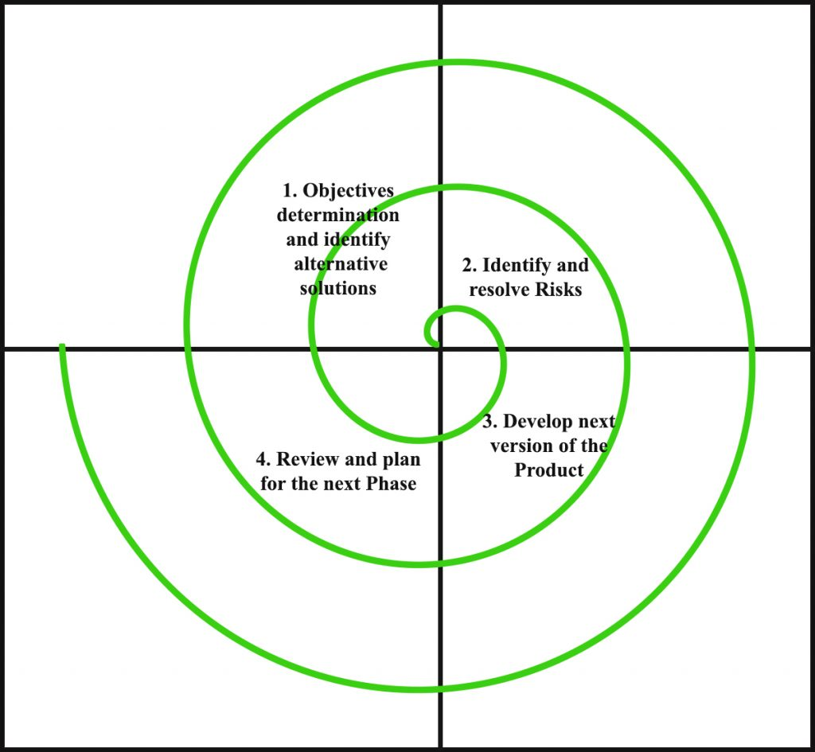
6. METHODOLOGY
We followed the Spiral model as the development strategy for our project, as required.
The Spiral Model is a risk-driven approach to software development that emphasizes identifying and mitigating risks throughout the development process.
The Spiral Model involves planning, risk analysis, prototype development, evaluation, development, deployment, and maintenance.

Slide 8
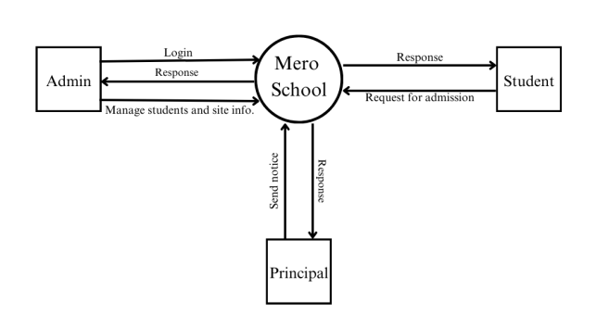
7. CONTEXT LEVEL DATA FLOW DIAGRAM

Slide 9
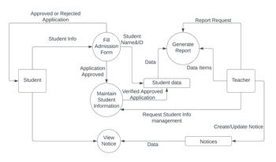
8. DFD LEVEL 1

Slide 10
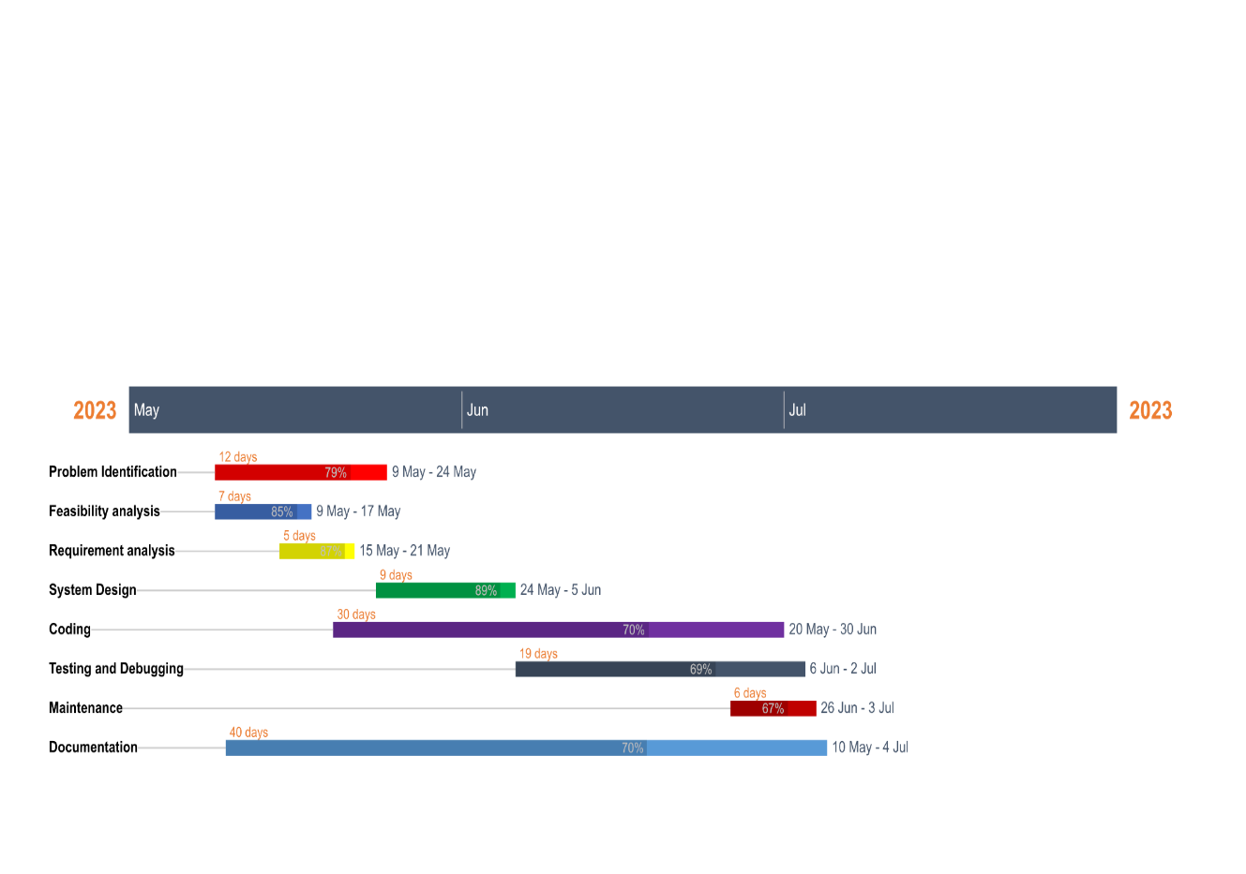
9. GANTT CHART

Slide 11
10. TESTING
Test Case ID | Test Case | Test Steps | Test Data | Results
TC001 | website Access | Open the web browser | N/A | The website interface loads successfully.
TC002 | Admin login | 1.Click on the “login” button. 2.Enter admin credentials. | Admin username and password | The admin dashboard is displayed
TC003 | User Management | 1.Navigate to the admin dashboard. 2.Click on “manage Users” | N/A | The user management page is displayed
TC004 | File Management | 1.Navigate to the admin dashboard. 2.Click on “manage Files” | N/A | The file management page is displayed

Slide 12
TC005 | Dynamic page creation | 1.Navigate to the admin dashboard. 2.Click on “create New Page” 3.Fill in the required information 4.Save the changes | Page content and details | The new page is created and visible on the website
TC006 | Student enrollment | 1.Open the enrollment form 2.Fill in the required fields 3.submi the form | Student information | The enrollment is successful and the student receives a confirmation
TC007 | Notice visibility | 1.Login as a student 2.Navigate to the homepage 3.check the latest notices section | N/A | The latest notices are displayed on the homepage
TC008 | News and Events | 1.login as a student 2.Navigate to the homepage 3.Check the news and events section | N/A | The latest news and events are displayed on the homepage

Slide 13
11. DELIVERABLES
A comprehensive school management website will provide a feature that allows the school administrators to post notices and announcements to students and teachers.
A feature that enables students to communicate with their teachers when they face problems or have questions related to their studies.
Mero School PHP web-based school management system will be designed as a complete dynamic web-based system. In contrast, a dynamic site allows changes to be made easily through a dashboard without coding.

Slide 14
12. CONCLUSION
Our project focuses on developing an automated school management system that streamlines various activities that take place in schools.
The main purpose of "Mero School" is to address administrative problems by making our site completely dynamic.
It makes use of appropriate materials and ensures the effective development of human qualities through the execution of programs, arrangement of activities, and the attainment of objectives.

Slide 15
THANK YOU

